Slide 1
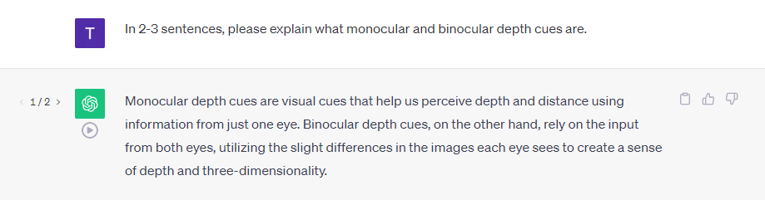
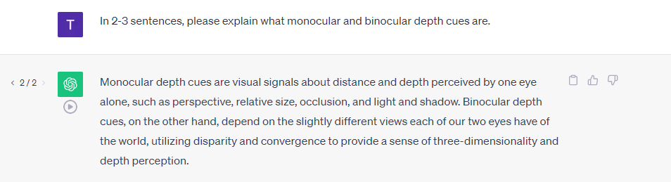
In 2-3 sentences, please explain what monocular and binocular depth cues are.

Slide 2
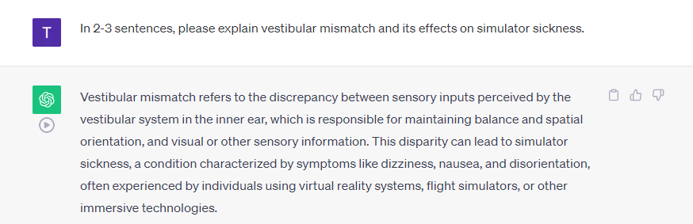
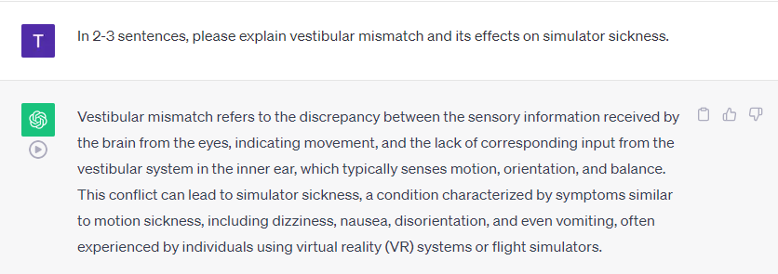
In 2-3 sentences, please explain vestibular mismatch and its effects on simulator sickness.

Slide 3
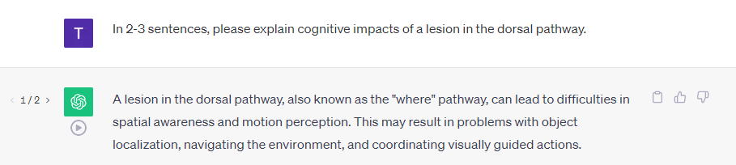
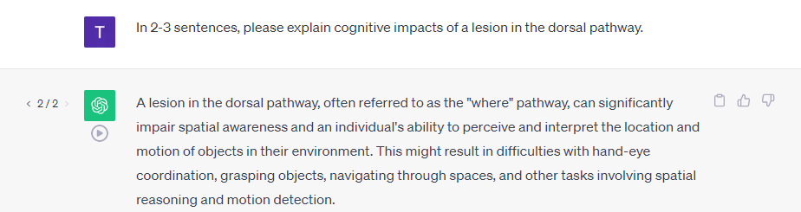
In 2-3 sentences, please explain cognitive impacts of a lesion in the dorsal pathway.

Slide 4
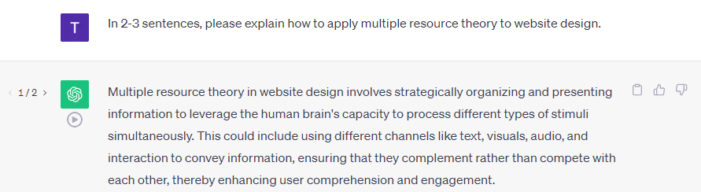
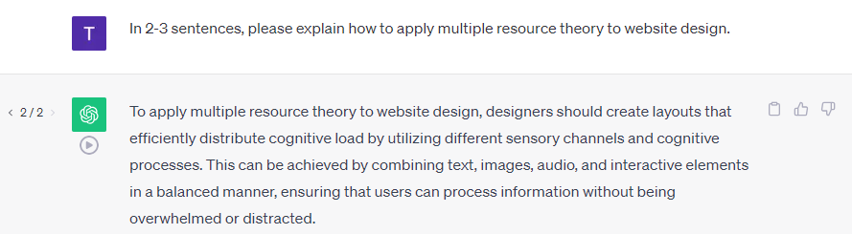
In 2-3 sentences, please explain how to apply multiple resource theory to website design.

Slide 5
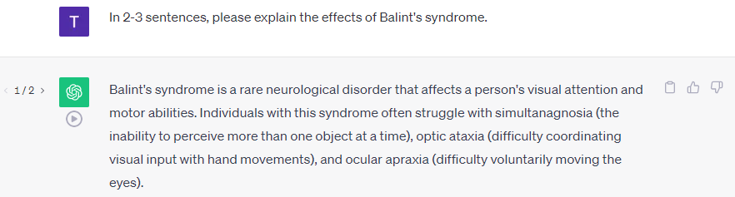
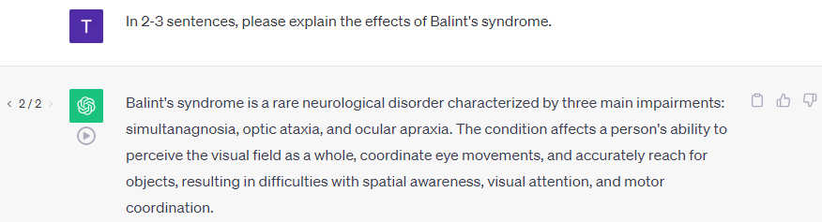
In 2-3 sentences, please explain the effects of Balint's syndrome.

Slide 6
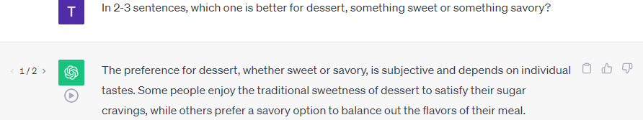
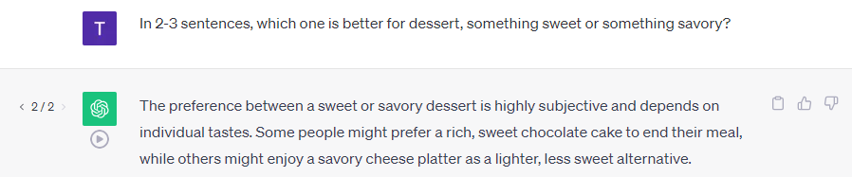
In 2-3 sentences, which one is better for dessert, something sweet or something savory?

Slide 7
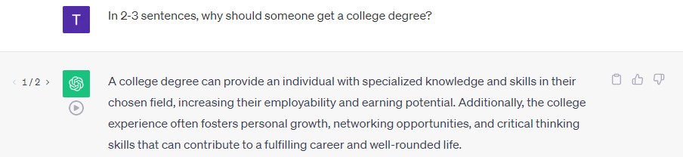
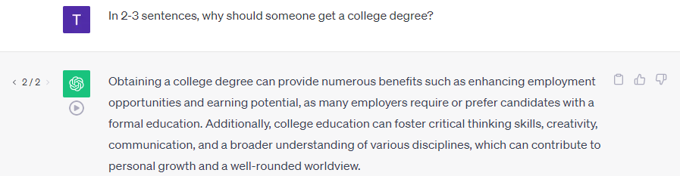
In 2-3 sentences, why should someone get a college degree?

Slide 8
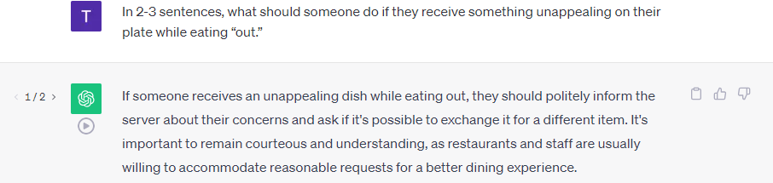
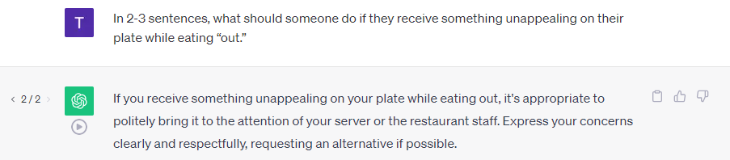
In 2-3 sentences, what should someone do if they receive something unappealing on their plate while eating “out.”

Slide 9
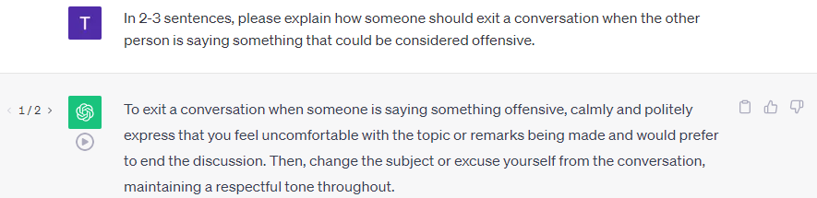
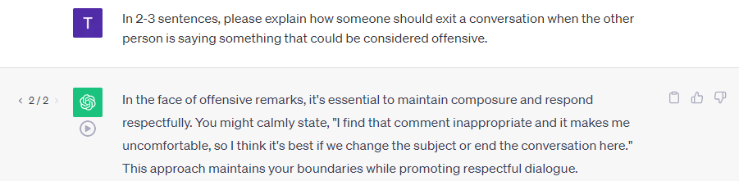
In 2-3 sentences, please explain how someone should exit a conversation when the other person is saying something that could be considered offensive.

Slide 10
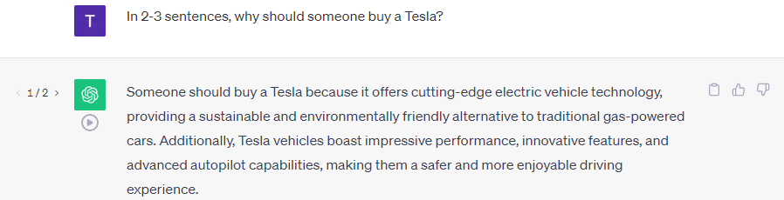
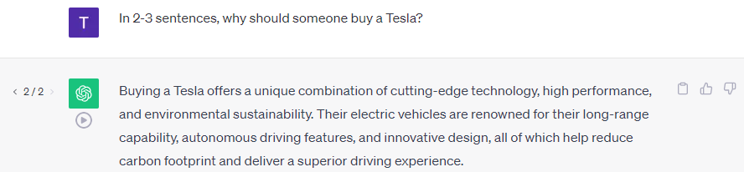
In 2-3 sentences, why should someone buy a Tesla?

Slide 11
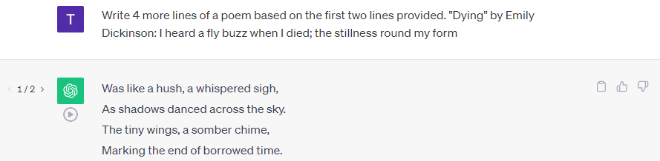
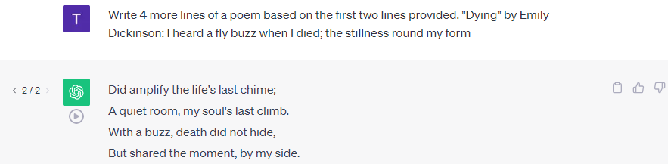
Write 4 more lines of a poem based on the first two lines provided. "Dying" by Emily Dickinson: I heard a fly buzz when I died; the stillness round my form

Slide 12
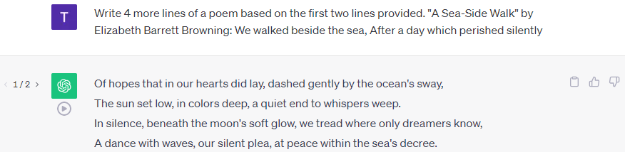
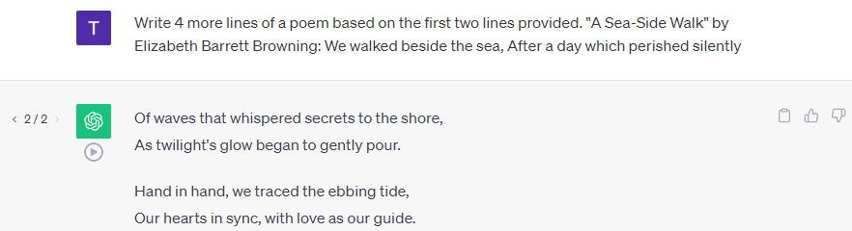
Write 4 more lines of a poem based on the first two lines provided. "A Sea-Side Walk" by Elizabeth Barrett Browning: We walked beside the sea, After a day which perished silently

Slide 13
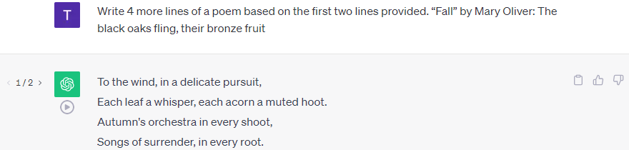
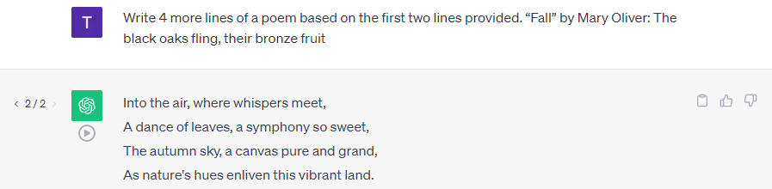
Write 4 more lines of a poem based on the first two lines provided. “Fall” by Mary Oliver: The black oaks fling, their bronze fruit

Slide 14
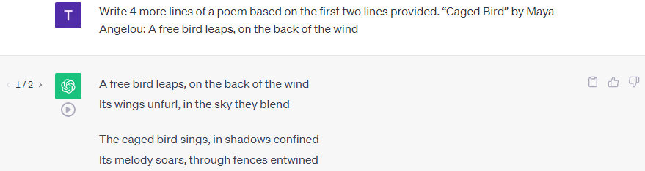
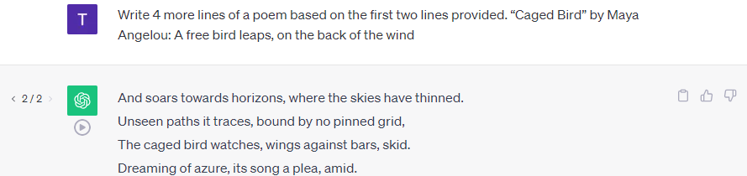
Write 4 more lines of a poem based on the first two lines provided. “Caged Bird” by Maya Angelou: A free bird leaps, on the back of the wind

Slide 15
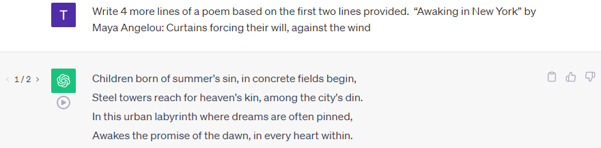
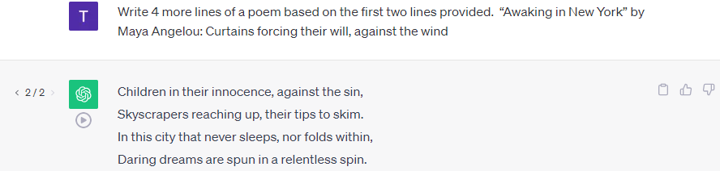
Write 4 more lines of a poem based on the first two lines provided. “Awaking in New York” by Maya Angelou: Curtains forcing their will, against the wind

