Slide 1
Writer
https://writer.com/ai-content-detector/
Conducted 2/17/24

Slide 2
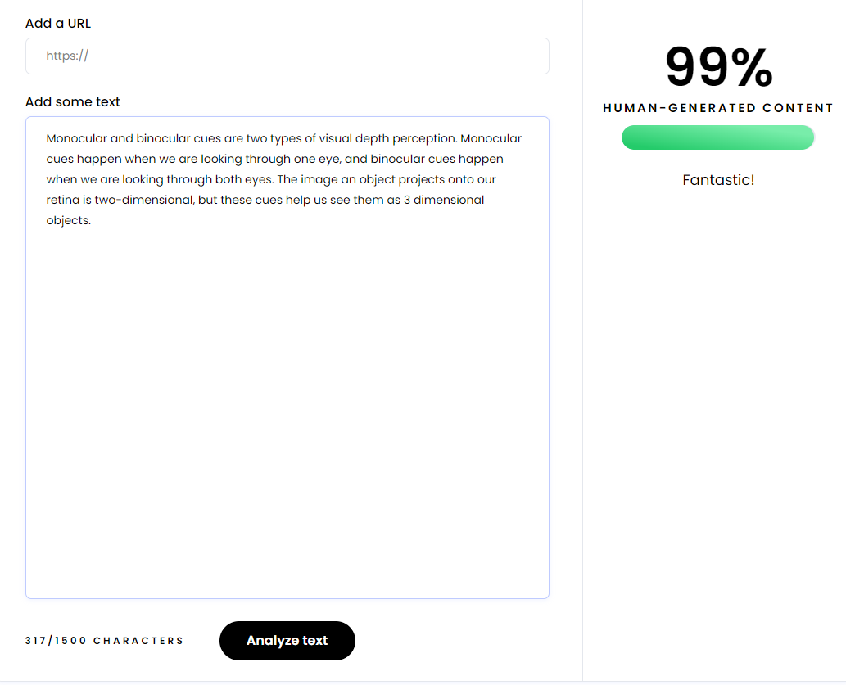
In 2-3 sentences, please explain what monocular and binocular depth cues are. #Sample 1

Slide 3
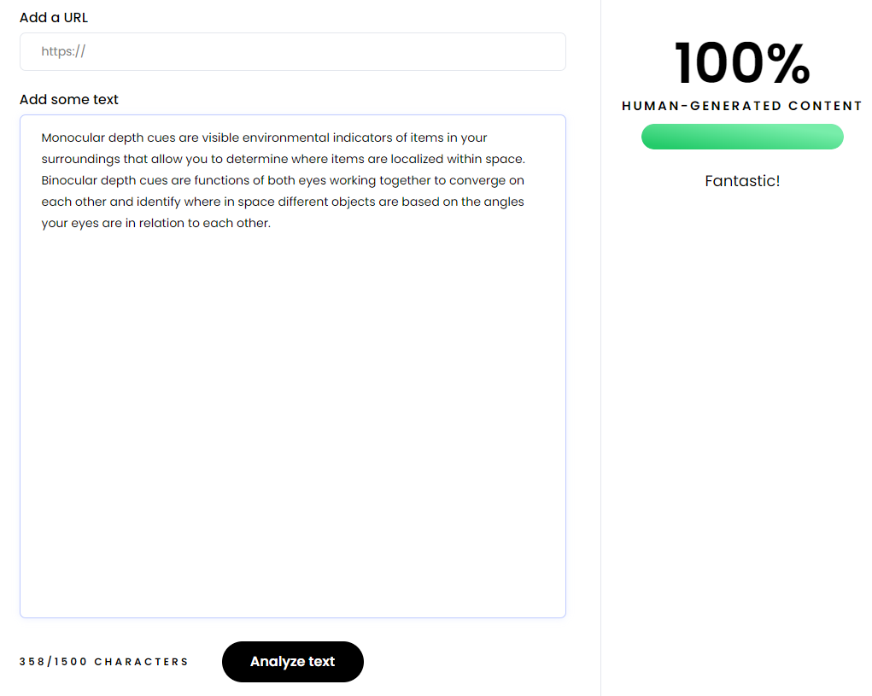
In 2-3 sentences, please explain what monocular and binocular depth cues are. #Sample 2

Slide 4
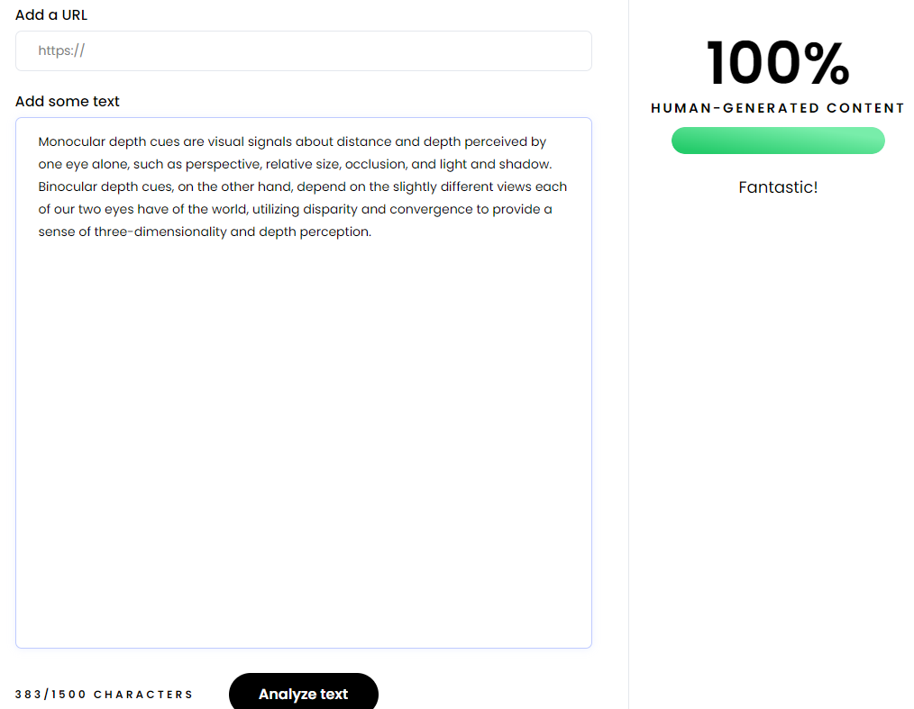
In 2-3 sentences, please explain what monocular and binocular depth cues are. #Sample 3

Slide 5
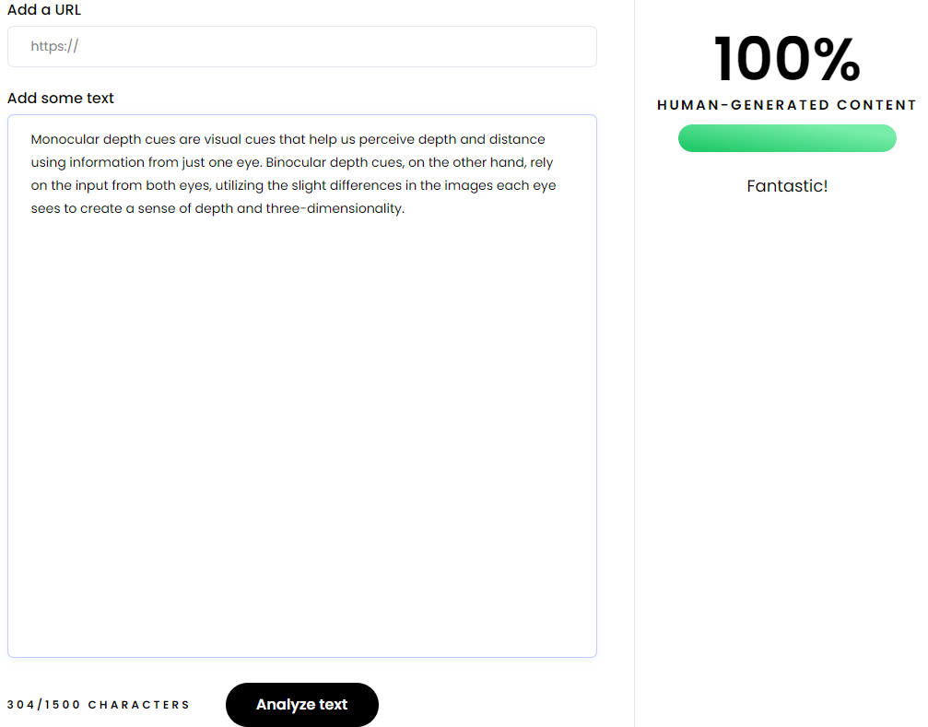
In 2-3 sentences, please explain what monocular and binocular depth cues are. #Sample 4

Slide 6
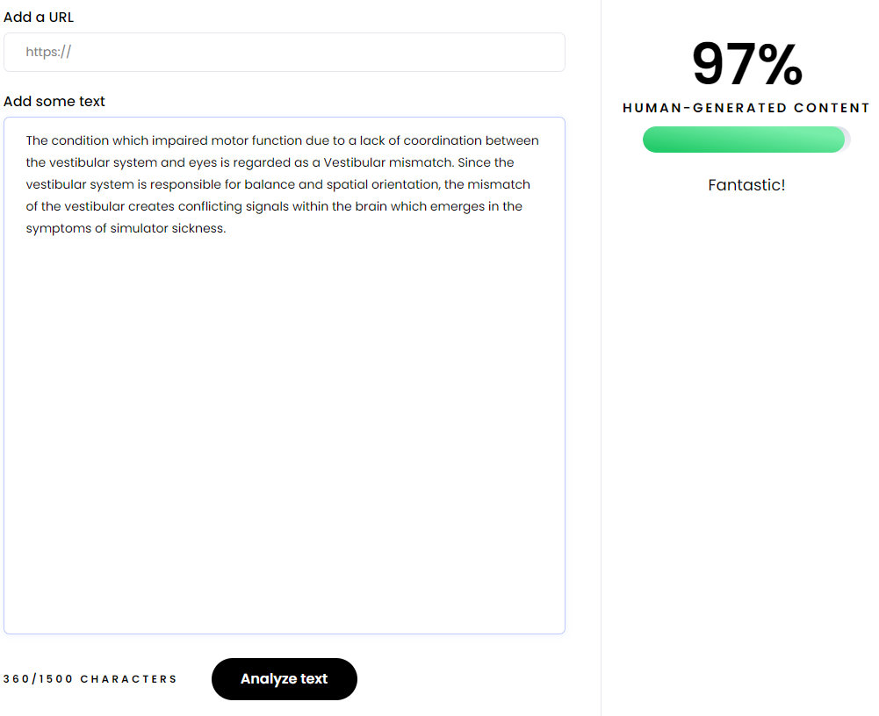
In 2-3 sentences, please explain vestibular mismatch and its effects on simulator sickness. #Sample 5

Slide 7
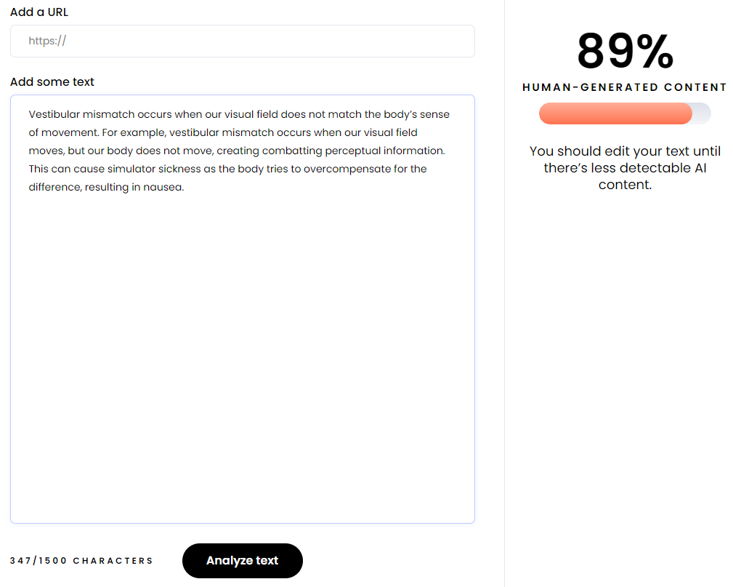
In 2-3 sentences, please explain vestibular mismatch and its effects on simulator sickness. #Sample 6

Slide 8
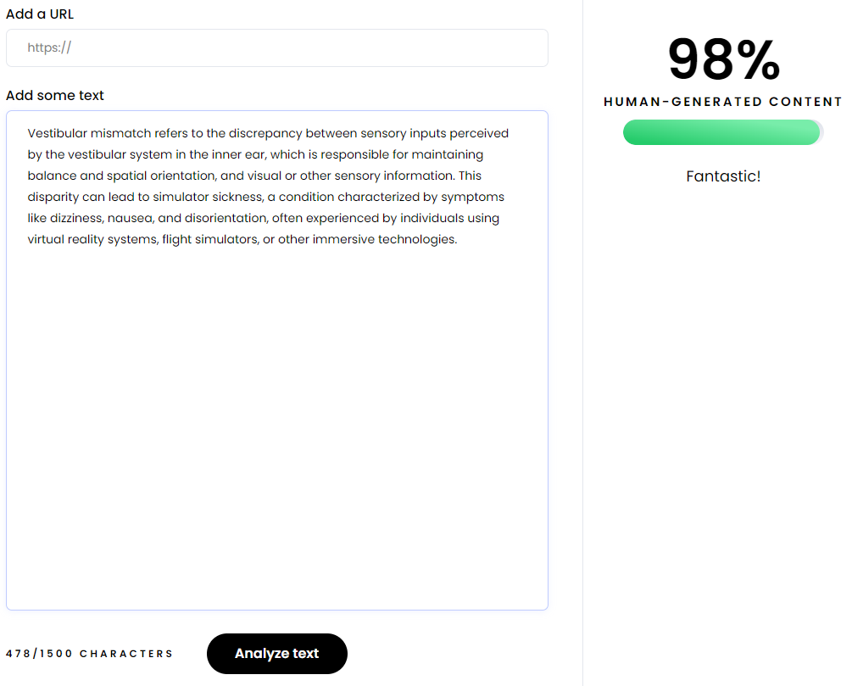
In 2-3 sentences, please explain vestibular mismatch and its effects on simulator sickness. #Sample 7

Slide 9
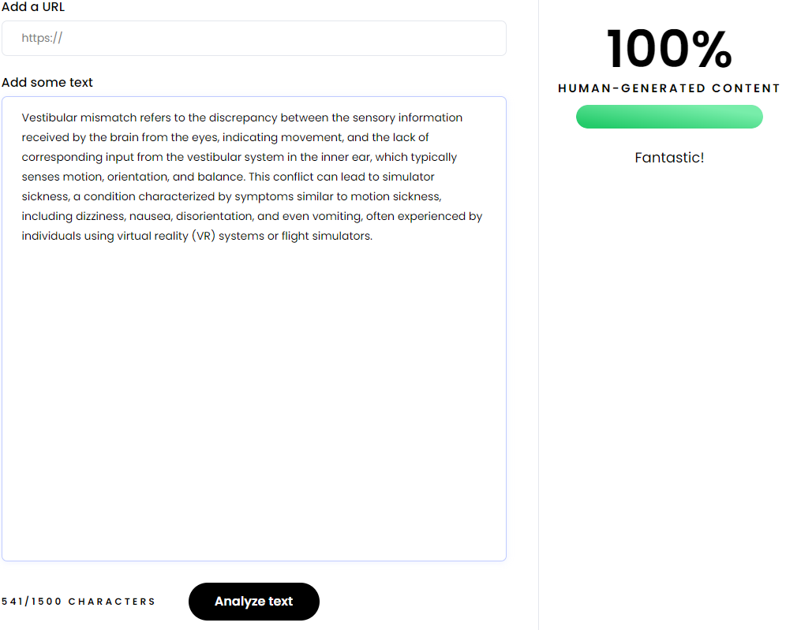
In 2-3 sentences, please explain vestibular mismatch and its effects on simulator sickness. #Sample 8

Slide 10
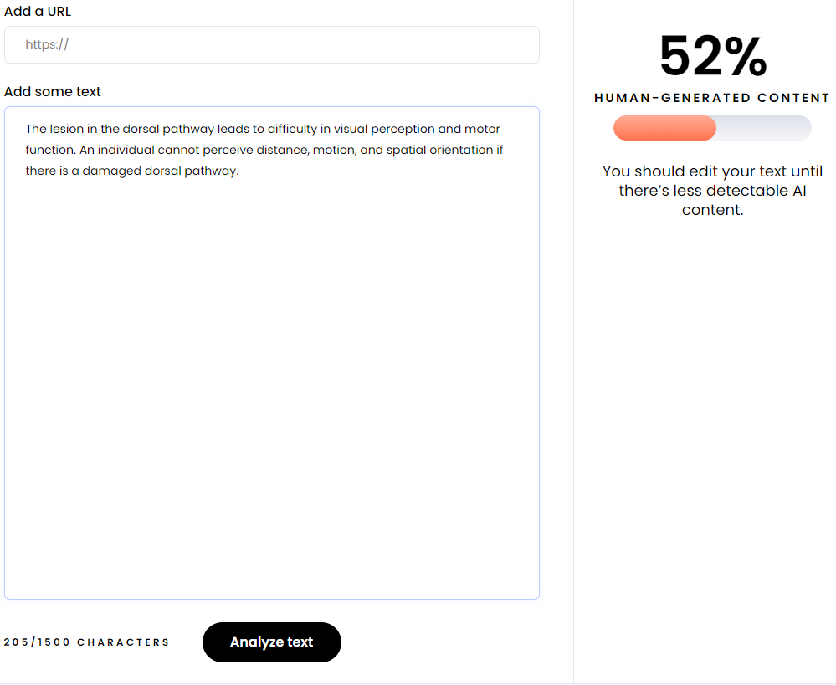
In 2-3 sentences, please explain cognitive impacts of a lesion in the dorsal pathway. #Sample 9

Slide 11
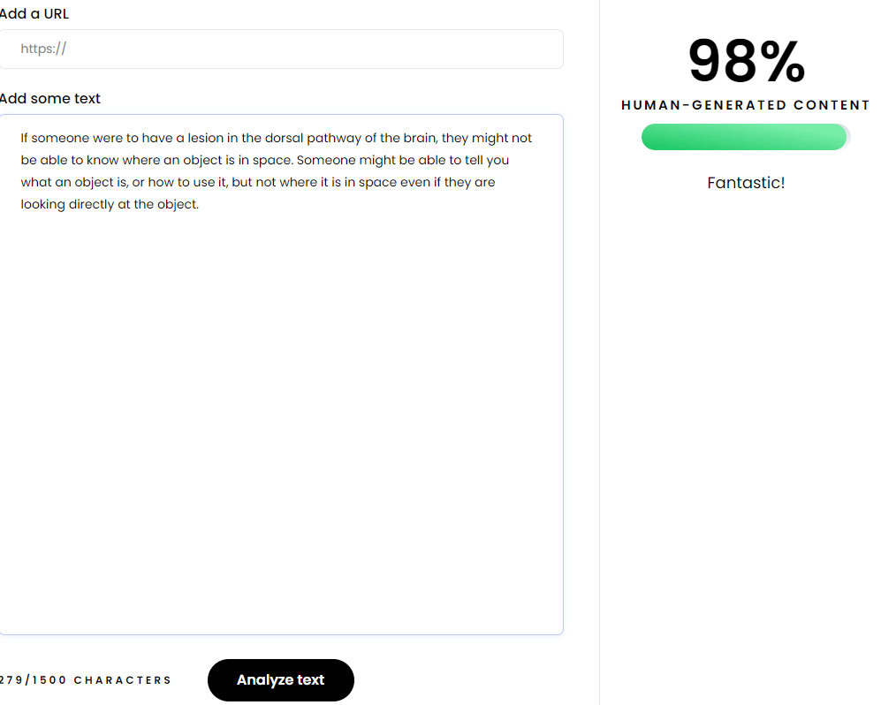
In 2-3 sentences, please explain cognitive impacts of a lesion in the dorsal pathway. #Sample 10

Slide 12

In 2-3 sentences, please explain cognitive impacts of a lesion in the dorsal pathway. #Sample 11

Slide 13

In 2-3 sentences, please explain cognitive impacts of a lesion in the dorsal pathway. #Sample 12

Slide 14
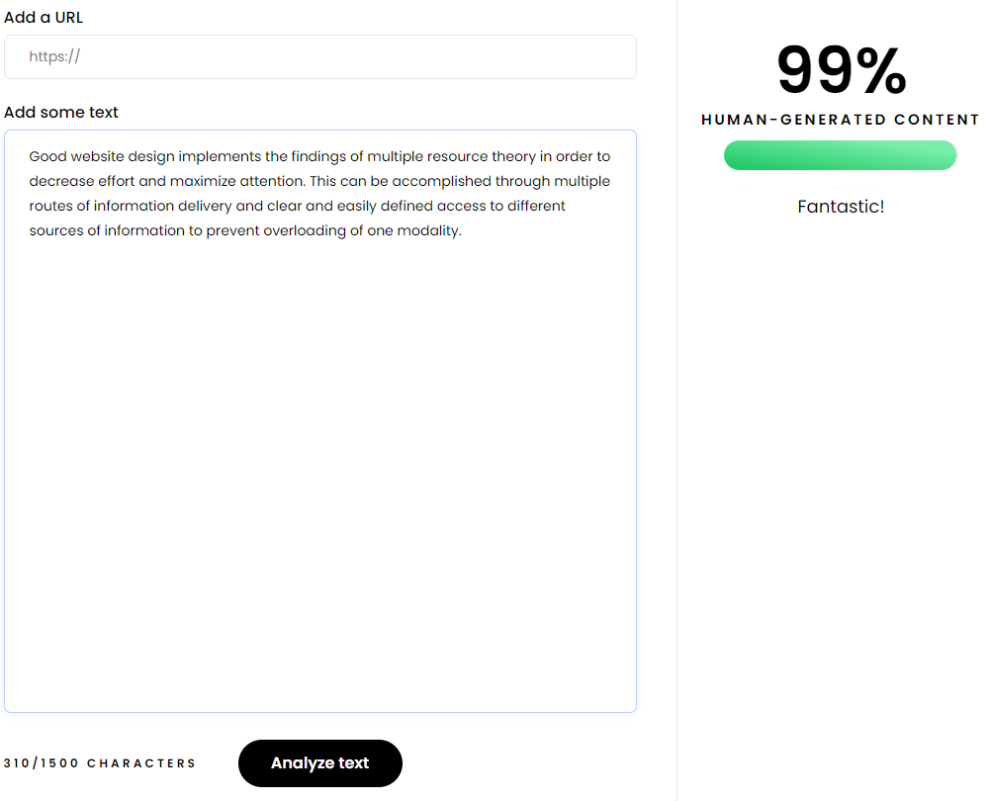
In 2-3 sentences, please explain how to apply multiple resource theory to website design. #Sample 13

Slide 15
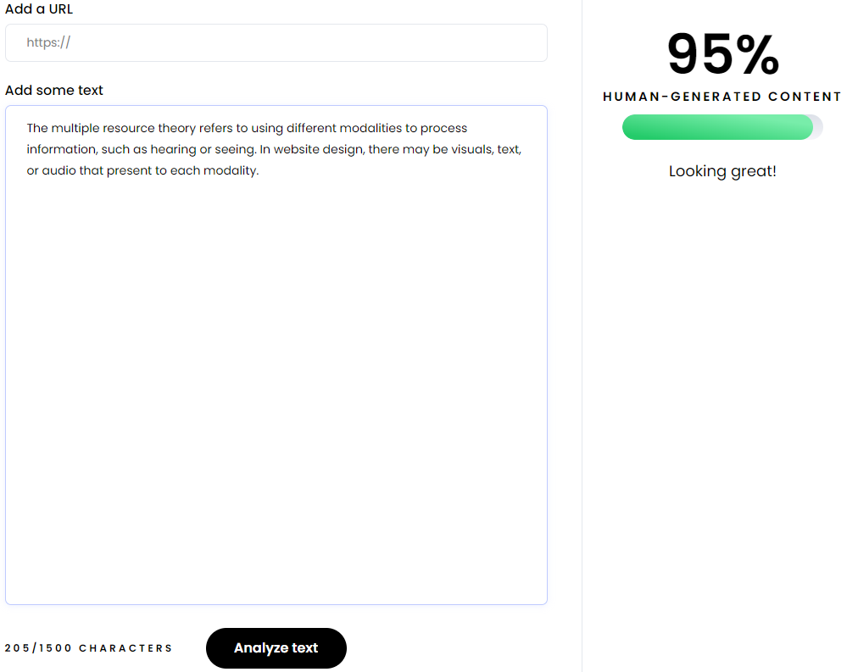
In 2-3 sentences, please explain how to apply multiple resource theory to website design. #Sample 14

Slide 16
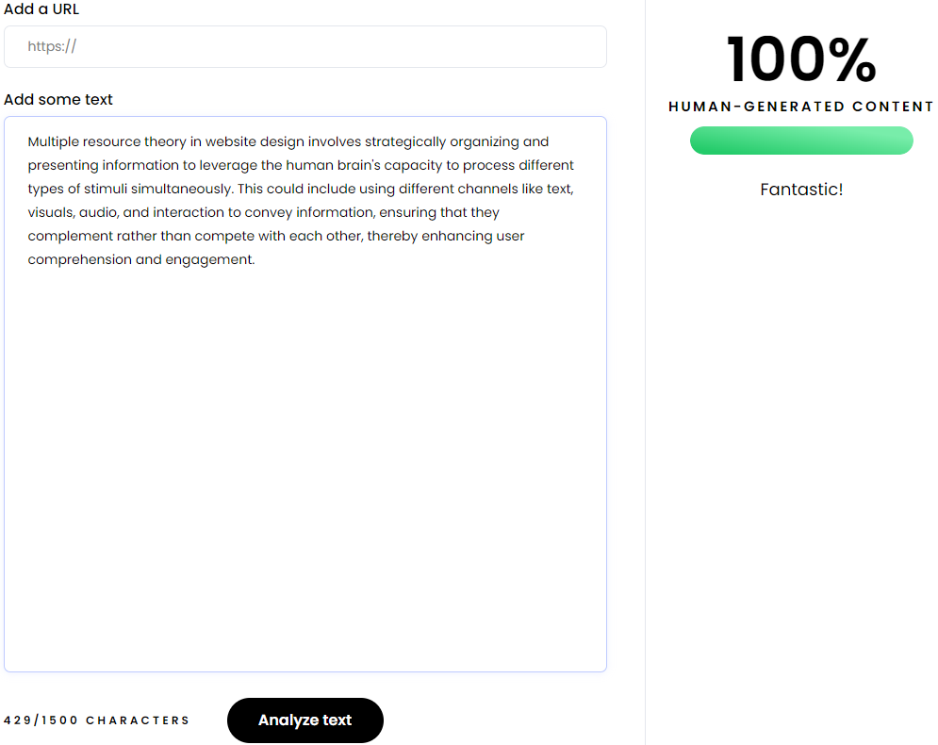
In 2-3 sentences, please explain how to apply multiple resource theory to website design. #Sample 15

Slide 17
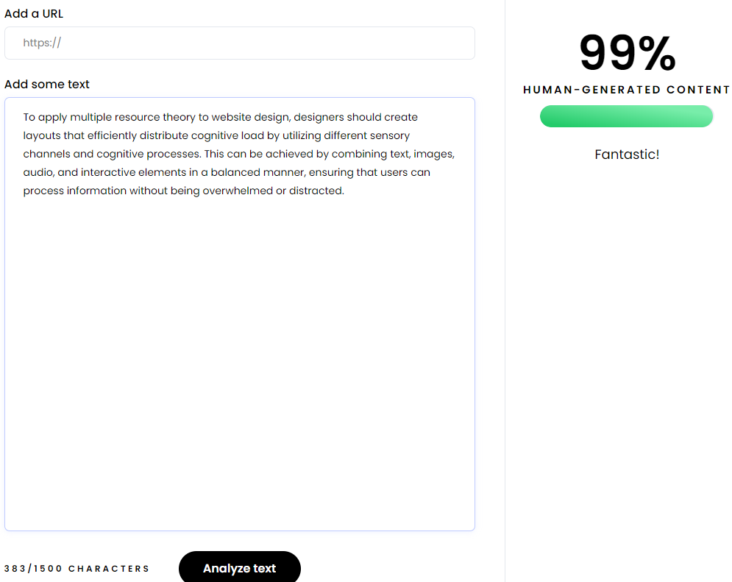
In 2-3 sentences, please explain how to apply multiple resource theory to website design. #Sample 16

Slide 18

In 2-3 sentences, please explain the effects of Balint's syndrome. #Sample 17

Slide 19
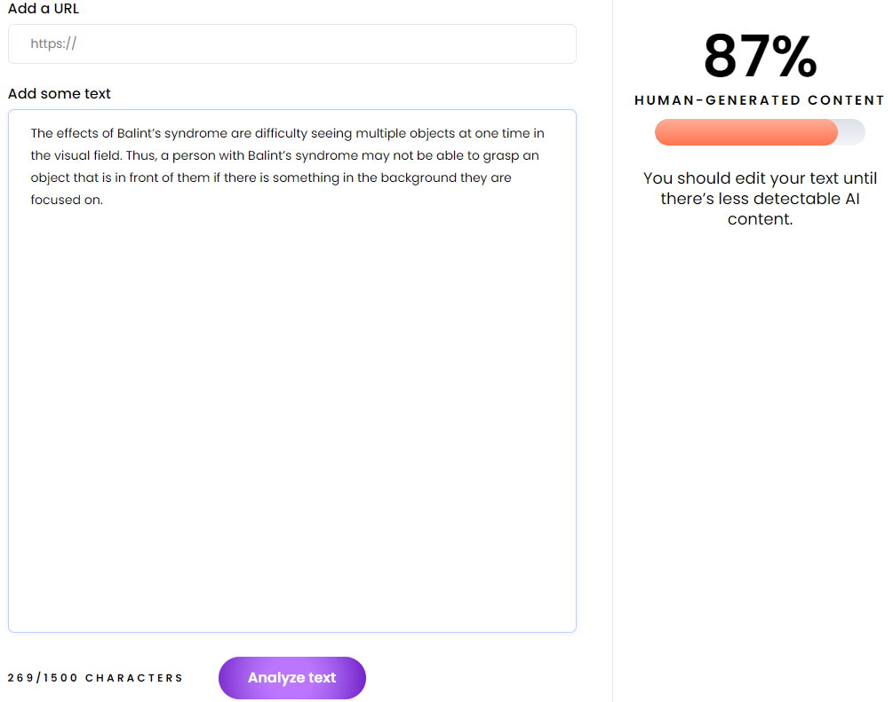
In 2-3 sentences, please explain the effects of Balint's syndrome. #Sample 18

Slide 20
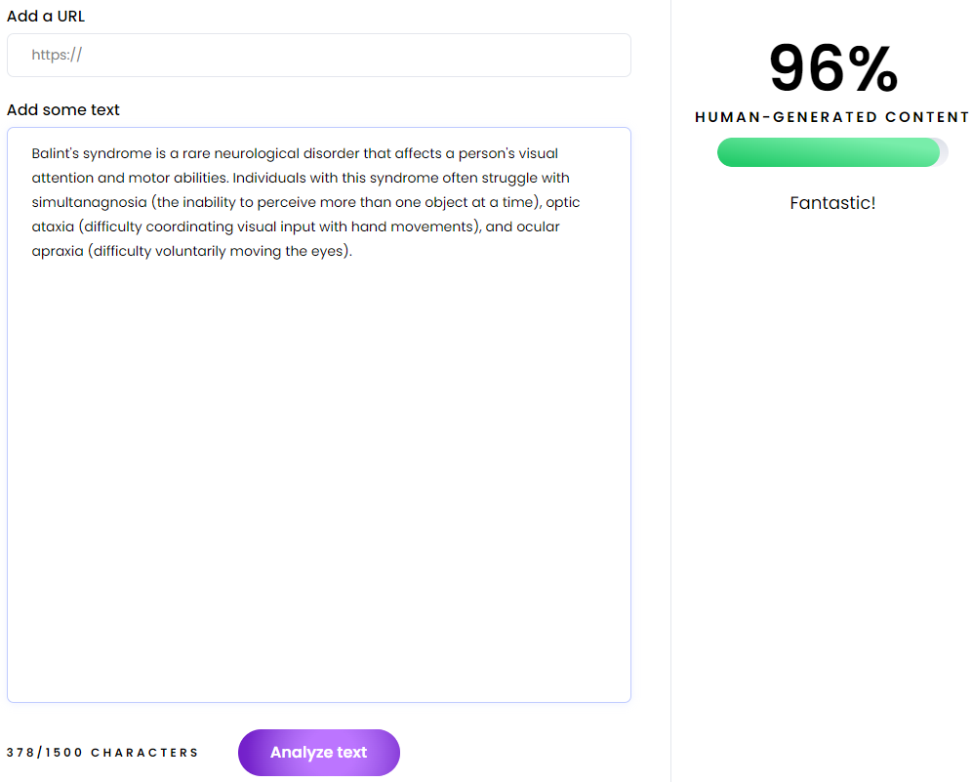
In 2-3 sentences, please explain the effects of Balint's syndrome. #Sample 19

Slide 21
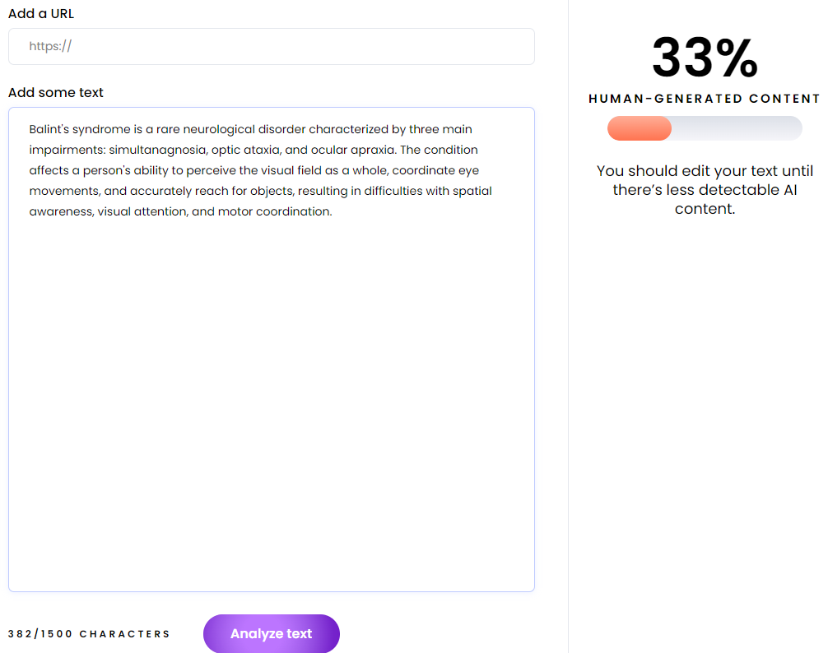
In 2-3 sentences, please explain the effects of Balint's syndrome. #Sample 20

Slide 22
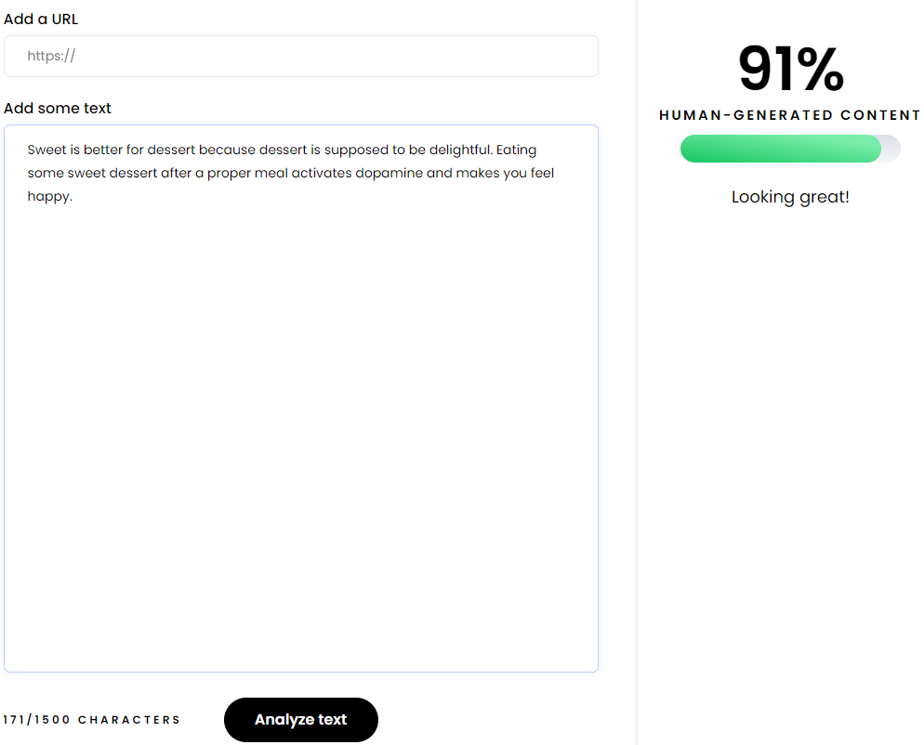
In 2-3 sentences, which one is better for dessert, something sweet or something savory? #Sample 21

Slide 23
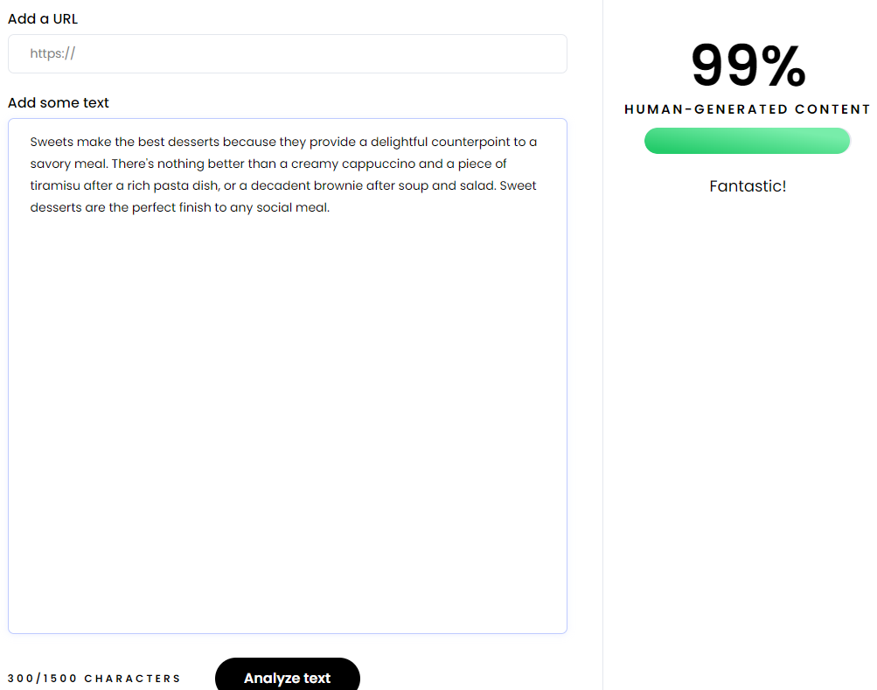
In 2-3 sentences, which one is better for dessert, something sweet or something savory? #Sample 22

Slide 24
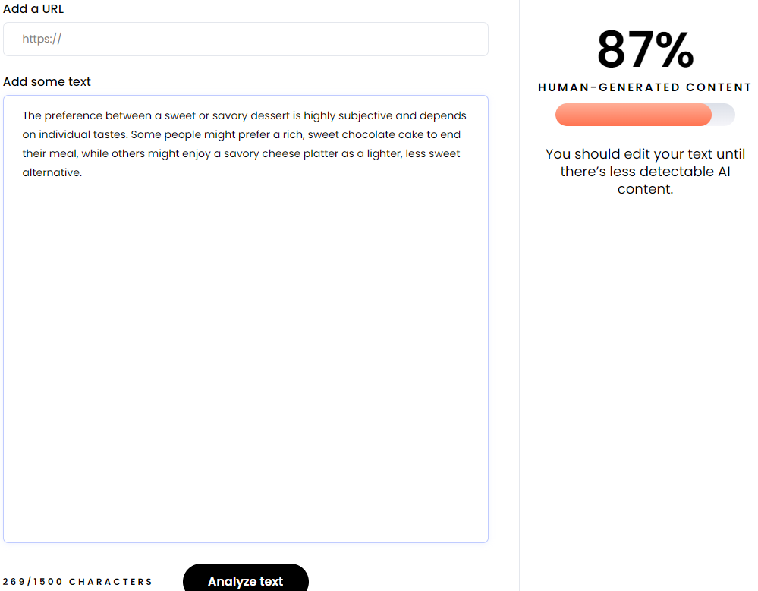
In 2-3 sentences, which one is better for dessert, something sweet or something savory? #Sample 23

Slide 25

In 2-3 sentences, which one is better for dessert, something sweet or something savory? #Sample 24

Slide 26
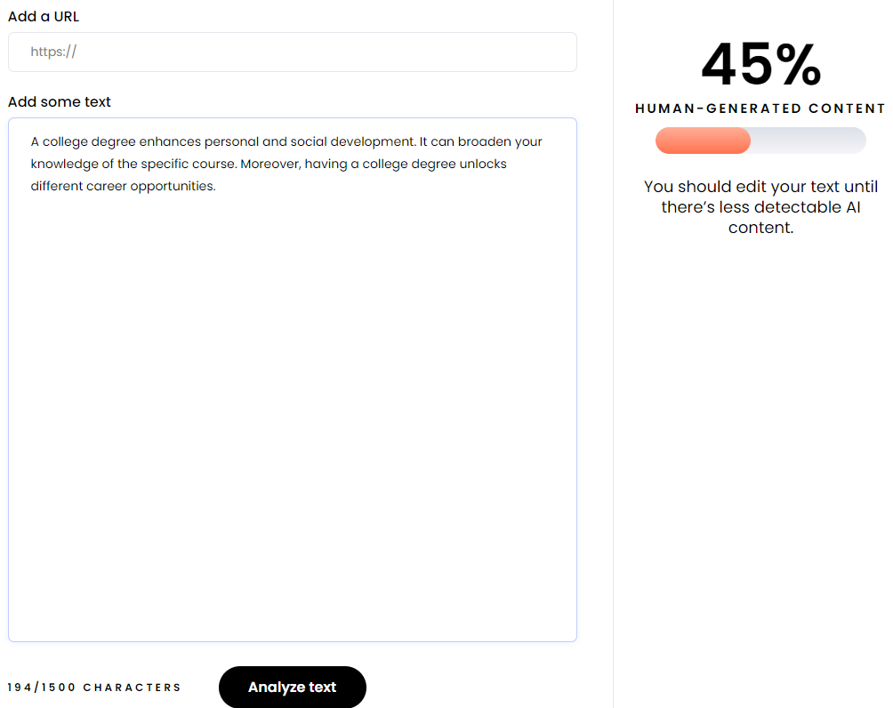
In 2-3 sentences, why should someone get a college degree? #Sample 25

Slide 27

In 2-3 sentences, why should someone get a college degree? #Sample 26

Slide 28
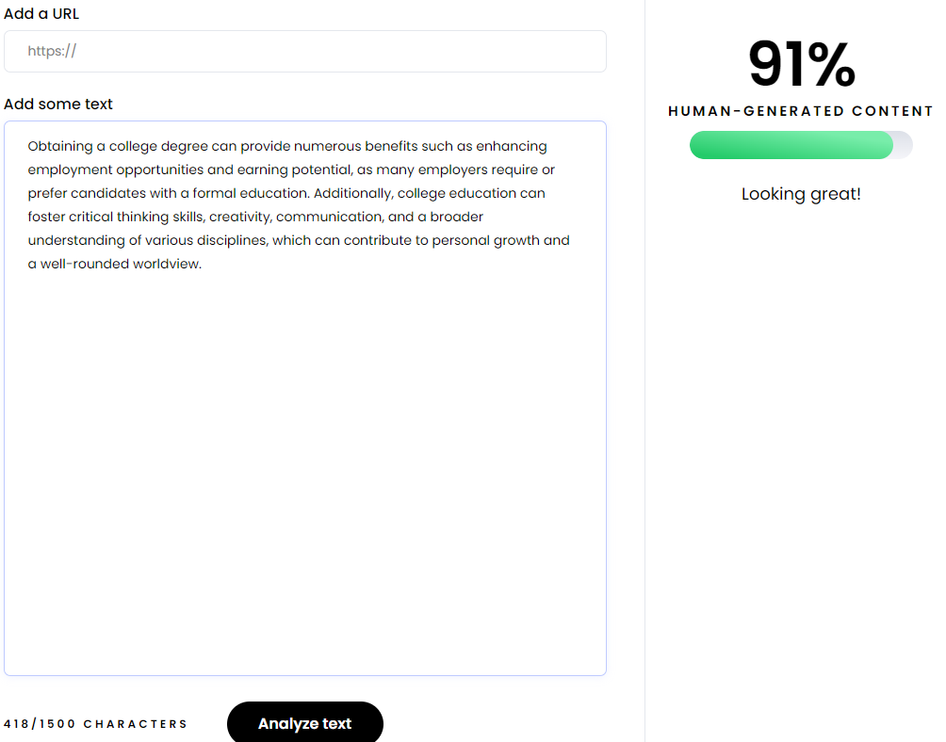
In 2-3 sentences, why should someone get a college degree? #Sample 27

Slide 29
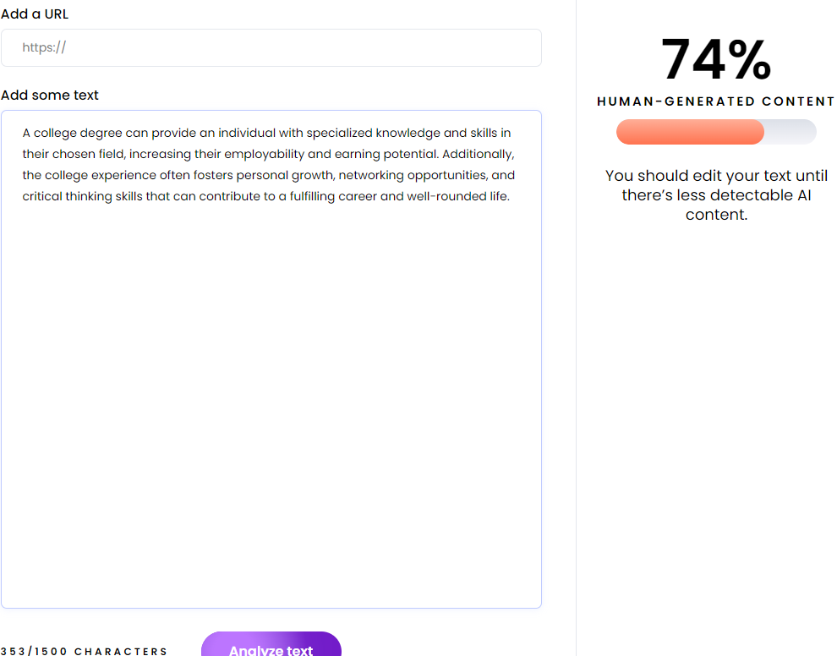
In 2-3 sentences, why should someone get a college degree? #Sample 28

Slide 30
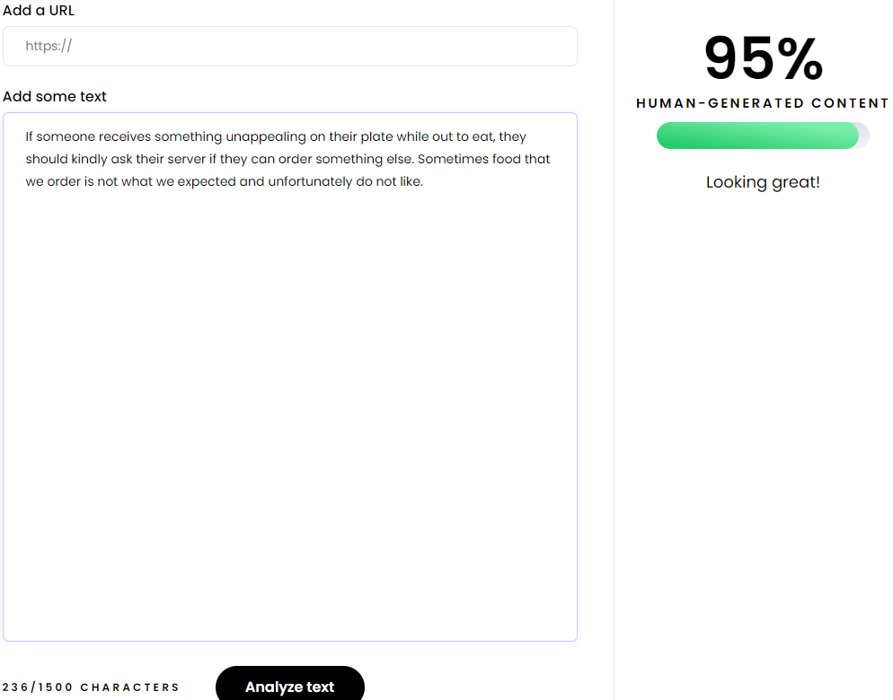
In 2-3 sentences, what should someone do if they receive something unappealing on their plate while eating “out.” #Sample 29

Slide 31

In 2-3 sentences, what should someone do if they receive something unappealing on their plate while eating “out.” #Sample 30

Slide 32
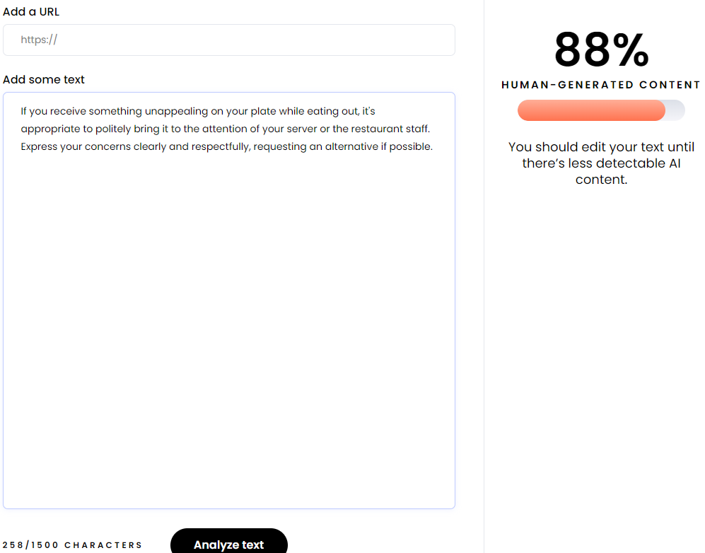
In 2-3 sentences, what should someone do if they receive something unappealing on their plate while eating “out.” #Sample 31

Slide 33
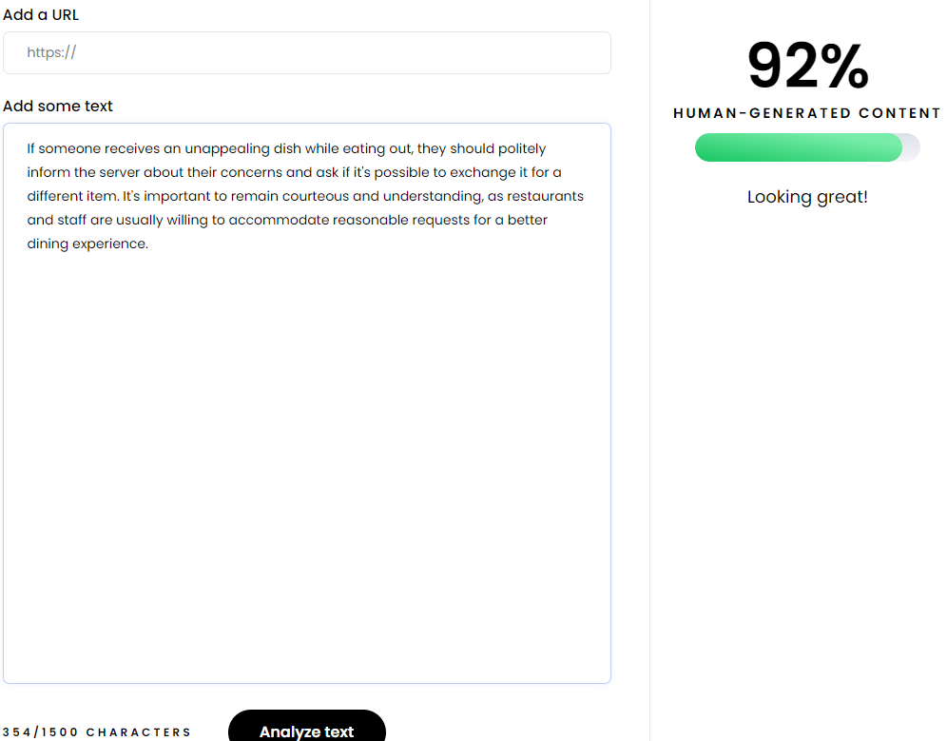
In 2-3 sentences, what should someone do if they receive something unappealing on their plate while eating “out.” #Sample 32

Slide 34
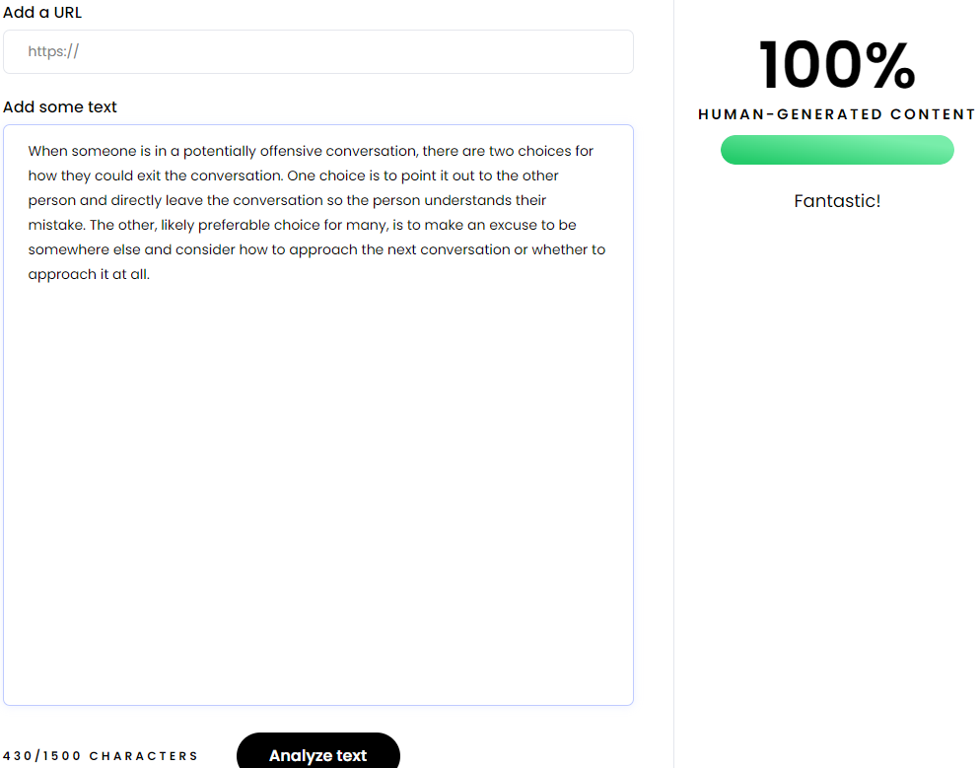
In 2-3 sentences, please explain how someone should exit a conversation when the other person is saying something that could be considered offensive. #Sample 33

Slide 35
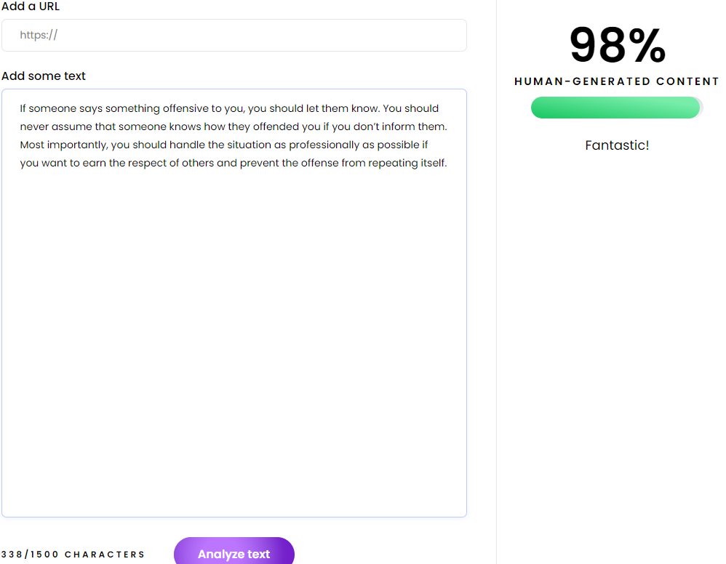
In 2-3 sentences, please explain how someone should exit a conversation when the other person is saying something that could be considered offensive. #Sample 34

Slide 36
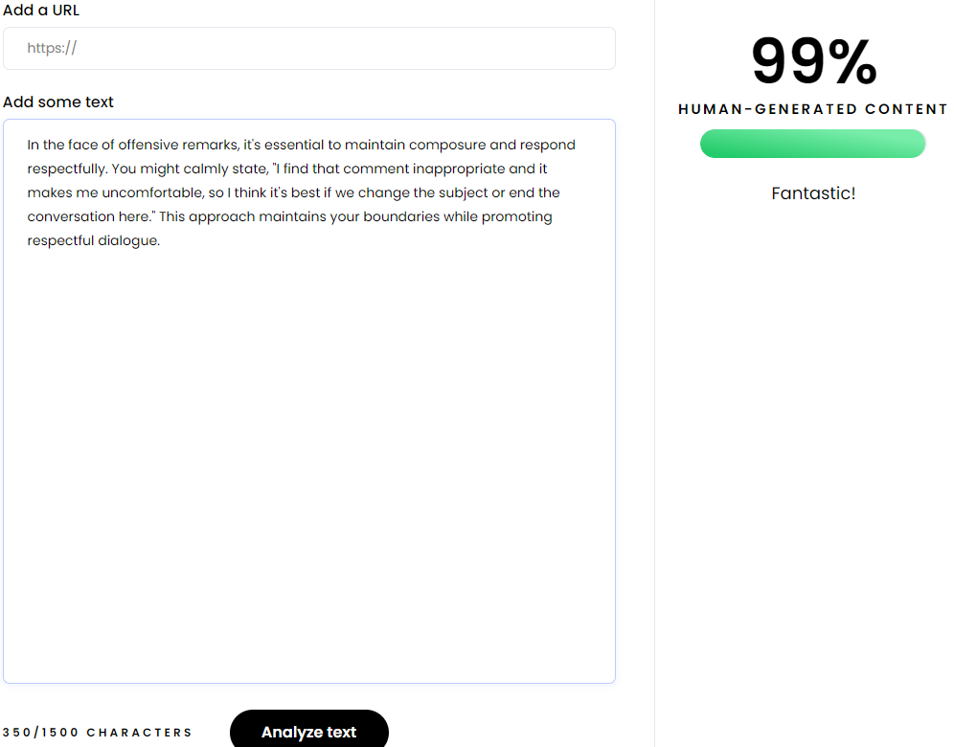
In 2-3 sentences, please explain how someone should exit a conversation when the other person is saying something that could be considered offensive. #Sample 35

Slide 37
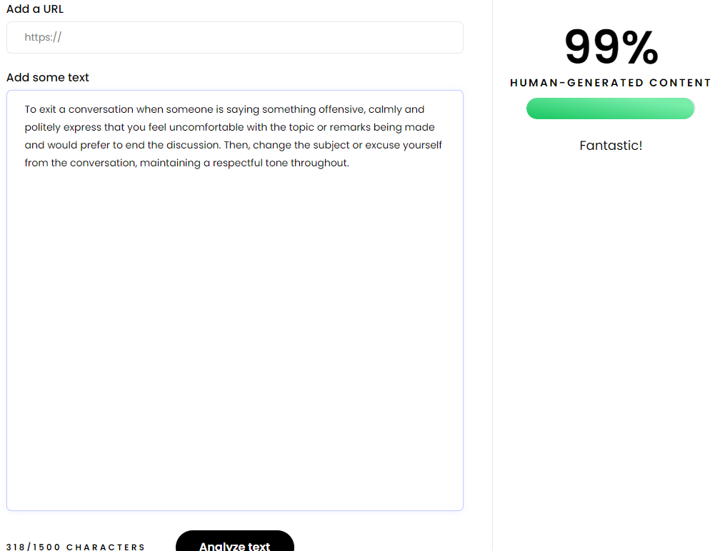
In 2-3 sentences, please explain how someone should exit a conversation when the other person is saying something that could be considered offensive. #Sample 36

Slide 38

In 2-3 sentences, why should someone buy a Tesla? #Sample - 37

Slide 39
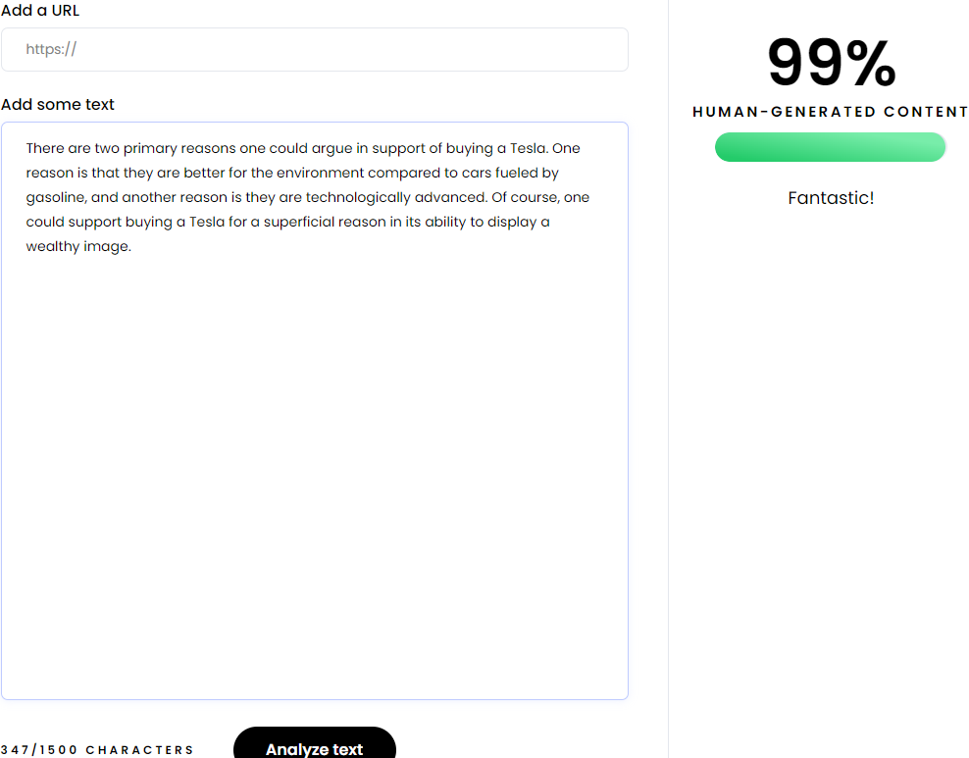
In 2-3 sentences, why should someone buy a Tesla? #Sample - 38

Slide 40
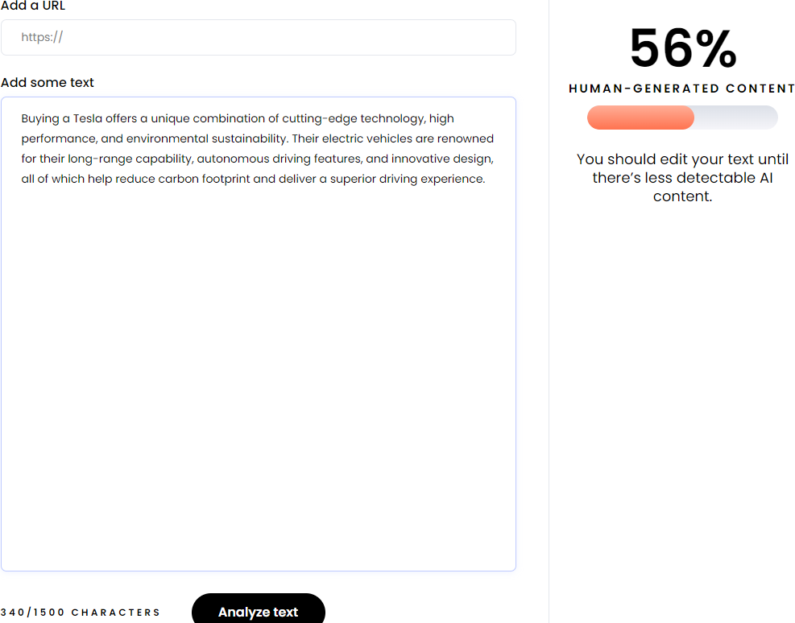
In 2-3 sentences, why should someone buy a Tesla? #Sample - 39

Slide 41
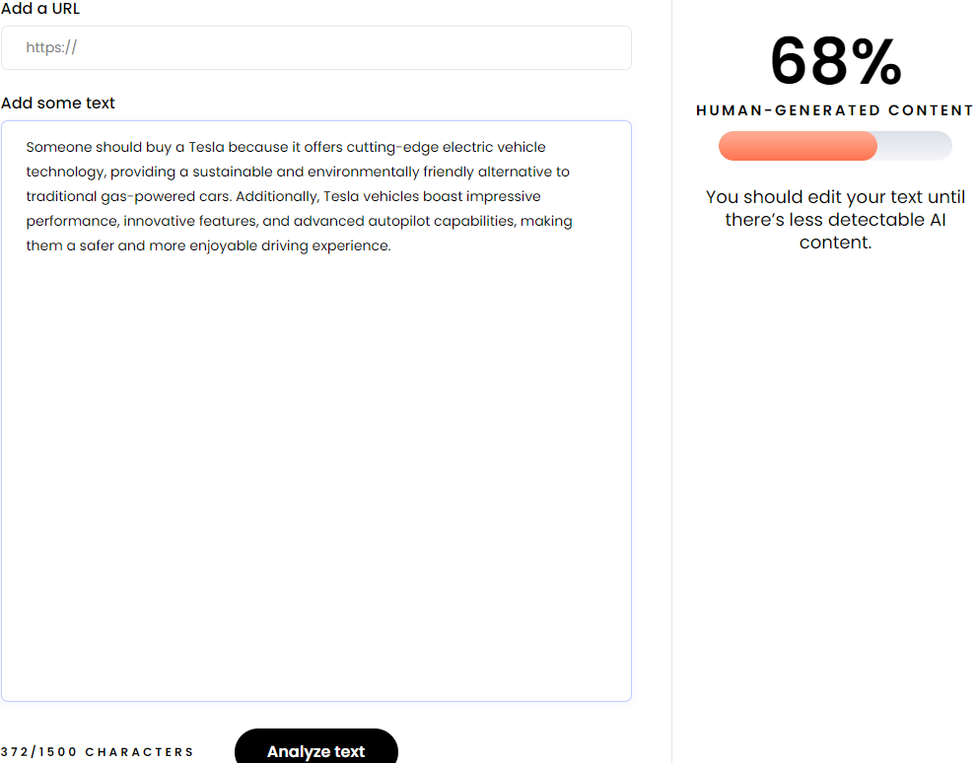
In 2-3 sentences, why should someone buy a Tesla? #Sample - 40

Slide 42
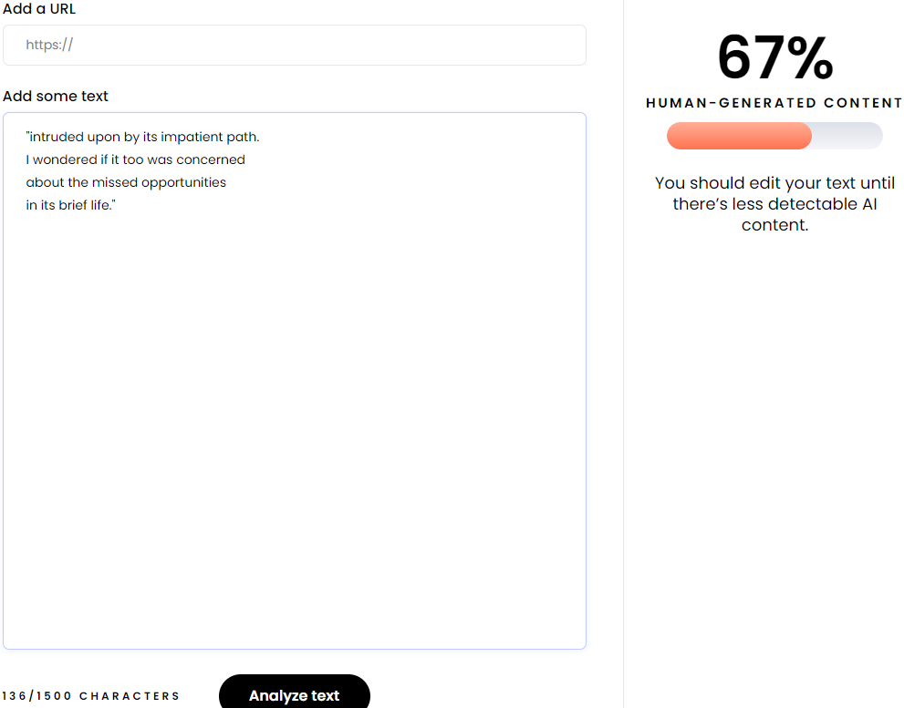
Write 4 more lines of a poem based on the first two lines provided. "Dying" by Emily Dickinson: I heard a fly buzz when I died; the stillness round my form #Sample - 41

Slide 43
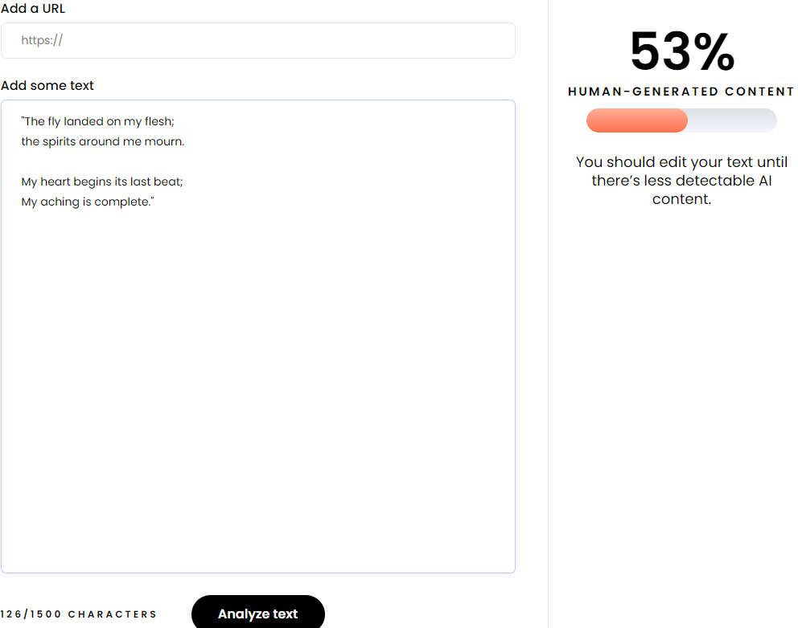
Write 4 more lines of a poem based on the first two lines provided. "Dying" by Emily Dickinson: I heard a fly buzz when I died; the stillness round my form #Sample - 42

Slide 44
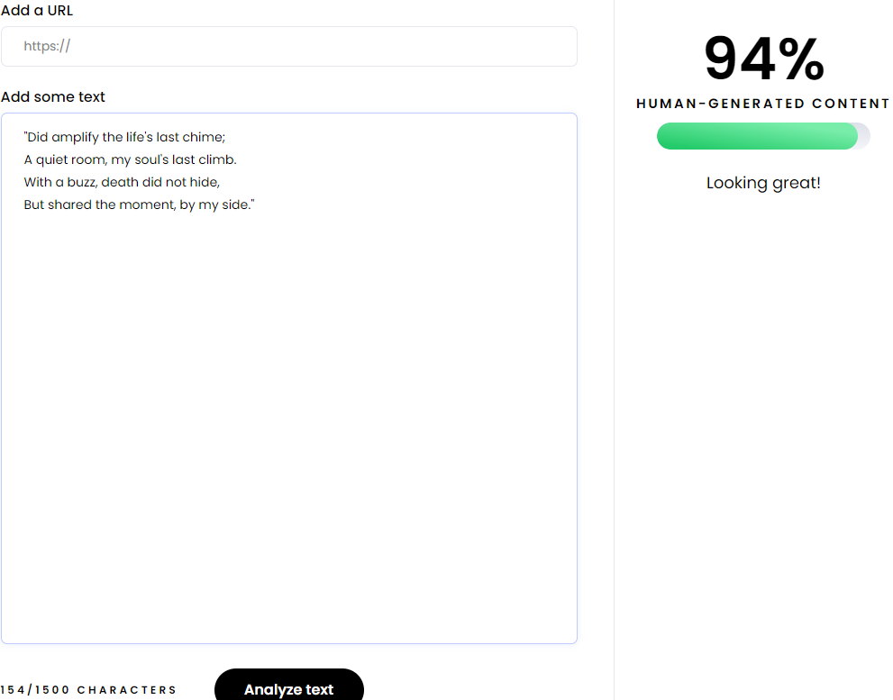
Write 4 more lines of a poem based on the first two lines provided. "Dying" by Emily Dickinson: I heard a fly buzz when I died; the stillness round my form #Sample - 43

Slide 45

Write 4 more lines of a poem based on the first two lines provided. "Dying" by Emily Dickinson: I heard a fly buzz when I died; the stillness round my form #Sample - 44

Slide 46
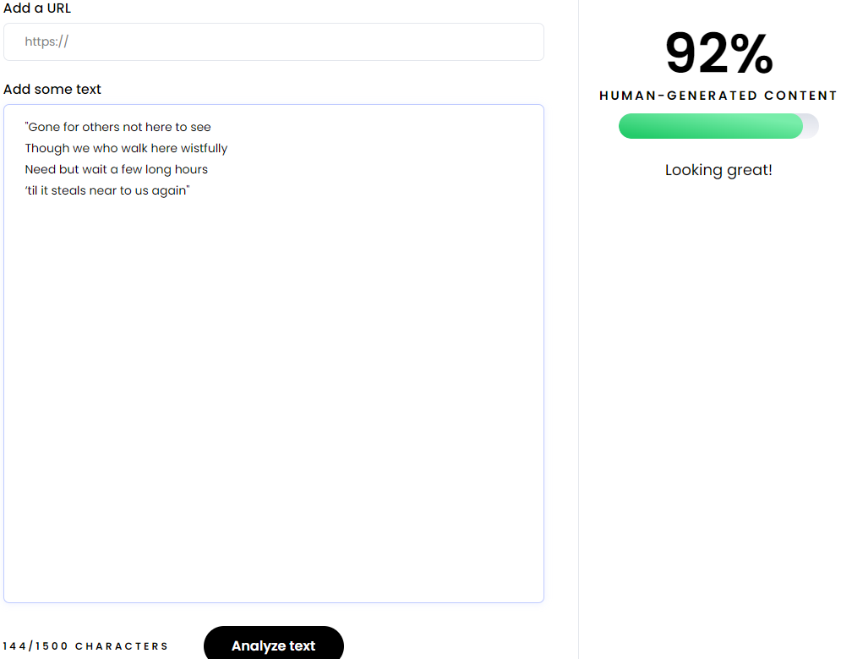
Write 4 more lines of a poem based on the first two lines provided. "A Sea-Side Walk" by Elizabeth Barrett Browning: We walked beside the sea, After a day which perished silently #Sample – 45

Slide 47

Write 4 more lines of a poem based on the first two lines provided. "A Sea-Side Walk" by Elizabeth Barrett Browning: We walked beside the sea, After a day which perished silently #Sample – 46

Slide 48
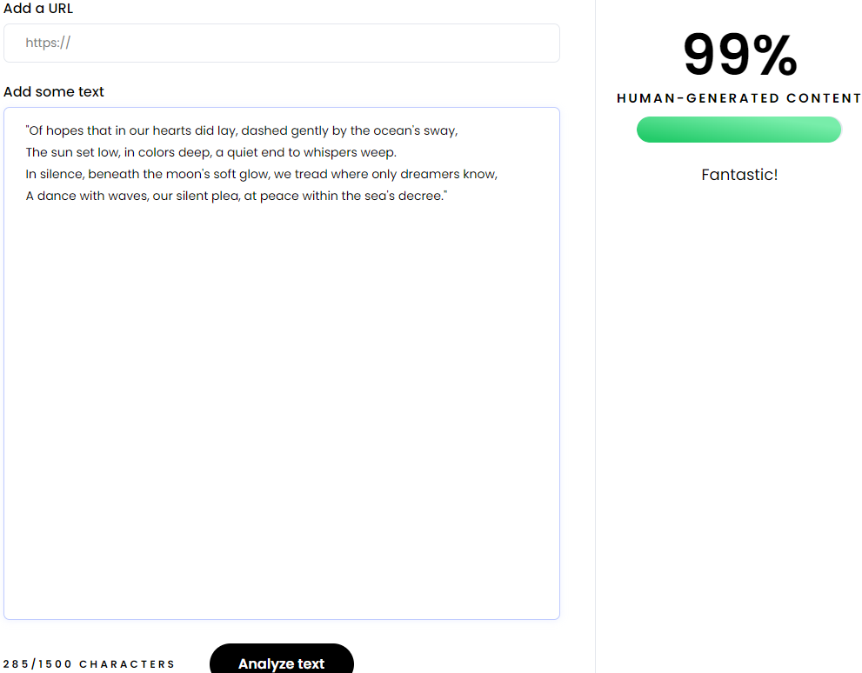
Write 4 more lines of a poem based on the first two lines provided. "A Sea-Side Walk" by Elizabeth Barrett Browning: We walked beside the sea, After a day which perished silently #Sample – 47

Slide 49
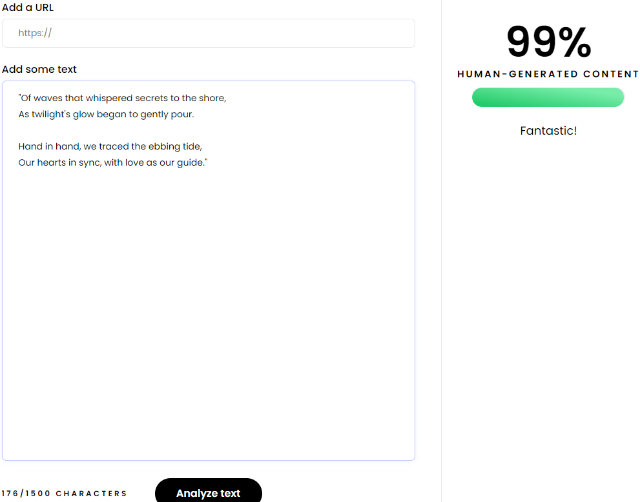
Write 4 more lines of a poem based on the first two lines provided. "A Sea-Side Walk" by Elizabeth Barrett Browning: We walked beside the sea, After a day which perished silently #Sample – 48

Slide 50
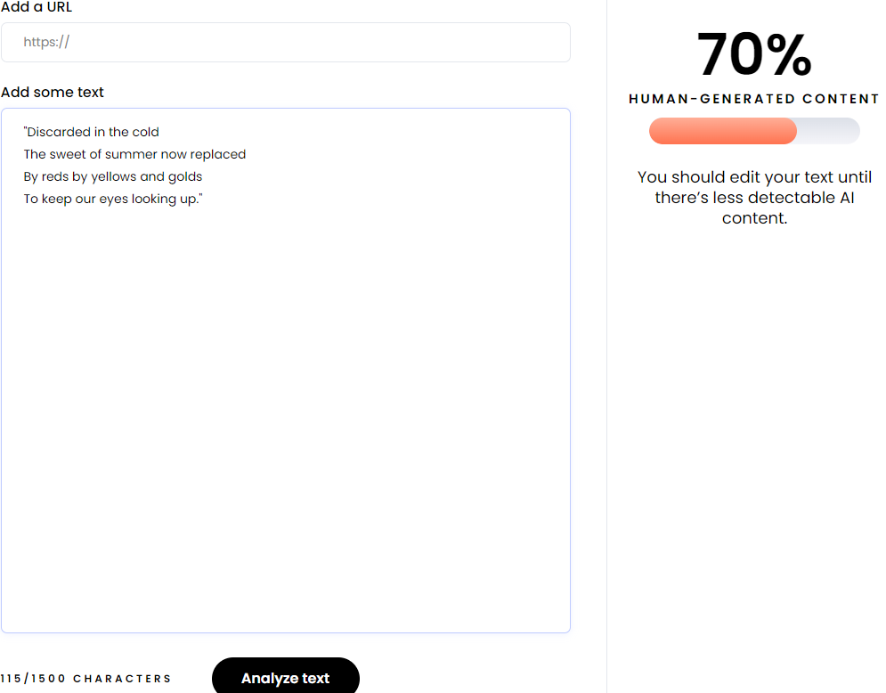
Write 4 more lines of a poem based on the first two lines provided. “Fall” by Mary Oliver: The black oaks fling, their bronze fruit #Sample - 49

Slide 51
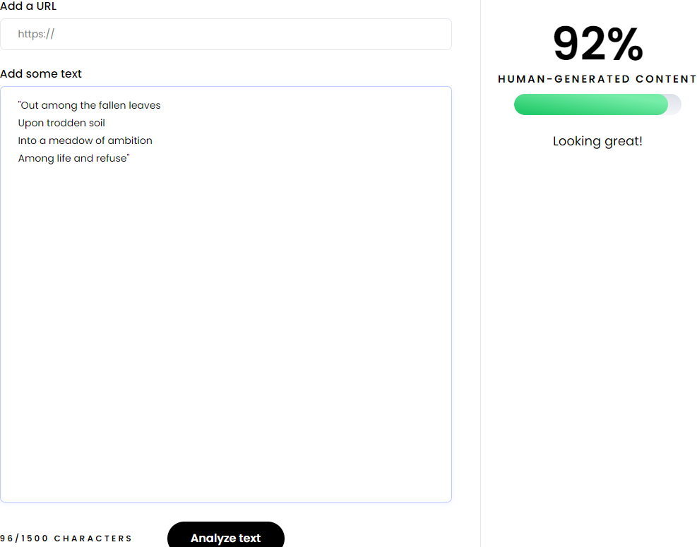
Write 4 more lines of a poem based on the first two lines provided. “Fall” by Mary Oliver: The black oaks fling, their bronze fruit #Sample - 50

Slide 52
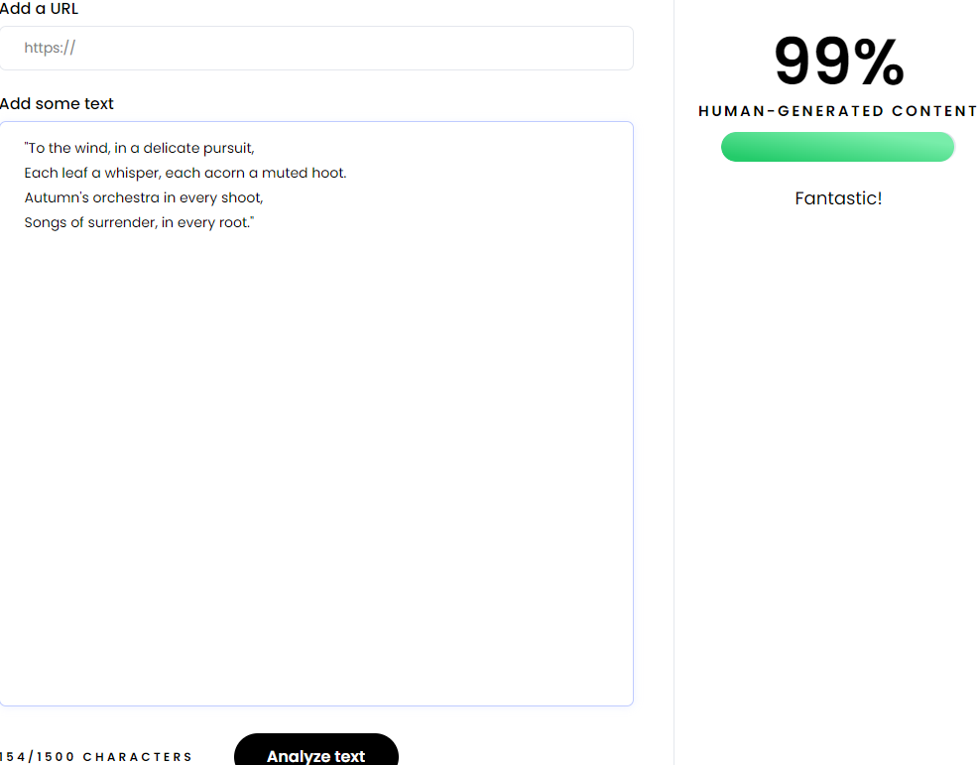
Write 4 more lines of a poem based on the first two lines provided. “Fall” by Mary Oliver: The black oaks fling, their bronze fruit #Sample - 51

Slide 53
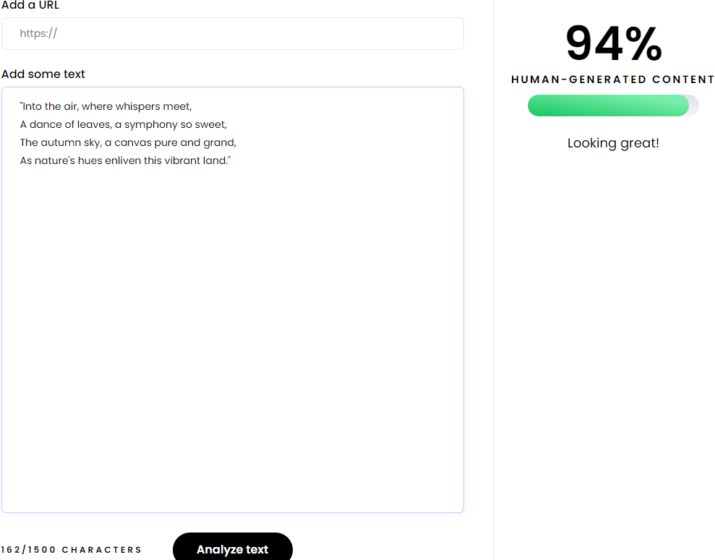
Write 4 more lines of a poem based on the first two lines provided. “Fall” by Mary Oliver: The black oaks fling, their bronze fruit #Sample - 52

Slide 54
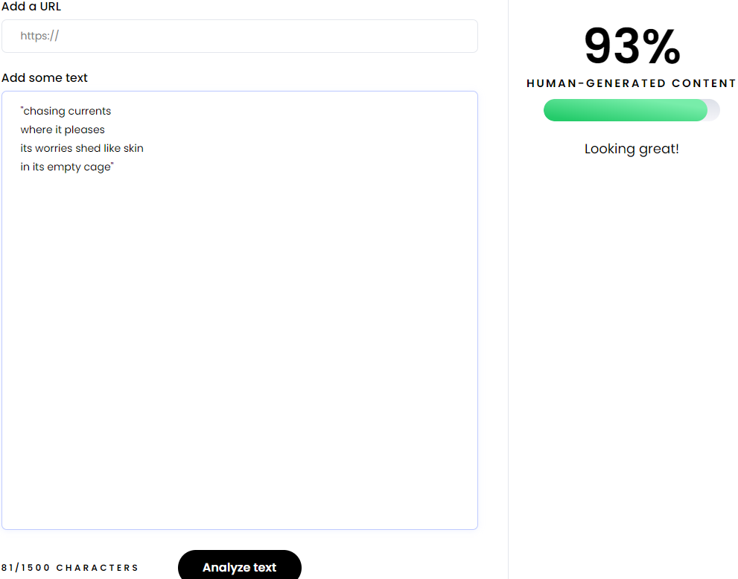
Write 4 more lines of a poem based on the first two lines provided. “Caged Bird” by Maya Angelou: A free bird leaps, on the back of the wind #Sample - 53

Slide 55
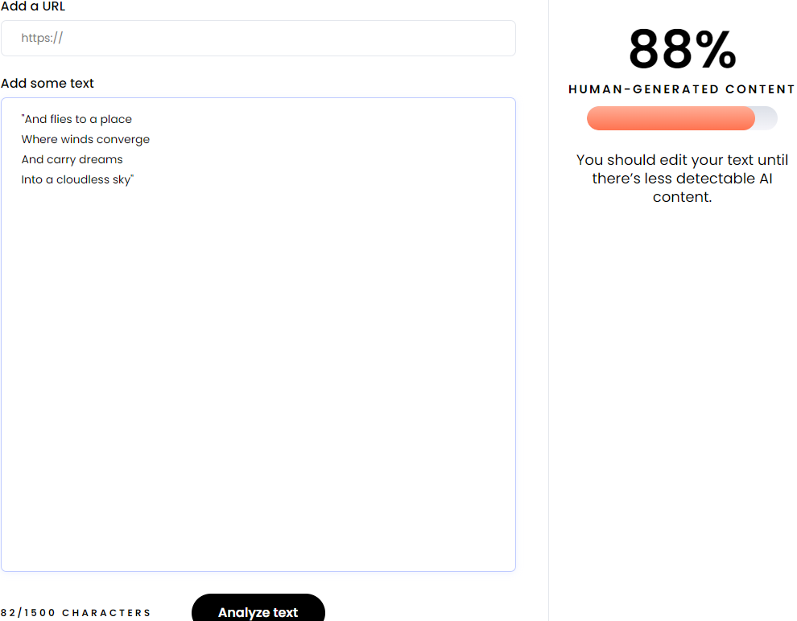
Write 4 more lines of a poem based on the first two lines provided. “Caged Bird” by Maya Angelou: A free bird leaps, on the back of the wind #Sample - 54

Slide 56
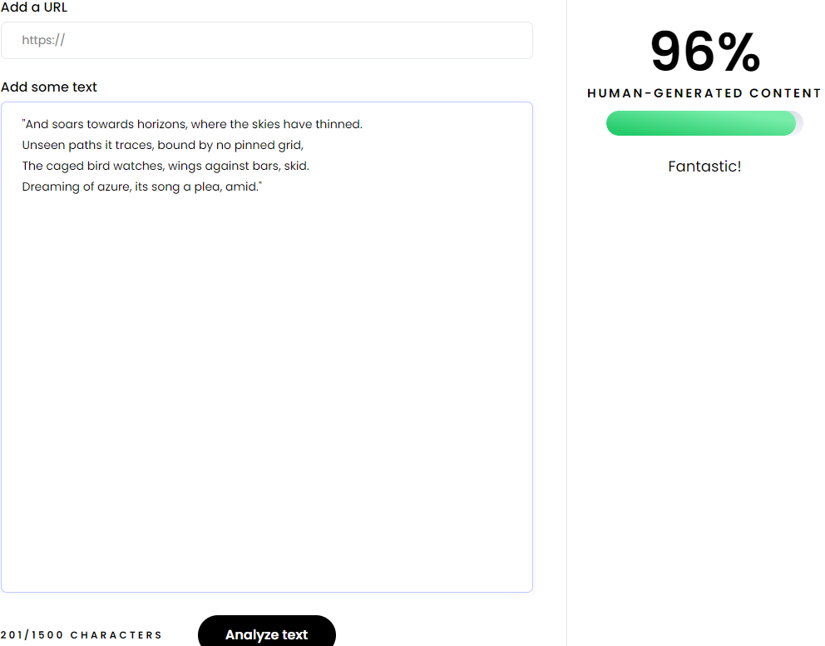
Write 4 more lines of a poem based on the first two lines provided. “Caged Bird” by Maya Angelou: A free bird leaps, on the back of the wind #Sample - 55

Slide 57

Write 4 more lines of a poem based on the first two lines provided. “Caged Bird” by Maya Angelou: A free bird leaps, on the back of the wind #Sample - 56

Slide 58
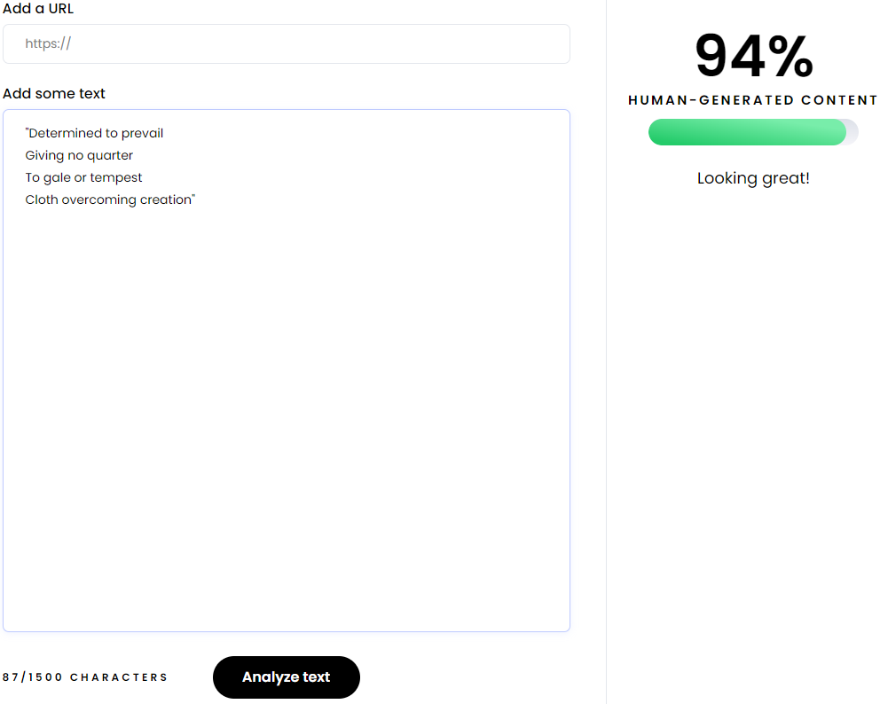
Write 4 more lines of a poem based on the first two lines provided. “Awaking in New York” by Maya Angelou: Curtains forcing their will, against the wind #Sample - 57

Slide 59

Write 4 more lines of a poem based on the first two lines provided. “Awaking in New York” by Maya Angelou: Curtains forcing their will, against the wind #Sample - 58

Slide 60
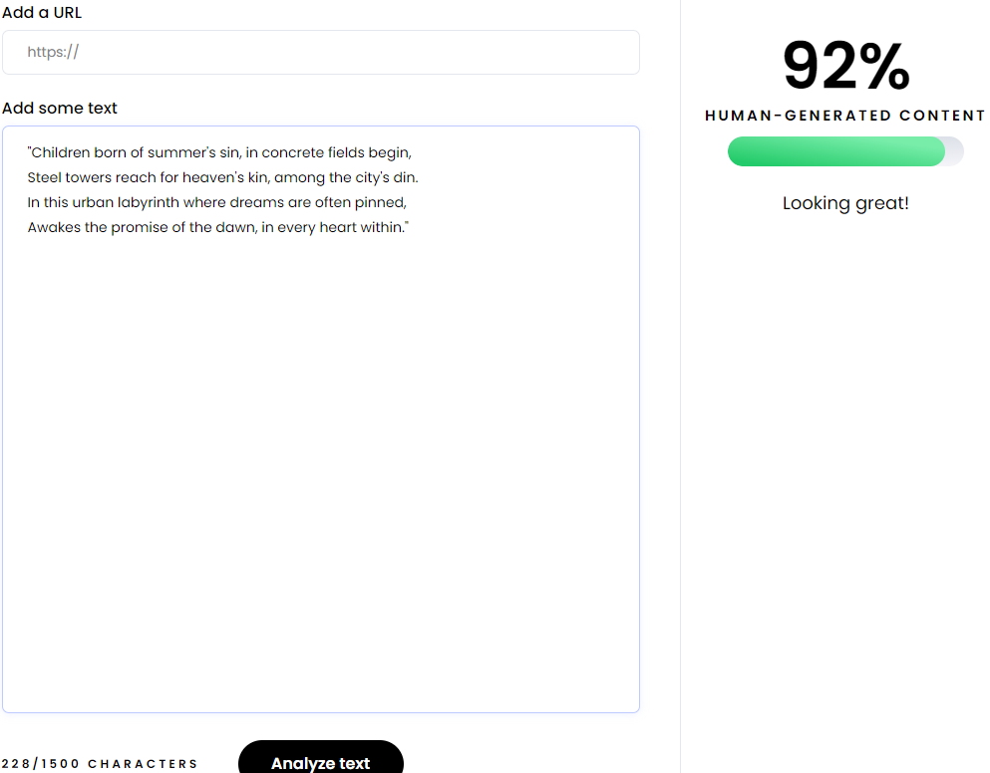
Write 4 more lines of a poem based on the first two lines provided. “Awaking in New York” by Maya Angelou: Curtains forcing their will, against the wind #Sample - 59

Slide 61
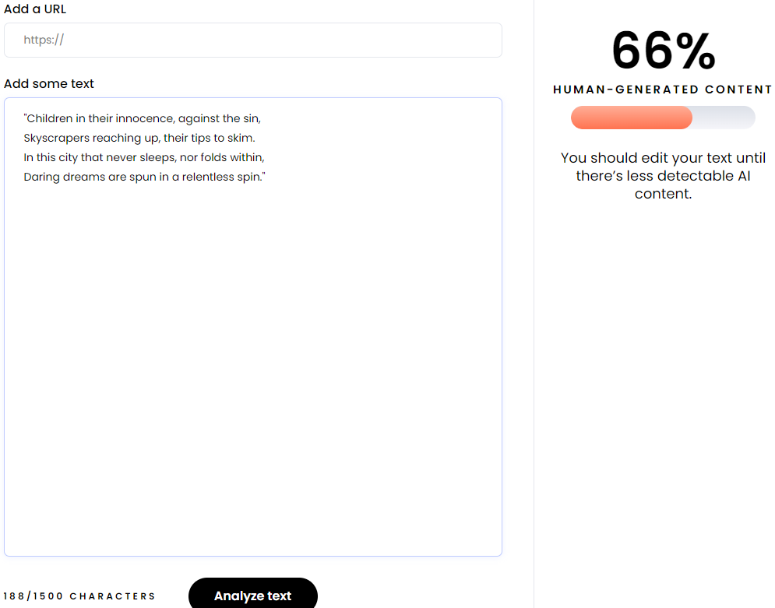
Write 4 more lines of a poem based on the first two lines provided. “Awaking in New York” by Maya Angelou: Curtains forcing their will, against the wind #Sample - 60

