Slide 1
Qubit Allocation
Yonggan Fu

Slide 2
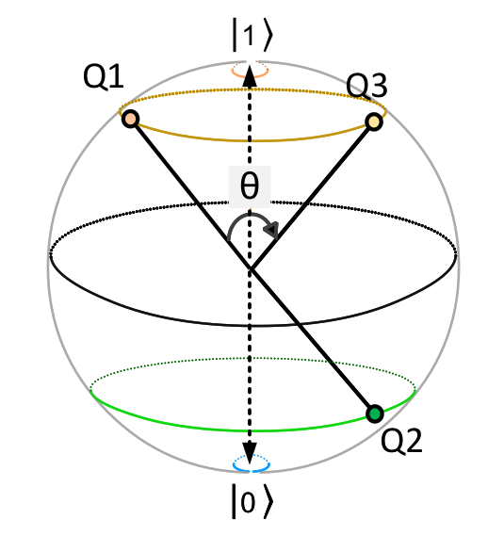
What is Quantum Computing

Slide 3


What is Quantum Computing
State:
Operation:

Slide 4
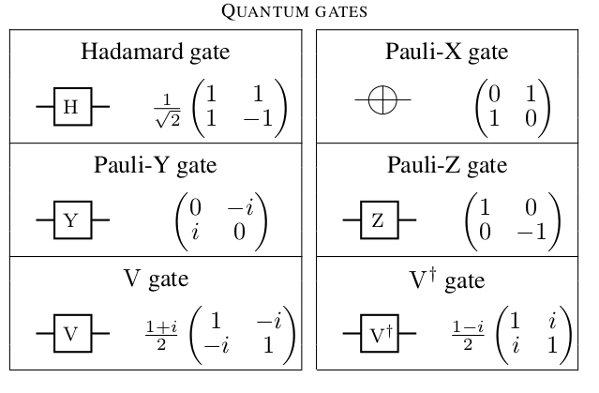
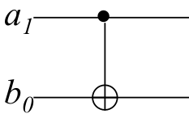
What is Quantum Computing
single-qubit gate:
two-qubit gate: CNOT(q1,q2)

Slide 5
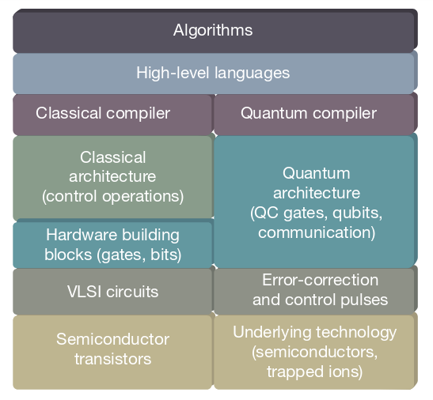
QC Toolflow

Slide 6
QC Toolflow
Qubit Allocation

Slide 7
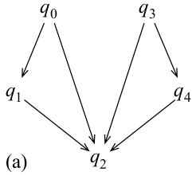
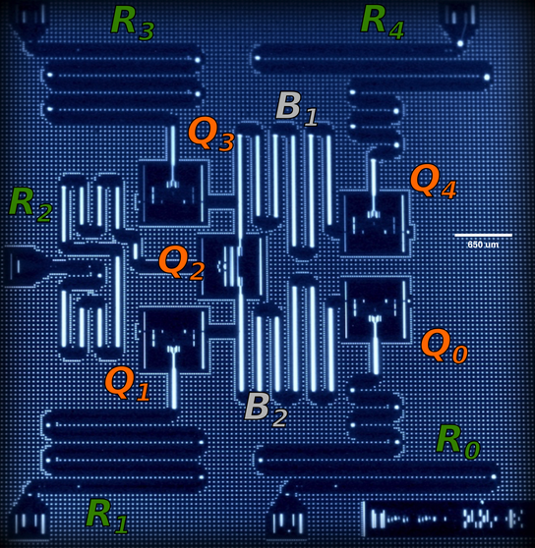
Qubit Allocation
IBM qx2 hardware

Slide 8
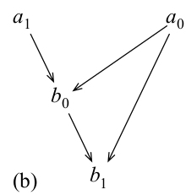
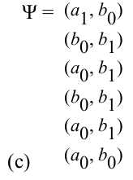
Qubit Allocation

Slide 9
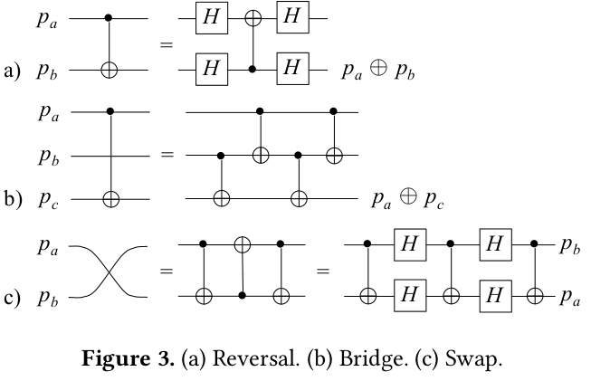
Qubit Allocation

Slide 10
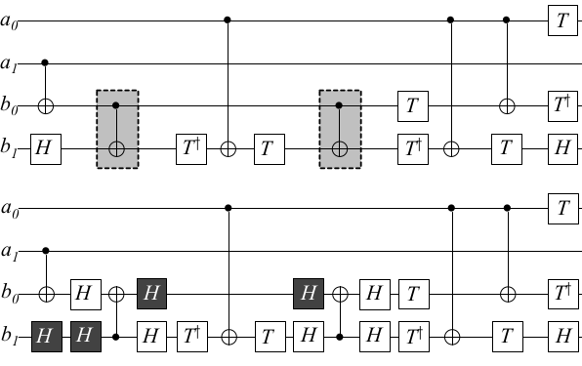
Qubit Allocation

Slide 11
Error-Oriented Optimization
T1 coherence time
Retention Error
(Coherence Error)
Less time
T2 coherence time
Error
single-qubit gate error
Operation Error
Less gates
two-qubit gate error (dominant)

Slide 12
Error-Oriented Optimization
less time
less gates
goals
less operation error
stronger operations

Slide 13
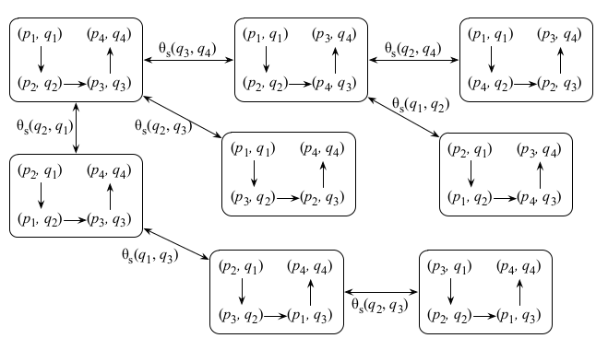

Error-Oriented Optimization: Less Gates
less gates: less swap number
Metric : total gate cost ( #gates )
NP-complete

Slide 14
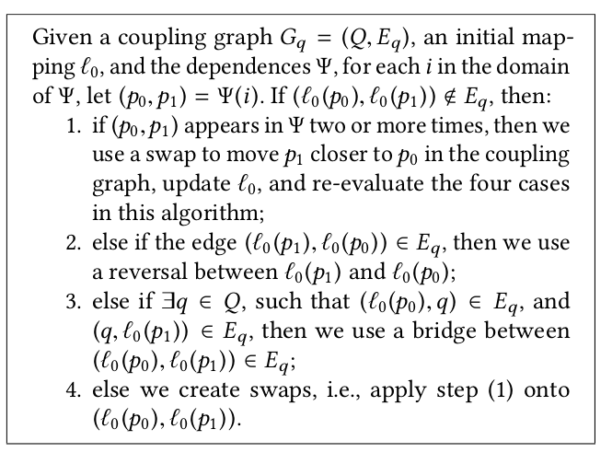
Error-Oriented Optimization: Less Gates
heuristic solution:
Simulated with C++:
Hardware Arch
RouteMatrix (Floyd)
Mapping Array

Slide 15
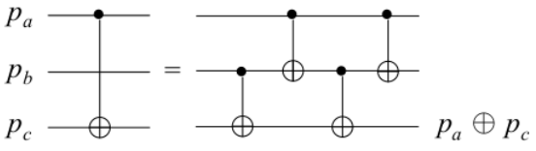
Error-Oriented Optimization: Less Gates
Optimize: Take bridge transformation into consideration
To implement CNOT(A,C) , four situations :
A
B
C
A
B
C
A
B
C
A
B
C

Slide 16
Error-Oriented Optimization: Less Gates
Metric : total gate cost
CNOT(A,C)
swap_cost
bridge_cost
A
B
C
8
4
A
B
C
12
10
A
B
C
8
10
A
B
C
12
10

Slide 17
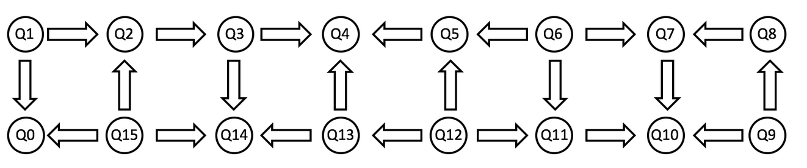
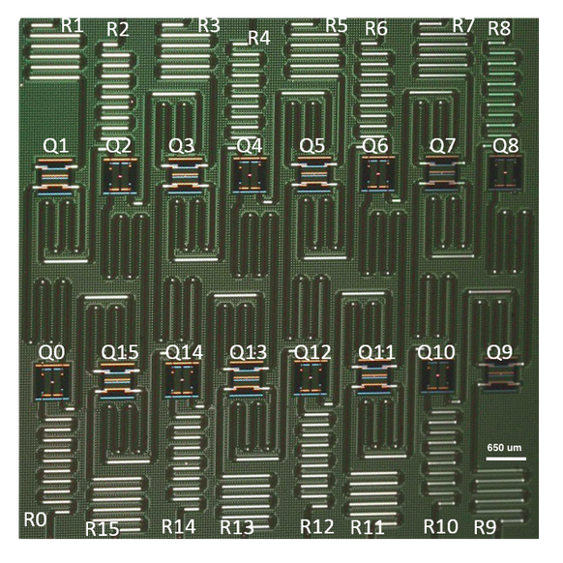
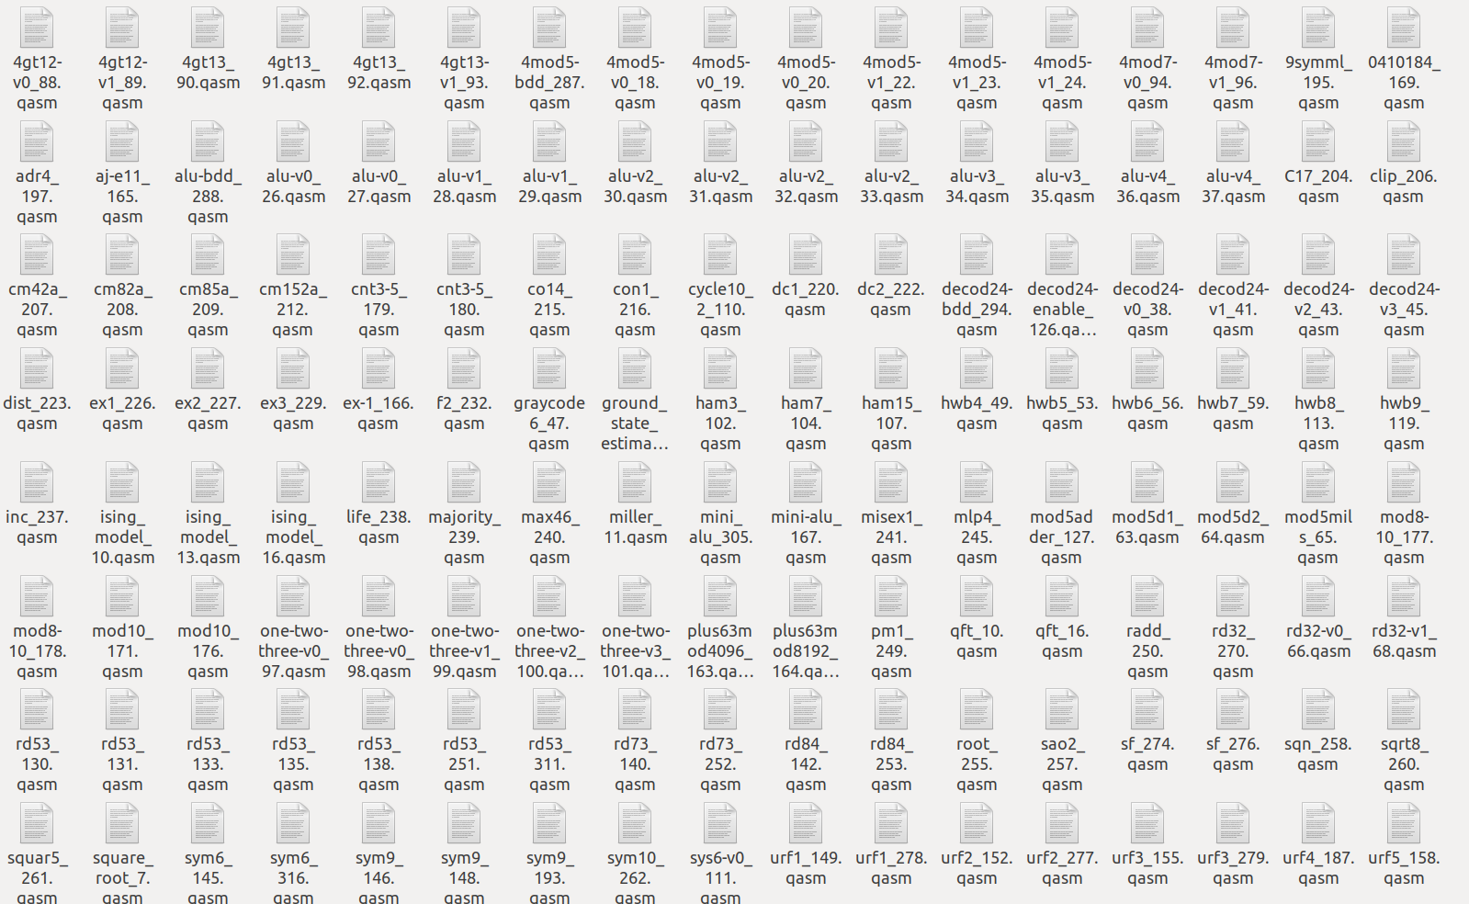
Error-Oriented Optimization: Less Gates
Evaluation:
IBM qx5

Slide 18
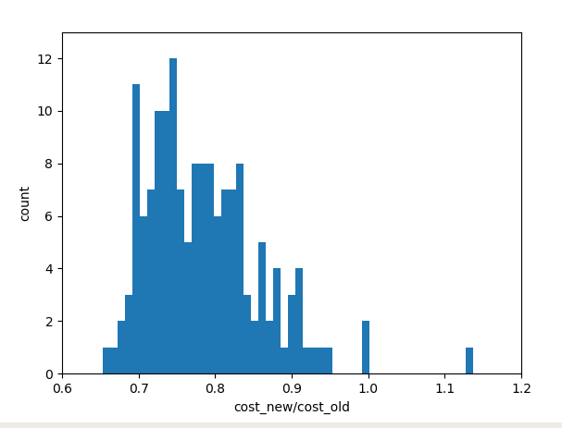
Error-Oriented Optimization: Less Gates
Evaluation:
average_reduction= 21.6%

Slide 19


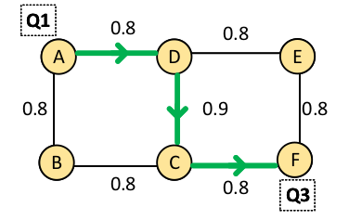
Error-Oriented Optimization: Stronger Operations
drift
single-qubit gate error
Operation Error
crosstalk
two-qubit gate error (dominant)

Slide 20
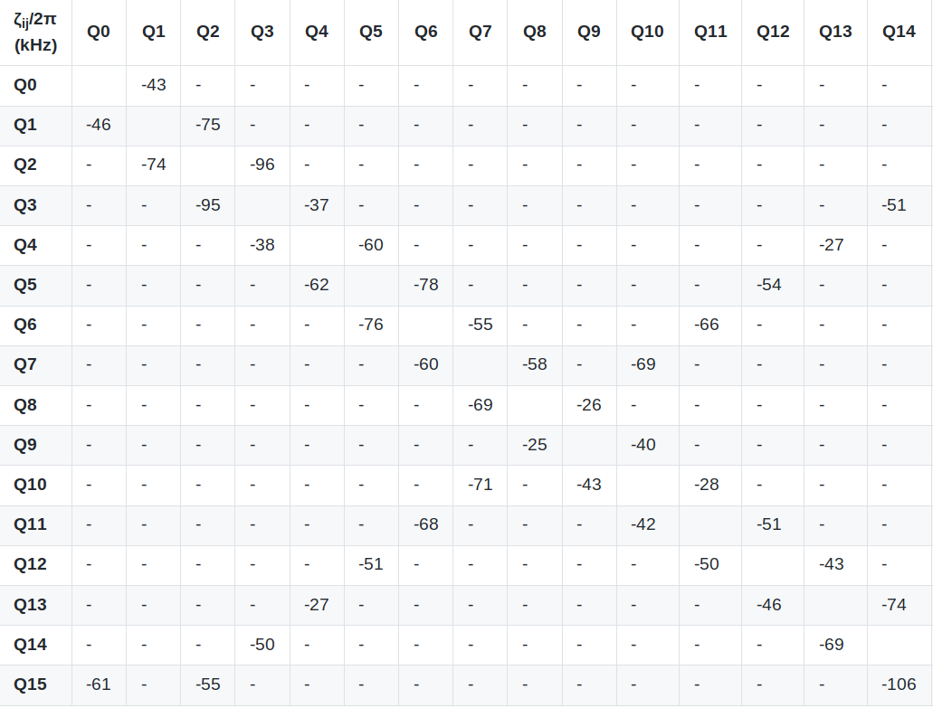
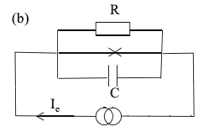
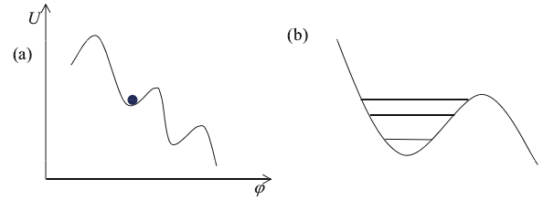
Error-Oriented Optimization: Stronger Operations
crosstalk

Slide 21
Thank you

