Slide 1

Welcome to “figclick”. I hope it saves you time when marking up figures for patents with part numbers. Click on “sponser” to read legal disclaimer.
For various technical reasons, getting it up and running requires a few steps.
The simplest mode of operation is having this file open while editing your figure set in your figure presentation file.
First use (all steps to be done in the window showing the powerpoint presentation with your figure set):
Turn on developer menu/tab
Click on developer tab
Click on macros
In pulldown under list, select “macros in” from this (figclick) presentation
Run the “runmefirst…” macro (required every time you open your presentation)
Go to “add ins” tab
Click “clickon” (this needs to be repeated for each slide)
Now, every time you click on page, a new number will be added
“Clickoff” when you want to make other changes to page
The follow pages show this steps with images

Slide 2
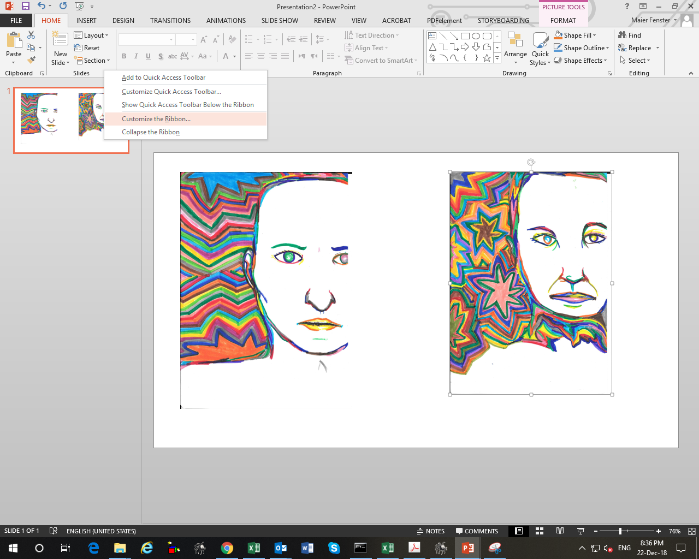
Turn on developer menu/tab
By right-clicking on the ribbon and selecting “customize ribbon”

Slide 3
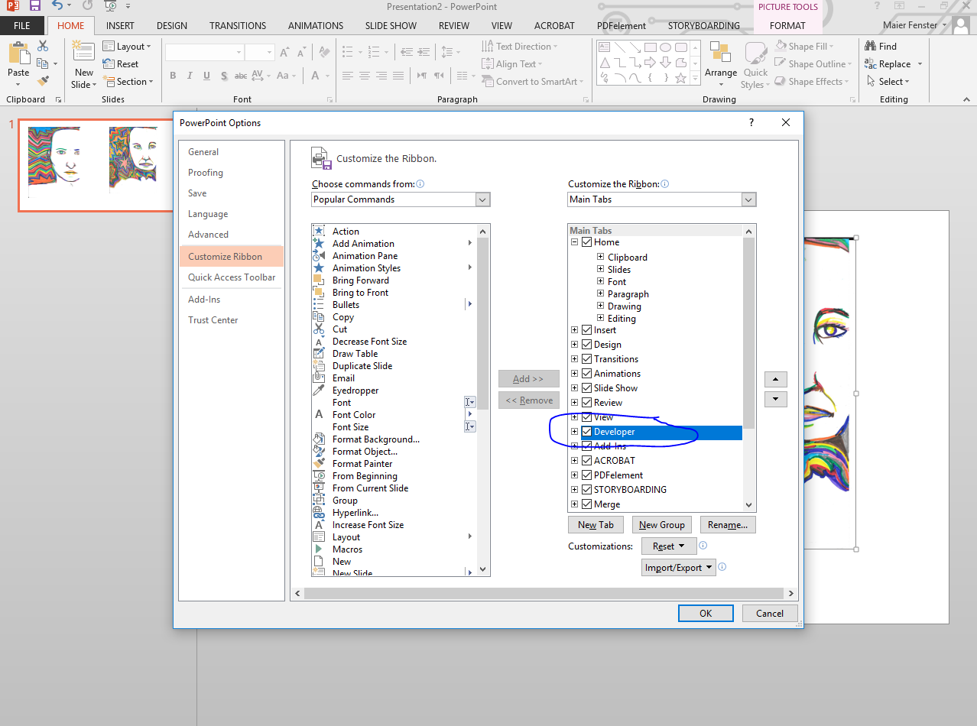
Turn on developer menu/tab-cont
Check off “developer” in right-side list

Slide 4
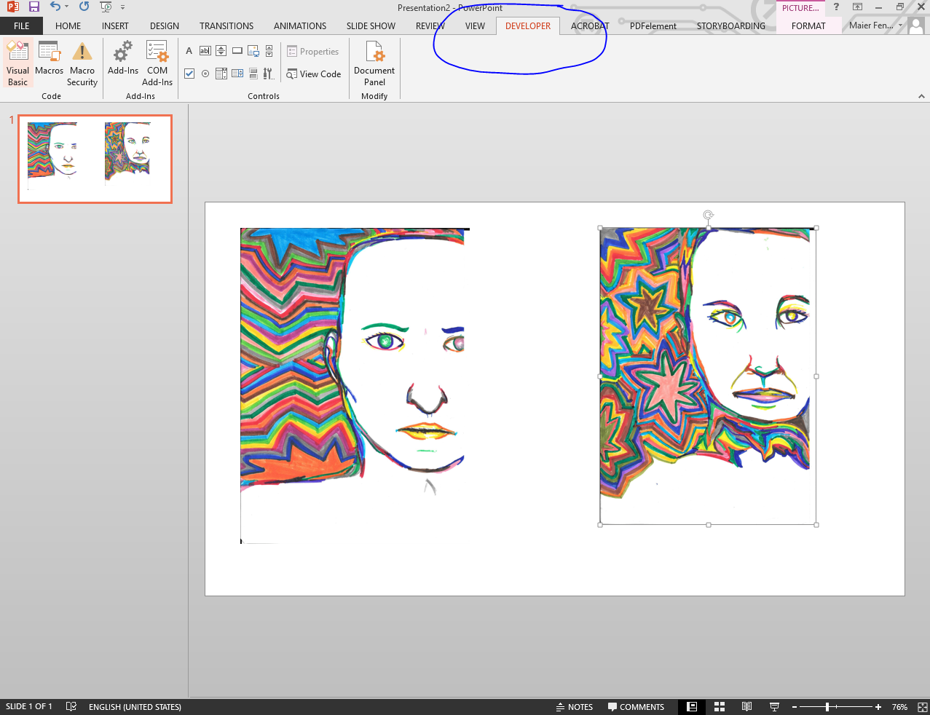
2. Click on developer tab
(which has now appeared)

Slide 5
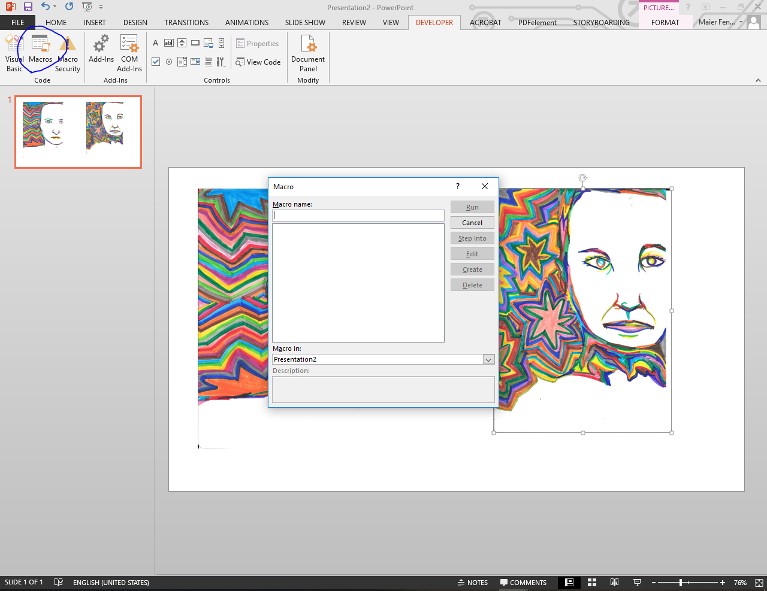
3. Click on macros
(if needed, enable macro security)

Slide 6
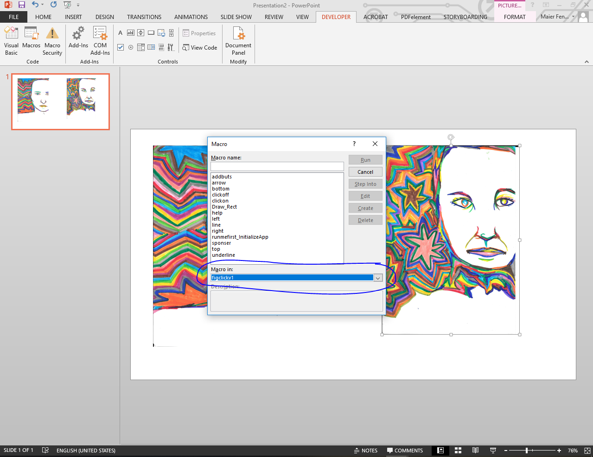
4. Select “macros in”.
From this (figclick) presentation.

Slide 7
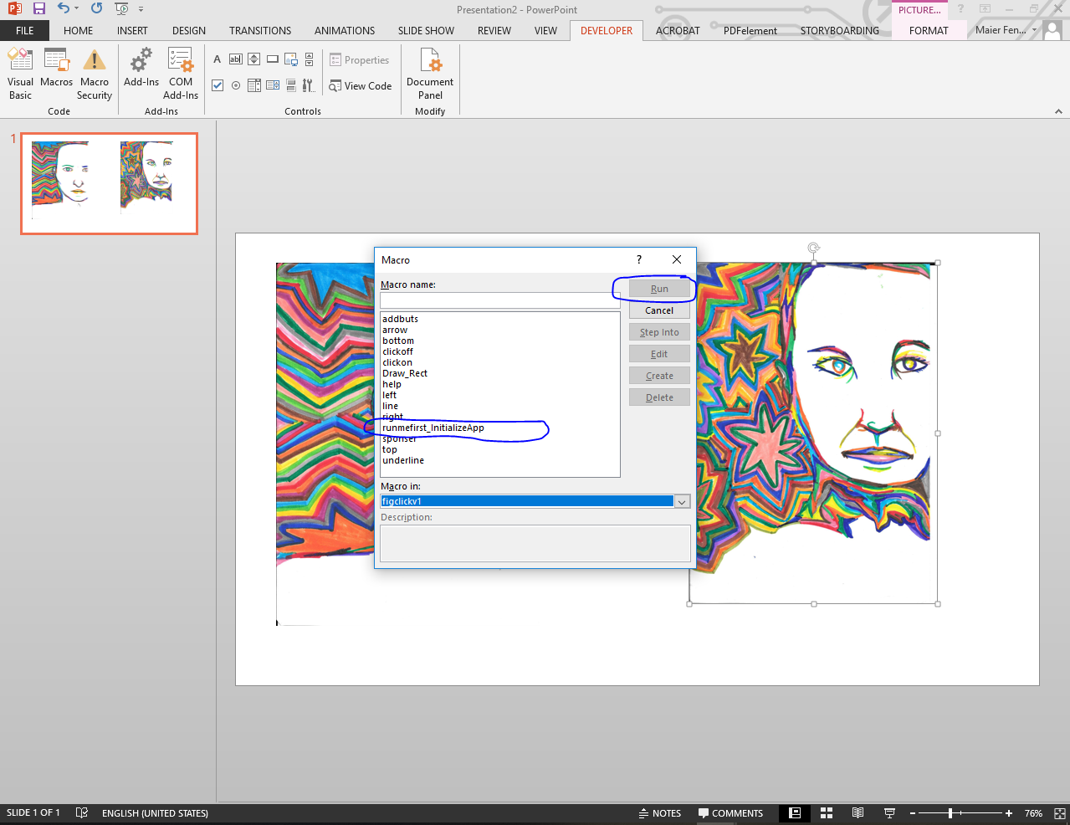
5. Run the “runmefirst…” macro
required every time you run application

Slide 8
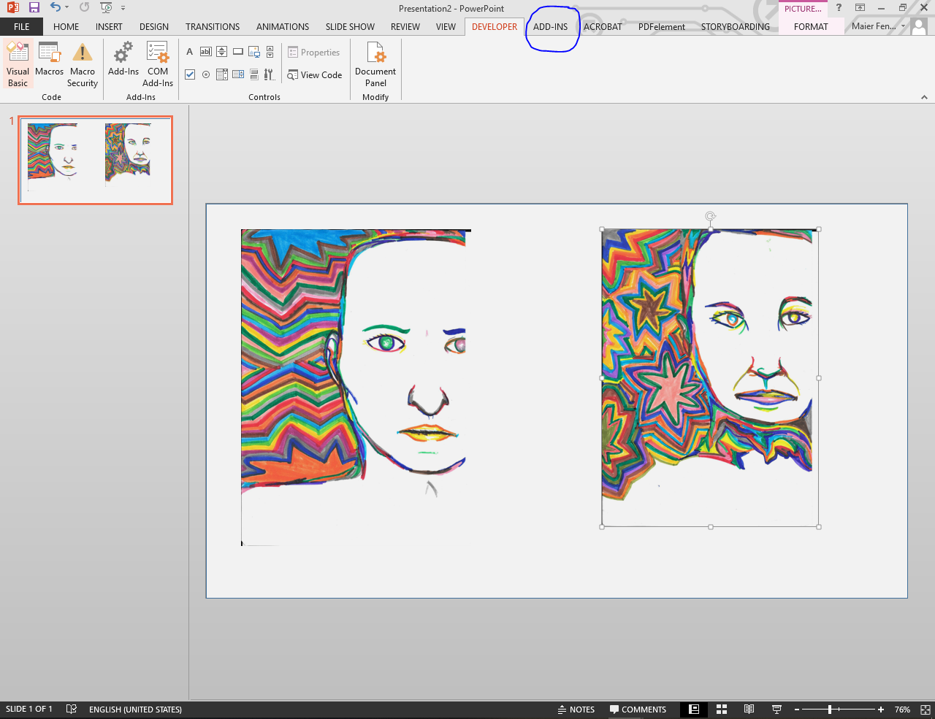
6. Go to “add ins” tab
which has now appeared. If not, unselect and reselect it in the “customize ribbon” as shown for steps 1 & 2

Slide 9
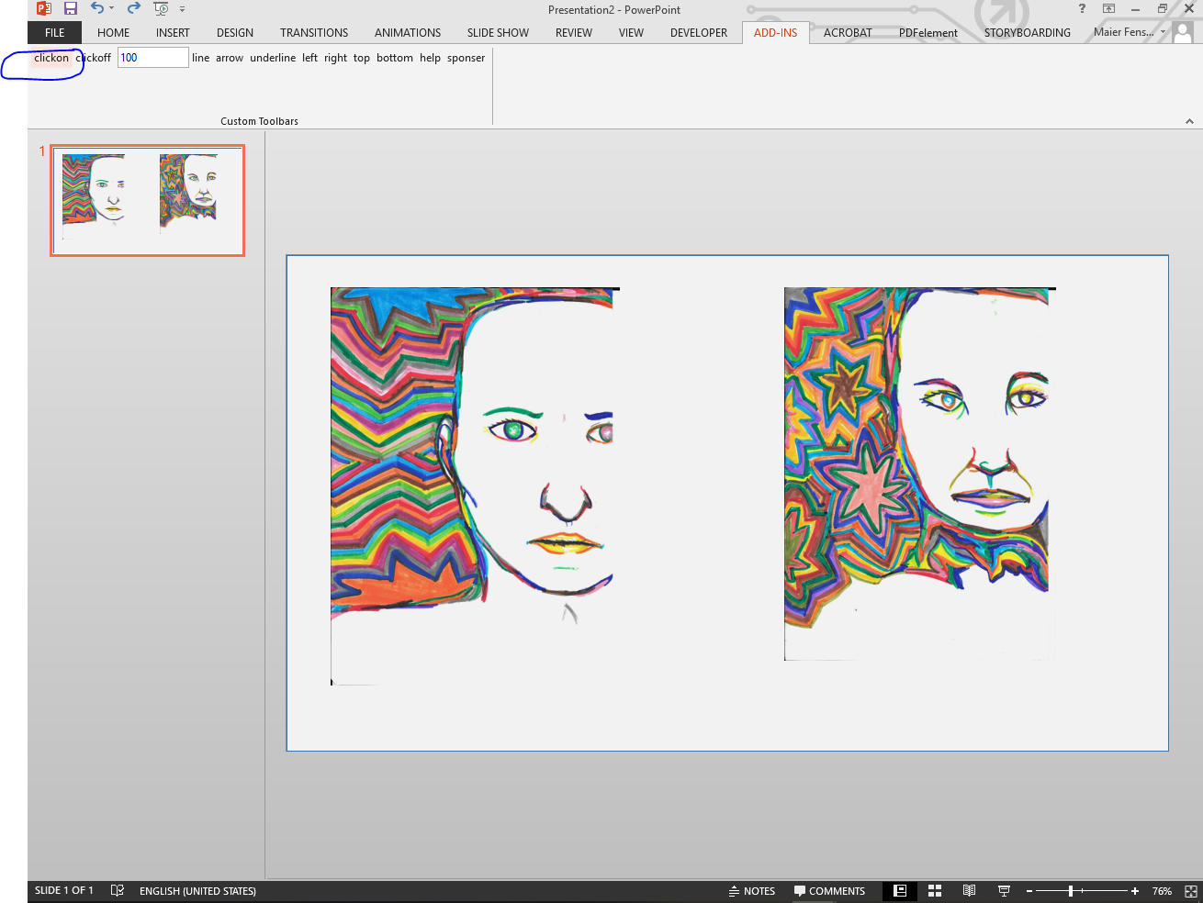
7. Click “clickon”
this needs to be repeated for each slide when you work on it. You may notice a thin border appearing around slide

Slide 10
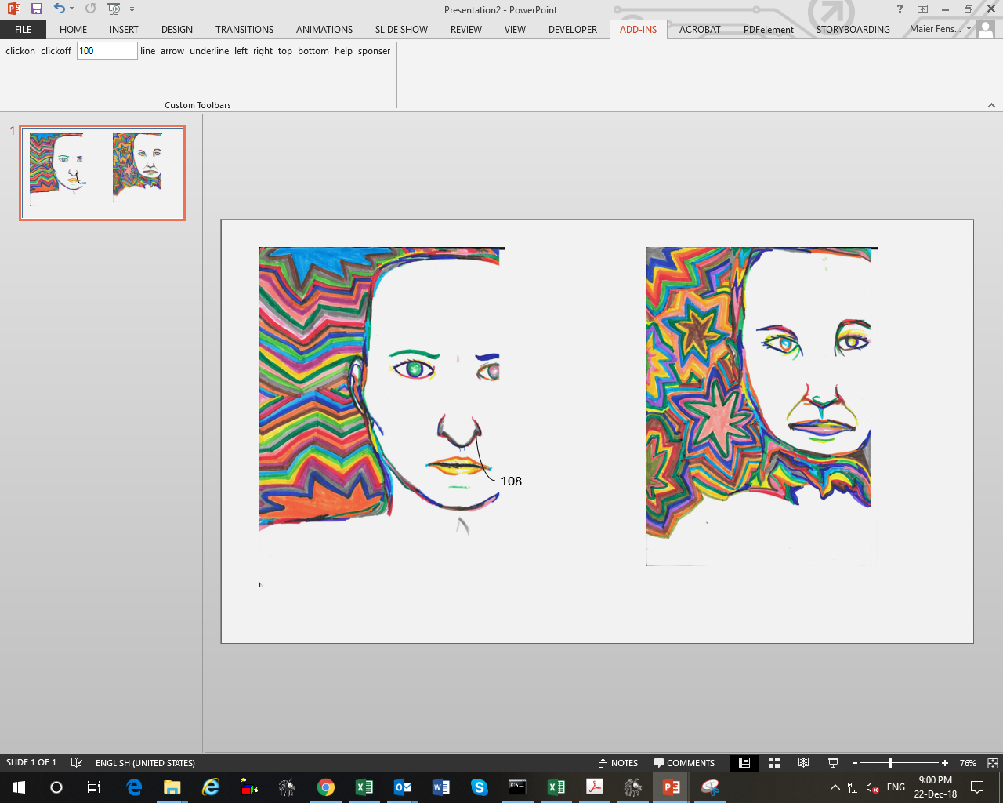
Help message
Usage
Number text can be changed and textbox dragged, as seen below
plain line
No line
Various line directions
Arrow head
To stop
clicking from adding callout
Sample number added by clicking
with left mouse
Enter number to count from

