Slide 1



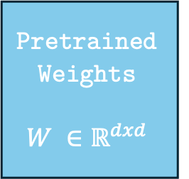



$$h$$
Pretrained Weights
$$W ∈ℝ^{dxd}$$
$$B=0$$
$$r$$
$$A=𝒩(0,σ^{2})$$
$$d$$
$$x$$

