Slide 1
Preliminaries
§1.1
On time-warping
Case studies
§1.2
Process rate and
the internal structure of events
§4.1
CVC syllable production
§1.3
Linear vs. nonlinear time-warping
§4.2
SVO utterance production
DTW
§2.4
standard dynamic time warping (DTW)
§2.5
extensions of DTW
Local relative
rate (LRR)
method
§3.1
Assumptions of the method
§3.2
Local slope of the warping curve
§3.3
Local relative rate and inferences
about temporal structure
§3.4
Inferences from partial matching

Slide 2
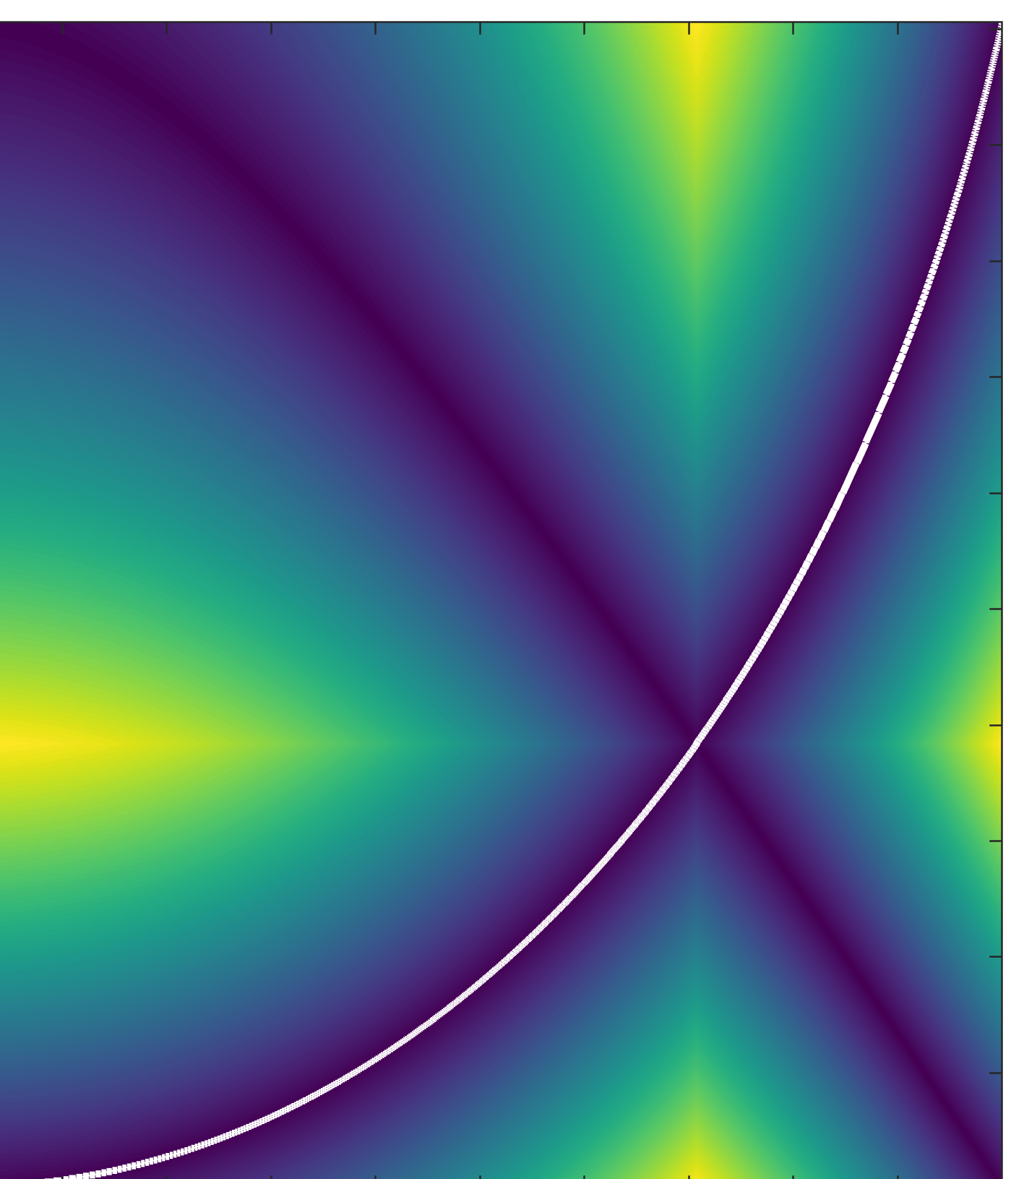
time-warping/normalization
array
of LRR
timeseries
reference signal
linear time
warping (LTW)
dynamic time
warping (DTW)
other
methods
input:
signal pair
standard DTW
or lsc-DTW
extensions:
global windows
open endpoints
test signal
output:
time index
mapping
impose reference frame
mean/variance analysis
GAM analysis
signal
alignment
calculate
LRR
apply
pairwise

