Slide 1

Rockbuster Stealth LLC: Data Analysis Project
Presented by Neena Tilton
January 2022

Slide 2


Project Overview
GOAL
Rockbuster Stealth LLC has been a leading movie rental company with extensive movie licenses. In more recent years, with streaming services becoming more commonplace, Rockbuster faces stiff competition in keeping the lead. To stay competitive, Rockbuster will enter the online streaming service with a detailed launch strategy that will maximize this new and exciting shift.
OBJECTIVE
This project will inform the new launch strategy by identifying the following: Which geographic location to prioritize, which types of film are most popular, and who our top customers are to include our new rewards program.

Slide 3
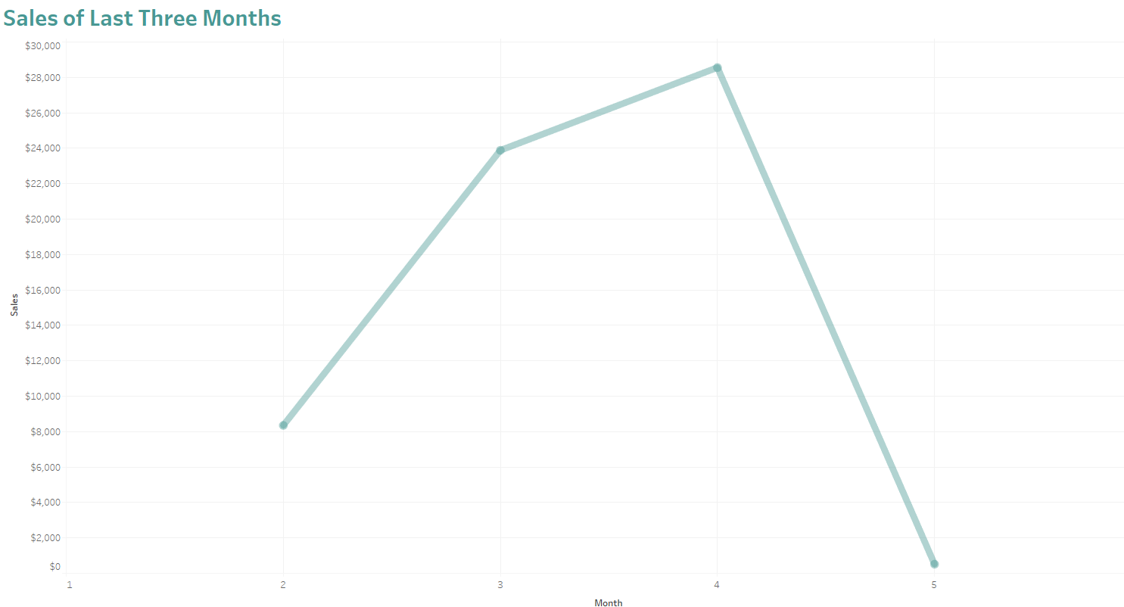
Declining Sales
Total revenue from rentals for the last month has been rapidly declining, no doubt due to competition from other rental companies offering online streaming option. We are confident that Rockbuster will see increase in revenue by launching an online streaming service to our customer base.

Slide 4

Where Are Rockbuster Customers Located?

Slide 5
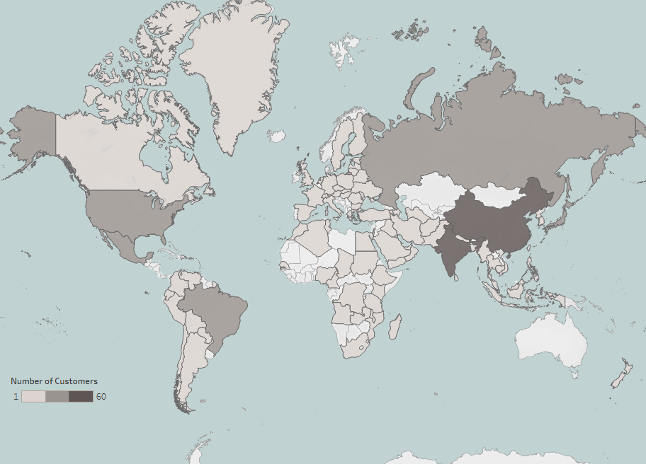
Global Customer Base
Rockbusters LLC currently has customers located throughout the world. However, the areas with higher total count of customers are found within Asia, Americas, and Eastern Europe.

Slide 6
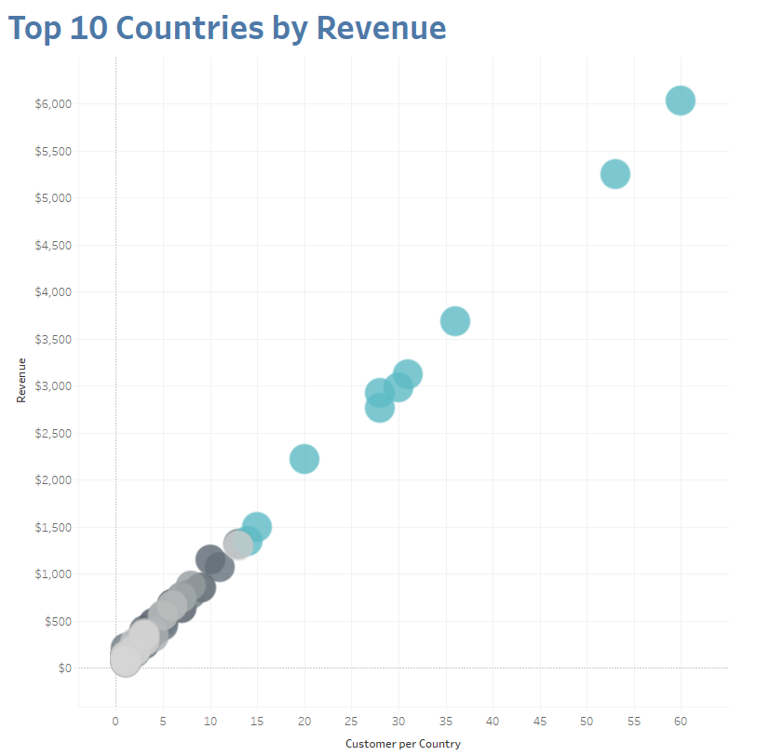
Top 10 Countries by Revenue
Country: India
Revenue: $6035
Customers: 60
Country: China
Revenue: $5251
Customers: 53
Country: United States
Revenue: $3685
Customers: 36
Country
India
China
United States
Japan
Mexico
Brazil
Russia Philippines
Turkey
Indonesia
Customers
60
53
36
31
30
28
28
20
15
14
Revenue
$6034.78
$5251.03
$3685.31
$3122.51
$2984.82
$2919.19
$2765.62
$2219.70
$1498.49
$1352.69
Japan, Mexico, Brazil, & Russia are very similar in revenue and customer count.

Slide 7
Top 10 Cities
Here are the top 10 cities where Rockbusters is most popular:
CITY
Aurora
Atlixco
Xintai
Adoni
Dhule (Dhulia)
Kurashiki
Pingxiang
Sivas
Celaya
So Leopoldo
COUNTRY
United States
Mexico
China
India
India
Japan
China
Turkey
Mexico
Brazil

Slide 8

Customer Rewards Program

Slide 9
Top 5 customers
To generate buzz around the launch of online streaming, a customer appreciation program will be introduced for our most loyal customers from our top 10 cities:
CUSTOMER NAME | CITY | COUNTRY | TOTAL SPENT
Sara Perry | Atlixco | Mexico | $128.70
Gabriel Harder | Sivas | Turkey | $108.75
Sergio Stanfield | Celaya | Mexico | $102.76
Clinton Buford | Aurora | United States | $98.76
Adam Gooch | Adoni | India | $97.80
Average total spent by our top 5 customers was $107.35.

Slide 10
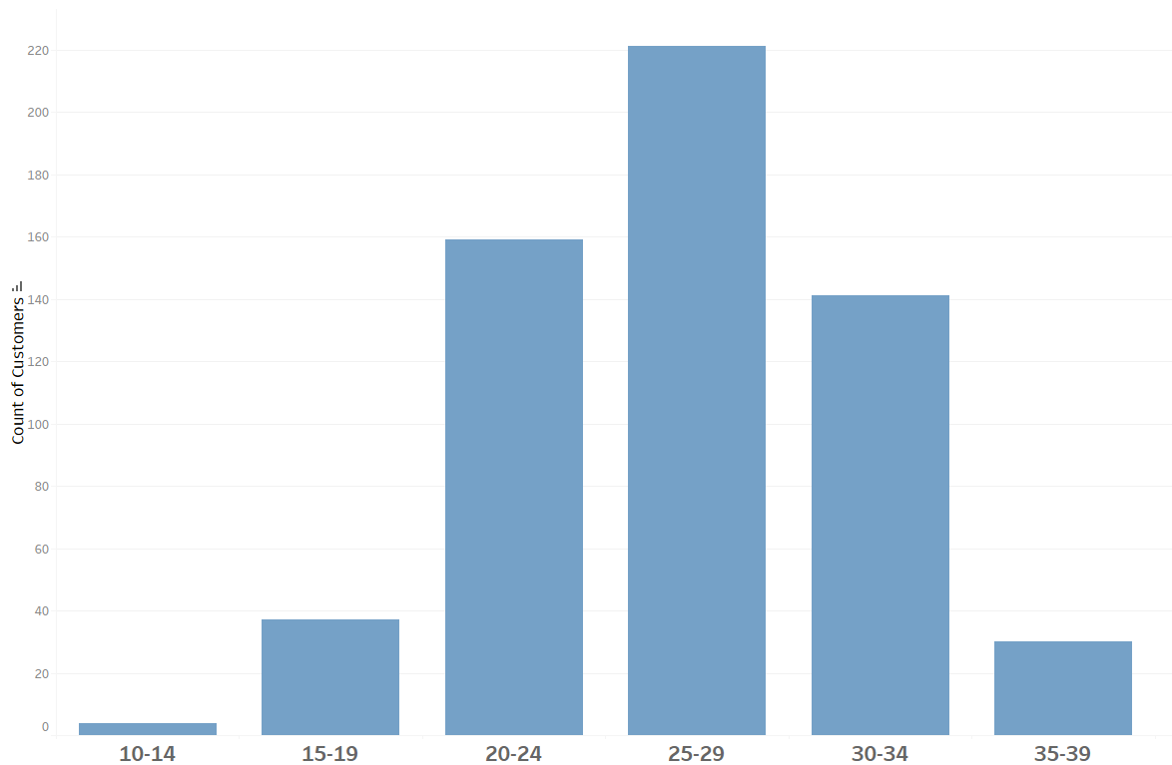
Total Rentals Made per Customer
On average, most customers made between 25 to 29 rentals.
Other ways to incentivize more rentals is to offer rewards and discounts to customers who reache the 30+ rentals mark.
Our predictions expect total rentals per customer will increase with the added convenience of online streaming.

Slide 11

Rentals Overview
What were Rockbusters most popular films?

Slide 12



Rental Analysis
Rental Rate
Average: $2.98
Maximum: $4.99
Minimum: $0.99
Rental Duration
Average: 4.9 days
Maximum: 7 days
Minimum: 3 days
Film Length
Average: 115.3 minutes
Maximum: 185 minutes
Minimum: 46 minutes

Slide 13
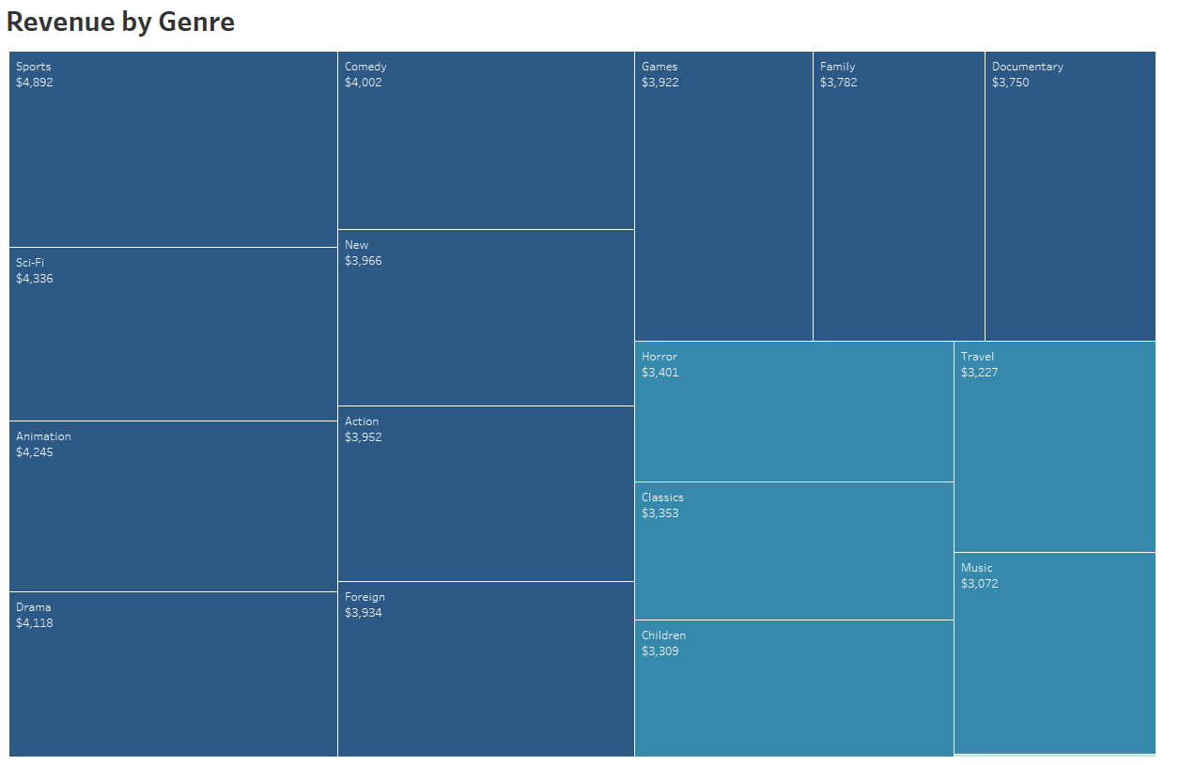
Which Genre Was Most Popular?
Most popular genres were Sports, Sci-Fi, Animation, Drama, and Comedy; all of them generating a total revenue over $4,000 each.
The least popular genre was Thriller, only generating a total revenue of $47.
The genre Thriller is this slice here at the bottom.

Slide 14
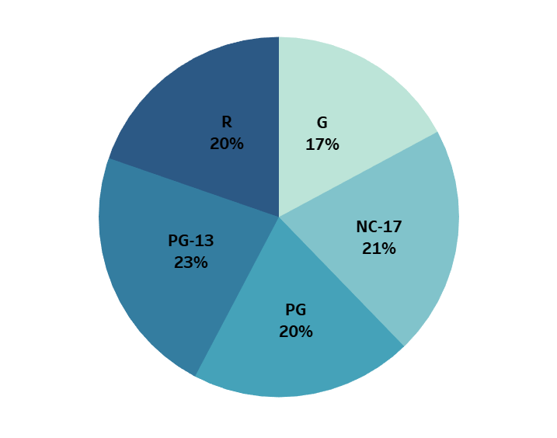
Which Rating Was Most Popular?
Rating | Total Rentals | Total Revenue | Avg. Rental Rate
PG-13 | 3,245 | $13,855 | $3.03
NC-17 | 3,008 | $12,635 | $2.97
PG | 2,938 | $12,237 | $3.05
R | 2,897 | $12,073 | $2.94
G | 2,508 | $10,512 | $2.89
Films rated PG-13 were rented most frequently and brought in the most revenue.

Slide 15


Which Film Titles Were Most / Least Popular?
TOP 10 FILMS
BOTTOM 10 FILMS
Film Title | Total Revenue
Telegraph Voyage | $215.75
Zorro Ark | $199.72
Wife Turn | $198.73
Innocent Usual | $191.74
Hustler Party | $190.78
Saturday Lambs | $190.74
Titans Jerk | $186.73
Harry Idaho | $177.73
Torque Bound | $169.76
Dogma Family | $168.72
Film Title | Total Revenue
Texas Watch | $5.94
Oklahoma Jumanji | $5.94
Duffel Apocalypse | $5.94
Freedom Cleopatra | $5.95
Young Language | $6.93
Rebel Airport | $6.93
Cruelty Unforgiven | $6.94
Treatment Jekyll | $6.94
Lights Deer | $7.93
Stallion Sundance | $7.94
Average Revenue: $189.04
Average Length: 130 minutes
Average Revenue: $6.74
Average Length: 126 minutes

Slide 16

Conclusions

Slide 17

Insights and Recommendations
As Rockbusters enter the realms of online streaming, prioritize marketing in geographical locations with already a robust customer base.
Since average rental duration was 4.9 days, let all online streaming rentals last up to 5 days.
Encourage customer loyalty and rental frequency by offering rewards program for customers who make 30+ rentals.
Top 10 Films generated on average a revenue of $189.04, whereas Bottom 10 Films generated $6.74; consider eliminating any films with total revenue less than $20.00 to make space for more popular titles.

Slide 18
End of Presentation
Thank you for your attention

