Slide 1
Modeling Shark Attack Occurrence
A Supervised Learning Approach

Slide 2
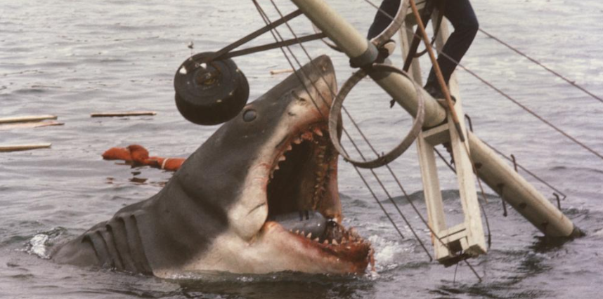
Introduction/Background
Shark Attack Rarity
Individual risk, as captured by the University of Florida Program for Shark research is 1 in 11.5 Million, whereas public exposure to these events are high.
Data Source
Main source of data for this project is the International Shark Attack File (ISAF), a globally trusted database of all shark attack occurrences (special acknowledgement and thank you to Dr. Gavin Naylor and Joseph Miguez for sharing this data with me).
Supplementary data sources, such as meteostat (meteorological library within python) and Flight inflow data into Florida costal airports were used as well

Slide 3
Problem Statement & Hypotheses
Given temporal and weather data, can a shark attack occurrence be reliably predicted?
Distinction between individual risk and general attack occurrence
Temporal Hypothesis: Seasonality, Lunar Phases, and time of day will be strong indicators of a shark attack occurrence.
Weather Hypothesis: Temperature, Pressure, Change of these features, and Rate of Change (slope) of these features will be a strong indicator of a shark attack occurence

Slide 4
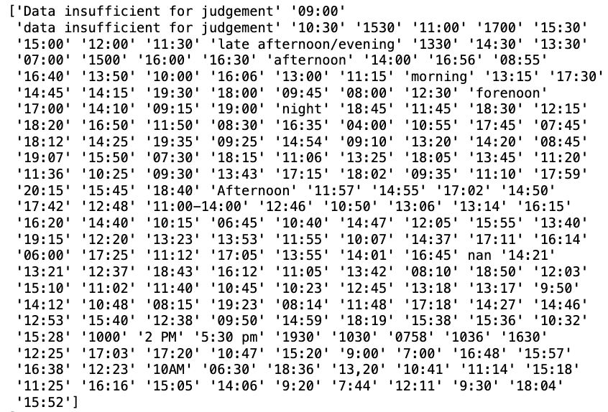
Data Cleansing Pipeline
Background on ISAF- near century old project, data drift has occurred over that time
e.g. ‘time-of-attack’ varied from inputs such as “Forenoon” and “Afternoon”, the usage of AM/PM, military time, and general ranges such as “2:00- 4:00”
Multiple data parsing functions were created to cleanse and normalize data
Additional data features created such as lunar phase, lunar illumination, season, month, and hour.

Slide 5
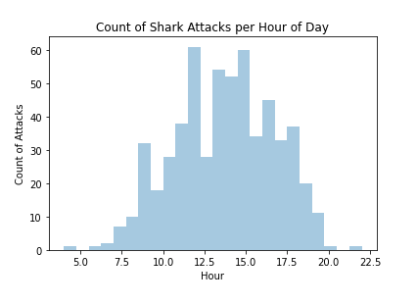
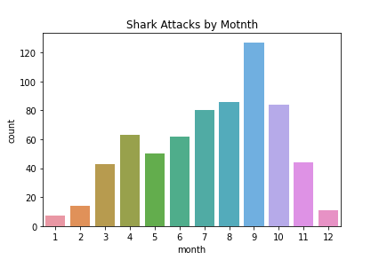
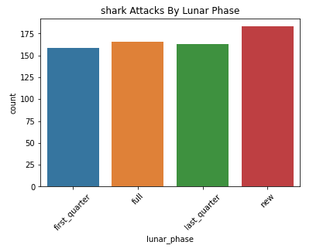
EDA: Highlighted Temporal Visualizations

Slide 6
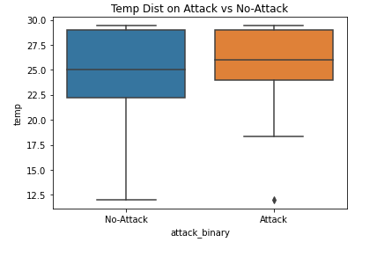
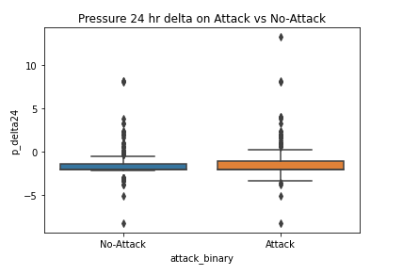
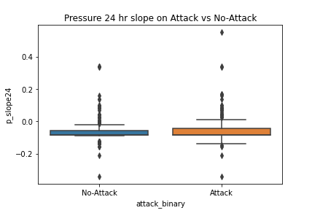
EDA: Highlighted Weather Visualizations

Slide 7
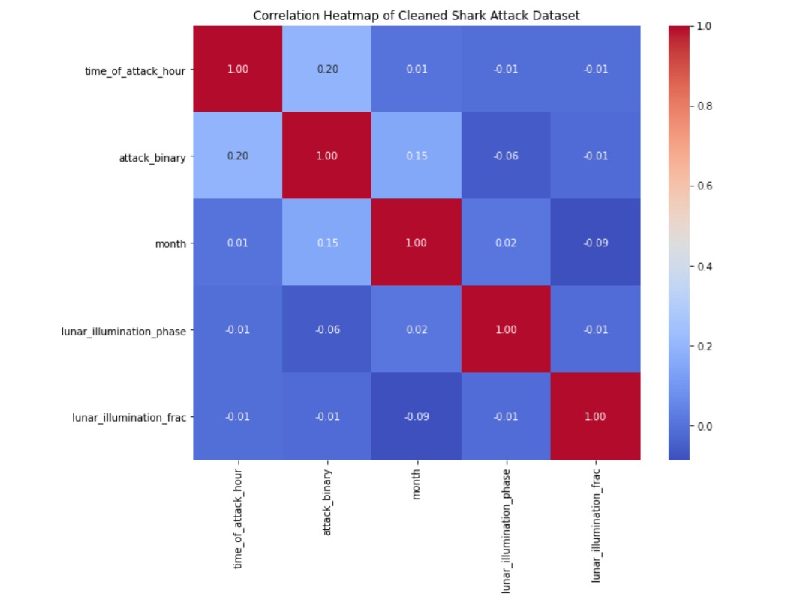
EDA: Correlation Matrix
Stronger correlation of month and hour on attack binary (attack vs non-attack)
Comparison between linear and binary values

Slide 8
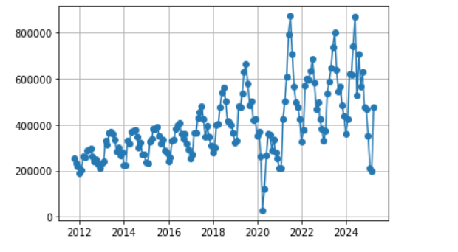
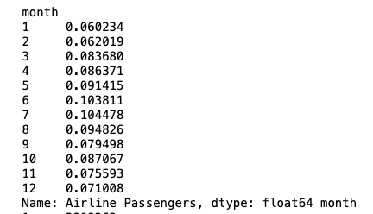
Modeling Approach
Logistic Regression
As this model outcome was binary (Shark Attack or No shark Attack Occurrence), logistic regression seemed to be the obvious candidate
Accounting for Non-Shark Attack Occurrences (Negative Events)
Synthetic negatives allow for the creation of non-attack occurrence, which isnt captured in the data
Creating Synthetic Negatives- Weighting Beachgoer Seasonality
Using Florida Costal Airport flight inflow data to weight the random choice function and normalize for beachgoer seasonality

Slide 9
Modeling Results- 10 LogReg Models
Shark Attack Occurrence ~ Lunar Illumination,
Shark Attack Occurrence ~ Month of Attack,
Shark Attack Occurrence ~ Hour of Attack,
Shark Attack Occurrence ~ Hourly Bucket (Time of Day),
Shark Attack Occurrence ~ Lunar Phase,
Shark Attack Occurrence ~ Month of Attack + Hourly Bucket (Time of Day),
Shark Attack Occurrence ~ Temperature,
Shark Attack Occurrence ~ 24 Hour Pressure Change,
Shark Attack Occurrence ~ 24 Hour Pressure Rate of Change,
Shark Attack Occurrence ~ Temp + 24 Hour Pressure Change + 24 Hour Pressure Rate of Change

Slide 10
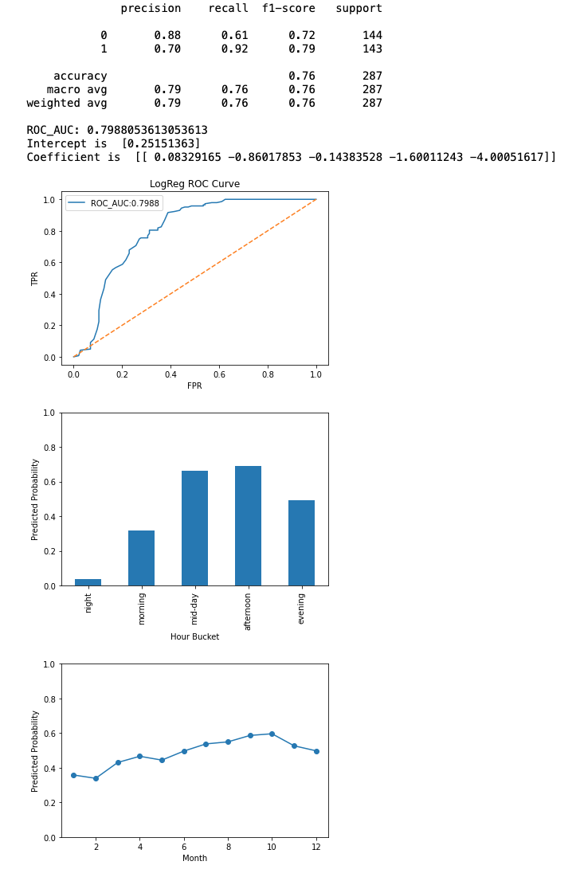
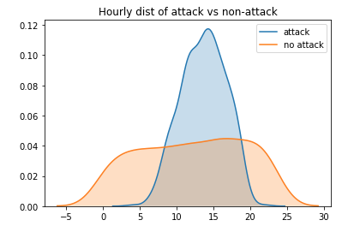
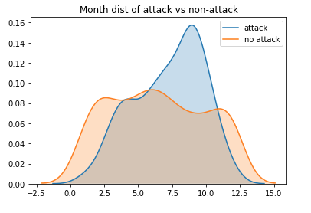
Modeling Results: Shark Attack Occurrence ~ Month of Attack + Hourly Bucket (Time of Day)
This LogReg model had the highest efficacy out of all Temporal Models
ROC AUC score of ~0.80, and strong distribution of predicted probability across the different features that matched our initial EDA well

Slide 11
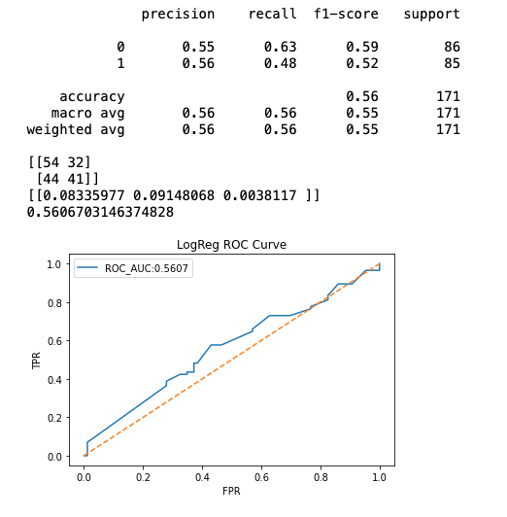
Modeling Results: Shark Attack Occurrence ~ Temp + 24 Hour Pressure Change + 24 Hour Pressure Rate of Change
This LogReg model had the highest efficacy out of all Weather-Based models, but was still little better than a coin flip in predicting Shark Attack Outcomes
ROC AUC score of ~0.56 is a poor result and tells us for this particular dataset that these features are poor indicators

Slide 12
Table of All Modeled Results
Model | Encoding | ROC-AUC | Notes
Shark Attack Occurrence ~ Lunar Illumination | Continuous | ~0.50 | Weak; nearly random performance.
Shark Attack Occurrence ~ Month of Attack | Cyclical (sin/cos) | ~0.69 | Not a strong predictor; small seasonal effect visible.
Shark Attack Occurrence ~ Hour of Attack | Cyclical (sin/cos) | ~0.76 | Moderate strength; improves over month alone.
Shark Attack Occurrence ~ Hourly Bucket (Time of Day) | Categorical | ~0.78 | Strongest single predictor; captures diurnal patterns well.
Shark Attack Occurrence ~ Lunar Phase | Categorical (New, Full, etc.) | ~0.45 | Weak; nearly random performance.
Shark Attack Occurrence ~ Month of Attack + Hourly Bucket (Time of Day) | One-hot month + Categorical | ~0.80 | Best performing combined model; strong diurnal + seasonal signal.
Shark Attack Occurrence ~ Temperature | Continuous (°C) | ~0.53 | Weak; nearly random performance.
Shark Attack Occurrence ~ 24 Hour Pressure Change | Continuous (Δ pressure, hPa) | ~0.54 | Weak; nearly random performance.
Shark Attack Occurrence ~ 24 Hour Pressure Rate of Change | Continuous (slope, hPa/hr) | ~0.54 | Weak; nearly random performance.
Shark Attack Occurrence ~ Temp + 24 Hour Pressure Change + 24 Hour Pressure Rate of Change | Continuous (3 features) | ~0.56 | Adding multiple meteorological features doesn’t improve model; near random.

Slide 13
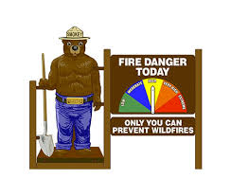
Discussion and Conclusion
Results Discussion-
The highest performing model was Shark Attack Occurrence ~ Month of Attack + Hourly Bucket (Time of Day) with ROC AUC of ~0.8 and an accuracy to predict correctly of 76%
Other temporal models and meteorological models need further refinement
Limitations of Current Modeling
Synthetic negative weighting for all models
Lack of expertise in Ichthyology/biology, missing potential features to include
Bias in the geographical nature of the data (only limited to Florida Atlantic Coast)
Future Applications and Model Iterations
Additional features could be added to increase efficacy
Potential application could be a shark attack occurrence risk meter, similar to Smokey the Bear’s Wildfire Risk Meter

