Slide 1

Expert Session
An informal expert session on pricing issues
Heribert Knittlmayer, Aurelio Caliaro | SERV
Tim Herpich | d-fine

Slide 2

Agenda
Introduction
Modifications of insurances
Graphical Examples
Formal Approach
Premium Financing
FAQ
Conclusion and Outlook

Slide 3
Introduction
  Introduction
Modifications of insurances
Graphical Examples
Formal Approach
Premium Financing
FAQ
Conclusion and Outlook
#01

Slide 4
Modifications of insurances
Introduction
  Modifications of insurances
Graphical Examples
Formal Approach
Premium Financing
FAQ
Conclusion and Outlook
#02
New insurances and their modifications

Slide 5

What are we talking about?
OECD defines how to price new transactions:
    Minimum pricing methodologies for OECD transactions: MPR, MB
    ECA-specific pricing methodologies for all other transactions
    Risk premium is 80% of total premium
However:
    OECD does not help on pricing modifications of insurances
    ECA-specific pricing methodologies for all changes
Notes:
Thank you, Heribert, for your introduction, and thank you all for participating to this exchange.
I would first like to point out what this topic of pricing modifications is about.
We all know that the OECD defines minimum pricing for all new products that are covered by the OECD arrangement. Depending on the country of the buyer or the guarantor the experts of the ECAs have developed the MPR – minimum premium rate – method. In High Income countries, the Market Benchmarking methodology is applied. For all other transactions, eg other products or repayment periods shorter than 2 years, every ECA has an own model.
The OECD methodologies assume that 20% of the premium is reserved for the internal cost of the ECA. The rest, 80%, is reserved for the risk. This will be important in the following slides.
However, what is not covered by the OECD are the consequences of changes of transactions. Modifications are not addressed or discussed. Every ECA has to think about how to price those modifications, also for OECD products.

Slide 6
Why is this relevant?
Modifications are frequent: Less than half of the insured buyer + supplier credits stay unmodified.
Why?
    Delivery contract may contain some flexibility in terms of dates (delivery)
    Definition of SPOC might be flexible (commissioning date)
    Delivery is delayed
    Repayments are anticipated
    Repayments are delayed (restructuring)
    Whole transaction is repaid early.
Notes:
You might ask: Why is it important how we price modifications? From the graph you see that less than half of the supplier or buyer credit insurances stay as they are in the beginning. 30% are changed once in the product life, the other 20% even more often.
One might think that the exporter knows when the deliveries take place, and when the buyer pays for them. However, reality proves different. → List
This shows the importance of defining how to price modifications. If there are shifts of a few days, pricing may not be that important. If there are major changes in terms of amounts or time, for example delays of delivery or prolongation of buyer’s credit due to a restructuring, the amounts ARE relevant.

Slide 7

SERV Experience with pricing modifications of insurances
Situation at SERV before 2021:
No SERV methodology for pricing modifications.
Modifications were priced as difference to corresponding new transaction.
With early repayments, administrative premium was reimbursed → net loss
Approach:
In 2021, SERV started to apply a new calculation method for (full or partial) early repayments or reductions of amounts.
Since July 2023, SERV applies the same methodology to all modifications.

Slide 8
Graphical
Examples
Introduction
Modifications of insurances
  Graphical Examples
Formal Approach
Premium Financing
FAQ
Conclusion and Outlook
#03
Two graphical examples for calculation

Slide 9
Risk represented by area: Example 1
To show our approach, we use a graphical approach.
As an example, we take the following transaction:
Buyer Credit
Cover: 9’000 EUR (might be 9’474 EUR with 95% cover)
Credit period: 4 years
Total premium: 2’250 EUR → Risk premium: 1’800 EUR
Notes:
As an example, we take a buyer credit with a cover of 9000 EUR. This is what we would effectively pay if we have a claim.

Slide 10
Risk represented by area: Example 1
As of 1.1.2003, an increase of amount is applied for:
New Cover: 10’000 EUR
Date of change: 1.1.2023
Notes:
The question is: Which premium do we ask for this additional cover amount?

Slide 11
Risk represented by area: Example 1
How does the area increase?
Red area: 18 «units»,
corresponds to unearned premium of EUR 900
Blue area: 2 «units»
➔ Increase of Area after 1.1.2003: 2/18=11.1%
➔ Increase of Risk Premium: 11.1% x EUR 900 = EUR 100
➔ Increase of Total Premium: EUR 100 / 0.8 = EUR 125

Slide 12
Risk represented by area: Example 1
How does the area increase?
Red area: 18 «units»,
corresponds to unearned premium of EUR 900
Blue area: 2 «units»
➔ Increase of Area after 1.1.2003: 2/18=11.1%
➔ Increase of Risk Premium: 11.1% x EUR 900 = EUR 100
➔ Increase of Total Premium: EUR 100 / 0.8 = EUR 125

Slide 13
Risk represented by area: Example 1
How does the area increase?
Red area: 18 «units»,
corresponds to unearned premium of EUR 900
Blue area: 2 «units»
➔ Increase of Area after 1.1.2003: 2/18=11.1%
➔ Increase of Risk Premium: 11.1% x EUR 900 = EUR 100
➔ Increase of Total Premium: EUR 100 / 0.8 = EUR 125

Slide 14
Risk represented by area: Example 1
How does the area increase?
Red area: 18 «units»,
corresponds to unearned premium of EUR 900
Blue area: 2 «units»
➔ Increase of Area after 1.1.2003: 2/18=11.1%
➔ Increase of Risk Premium: 11.1% x EUR 900 = EUR 100
➔ Increase of Total Premium: EUR 100 / 0.8 = EUR 125

Slide 15
Risk represented by area: Example 1
How does the area increase?
Red area: 18 «units»,
corresponds to unearned premium of EUR 900
Blue area: 2 «units»
➔ Increase of Area after 1.1.2003: 2/18=11.1%
➔ Increase of Risk Premium: 11.1% x EUR 900 = EUR 100
➔ Increase of Total Premium: EUR 100 / 0.8 = EUR 125

Slide 16
Risk represented by area: Example 1
How does the area increase?
Red area: 18 «units»,
corresponds to unearned premium of EUR 900
Blue area: 2 «units»
➔ Increase of Area after 1.1.2003: 2/18=11.1%
➔ Increase of Risk Premium: 11.1% x EUR 900 = EUR 100
➔ Increase of Total Premium: EUR 100 / 0.8 = EUR 125

Slide 17
Risk represented by area: Example 1
How does the area increase?
Red area: 18 «units»,
corresponds to unearned premium of EUR 900
Blue area: 2 «units»
➔ Increase of Area after 1.1.2003: 2/18=11.1%
➔ Increase of Risk Premium: 11.1% x EUR 900 = EUR 100
➔ Increase of Total Premium: EUR 100 / 0.8 = EUR 125

Slide 18
Risk represented by area: Example 1
How does the area increase?
Red area: 18 «units»,
corresponds to unearned premium of EUR 900
Blue area: 2 «units»
➔ Increase of Area after 1.1.2003: 2/18=11.1%
➔ Increase of Risk Premium: 11.1% x EUR 900 = EUR 100
➔ Increase of Total Premium: EUR 100 / 0.8 = EUR 125

Slide 19
Risk represented by area: Example 1
How does the area increase?
Red area: 18 «units»,
corresponds to unearned premium of EUR 900
Blue area: 2 «units»
➔ Increase of Area after 1.1.2003: 2/18=11.1%
➔ Increase of Risk Premium: 11.1% x EUR 900 = EUR 100
➔ Increase of Total Premium: EUR 100 / 0.8 = EUR 125

Slide 20
Risk represented by area: Example 1
How does the area increase?
Red area: 18 «units»,
corresponds to unearned premium of EUR 900
Blue area: 2 «units»
➔ Increase of Area after 1.1.2003: 2/18=11.1%
➔ Increase of Risk Premium: 11.1% x EUR 900 = EUR 100
➔ Increase of Total Premium: EUR 100 / 0.8 = EUR 125

Slide 21
Risk represented by area: Example 1
How does the area increase?
Red area: 18 «units»,
corresponds to unearned premium of EUR 900
Blue area: 2 «units»
➔ Increase of Area after 1.1.2003: 2/18=11.1%
➔ Increase of Risk Premium: 11.1% x EUR 900 = EUR 100
➔ Increase of Total Premium: EUR 100 / 0.8 = EUR 125

Slide 22
Risk represented by area: Example 1
How does the area increase?
Red area: 18 «units»,
corresponds to unearned premium of EUR 900
Blue area: 2 «units»
➔ Increase of Area after 1.1.2003: 2/18=11.1%
➔ Increase of Risk Premium: 11.1% x EUR 900 = EUR 100
➔ Increase of Total Premium: EUR 100 / 0.8 = EUR 125

Slide 23
Risk represented by area: Example 1
How does the area increase?
Red area: 18 «units»,
corresponds to unearned premium of EUR 900
Blue area: 2 «units»
➔ Increase of Area after 1.1.2003: 2/18=11.1%
➔ Increase of Risk Premium: 11.1% x EUR 900 = EUR 100
➔ Increase of Total Premium: EUR 100 / 0.8 = EUR 125

Slide 24
Risk represented by area: Example 1
How does the area increase?
Red area: 18 «units»,
corresponds to unearned premium of EUR 900
Blue area: 2 «units»
➔ Increase of Area after 1.1.2003: 2/18=11.1%
➔ Increase of Risk Premium: 11.1% x EUR 900 = EUR 100
➔ Increase of Total Premium: EUR 100 / 0.8 = EUR 125

Slide 25
Risk represented by area: Example 1
How does the area increase?
Red area: 18 «units»,
corresponds to unearned premium of EUR 900
Blue area: 2 «units»
➔ Increase of Area after 1.1.2003: 2/18=11.1%
➔ Increase of Risk Premium: 11.1% x EUR 900 = EUR 100
➔ Increase of Total Premium: EUR 100 / 0.8 = EUR 125

Slide 26
Risk represented by area: Example 1
How does the area increase?
Red area: 18 «units»,
corresponds to unearned premium of EUR 900
Blue area: 2 «units»
➔ Increase of Area after 1.1.2003: 2/18=11.1%
➔ Increase of Risk Premium: 11.1% x EUR 900 = EUR 100
➔ Increase of Total Premium: EUR 100 / 0.8 = EUR 125

Slide 27
Risk represented by area: Example 1
How does the area increase?
Red area: 18 «units»,
corresponds to unearned premium of EUR 900
Blue area: 2 «units»
➔ Increase of Area after 1.1.2003: 2/18=11.1%
➔ Increase of Risk Premium: 11.1% x EUR 900 = EUR 100
➔ Increase of Total Premium: EUR 100 / 0.8 = EUR 125

Slide 28
Risk represented by area: Example 1
How does the area increase?
Red area: 18 «units»,
corresponds to unearned premium of EUR 900
Blue area: 2 «units»
➔ Increase of Area after 1.1.2003: 2/18=11.1%
➔ Increase of Risk Premium: 11.1% x EUR 900 = EUR 100
➔ Increase of Total Premium: EUR 100 / 0.8 = EUR 125

Slide 29
Risk represented by area: Example 1
How does the area increase?
Red area: 18 «units»,
corresponds to unearned premium of EUR 900
Blue area: 2 «units»
➔ Increase of Area after 1.1.2003: 2/18=11.1%
➔ Increase of Risk Premium: 11.1% x EUR 900 = EUR 100
➔ Increase of Total Premium: EUR 100 / 0.8 = EUR 125

Slide 30
Risk represented by area: Example 1
How does the area increase?
Red area: 18 «units»,
corresponds to unearned premium of EUR 900
Blue area: 2 «units»
➔ Increase of Area after 1.1.2003: 2/18=11.1%
➔ Increase of Risk Premium: 11.1% x EUR 900 = EUR 100
➔ Increase of Total Premium: EUR 100 / 0.8 = EUR 125

Slide 31
Risk represented by area: Example 2
Typical structure of Buyer Credit:
Amortizing Buyer Credit
Cover: 10’000 EUR (might be 10’526 EUR with 95% cover)
Disbursement Period: 2 years
Credit period: 4 years
Total premium: 2’187 EUR → Risk premium: 1’750 EUR

Slide 32
Risk represented by area: Example 2
As of 1.1.2003, an change is applied for:
Shift of one amortization by one year
Date of change: 1.1.2023
Unearned premium: EUR 750
How does the area increase?
Red area: 6 «units»
Blue area: 4 «units»
➔ Increase of Area after 1.1.2003: 4/6=66.7%
➔ Increase of Risk Premium: 66.7% x EUR 750 = EUR 500
➔ Increase of Total Premium: EUR 500 / 0.8 = EUR 625

Slide 33
Formal Approach
Introduction
Modifications of insurances
Graphical Examples
  Formal Approach
Premium Financing
FAQ
Conclusion and Outlook
#04
Establishing a mathematical framework for the pricing of modifications

Slide 34


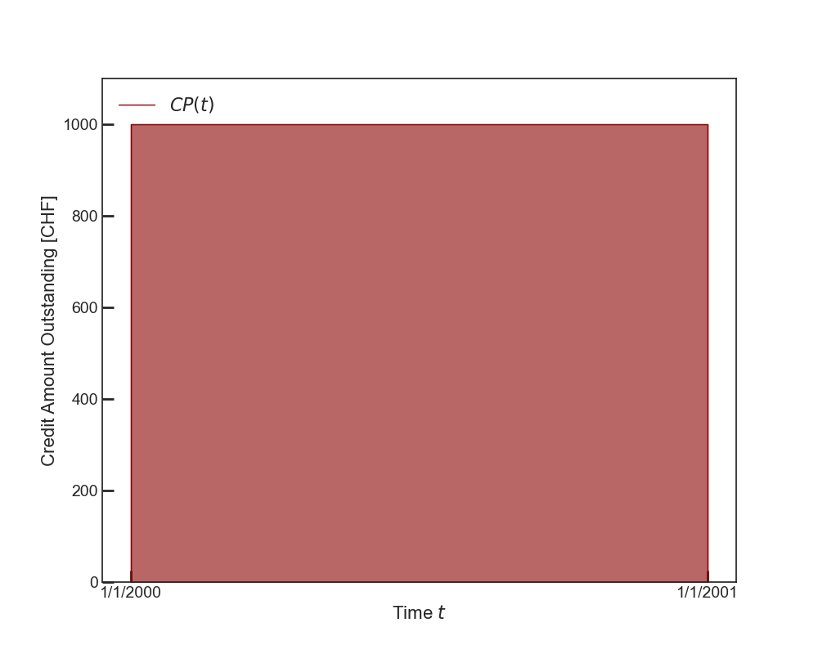


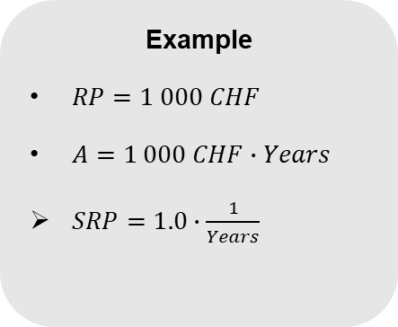








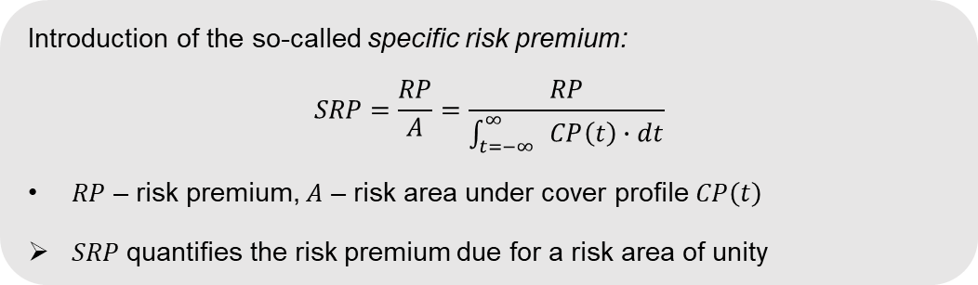
Specific Risk Premium as Premium Density
Introduction of the so-called specific risk premium:
$$SRP=\frac{RP}{A}=\frac{RP}{\int_{t=−∞}^{∞}{ }CP\left(t\right)∙dt}$$
$RP$ – risk premium, $A$ – risk area under cover profile $CP\left(t\right)$
$SRP$quantifies the risk premium due for a risk area of unity
$$A =Credit ∙∆Time$$
$$=\# FX∙Years$$
$$Credit =\#∙FX$$
$$∆Time =\#∙Years$$
Example
$RP=1 000 CHF$
$A=1 000 CHF∙Years$
$SRP=1.0∙\frac{1}{Years}$
$$A =1 CHF∙Years$$
$$Credit = 1 CHF$$
$$1.0 CHF$$
$$Credit$$
$$0.5 CHF$$
$$A =0.5 CHF∙Years$$
$$∆Time = 1 Year$$
$$∆Time$$

Slide 35

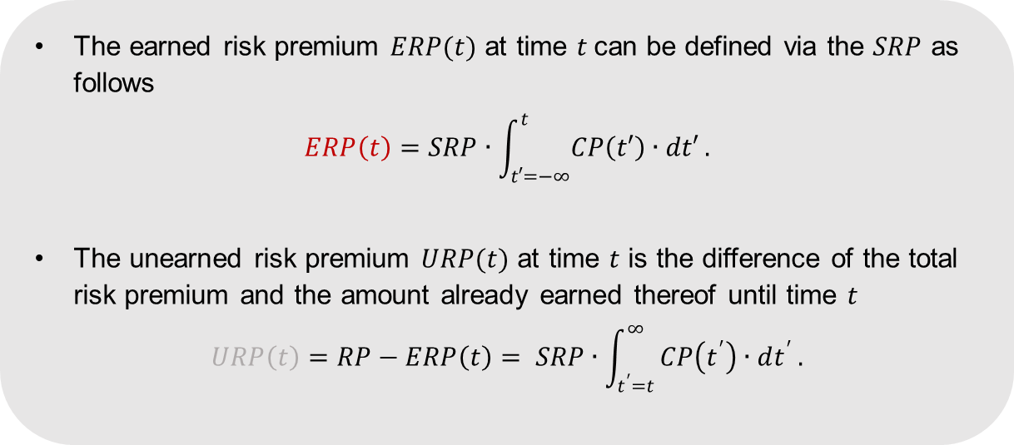



Earned and Unearned Premiums
The earned risk premium $ERP(t)$ at time $t$can be defined via the $SRP$ as follows
$$ERP\left(t\right)=SRP∙\int_{t′=−∞}^{t}{CP\left(t′\right)∙dt′}.$$
The unearned risk premium $URP(t)$ at time $t$ is the difference of the total risk premium and the amount already earned thereof until time $t$
$$URP\left(t\right)=RP−ERP\left(t\right)= SRP∙\int_{t^{′}=t}^{∞}{CP\left(t^{′}\right)∙dt^{′}}.$$
$$ERP\left(t\right)$$
$$URP\left(t\right)$$
Credit
$$t$$
Time $t′$
The earned and unearned risk premiums are related to the time-sliced cover profile via the specific risk premium and ensure consistency between premium calculation and accrual.

Slide 36
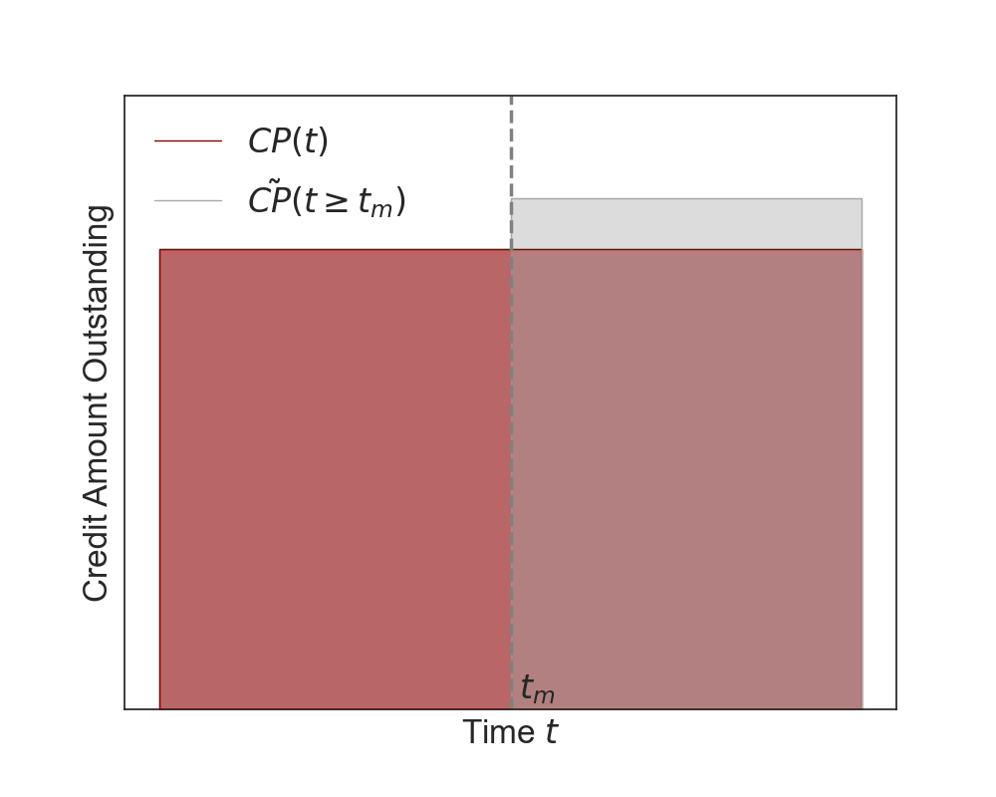
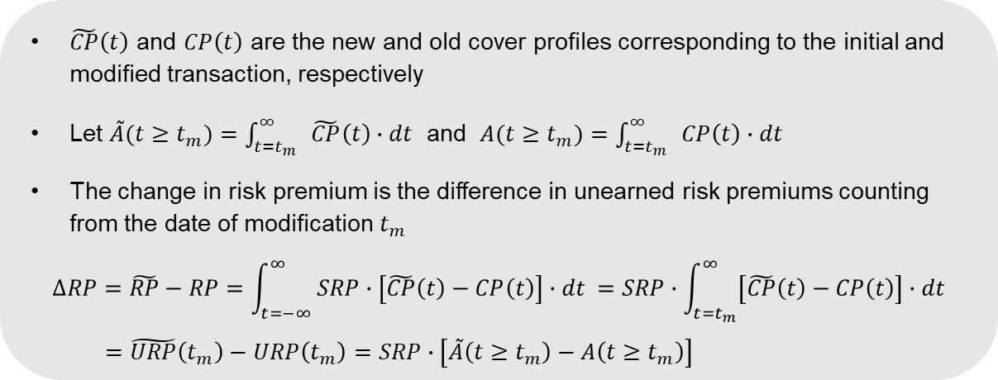
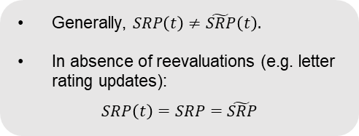

Pricing Framework for Modifications
$\tilde{CP}\left(t\right)$ and $CP\left(t\right)$ are the new and old cover profiles corresponding to the initial and modified transaction, respectively
Let $\tilde{A}(t≥t_{m})=\int_{t=t_{m}}^{∞}{ }\tilde{CP}\left(t\right)∙dt$ and $A(t≥t_{m})=\int_{t=t_{m}}^{∞}{ }CP\left(t\right)∙dt$
The change in risk premium is the difference in unearned risk premiums counting from the date of modification $t_{m}$
$$∆RP=\tilde{RP}−RP=\int_{t=−∞}^{∞}{ SRP∙\left[\tilde{CP}\left(t\right)−CP\left(t\right)\right]∙dt }=SRP∙\int_{t=t_{m}}^{∞}{\left[\tilde{CP}\left(t\right)−CP\left(t\right)\right]∙dt}$$
$$=\tilde{URP}\left(t_{m}\right)−URP\left(t_{m}\right)=SRP∙\left[\tilde{A}\left(t≥t_{m}\right)−A\left(t≥t_{m}\right)\right]$$
*
Generally, $SRP\left(t\right)≠\tilde{SRP}\left(t\right).$
In absence of reevaluations (e.g. letter rating updates):
$$SRP\left(t\right)=SRP=\tilde{SRP}$$
Risk premium
$$∆RP=SRP∙∆A(t_{m})$$
Cover profile topography
Constant* from initial pricing
Approach only requires knowledge of the cover profile topography and is therefore universally applicable across different export cases, policy types, etc.

Slide 37
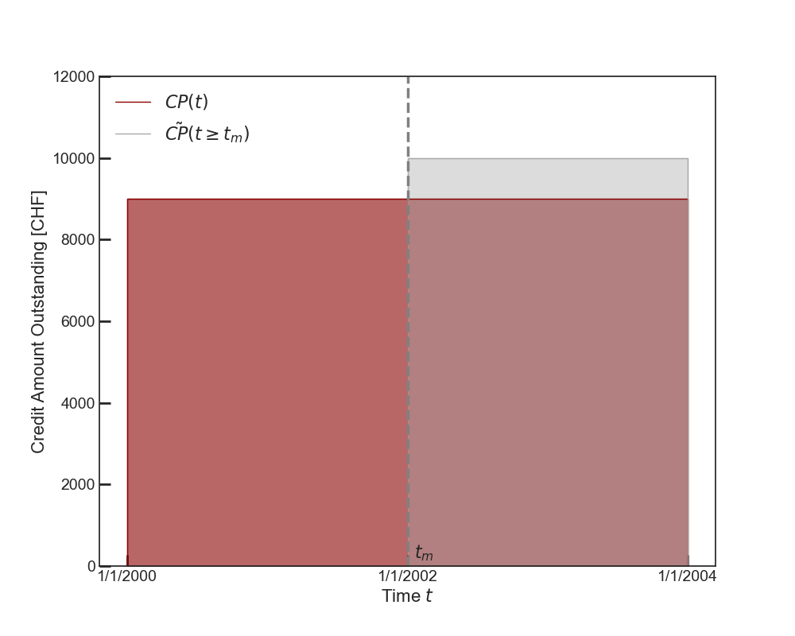

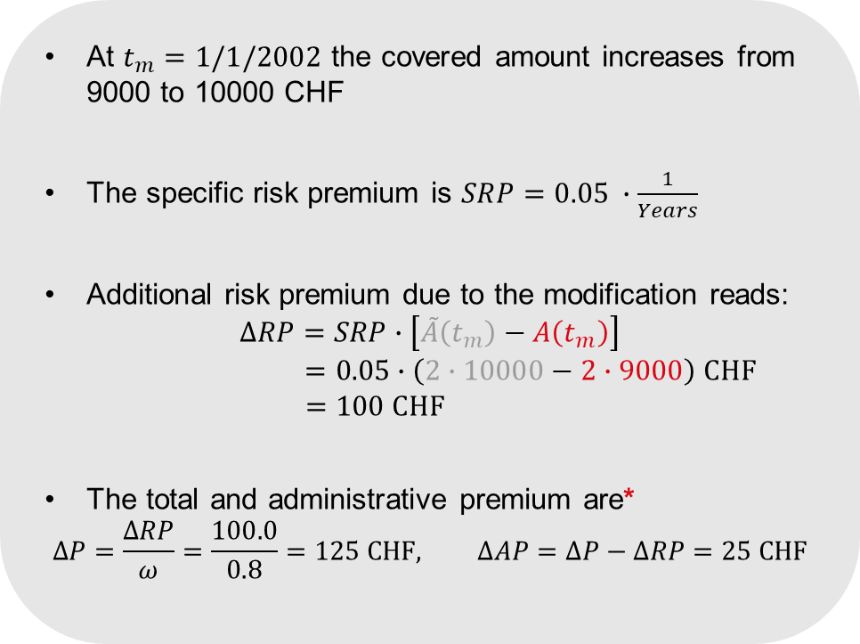
Example I: Increased Risk Coverage
At $t_{m}=1/1/2002$ the covered amount increases from 9000 to 10000 CHF
The specific risk premium is $SRP=0.05 ∙\frac{1}{Years}$
Additional risk premium due to the modification reads:
$$∆RP=SRP∙\left[\tilde{A}\left(t_{m}\right)−A\left(t_{m}\right)\right]$$
$$=0.05∙\left(2∙10000−2∙9000\right) CHF$$
$$=100 CHF$$
The total and administrative premium are*
$$∆P=\frac{∆RP}{ω}=\frac{100.0}{0.8}=125 CHF, ∆AP=∆P−∆RP=25 CHF$$
*$ω=0.8 −percentage of risk premium from total premium$

Slide 38
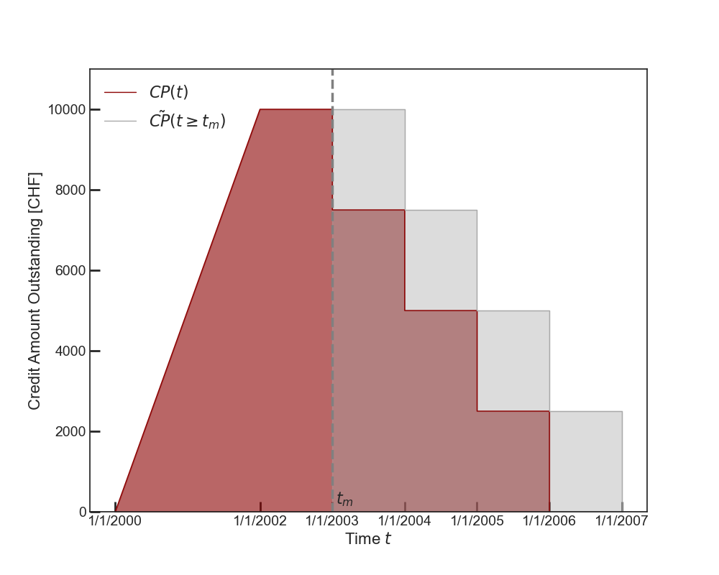
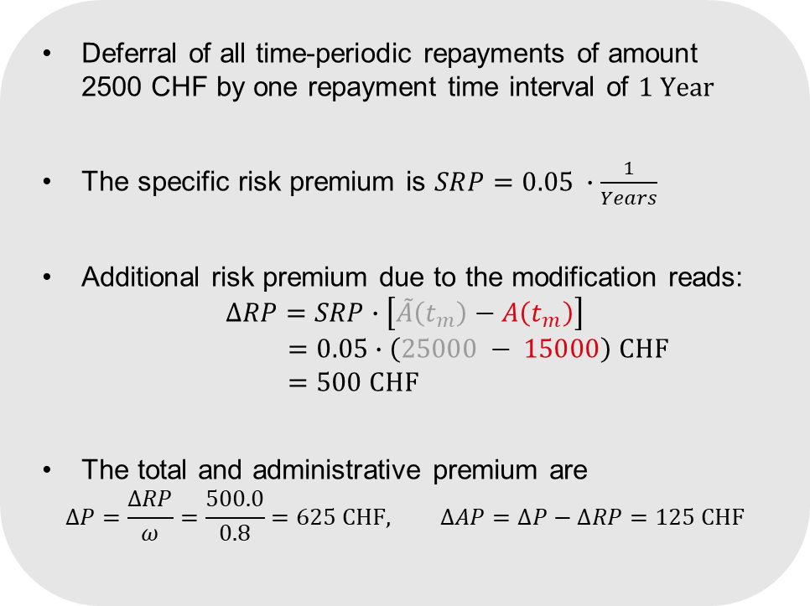
Example II: Extension of Repayment Period
Deferral of all time-periodic repayments of amount 2500 CHF by one repayment time interval of $1 Year$
The specific risk premium is $SRP=0.05 ∙\frac{1}{Years}$
Additional risk premium due to the modification reads:
$$∆RP=SRP∙\left[\tilde{A}\left(t_{m}\right)−A\left(t_{m}\right)\right]$$
$$=0.05∙\left(25000 − 15000\right) CHF$$
$$=500 CHF$$
The total and administrative premium are
$$∆P=\frac{∆RP}{ω}=\frac{500.0}{0.8}=625 CHF, ∆AP=∆P−∆RP=125 CHF$$

Slide 39
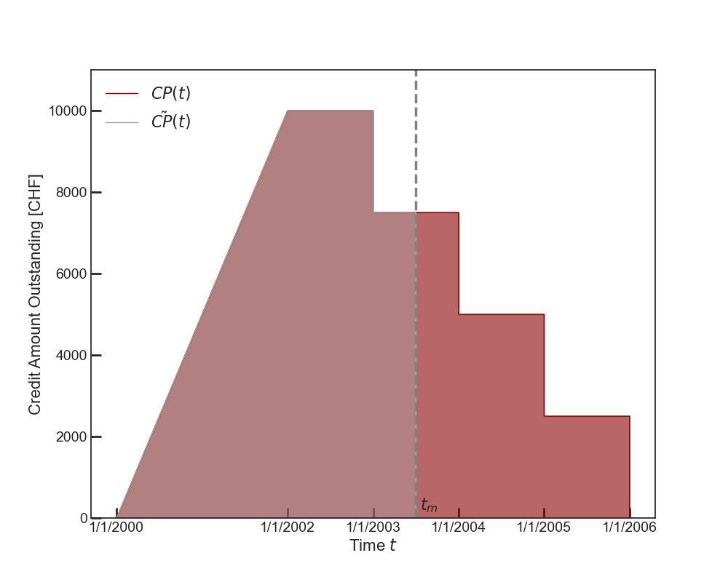
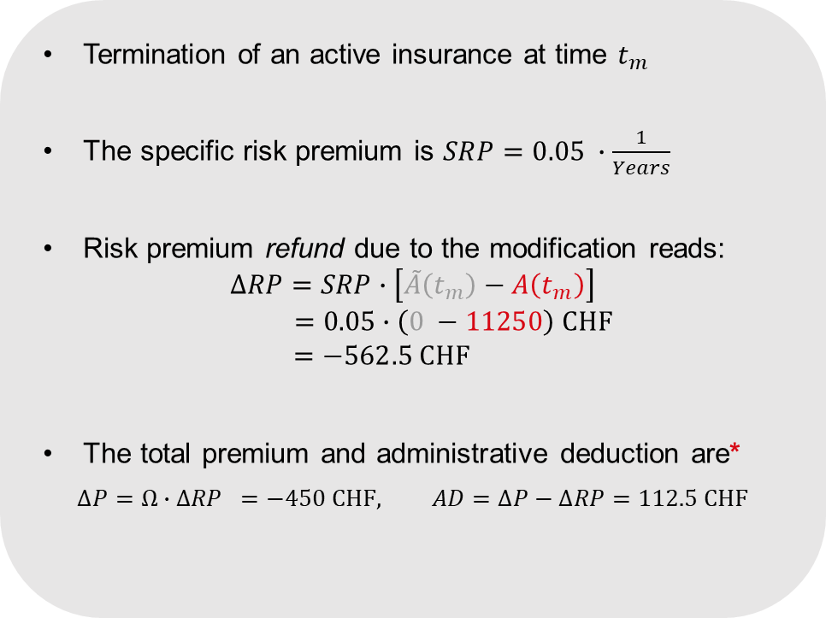
Example III: Premature Termination
Termination of an active insurance at time $t_{m}$
The specific risk premium is $SRP=0.05 ∙\frac{1}{Years}$
Risk premium refund due to the modification reads:
$$∆RP=SRP∙\left[\tilde{A}\left(t_{m}\right)−A\left(t_{m}\right)\right]$$
$$=0.05∙\left(0 −11250\right) CHF$$
$$=−562.5 CHF$$
The total premium and administrative deduction are*
$$∆P=Ω∙∆RP =−450 CHF, AD=∆P−∆RP=112.5 CHF$$
* $Ω =0.8 −percentage of risk premium refund from total premium refund$

Slide 40
Premium Financing
Introduction
Modifications of insurances
Graphical Examples
Formal Approach
  Premium Financing
FAQ
Conclusion and Outlook
#05
Development of a self-consistent solution for the premium financing of modifications

Slide 41








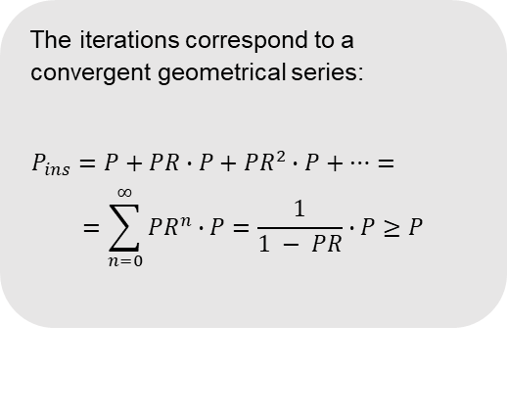

Recap: Premium Financing
$$∆Credit=∆P_{2}, Premium=∆P_{2}={PR}^{2}∙P$$
$$∆Credit=P,\text{∗}$$
$$Premium=∆P_{1}=PR∙P$$
$$∆Credit=∆P_{1}, Premium=∆P_{1}$$
Unfinanced Premium $P$
Risk Area $A$
1st Iteration
Unfinanced Premium $P$
Risk Area $A$
2nd Iteration
Unfinanced Premium $P$
Risk Area $A$
Credit
Credit
Credit
$$\max\left[CP\left(t\right)\right]$$
Time
Time
Time
Financed Premium $P_{ins}$
Risk Area $A_{ins}$
The iterations correspond to a convergent geometrical series:
$$P_{ins}=P+PR∙P+{PR}^{2}∙P+⋯=$$
$$=\sum_{n=0}^{∞}{{PR}^{n}}∙P=\frac{1}{1 − PR}∙P≥P$$
$∆Credit$ = $P_{ins}$
$⋯ ∞$Iterations
Credit
Time
*$PR=\frac{P}{\max\left[CP\left(t\right)\right]}$ −(𝑢𝑛𝑓𝑖𝑛𝑎𝑛𝑐𝑒𝑑) 𝑝𝑟𝑒𝑚𝑖𝑢𝑚 𝑟𝑎𝑡𝑒

Slide 42

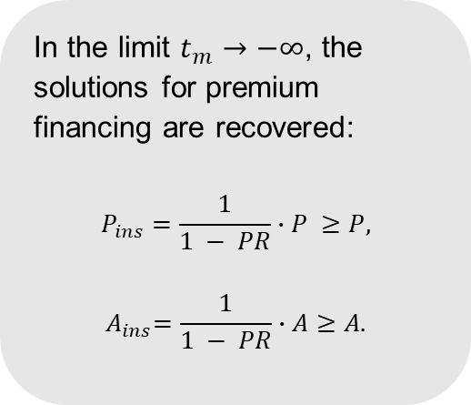
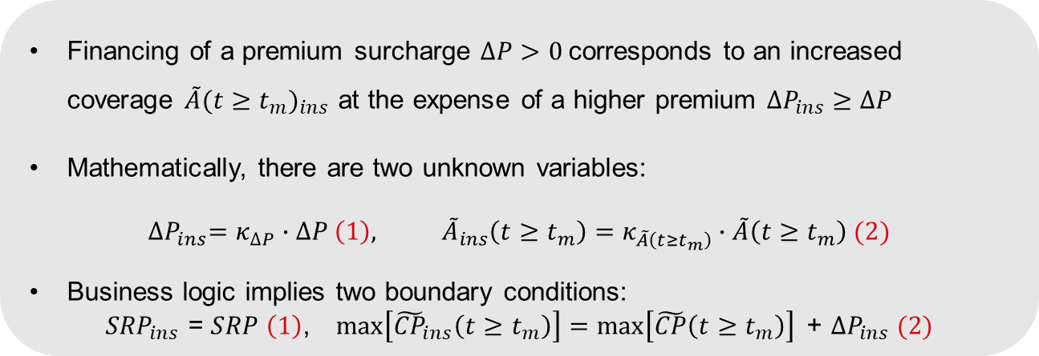

Premium Financing of Modifications
Financing of a premium surcharge $∆P>0$corresponds to an increased coverage ${\tilde{A}(t≥t_{m})}_{ins}$ at the expense of a higher premium ${∆P}_{ins} ≥∆P$
Mathematically, there are two unknown variables:
$${∆P}_{ins}=κ_{∆P}∙∆P \left(1\right), {\tilde{A}}_{ins}\left(t≥t_{m}\right)=κ_{\tilde{A}\left(t≥t_{m}\right)}∙\tilde{A}\left(t≥t_{m}\right) (2)$$
Business logic implies two boundary conditions:
$${SRP}_{ins}\text{ = }SRP \left(1\right)\text{,} \max\left[{\tilde{CP}}_{ins}\left(t≥t_{m}\right)\right]=\max\left[\tilde{CP}\left(t≥t_{m}\right)\right]\text{ + }{∆P}_{ins} (2)$$
OECD results for premium financing are contained as special cases of our solution
In the limit $t_{m}→−∞$, the solutions for premium financing are recovered:
$$P_{ins}=\frac{1}{1 − PR}∙P ≥P,$$
$${ A}_{ins}=\frac{1}{1 − PR}∙A≥A.$$
$${∆P}_{ins} =κ_{∆P}∙∆P=\frac{1}{1 − \frac{SRP ∙ \tilde{A}\left(t_{m}\right)}{ω∙max\left[\tilde{CP}\left(t_{m}\right)\right]}}∙∆P ≥∆P$$
$${\tilde{A}}_{ins}\left(t≥t_{m}\right)=\left[1+κ_{∆P}∙\frac{∆P}{\max\left[\tilde{CP}\left(t_{m}\right)\right]}\right]∙\tilde{A}\left(t_{m}\right)≥\tilde{A}\left(t_{m}\right)$$
Solution:

Slide 43
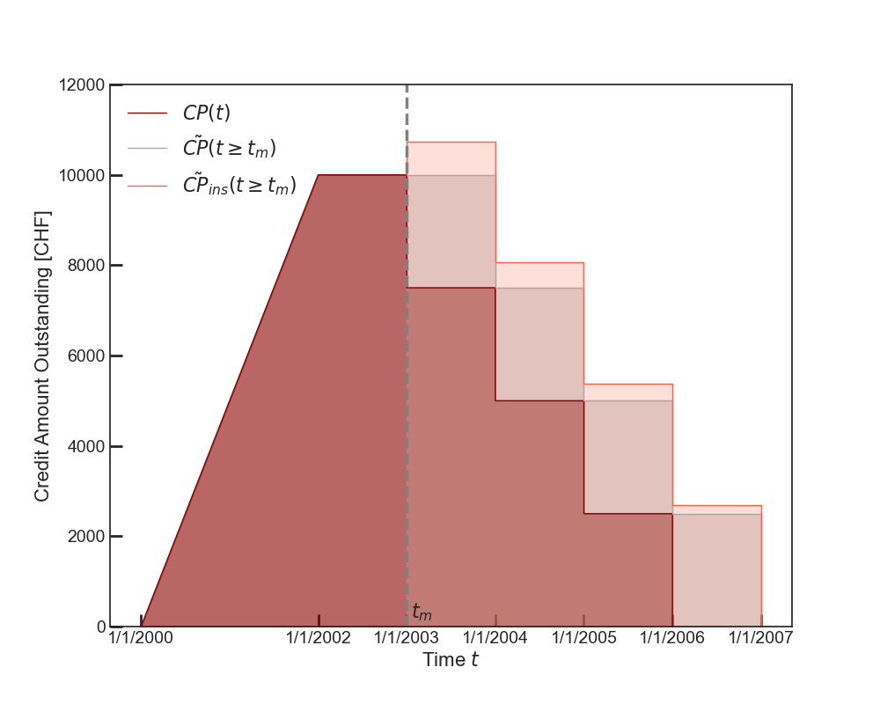
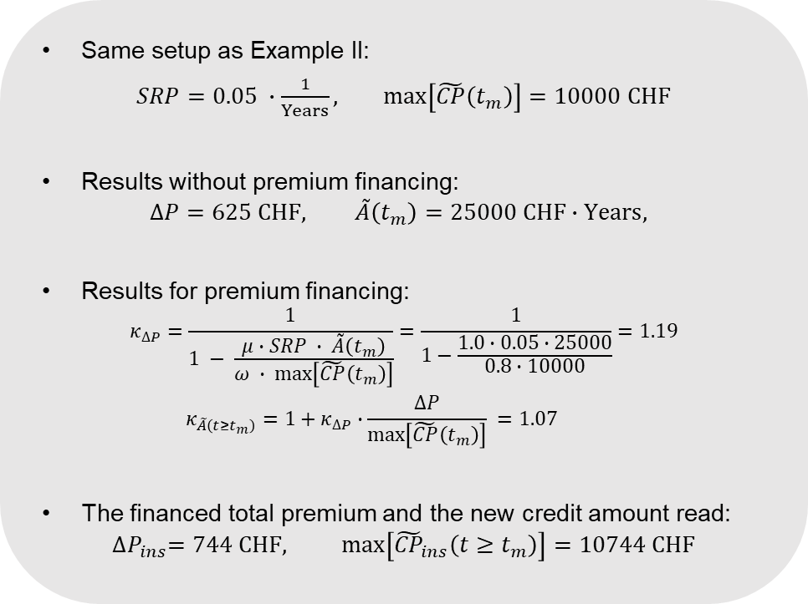
Example II Revisited: Premium Financing
Same setup as Example II:
$SRP=0.05 ∙\frac{1}{Years},$ $max\left[\tilde{CP}\left(t_{m}\right)\right]=10000 CHF$
Results without premium financing:
$$∆P=625 CHF, \tilde{A}\left(t_{m}\right)=25000 CHF∙Years,$$
Results for premium financing:
$$κ_{∆P}=\frac{1}{1 − \frac{μ∙SRP ∙ \tilde{A}\left(t_{m}\right)}{ω ∙ max\left[\tilde{CP}\left(t_{m}\right)\right]}}=\frac{1}{1−\frac{1.0∙0.05∙25000}{0.8∙10000}}=1.19$$
$$κ_{\tilde{A}\left(t≥t_{m}\right)}=1+κ_{∆P}∙\frac{∆P}{\max\left[\tilde{CP}\left(t_{m}\right)\right]} =1.07$$
The financed total premium and the new credit amount read:
$${∆P}_{ins}=744 CHF, \max\left[{\tilde{CP}}_{ins}\left(t≥t_{m}\right)\right]=10744 CHF$$

Slide 44
FAQ
Introduction
Modifications of insurances
Graphical Examples
Formal Approach
Premium Financing
  FAQ
Conclusion and Outlook
#06

Slide 45
Conclusion and Outlook
Introduction
Modifications of insurances
Graphical Examples
Formal Approach
Premium Financing
FAQ
  Conclusion and Outlook
#07

Slide 46



Contact

Slide 47
Risk represented by area: Example 1
How does the area increase?
Red area: 18 «units»,
corresponds to unearned premium of EUR 900
Blue area: 2 «units»
➔ Increase of Area after 1.1.2003: 2/18=11.1%
➔ Increase of Risk Premium: 11.1% x EUR 900 = EUR 100
➔ Increase of Total Premium: EUR 100 / 0.8 = EUR 125

Slide 48
Risk represented by area: Example 1
How does the area increase?
Red area: 18 «units»,
corresponds to unearned premium of EUR 900
Blue area: 2 «units»
➔ Increase of Area after 1.1.2003: 2/18=11.1%
➔ Increase of Risk Premium: 11.1% x EUR 900 = EUR 100
➔ Increase of Total Premium: EUR 100 / 0.8 = EUR 125

