Slide 1
Data Mining
Introduction

Slide 2
Lecturer
Veronica Liesaputra
Specializing in Data Mining, Process Mining, Information Retrieval, Mobile programming, Games, Website Development, etc.
E-mail: vliesaputra@unitec.ac.nz
All course materials will be on Moodle
http://moodle.unitec.ac.nz/
Post your questions on forum or come to me
Find me in 183 - 3003

Slide 3
Background
There is an explosive growth of data in every field
Storage devices have become cheaper with higher capacities
Rapidly increasing computing power
Faster communication
Better database management systems
Previously, we were just storing this data
Now, people are asking
What can we learn from the data
How can this data can help us make decisions

Slide 4
What’s Data Mining?
Data Mining
Tools, methodologies and theories for automatically revealing patterns in data (usually large amounts of data) that can give you useful predictions
Combines knowledge from
Statistics
Machine Learning
Databases
Pattern Recognition
Signal Processing

Slide 5
Application
Medical
Speech recognition, Drug discovery, Bioinformatics, Drug candidate screening, Preventive healthcare, Brain wave recognition, Image recognition, …
Business
Fraud detection, Targeted marketing, Promotion planning, Surveillance, Customer relationship management, Shop layout, Logistics prediction, …
Web
Search engines, Targeted advertising and news, Spam, Flu Trends, …
Many other fields …

Slide 6
Data Mining vs. Traditional Programming
Traditional Programming
Data Mining
Program
Data
Output
New Data
Program
Learning Algorithm
Output
Training Data

Slide 7
Data Mining Example
Task: Identify whether a user is writing a number 2 in both of these images

Slide 8
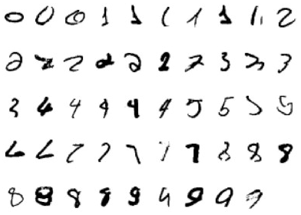
Data Mining Process
Training Data: A sample of people’s handwriting
Each character is labelled with whether or not it is the number 2
N | N | N | N | N | N | N | N | N | Y
Y | Y | Y | Y | Y | Y | Y | N | N | N
N | N | N | N | N | N | N | N | N | N
N | N | N | N | N | N | N | N | N | N
N | N | N | N | N | N | N | N | N
New Data
Program
Learning Algorithm
Output
Training Data

Slide 9
Data Mining Process
Learning Algorithm: Algorithm we use to identify the distinguishing features of each number
For example, based on the given label in the data, the algorithm might deduce that a character is the number 2 if
It has 1 horizontal line at the top and 1 horizontal line at the bottom connected by a diagonal line
Or, it has 1 bottom facing semi circle overlapping with 1 left facing semi circle
New Data
Program
Learning Algorithm
Output
Training Data

Slide 10
Data Mining Process
Learning Algorithm: Algorithm we use to identify the distinguishing features of each number
For example, based on the given label in the data, the algorithm might deduce that a character is the number 2 if
It has 1 horizontal line at the top and 1 horizontal line at the bottom connected by a diagonal line
Or, it has 1 bottom facing semi circle overlapping with 1 left facing semi circle
These if-rules are the output of the learning algorithm and is the program that we will use on the new data
New Data
Program
Learning Algorithm
Output
Training Data

Slide 11
Data Mining Example
Task: Identify whether a user is writing a number 2 in both of these images

Slide 12
Data Mining Process
The program resulted from our learning algorithm said that
A character is a number 2 if
It has 1 horizontal line at the top and 1 horizontal line at the bottom connected by a diagonal line
Or, it has 1 bottom facing semi circle overlapping with 1 left facing semi circle
Identify whether a user is writing a number 2 in
is the new data
New Data
Program
Learning Algorithm
Output
Training Data

Slide 13
Data Mining Process
The program resulted from our learning algorithm said that
A character is a number 2 if
It has 1 horizontal line at the top and 1 horizontal line at the bottom connected by a diagonal line
Or, it has 1 bottom facing semi circle overlapping with 1 left facing semi circle
Identify whether a user is writing a number 2 in
is the new data
Based on the first rule above, the program will output Y
New Data
Program
Learning Algorithm
Output
Training Data

Slide 14
Data Mining Process
The program resulted from our learning algorithm said that
A character is a number 2 if
It has 1 horizontal line at the top and 1 horizontal line at the bottom connected by a diagonal line
Or, it has 1 bottom facing semi circle overlapping with 1 left facing semi circle
Identify whether a user is writing a number 2 in
is the new data
New Data
Program
Learning Algorithm
Output
Training Data

Slide 15
Data Mining Process
The program resulted from our learning algorithm said that
A character is a number 2 if
It has 1 horizontal line at the top and 1 horizontal line at the bottom connected by a diagonal line
Or, it has 1 bottom facing semi circle overlapping with 1 left facing semi circle
Identify whether a user is writing a number 2 in
is the new data
Based on the first rule above, the program will output N
New Data
Program
Learning Algorithm
Output
Training Data

Slide 16
Data Mining Process
The program resulting from our learning algorithm is called Model
New Data
Program
Learning Algorithm
Output
Training Data

Slide 17
Data Mining Process
In our example, our algorithm has generated rules with 100% accuracy
However, in real life, this rarely happens! (It’s a question mark when it does…)
Furthermore, in real-world applications you might also need to deal with issues such as
Noisy data
Missing data
Curse of dimensionality

Slide 18
Process
Develop understanding of application and the goals of the tasks
Create sample datasets (often from Data Warehouse)
Pre-processing (including Data Cleaning & Data Reduction)
Use Data Mining algorithms on the datasets (including Optimization)
Evaluate the performance of each algorithm
Repeat all the steps until we can formulate a prediction
Deploy the system into the real world application

Slide 19
Evaluation Setup
To know the performance of a learning algorithm
Get 2 sample datasets
Training data: Data we used on the learning algorithm to build the prediction model
Test data: Data we used on the prediction model to get an output
Should not be created by getting samples from the training data!
May include data that the learning algorithm did not see in the training data
See the performance of each model on the test data
Pick the one with the highest performance
New Data
Model
Learning Algorithm
Output
Training Data

Slide 20
Data Representation - Dataset
Collection of examples/instances represented as a single relation/flat file
 | Outlook | Temperature | Humidity | Windy | Year | Play
1 | Sunny | Hot | 95 | False | 1984 | No
2 | Sunny | Mild | 70 | True | 2001 | Yes
3 | Overcast | Hot | 86 | False | 2000 | Yes
4 | Overcast | Mild | 90 | True | 2001 | Yes
5 | Rainy | Cool | 70 | True | 1985 | No
6 | Rainy | Mild | 96 | False | 1990 | Yes

Slide 21
Data Representation - Instance
Data/Point/Instance/Example/Sample/Record/Row
An individual, independent example of target data
 | Outlook | Temperature | Humidity | Windy | Year | Play
1 | Sunny | Hot | 95 | False | 1984 | No
2 | Sunny | Mild | 70 | True | 2001 | Yes
3 | Overcast | Hot | 86 | False | 2000 | Yes
4 | Overcast | Mild | 90 | True | 2001 | Yes
5 | Rainy | Cool | 70 | True | 1985 | No
6 | Rainy | Mild | 96 | False | 1990 | Yes

Slide 22
Data Representation - Attribute
Feature/Attribute/Dimension/Predictor/Column
Properties/Characteristics of an instance/example
The value of an attribute may depend on the value of the other attributes
Possible attribute types: Nominal, ordinal, interval and ratio
 | Outlook | Temperature | Humidity | Windy | Year | Play
1 | Sunny | Hot | 95 | False | 1984 | No
2 | Sunny | Mild | 70 | True | 2001 | Yes
3 | Overcast | Hot | 86 | False | 2000 | Yes
4 | Overcast | Mild | 90 | True | 2001 | Yes
5 | Rainy | Cool | 70 | True | 1985 | No
6 | Rainy | Mild | 96 | False | 1990 | Yes

Slide 23
Data Representation – Nominal Attribute
Discrete/Nominal/Categorical/Enumerated: A symbol, like cat or dog
Values serve only as labels or names
No relation is implied among nominal values (no ordering or distance measured)
Only equality tests can be performed (special case for Boolean attribute)
 | Outlook | Temperature | Humidity | Windy | Year | Play
1 | Sunny | Hot | 95 | False | 1984 | No
2 | Sunny | Mild | 70 | True | 2001 | Yes
3 | Overcast | Hot | 86 | False | 2000 | Yes
4 | Overcast | Mild | 90 | True | 2001 | Yes
5 | Rainy | Cool | 70 | True | 1985 | No
6 | Rainy | Mild | 96 | False | 1990 | Yes

Slide 24
Data Representation – Ordinal Attribute
A symbol just like Nominal. However, it imposes order on values
For example: Hot > Mild > Cool
We cannot measure distance between values, or perform addition/subtraction
Distinction between nominal and ordinal not always clear
 | Outlook | Temperature | Humidity | Windy | Year | Play
1 | Sunny | Hot | 95 | False | 1984 | No
2 | Sunny | Mild | 70 | True | 2001 | Yes
3 | Overcast | Hot | 86 | False | 2000 | Yes
4 | Overcast | Mild | 90 | True | 2001 | Yes
5 | Rainy | Cool | 70 | True | 1985 | No
6 | Rainy | Mild | 96 | False | 1990 | Yes

Slide 25
Data Representation – Interval Attribute
A number without a defined zero point
They can be measured, ordered and have fixed units
For example: Year 2004 > Year 1984
We can do subtraction. However it doesn’t make sense to add/multiply/divide.
 | Outlook | Temperature | Humidity | Windy | Year | Play
1 | Sunny | Hot | 95 | False | 1984 | No
2 | Sunny | Mild | 70 | True | 2001 | Yes
3 | Overcast | Hot | 86 | False | 2000 | Yes
4 | Overcast | Mild | 90 | True | 2001 | Yes
5 | Rainy | Cool | 70 | True | 1985 | No
6 | Rainy | Mild | 96 | False | 1990 | Yes

Slide 26
Data Representation – Ratio Attribute
A number that has been measured, e.g. 5 km, 70°
It has an inherent zero point
All mathematical operations are allowed
 | Outlook | Temperature | Humidity | Windy | Year | Play
1 | Sunny | Hot | 95 | False | 1984 | No
2 | Sunny | Mild | 70 | True | 2001 | Yes
3 | Overcast | Hot | 86 | False | 2000 | Yes
4 | Overcast | Mild | 90 | True | 2001 | Yes
5 | Rainy | Cool | 70 | True | 1985 | No
6 | Rainy | Mild | 96 | False | 1990 | Yes

Slide 27
Data Representation – Numeric Attribute
For simplicity, in practice, ratio and interval attributes are identified as numeric/continuous attributes
 | Outlook | Temperature | Humidity | Windy | Year | Play
1 | Sunny | Hot | 95 | False | 1984 | No
2 | Sunny | Mild | 70 | True | 2001 | Yes
3 | Overcast | Hot | 86 | False | 2000 | Yes
4 | Overcast | Mild | 90 | True | 2001 | Yes
5 | Rainy | Cool | 70 | True | 1985 | No
6 | Rainy | Mild | 96 | False | 1990 | Yes

Slide 28
Data Representation - Attribute
In practice, 2 Types of attributes:
Discrete/Nominal/Categorical/Enumerated: A symbol, like “red”, “yellow”, “blue”
Ordinal: An ordered symbol, like “poor”, “satisfactory”, “excellent”
Continuous/Numeric: A number, like -3.14, 0, 700, 6E23, 10.2
 | Outlook | Temperature | Humidity | Windy | Year | Play
1 | Sunny | Hot | 95 | False | 1984 | No
2 | Sunny | Mild | 70 | True | 2001 | Yes
3 | Overcast | Hot | 86 | False | 2000 | Yes
4 | Overcast | Mild | 90 | True | 2001 | Yes
5 | Rainy | Cool | 70 | True | 1985 | No
6 | Rainy | Mild | 96 | False | 1990 | Yes

Slide 29
Data Representation - Label
Target/Outcome/Label/Class
Attribute to be predicted
Sometimes these labels are not explicitly defined in the dataset
 | Outlook | Temperature | Humidity | Windy | Year | Play
1 | Sunny | Hot | 95 | False | 1984 | No
2 | Sunny | Mild | 70 | True | 2001 | Yes
3 | Overcast | Hot | 86 | False | 2000 | Yes
4 | Overcast | Mild | 90 | True | 2001 | Yes
5 | Rainy | Cool | 70 | True | 1985 | No
6 | Rainy | Mild | 96 | False | 1990 | Yes

Slide 30
Types of Learning
Supervised Learning
Provide the learning algorithm with training data and desired labels
Just like our previous example
Predicting an item label(s) – accuracy can be measured directly
Classification (for Nominal label), Regression (for Numeric label)
Unsupervised Learning
Provide the learning algorithm with training data (without desired labels)
Detecting associations/clusters in the data – indirect or qualitative evaluation
Trying to understand the data
Clustering, Association rules, Density estimation, Dimensionality reduction

Slide 31
Supervised Learning
attr1 | … | attrN | Class
 |  |  | A
 |  |  | B
 |  |  | A
Learning Algorithm
Model
Training Data
attr1 | … | attrN | Class
 |  |  | ?
 |  |  | ?
 |  |  | ?
attr1 | … | attrN | Class
 |  |  | B
 |  |  | B
 |  |  | A
Model
Test Data
Test Output

Slide 32
Unsupervised Learning
attr1 | … | attrN
Learning Algorithm
Model
Training Data
attr1 | … | attrN
attr1 | … | attrN
Model
Test Data
Test Output

Slide 33
Example: Cancer
Application: automatic disease detection
Goal: Based on past patients, predicts if you have cancer
Datasets:
Past patients with and without the disease
It’s important to include patients without the disease so that your learning algorithm can learn which examples are good and which ones are bad
Label:
Cancer or no-cancer
Features:
Concentrations of various proteins in your blood, or the existence of various genes

Slide 34
Example: Credit Scoring
Application: automatic loan defaulter detection
Goal: Based on past borrowers, predict whether the bank should gives you a loan
Datasets:
Past borrowers who have defaulted and who have paid
Label:
Defaulted or Paid
Features:
Loan amount and length, Number of installments, Assets, Income, Savings, Employment status

Slide 35
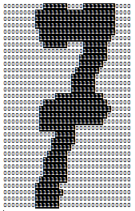
Example: Postal codes
Application: automatic postal code detection
Goal: Based on people’s handwritten digits, predict what postal code you wrote
Datasets:
Bitmap images of handwritten digits made by past senders
Label:
The number for each digit
Features:
Pixel value at row x and column y in the bitmap image (0 to 1) ?
Recognizing the types of lines, i.e. number of horizontal lines on top, number of diagonal lines in the centre, etc. ?

Slide 36
Lesson’s Learned
It’s important to input the correct data
Correct attributes (only the relevant ones)
Provides a variety of samples so that it can handle any data seen during deployment
Sometimes, you may need to create a new attribute based on the values of the other attributes
It’s your job to decide
Which learning algorithm to use
Ways to optimize the performance of your model
Your ability to master these skills is what will set you apart from other data mining experts

Slide 37
WEKA
Waikato Environment for Knowledge Analysis
Machine learning algorithms for data mining tasks
Download and install WEKA
http://www.cs.waikato.ac.nz/ml/weka/downloading.html
This is the software that you will use throughout this course
It includes datasets for the course
It is written in JAVA
It will be good for you to brush up on your knowledge of JAVA programming

Slide 38
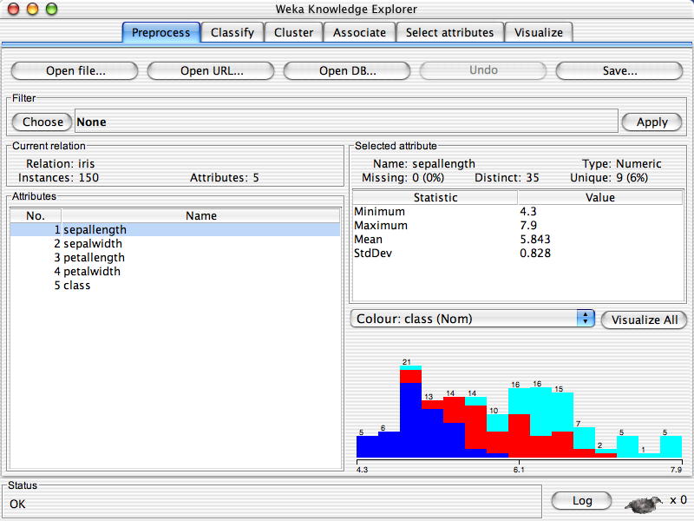
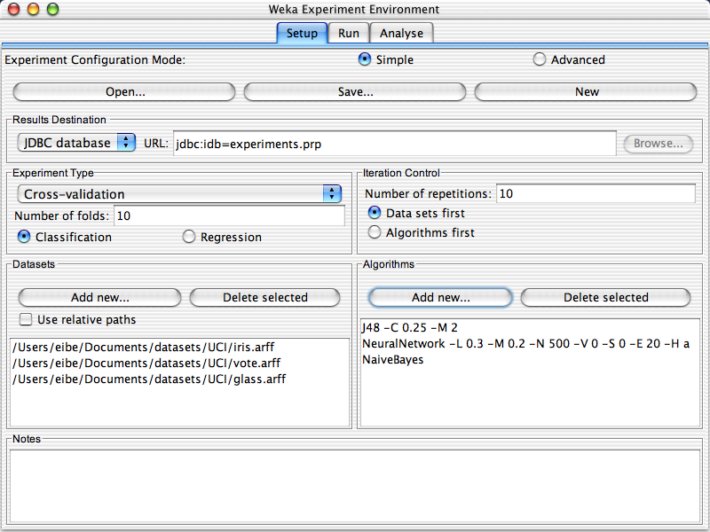

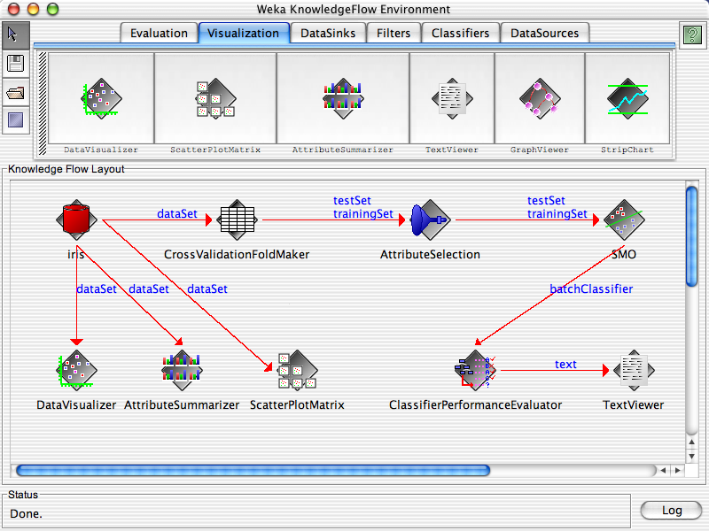
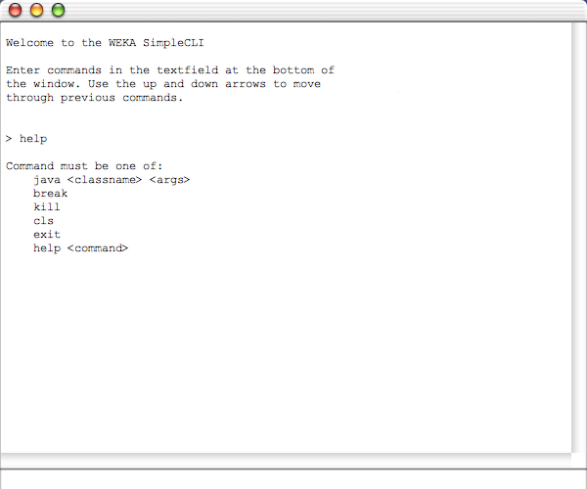
WEKA – GUI Chooser

Slide 39
WEKA – GUI Chooser
Explorer
Trying out and understanding your data
Perform data pre-processing, learning scheme and evaluation on a dataset using a single learning scheme
Experimenter
Compare the performance of different learning schemes on various datasets
Knowledge Flow
Graphically select the data pre-processing, learning scheme and evaluation needed to be done on the given dataset – define the flow of the data

Slide 40
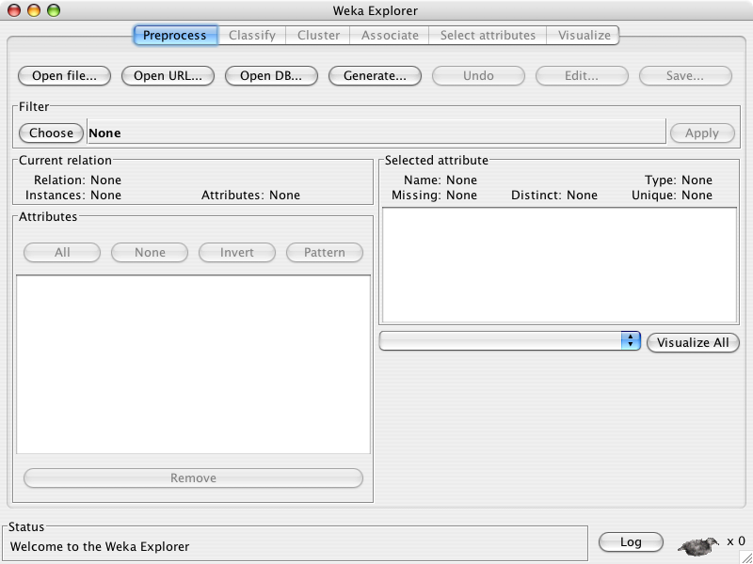
WEKA - Explorer

Slide 41
Input format
WEKA Explorer accepts data from
A file in ARFF, CSV, C4.5 or binary formats
A URL
An SQL database (using JDBC)
By default, try to convert your input dataset into an ARFF format
WEKA only deals with “flat” files
Cannot handle parent-child or entity-entity relations
Sometimes, you will need to de-normalize your input data before you can input it into WEKA

Slide 42
ARFF file
Name of the relation
@relation heart-diease-simplified
@attribute age numeric
@attribute gender {female, male}
@attribute cholesterol numeric
@attribute chest_pain_type {typ,_angina, asmpt, non_angina, atyp_angina}
@attribute class {present, not_present}
@data
63, male, 233, typ_angina, not_present
67, male, 286, asympt, present
….
Nominal attribute
Name and types of each attribute
Numeric attribute
Attribute to be classified.
It has to be specified last and it has to be called class!
The list of all the attribute values in each row.
The values are listed based on the order of the attribute listed in the file.
In our case it is: age, gender, cholesterol, chest_pain_type and class

Slide 43
Exploring the Interface
Load the iris.arff file

Slide 44
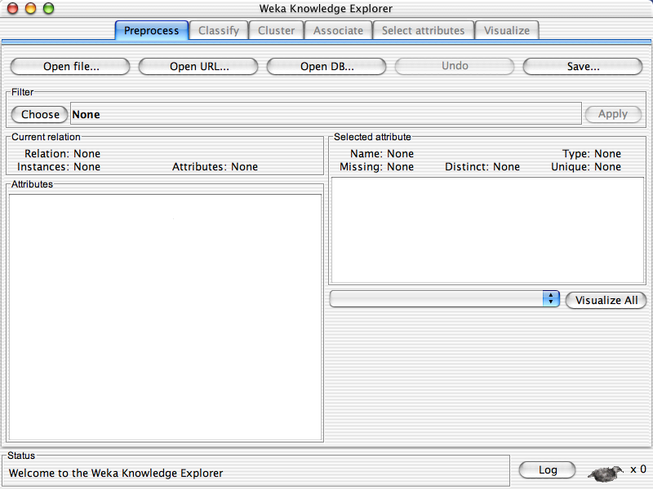

Slide 46
Exploring the Interface
Load the iris.arff file
How many instances does this dataset have?
How many attributes?
How many numeric and nominal values does this dataset have?
What is the range of possible values of the attribute petallength?

Slide 48
Exploring the Interface
Load the iris.arff file
How many instances does this dataset have?
How many attributes?
How many numeric and nominal values does this dataset have?
What is the range of possible values of the attribute petallength?
What are the possible class values in this dataset?

Slide 49
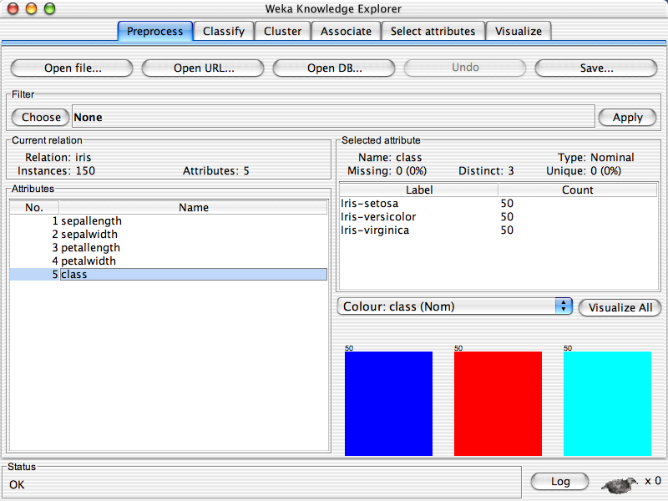

Slide 50
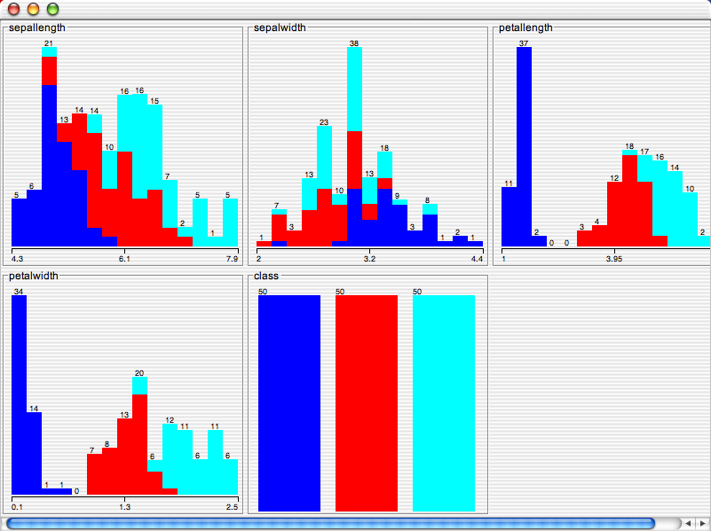

Slide 51
Exploring the Interface
Load the iris.arff file
How many instances does this dataset have?
How many attributes?
How many numeric and nominal values does this dataset have?
What is the range of possible values of the attribute petallength?
What are the possible class values in this dataset?
Click on the Edit button, what is the class value of the instance number 3?

Slide 52
Exploring the Interface - 2
Load the weather.nominal.arff file
How many instances does this dataset have?
How many attributes?
How many numeric and nominal values does this dataset have?
What are the possible values of the attribute temperature?
What are the possible class values in this dataset?
Click on the Edit button, what is the class value of the instance number 8?

Slide 53
Exploring the Interface - 3
Load the weather.numeric.arff file
How many instances does this dataset have?
How many attributes?
How many numeric and nominal values does this dataset have?
What are the possible values of the attribute temperature?
What are the possible class values in this dataset?
Click on the Edit button, what is the class value of the instance number 8?

Slide 54
Look at assignment 1
Assignment1.docx
What to do
Marking Schedule for Assignment 1
How you are you going to be marked
Detail Instructions
Helps to get higher mark

Slide 55
The end of today
Home work
Collect and label data for Assignment 1
Play more with Weka

