Slide 1
Predicting Black Friday Sales via Bayesian Multiple Regression
By Arion Evans, Jake Mott, Josh Grosman, and Tim Kirkbride

Slide 2
Introduction
Black Friday is the name given to the day following the Thanksgiving holiday in the USA.
On Black Friday, many major retailors open very early and offer promotional sales on their stock, which leads to high sales throughout its duration.
Black Friday is often an extremely busy day for shopping, and has gained an infamous reputation due to regular reports of violence between shoppers and retail staff walkouts.
Given the high amount of sales associated with Black Friday, understanding the kind of shoppers who participate in the shopping event and how much they spend could prove important.

Slide 3
Methodology
This project was ultimately concerned with fitting a multiple regression to predict Black Friday customer’s average sales amounts based on a selection of predictor variables.
Data pre-processing and descriptive analysis
A Bayesian framework was utilised here through Markov Chain Monte Carlo (MCMC) simulations.
- Non-informative priors.
MCMC diagnostic checks were completed to ensure chain representativeness and accuracy.
Posterior inferences were noted and unseen test data was fed into the final model and the generated predictions were compared to the actual values.

Slide 4
Dataset Overview
The dataset used was obtained from Kaggle and can be accessed here: https://www.kaggle.com/abhisingh10p14/black-friday
The data were aggregated to ensure each individual was represented once.
New variables were created to represent total and average amounts spent by each individual.
Factor columns such as sex and age were made into binary dummy variables

Slide 5
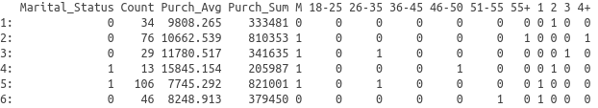
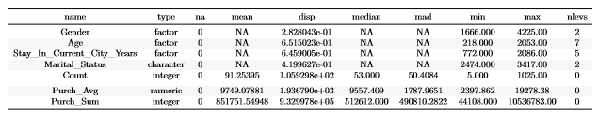
Descriptive Summary Tables
Head of Dataset (Binary):
Descriptive Statistics (Factor):

Slide 6
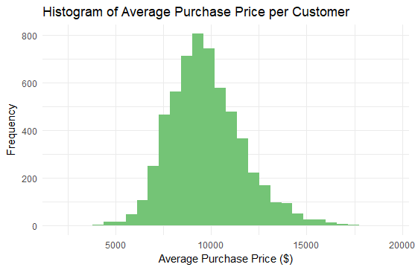
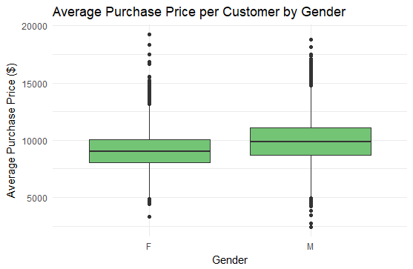
Data Visualisation
Response Variable
Clear likeness to normal distribution
Slightly right-skewed with mode of around $10,000
Very slight difference in median lines
Males appear to spend more on average than females.

Slide 7
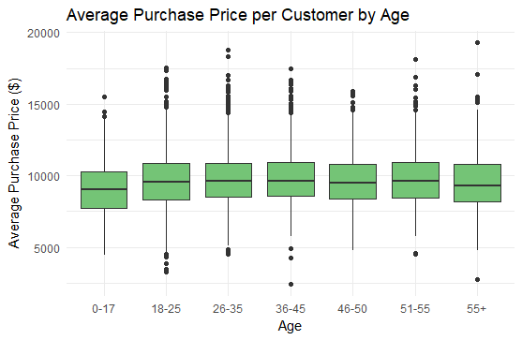
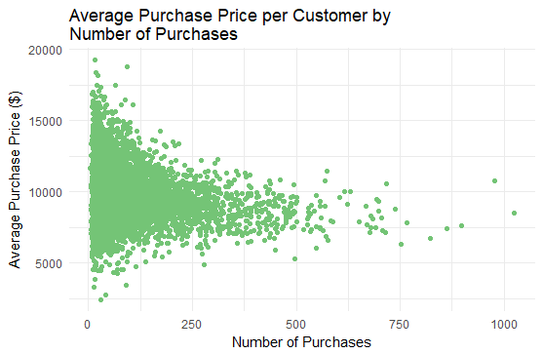
Data Visualisation
Very little variance in purchase price across age bins.
Slight positive trend from 0-17 through to 36-45.
Unusual relationship.
Individuals who purchase many items more likely to spend an average amount.

Slide 8
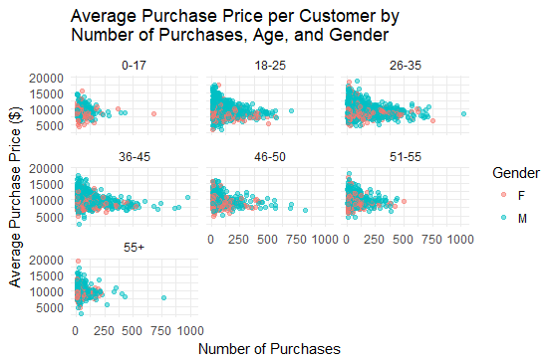
Data Visualisation
Lower density in 0-17 and 55+ facets.
More males than females overall.
Although difficult to interpret, males appear to be spending more on average once more.
Similar relationship between count and average sales across all facets.

Slide 9
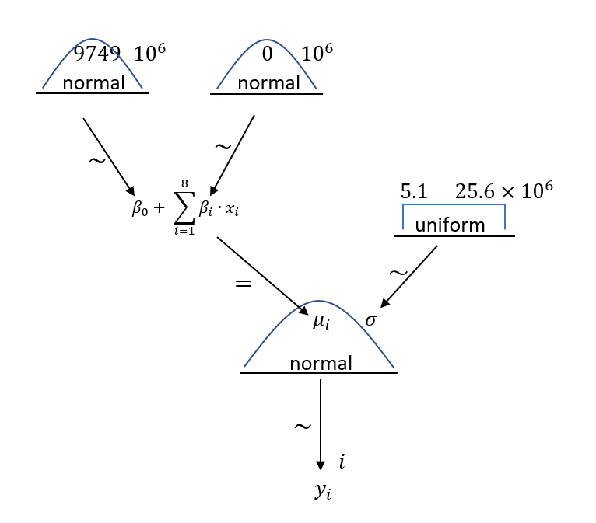
Model Diagram

Slide 10
Model Considerations
Initially, a model was created and run with the full set of independent variables.
Non-significant predictors were identified based on the outcome, and a new, reduced model was run which only included the Gender, Age and Count variables as predictors.
All results presented here related to the reduced model.
For the final MCMC run, 100,000 iterations were run with 5000 burn-in and 5000 adaption steps. A thinning of 15 was used.

Slide 11
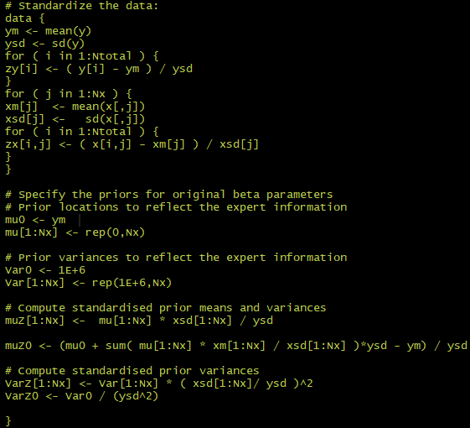
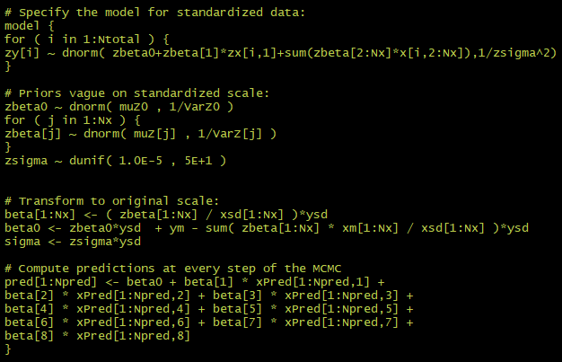
Data and Model Strings
Data Block:
Model Block:

Slide 12
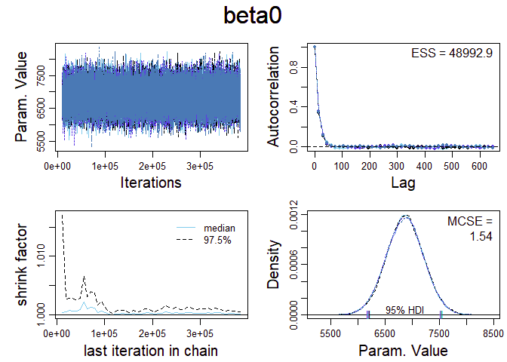
Model Diagnostics
The diagnostic plots are very positive. We can see that there is very good representation as the chains are almost entirely overlapping and the shrink factor approaches 1.
Also, the accuracy of the chains is very good with the very small MCSE value and very high ESS value. Although MSCE is not exactly zero, this may attributable to the relatively large scale of the parameter.
The results here are not unique to beta0 with the rest of the beta parameter diagnostic plots all showing similar outcomes.

Slide 13
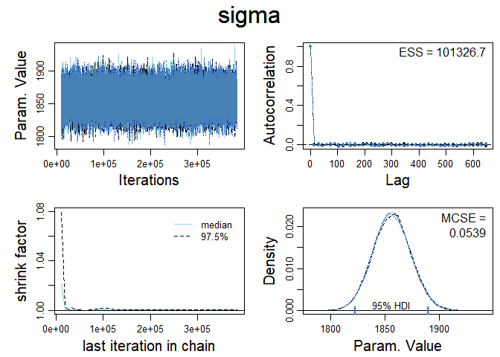
Model Diagnostics
These diagnostics are also very positive.
As with the beta model diagnostics we can see that the shrink factor is well below 1.1 and that chains are overlapping which indicates that they have converged well.
The autocorrelation plot flattens immediately and the effective sample size is very large. Furthermore, the MSCE is very close to zero. This implies that there is independent information in the chains.

Slide 14
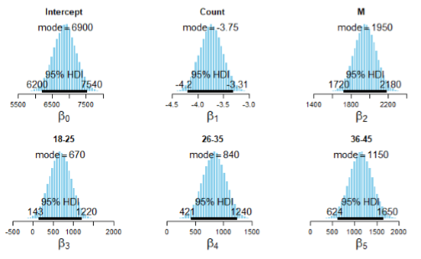
Posterior Analysis
All estimates may be considered significant. Mode estimates appear to roughly correspond to with descriptive trends.
Count estimate is unexpectedly negative.

Slide 15
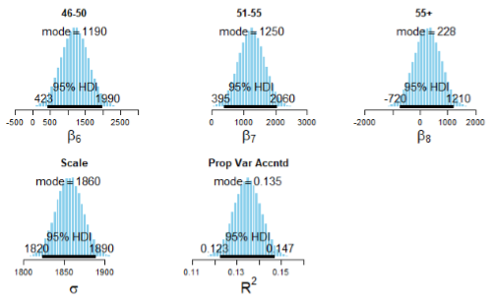
Posterior Analysis
R² value is fairly low, suggesting a large portion of variation in response variable is not explained by the model.

Slide 16
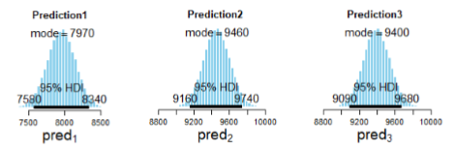
Model Equation and Predictions
The posterior mode estimates were used to form the parameters for the multiple regression equation:
Average Sales = 6900 - 3.75*Count + 1950*Male + 670*(18-25y) + 840*(26-35y) + 1150*(36-45y) + 1190*(46-50y) + 1250*(51-55y) + 228*(55+y)
Some of the prediction posterior distributions obtained
using the above equations are shown below.

Slide 17
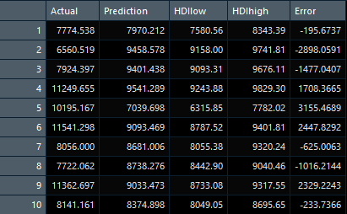
Predictions
All predictions are summarized below and
compared to the actual values of the test set.
MSE = 3,638,930

Slide 18
Summary
Overview:
This report looked to construct a multiple regression model for predicting average Black Friday sales per person using Bayesian estimation and MCMC.
Model diagnostics and posterior distributions were good.
Ultimately, predictions generated on the test data were shown to be fairly inaccurate, with a large MSE.
Recommendations:
To construct a more accurate model, additional predictor variables might be considered, as those used here were only able to explain a small proportion of the variance in the response variable.
Introducing some kind of expert information to create informative priors might also aid in the construction of a more effective model.

Slide 19
Thank You!

Slide 20
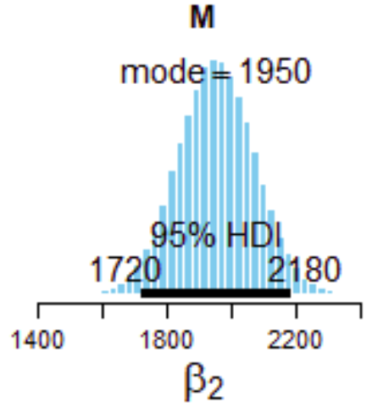
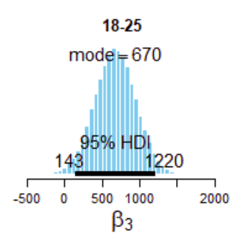
Posterior Analysis
Beta 2 here shows that being Male will increase the average amount spend by $1950. This average increase should be given a high level of confidence due to the small associated interval
Beta 3 is an example of the age bracket variables within the black friday dataset. Unlike the previously seen posterior plots, beta 3 has a relatively low level of confidence associated with it. This is seen in all of the age variables with the mode increasing as the age bracket increases

Slide 21
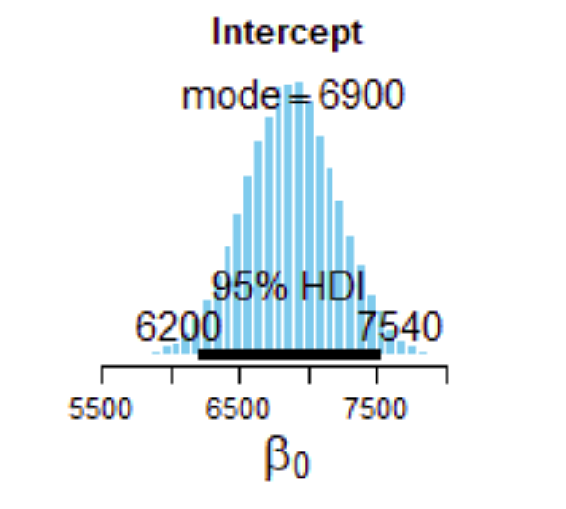
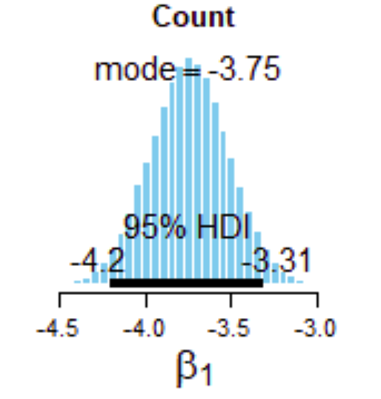
Posterior Analysis
The intercept here has a mode of 6900, with a relatively small HDI range (6200, 7540). This would suggest a high level of confidence in the Intercept value.
The count variable also has a very small interval suggesting that there is high level of confidence in the mode of -3.75. This figure unexpectedly shows that an increase in one transaction to the total will reduce the average amount spent by $3.75

