Slide 1
COVER SLIDE
By Arion Evans, Jake Mott, Josh Grosman, and Tim Kirkbride

Slide 2
Problem Description - Introduction
- What is the dataset we are investigating?
- What questions are we asking?

Slide 3
Problem Description - Expectations
- What answers are we expecting to see?
- Do we foresee any challenges?

Slide 4
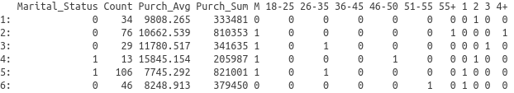
Data Visualisation and Data Analysis
- Head of dataset
- Description of Variables

Slide 5
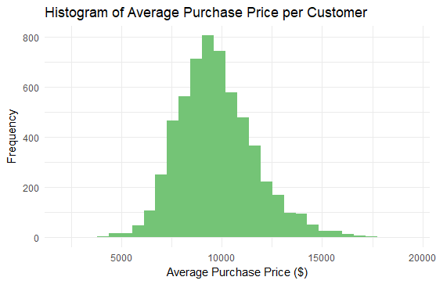
Data Visualisation and Interpretation
Any additional comments
-
-

Slide 6
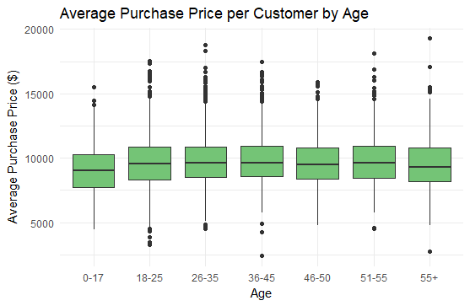
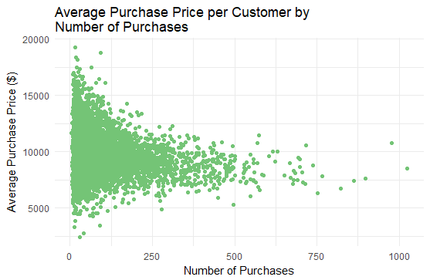
Data Visualisation and Interpretation

Slide 7
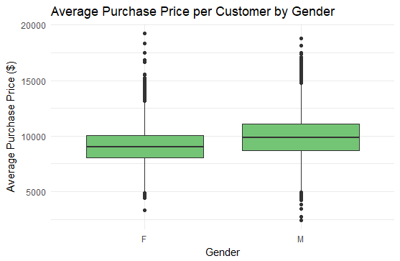
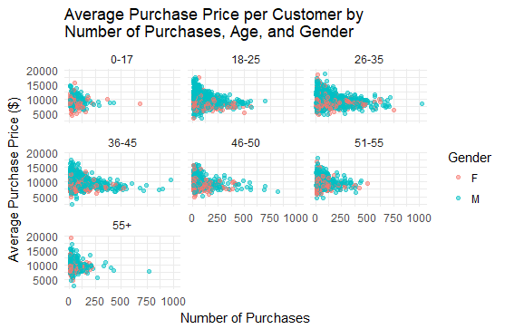
Data Visualisation and Interpretation

Slide 8
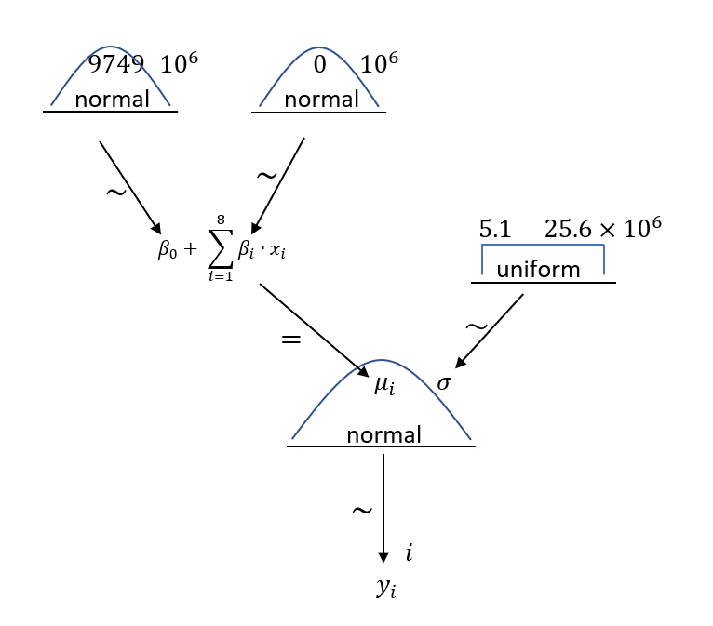
Model Diagram

Slide 9
Model String

Slide 10
Model Diagnostics

Slide 11
Posterior Analysis 1
2 posteriors per slide

Slide 12
Posterior Analysis 2
2 posteriors per slide

Slide 13
Posterior Analysis 3
2 posteriors per slide

Slide 14
Posterior Analysis 4
2 posteriors per slide

Slide 15
Predictions

Slide 16
Summary

