Slide 1
Context Engineering Development Model
(CEDM)
A Pragmatic, Risk-Aware Approach to using AI in Software Development

Slide 2
Context Engineering Development Model
Timothy McCrimmon
# Intellectual Property Notice
© 2025 Timothy McCrimmon. All rights reserved.
Context Engineering Development Model™ (CEDM) is an original methodology developed by Timothy McCrimmon.
This work, including all written materials, diagrams, and related documentation, is protected under copyright law.
Permission is granted to reference or quote small portions of this work for educational or research purposes, provided that proper attribution is given.
No part of this work may be reproduced, distributed, or used commercially without prior written consent of the author.

Slide 3
Book Outline
Section | Description
Introduction | Using AI in the software development process carries risks and requires changes in the development model. Introducing CEDM
Concept Deep Dives | Structured Context©️ Teams (XP.AI) Contracts AI Driven Governance
Case Study (reference model) | Example of the process, deliverables, context management, teams, governance and reporting.

Slide 4
Introduction
Attractiveness and issues associated with using AI in your SDLC

Slide 5
Mythology
Reality
Anyone can build applications
All software will be written by AI
We don’t need expensive developers
Gen-AI writes perfect code
Vibe Coding is the future!!
AI is here to stay
“Wait and see” will hurt you
AI tech (good and bad) moving VERY fast
Scenarios:
Build software using AI
Build applications that leverage AI
Both are RISKY
Both require SKILL
Both require a PLAN
Getting it wrong could prove fatal to your biz

Slide 6

Today’s Development Teams
Stakeholders
Types:
Product:
Offering for Sale to a market
Build what customers NEED
Services:
Software built as specified by a contract
Build what customers WANT
Maintenance:
Maintain existing systems and solutions
Enhance/Maintain what customers HAVE
Managers
Stakeholders
AI Forces a change in the game
Waterfall
Agile
AI Assistants
(holy hand grenade)
Developers
Agile
Developers

Slide 7
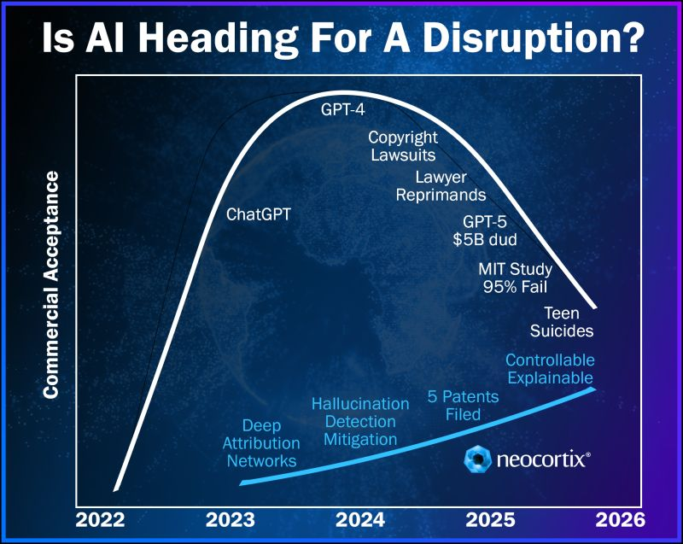
What is forcing the change?
AI makes you faster but introduces new risks.
You need protection
Indemnification
Intellectual Property Protection
Provenance
Copyright
More

Slide 8
Context Engineering
Lingo Level Set:
Context Engineering is a shift in how we think about software development itself.
CEDM Context:
Context is the single source of truth that ensures alignment, accountability, and continuity across the system.
Context is the living framework of data and intent that guides both human and AI decision-making within well-defined boundaries.
Context is live, evolving continuously, and maintained as an integral part of the codebase. This is not an option.
Context is your code’s metadata
Context creates opportunity for project automation (change management for example)
Training:
- Make an LLM Smarter
Prompt:
- Ask an LLM a question
Prompt Engineering:
- Misnomer (IMHO)
Context:
- Supporting information for a series of prompts
Context Engineering: (per CEDM)
- The practice of structuring and managing information that AI systems use to reason and respond

Slide 9




Structured Context is the Source of Truth
Create Context
Build the Source of Truth
Creators: Vision, Design, Architecture, Governance Inputs: Text, Models, Diagrams, Data Outputs: Structured Context definitions (SCID, Contracts, Models) Goal: Define intent, scope, rules, and boundaries
Leverage Context
Build, Test, and Govern Through Context
Consumers: Developers, Testers, Analysts, AI Agents Activities: Build systems aligned with definitions Generate and validate code Execute automated testing Apply guardrails and measure KPIs Goal: Deliver outcomes that remain true to intent
Project Team
Source of Truth
Structured
Context
Documents
(Versioned SCD’s)
Standards Bodies
Builders
Project Guardrails
aka
Contracts
Investors

Slide 10
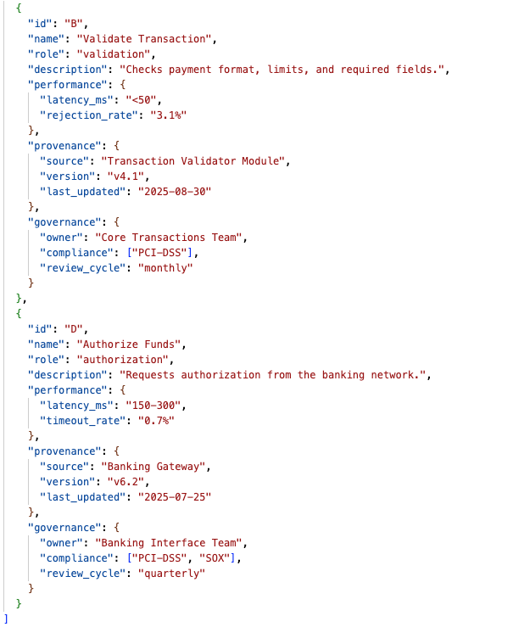
Structured Context Documents (SCDs)
Structured context is represented as either JSON or YAML.
AI Agent transforms specifications, documents, tables, drawings into SCDs
SCDs are both machine and human readable.
SCDs provide AI with meta data (context) for Generative Tasks.
Provides Humans with explicit yet concise contract for development criteria.

Slide 11
SCD Specification

Slide 12
Project Bundle
1 per project
Versioned
M
Meta Bundle
1 per project bundle, root bundle
Versioned
Each bundle must contain a Manifest
Manifest is a special SCD with a header and lists all content (and versions of each document)
4 types of bundles:
Project
Meta
Standards
Domain
Each bundle must contain a manifest at least 2 SCDs
All domains require a bundle (with manifest)
M
Meta
Standards Bundle
1 per project bundle, root bundle
May contain other bundles (HIPAA or SOC2) or SCDs (corporate standards)
Versioned
M
Standards
Domain Bundles
10 core bundles, no duplicates
Contains only SCDs
Customer may add more but the 10 core are the minimum prescribed set.
M
Domain
M
Domain
...
M
Domain

Slide 13
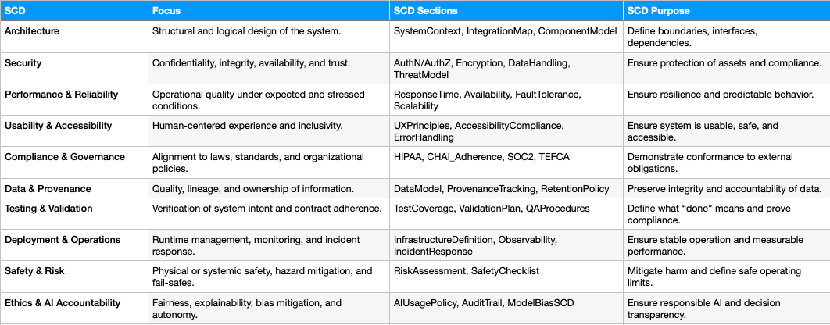
SCDs for Projects

Slide 14
SCDs for Standards

Slide 15
Deep Dive
PPT in process

Slide 16
Case Study
(reference implementation)
PPT in process

Slide 17
Teams
Vision • Design • Build • Govern
Vision — defines intent and value (leaders, stakeholders)
Design — shapes structure and flow (architects, analysts)
Build — implements and adapts (developers, engineers)
Govern — ensures continuity and integrity (managers, compliance, AI)
Each team member works with an AI Assistant.
Formerly: Extreme Programming (XP)
Now: Extended Programming (ExP)
All accountable roles are part of the team (with their personal AI Assistant), each with defined responsibilities and a shared contract.

Slide 18
Team Layers
Vision | Design | Build | Govern
Defines why the system exists and what value it delivers | Shapes how the system achieves intent within defined boundaries | Implements and evolves the designed system through living code and context | Ensures continuity, integrity, and alignment across all components
• System Concept & Intent • Purpose, scope, outcomes, and success metrics • Stakeholders, constraints, dependencies • Establish initial context boundaries for AI and humans | • Architecture models (System → Assembly → Component) • Data models, interfaces, and contracts • Context structure (definitions, Inputs, outputs, constraints) • Governance hooks for compliance and telemetry | • Develop Components within scope of contracts • Maintain synchronized context files with code • Perform continuous testing, validation, and integration • Generate autonomic documentation (self-updating via context) | • Manage versioned context and configuration • Monitor compliance, telemetry, and performance metrics • Validate alignment to intent and scope (closed-loop feedback) • Oversee AI behavior, bias, and transparency

Slide 19
Team Members
Vision | Design | Build | Govern
Defines why the system exists and what value it delivers | Shapes how the system achieves intent within defined boundaries | Implements and evolves the designed system through living code and context | Ensures continuity, integrity, and alignment across all components
Product Manager Investment Board / Executive Sponsor CFO / CSO (strategy, risk, funding) Clinical / Domain Leads (where applicable) AI Vision Assistant (maintains SCID, value tracking) | Enterprise Architect Solution Architect Business / Data Analyst UX / Service Designer QA / Test Architect AI Design Assistant (context modeling, compliance mapping) | Developers / Engineers AI Agents / Developers (for specialized components) DevOps / MLOps Engineers Data Engineers / Model Trainers Test Automation / Integration AI Build Assistant (code + test generation, validation) | Governance Manager / Compliance Officer Security & Privacy Lead Performance / Reliability Engineer Infrastructure / Platform Engineer AI Governance Assistant (policy checks, bias monitoring, telemetry validation)

