Slide 1
Project Bundle
1 per project
Versioned
M
Each bundle must contain a Manifest
Manifest is a special SCD with a header and lists all content (and versions of each document)
4 types of bundles:
Project
Meta
Standards
Domain
Each bundle must contain a manifest at least 2 SCDs
All domains require a bundle (with manifest)
Meta Bundle
1 per project bundle, root bundle
Versioned
M
M
Meta
Standards Bundle
1 per project bundle, root bundle
May contain other bundles (HIPAA or SOC2) or SCDs (corporate standards)
Versioned
M
Standards
Domain Bundles
10 core bundles, no duplicates
Contains only SCDs
Customer may add more but the 10 core are the minimum prescribed set.
M
Domain
M
Domain
...
M
Domain

Slide 2
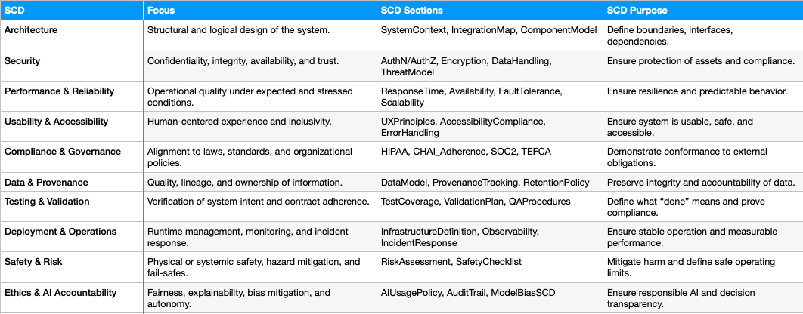
SCDs for Projects

Slide 3
Team Layers
Vision | Design | Build | Govern
Defines why the system exists and what value it delivers | Shapes how the system achieves intent within defined boundaries | Implements and evolves the designed system through living code and context | Ensures continuity, integrity, and alignment across all components
• System Concept & Intent • Purpose, scope, outcomes, and success metrics • Stakeholders, constraints, dependencies • Establish initial context boundaries for AI and humans | • Architecture models (System → Assembly → Component) • Data models, interfaces, and contracts • Context structure (definitions, Inputs, outputs, constraints) • Governance hooks for compliance and telemetry | • Develop Components within scope of contracts • Maintain synchronized context files with code • Perform continuous testing, validation, and integration • Generate autonomic documentation (self-updating via context) | • Manage versioned context and configuration • Monitor compliance, telemetry, and performance metrics • Validate alignment to intent and scope (closed-loop feedback) • Oversee AI behavior, bias, and transparency

Slide 4
Team Members
Vision | Design | Build | Govern
Defines why the system exists and what value it delivers | Shapes how the system achieves intent within defined boundaries | Implements and evolves the designed system through living code and context | Ensures continuity, integrity, and alignment across all components
Product Manager Investment Board / Executive Sponsor CFO / CSO (strategy, risk, funding) Clinical / Domain Leads (where applicable) AI Vision Assistant (maintains SCID, value tracking) | Enterprise Architect Solution Architect Business / Data Analyst UX / Service Designer QA / Test Architect AI Design Assistant (context modeling, compliance mapping) | Developers / Engineers AI Agents / Developers (for specialized components) DevOps / MLOps Engineers Data Engineers / Model Trainers Test Automation / Integration AI Build Assistant (code + test generation, validation) | Governance Manager / Compliance Officer Security & Privacy Lead Performance / Reliability Engineer Infrastructure / Platform Engineer AI Governance Assistant (policy checks, bias monitoring, telemetry validation)

