Slide 1
AI at NexTern
What we've learned, what we've concluded, and what we're asking for.
Prepared for review by Mike Brenzel (CTO), CFO, and COO · Ohana Consulting — architecture & governance advisor

Slide 2
AGENDA
Defining and Managing AI Guardrails
PART 1
PART 2
PART 3
Overview
How to Use
What’s Next
Goals · Status · Recommendation
Context
Why Structured Context
SCS Structure
SCS Components
What’s new in 0.5
Gather · Build · Review · Version
Executive Team Engagement
Locate or define policy documents
Validate Policies
Generate SCDs
Review and approve SCDs
Version and Deploy
FY27 given successful pilot.
Tim takes some time off
2

Slide 3
What is SCS and what problem is it solving?
Key Drivers:
Without context, AI is stupid and dangerous
  AI makes assumptions. Without context, it assumes that you don’t care.
  Rule: AI Doesn’t Make Mistakes, People Do.
Guardrails are essential to keep AI from being stupid
  Guardrails (rules, limits, conditions, criteria) are forms of context
  Guardrails rarely change. When they do change, it’s a reflection of policy change.
  To support changing policies, Guardrails (Context) is versioned and managed as an asset.
Kinds of Guardrails
  Corporate Policy
  Technical Requirements
  Security Requirements
  Regulation Requirements
  Audience/customer
  Project Requirements
  Departmental Requirements
SCS is designed to create machine readable context from your policy documents and train agents on things your employees already know.

Slide 4
What is Context?
Key Drivers:
The Prompt
  xx
Guardrails
  xx
State Data
  xx

Slide 6
AI is here to stay
As AI becomes a permanent feature of modern software, managed adoption is a necessity, not an option. We are implementing a phased architecture designed to mitigate operational and compliance risks, ensuring complete data privacy, audit-readiness, and immediate process improvements.
NexTern Imperatives:
1
2
3
Complete Data Privacy
Risk Management &
Audit-Readiness
Immediate Process Improvement
Customer and IP data governed by design, not by policy alone.
Every session, context delivery, and tool call leaves an evidentiary trail.
Real productivity gains across engineering, QMS, and proposals.
3

Slide 7
What the POC taught us
Business Directive: AI adds new risk. Make it safe for NexTern, or don’t use it.
POC Goal: Test market offerings and define a solution that is safe for NexTern and its clients - if it exists.
We evaluated six enterprise level AI platforms during the POC. Each has real strengths, but on one point, whether data can be guaranteed as a technical fact (not a contract clause) to never leave the vendor's infrastructure, none clear that bar today.
Platform | Data Residency | Notes: Governance / Compliance Gap / Operational Readiness
Claude Enterprise | Cloud SaaS; U.S.-only inference option; no on-prem deployment; zero Cowork audit metrics | No support for on-prem. Strongest platform overall and the basis for our POC, however Cowork sits outside the compliance/activity API on every plan tier — a disclosed, known gap.
Gemini Enterprise | Cloud SaaS | No support for on-prem. Capable agent platform, however agentic-activity compliance API coverage is unresolved and admin-context precedence is undocumented — an open question, not a confirmed gap.
ChatGPT Enterprise | Cloud SaaS | No support for on-prem. Governance claims look strong, however they come from third-party reporting rather than OpenAI’s own documentation — unverified.
IBM Bob | SaaS-only as evaluated; on-prem claimed for 3Q26 (unverified); scoped to SDLC/coding agents | Future support for on-prem. Strongest governance design by intent, but designed as an SDLC tool that doesn’t align well to CDMO. IBM recommended WatsonX Orchestrate.
Geordie | Allows for private LLM but all data still flows through Geordie SaaS cloud. | No support for on-prem. Solid solution with AI discovery tools and governance management.
IBM WatsonX Orchestrate | Private deploy capable. All data stays inside NexTern security boundaries | Supports full deployment on-prem, however solution incomplete and not designed to support CDMO.
That's not a knock on any of these vendors. This is a reasonably new requirement for the industry, and our honest read is that it may take a long time to resolve. We'll continue to re-test as the vendor landscape evolves.
4

Slide 8
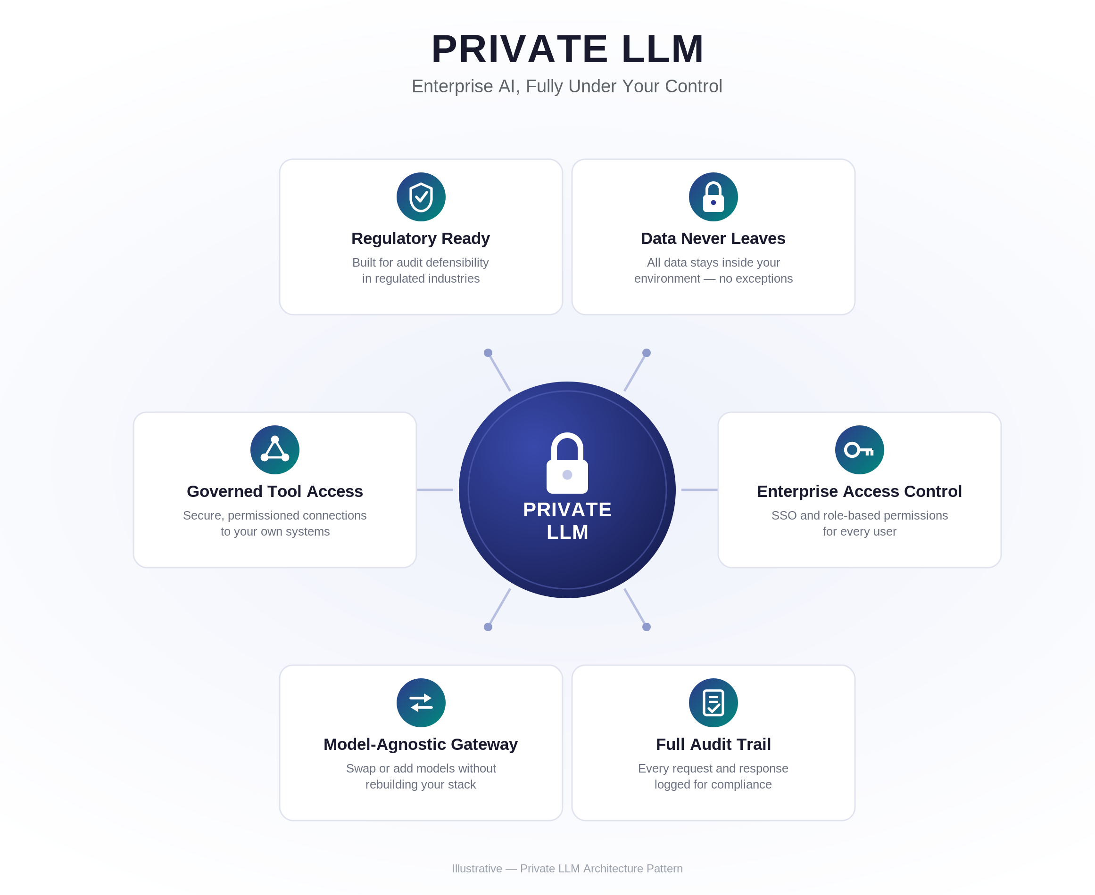
The case for Private AI
Driven by surging security concerns, strict data sovereignty regulations, and the rapid rise of autonomous AI agents, organizations in regulated sectors are moving beyond basic cloud APIs to deploy fully self-hosted, offline AI stacks
Key Drivers:
Customer Data Safety
  Issue: Customers are demanding that their data and IP not be used with public models.
  Resolution: With Private LLM all data stays within NexTern security boundaries.
AI Market Insulation
  Issues:
    Costs, availability, terms are subject to 3rd party decisions
    AI vendors will become a control point in your business.
  Resolution: NexTern maintains their control, costs and quality of service are predictable and manageable.
Customer data and IP stay inside NexTern's boundary by default, no exceptions. The gateway still provides a path to frontier models, but only for work touching no customer data and no IP, and only when CTO, CTO Delegate or IT Manager specifically approves it.

Slide 9
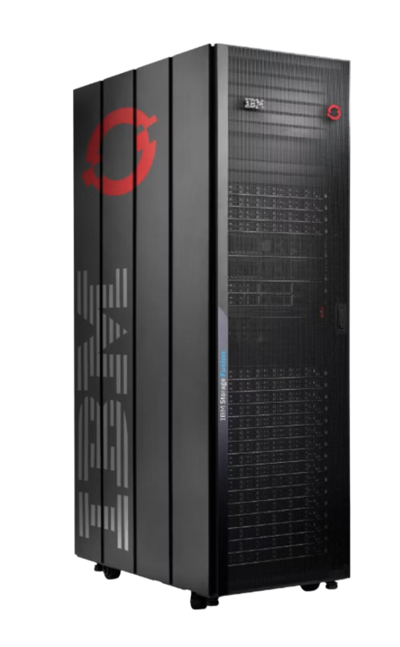
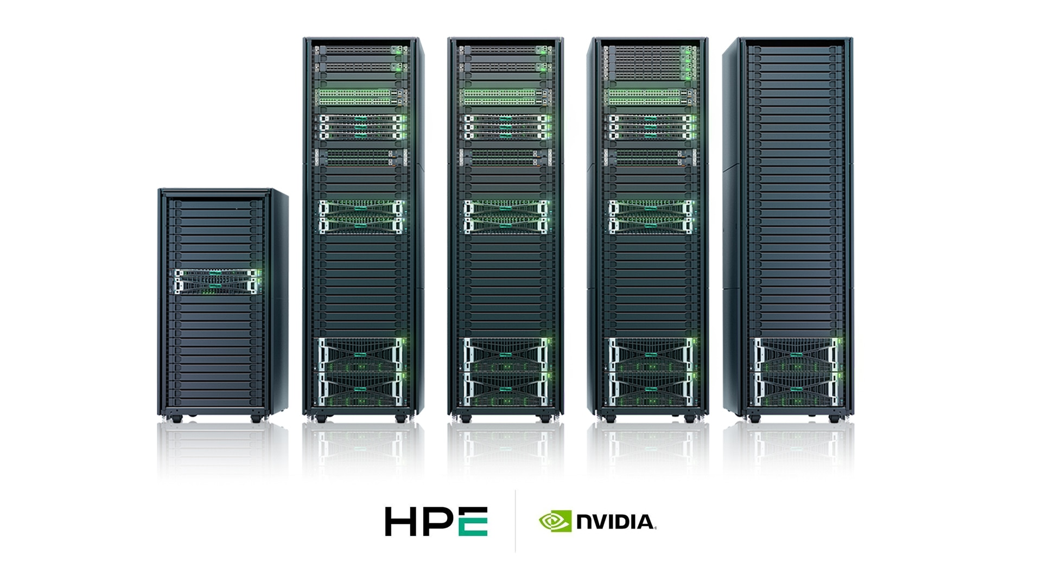
Benefits for NexTern
Private, self-hosted AI gives NexTern direct operational control over its AI platform, keeping customer data in-house and avoiding disruption from vendor pricing changes, outages, or policy shifts.
Private, cost-controlled, audit ready AI
You own your AI control point
Issues Private AI will address:
  Provides access to NexTern data via AI, with full role-based access control (RBAC).
  Enables vastly improved data curation capability.
  Supports advanced development of NexTern-specific AI workflows and applications.
  Control Plane enables centralized management and governance of AI use across NexTern.
  Enables transparency across all business processes.
Customer data and IP stay inside NexTern's boundary by default, no exceptions. The gateway still provides a path to frontier models, but only for work touching no customer data and no IP, and only when CTO, CTO Delegate or IT Manager specifically approves it.

Slide 10
Cost Comparison: Claude Enterprise vs Private AI
If we used Claude Enterprise, what would it cost?
NOTE: Claude doesn’t solve our problem, this is just a cost comparison
Variable Costs, Usage Based
Claude Enterprise
# Users | Total Seat Costs/mo | API Costs/user/mo | Total API Costs/mo | Total Annual Costs | 5 Year Total
200 | $4000 | $200 | $44,000 | $528K | $2.6M
200 | $4000 | $400 | $88,000 | $1.05M | $5.25M
200 | $4000 | $600 | $176,000 | $2.1M | $10.5M
Private AI
Private Cloud AI Appliance | Initial Build (MSRP) | Annual Maintenance (~20%) | 5 Year Total
Production Platform (small) | $2.1M | $400K | 3.3M
Production Platform (medium) | $3.2M | $600K | 5.6M
High Estimate
Notes:
Claude Enterprise Price Basis
$20/seat/month plus usage billed at API rates (usage based: the more you use it, the more it costs)
Billed annually (not monthly)
Everything in Team, plus: SSO, SCIM, role-based access with fine-grained permissioning, audit logs, a Compliance API, custom data retention controls, network-level access control, IP allowlisting, admin-set spend limits, HIPAA-ready offering, and (beta) Claude Security
500k context window on the default model — notably larger than Max's 200k

Slide 11
The ask & decision timeline
Ask 1: Now
Approve Pilot continuation funding for 2H26: $200,000 total, covering Ohana's direction, architecture, and delivery team plus NexTern's own Pilot infrastructure
Ask 2: Looking Ahead
Reserve a provisional AI line in the 2027 budget cycle to get started with private cloud AI
17

Slide 12
Thank you
Prepared by Ohana Consulting for NexTern's AI 2H26 planning engagement

Slide 13
The Pilot: turning our judgment into evidence
We believe self-hosting is the right path. The Pilot is how we find out whether it actually holds up at NexTern before asking for a larger commitment — the same governance chain run against both Claude's API and a candidate self-hosted model, side by side, with a cohort spanning Exec, Management, and Engineers.
Aug 2026
Sep 2026
Oct 2026
Nov 2026
Dec 2026
NexTern IT provisions the cloud account; gateway stood up; SSO wired; Claude API connected as initial backend
Time-boxed, rented-GPU evaluation of Llama 3.3 70B; latency/quality tested at 5–10 concurrent users
Propel MCP/RDAL integration extended; pilot users onboarded
Full pilot run; all three audit trails reproduced on the new stack
Evidence package assembled; cost model reconciled; 2027 funding recommendation delivered
Pilot Goal: Build and test Private AI solution within NexTern and select ideal production environment for deployment 1Q27
10

Slide 14
Private AI: Controlled Egress
Private AI, Controlled Egress:
Original two-tier "Private AI" concept
Narrow allow-listed outbound path (telemetry/metrics/updates only)
Everything else blocked at the boundary.

Slide 15
Private AI: Managed External Connections
Private AI — Managed External Connections:
Current design
A governed gateway broker for policy-enforced, audited connections (outbound-only telemetry plus bidirectional approved APIs/partner systems)
Core prompts and data still never leave

Slide 16
Private AI: Air-Gapped AI
Air-Gapped Private AI: zero network path in or out
Only path is manual physical-media transfer.

Slide 17
ROI
This didn't come from the ROI model. The case made earlier in this deck holds on its own, but Finance will reasonably want the numbers, so here they are: confident where we're confident, plain where we're not.
Hard ROI: annual value at full deployment (200-user scale)
Value Source | Conservative | Base | Optimistic | Confidence
Engineering productivity | $675k | $810k | $990k | Med–high
QMS / regulatory efficiency | $325k | $406k | $488k | Med–high
Proposal velocity | $190k | $410k | $770k | Low–med
PM and operations productivity | $293k | $351k | $429k | Medium
Risk avoidance (regulatory + IP/data) | $140k | $450k | $1,060k | Low–med
Onboarding + IT consolidation | $97k | $185k | $309k | Medium
Total annual, at full deployment | $1.72M | $2.61M | $4.05M
5-YR ROI: CONSERVATIVE
5-YR ROI: BASE CASE
5-YR ROI: COMBINED
27%
93%
203%
11

Slide 18
What we've already built
Before drawing the conclusions above, we ran a proof of concept and tested it against real governance rules.
The guardrails, tested live
A way to see it working, not just take it on faith
Respected the read-only boundary on the Propel connector — no create, edit, or approve capability built in
Declined to fabricate verification test results; pointed to the governance language it was given
Declined to approve a change outside its authority, and correctly named the actual owner
Registry: the governance context in force, and who owns each agent
Agent Activity: a timestamped record of every request, including rejections
Compliance: mapped to what an ISO 13485, FDA, or EU AI Act auditor would ask
POC success criteria
Criterion | What It Tests
End-to-End Workflow | Governed AI workflow functions with real Propel data in a sandbox
Context Governance | Project context governs the session; scope enforced; cross-program contamination prevented
Audit Defensibility | Logs produce defensible, Part-11-aligned evidentiary trace records
Measured Productivity | Cycle-time reduction measured under controlled conditions against a real baseline
9

Slide 19
Why the case doesn't rest on any single number
5-YR ROI: CONSERVATIVE
5-YR ROI: BASE CASE
5-YR ROI: COMBINED
27%
93%
203%
28-month payback
17-month payback · $4.1M NPV
11-month payback · $9.0M NPV
Three independent figures — we don't need all three to hold for this to make sense:
$500K–$1M
$3M+
$594K vs $425K
Cost of one avoided FDA 483 observation tied to ungoverned AI use — legal response, remediation, CAPA, re-inspection
Annual revenue from NexTern's largest customer relationship — retaining it once exceeds the program's full cost
Recovered engineer capacity vs. run cost at full build-out — cash-flow positive from go-live
Sensitivity check: at the Forrester-standard 50% productivity capture rate, the base case holds (93% ROI, 17-month payback). At a pessimistic 30% capture rate, ROI compresses to ~50% with a 26-month payback — still net positive. We'd recommend an explicit Year-1 adoption/change-management line of $75K–$150K as a hedge.
12

Slide 20
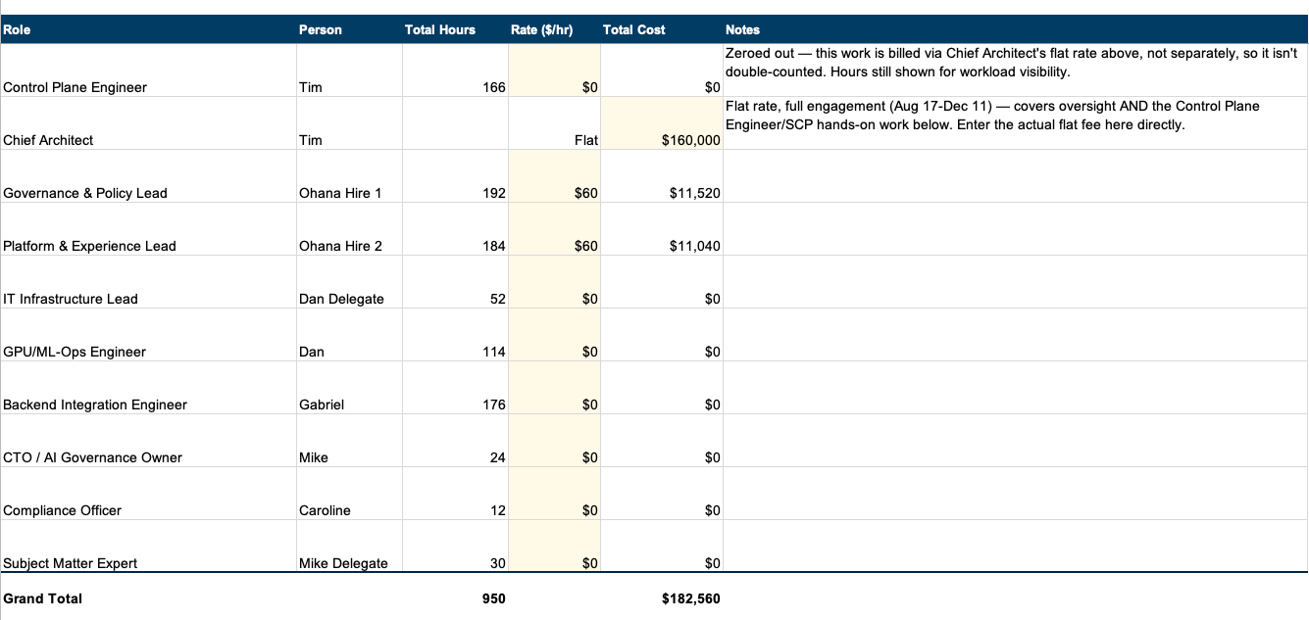
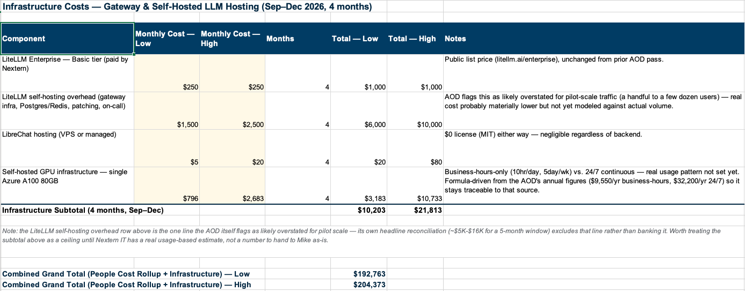
Costs
Labor
Infrastructure

Slide 21
Go deeper
This page is a summary. Full detail is available on request:
The 12-diagram architecture set (C4 + UML), architecture/docs/
Full Architecture Overview Document (AOD) and its DRAFT HTML rendering
Architecture Decision Records (ADR-0001 through ADR-0003), architecture/decisions/
Full ROI models and the original board-approved ROI deck (v7), ROI/
POC demo materials: VM deployment plan, Act 1/Act 2 demo scripts, audit-checklist mapping, docs/demo/
Vendor governance comparison (Claude, Gemini, ChatGPT, IBM Bob) — the working backdrop for evaluating any new vendor claim
18

