Slide 1
https://www.youtube.com/watch?v=yxMzAw2Sg5w
XR Plug-in Management
Install XR Plug-in Management
Plug-in Providers : OpenXR
[YES] to new Input System
Click [Warning Symbol] and click interaction profiles for Open XR
OpenXR
Add Interaction Profiles
Render Mode : Multi Pass
Install XR Interaction Toolkit
Package manager activate preview
Click [I Made a Backup]
Add Samples : Default Input Actions

Slide 2
Install Action Based Presets
In Preset Manager you should have 5 presets
Add right and left to the filters for left and right controllers
Add XR Origin (Action-Based)! It is the FULL SETUP CONTROLLER
Add Input Action Manager Component and drag XRI Default Input Actions

Slide 3
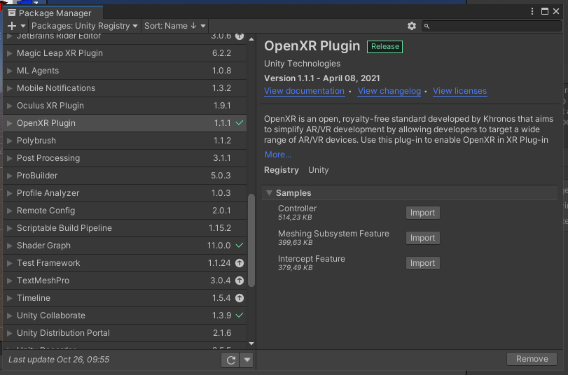

Slide 4
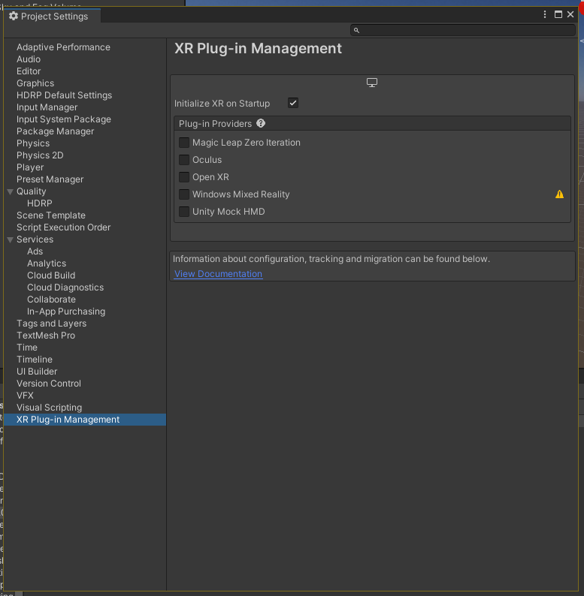
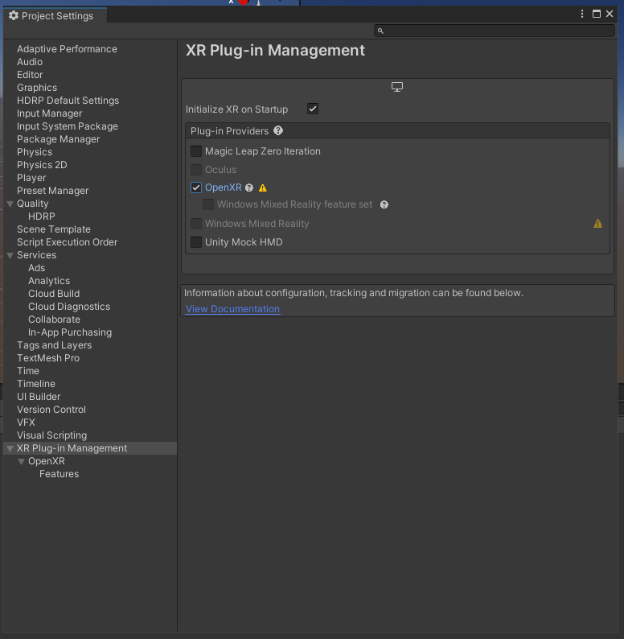

Slide 5
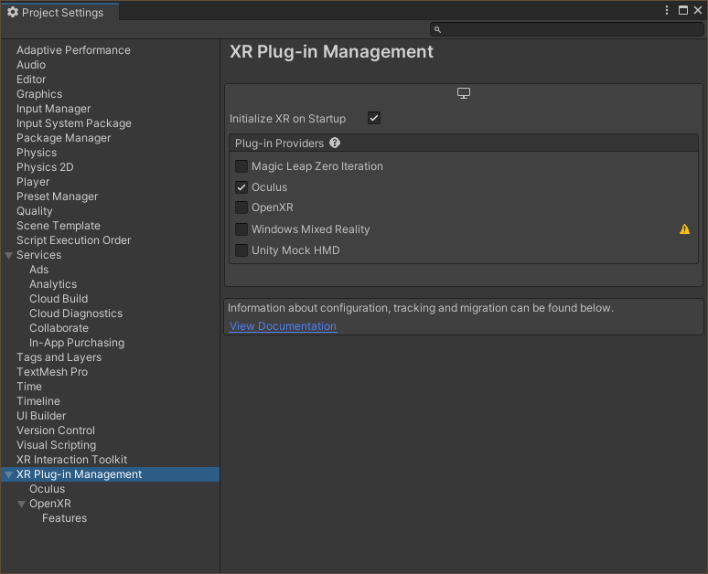

Slide 6
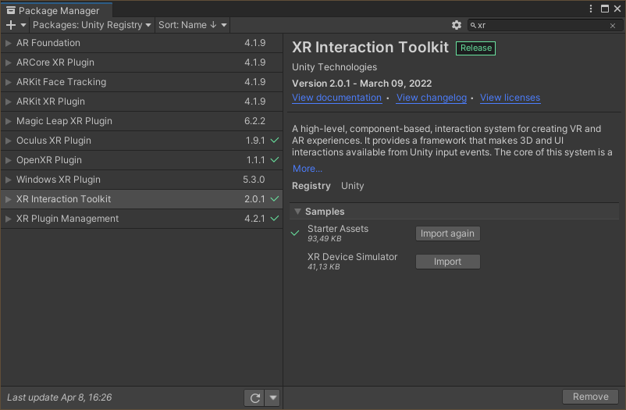

Slide 7
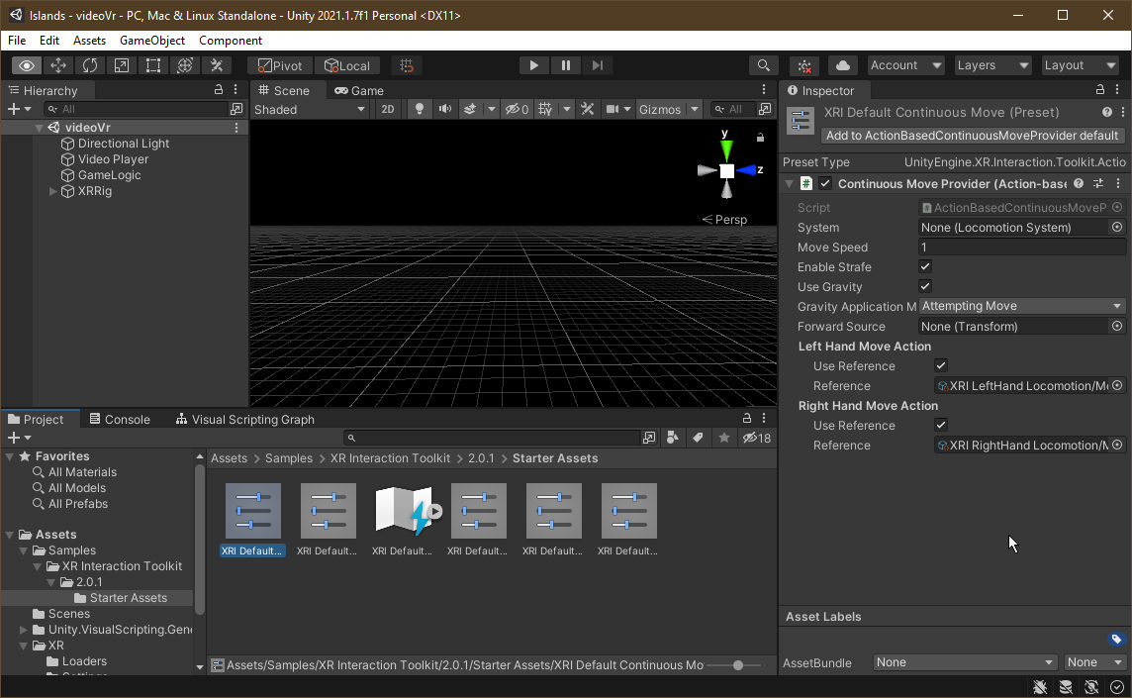
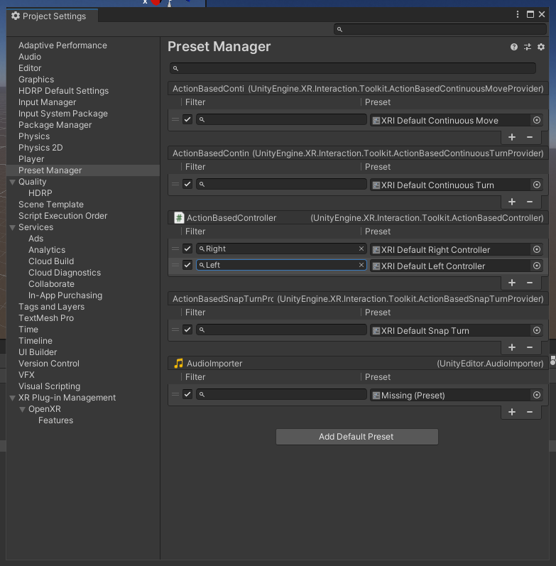
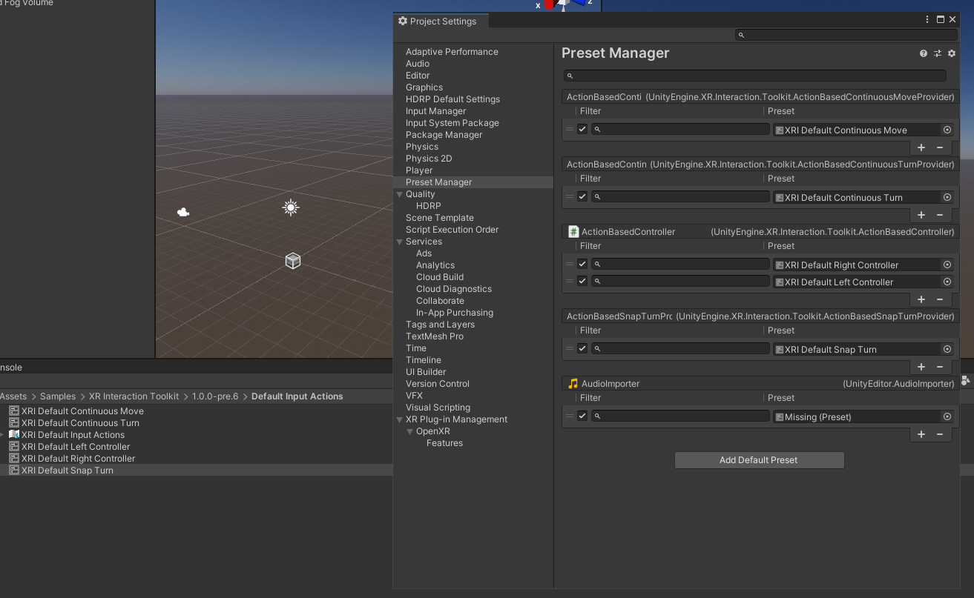

Slide 8
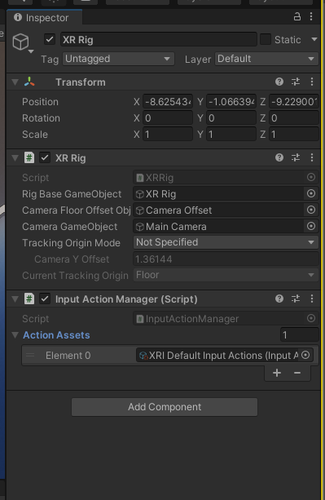
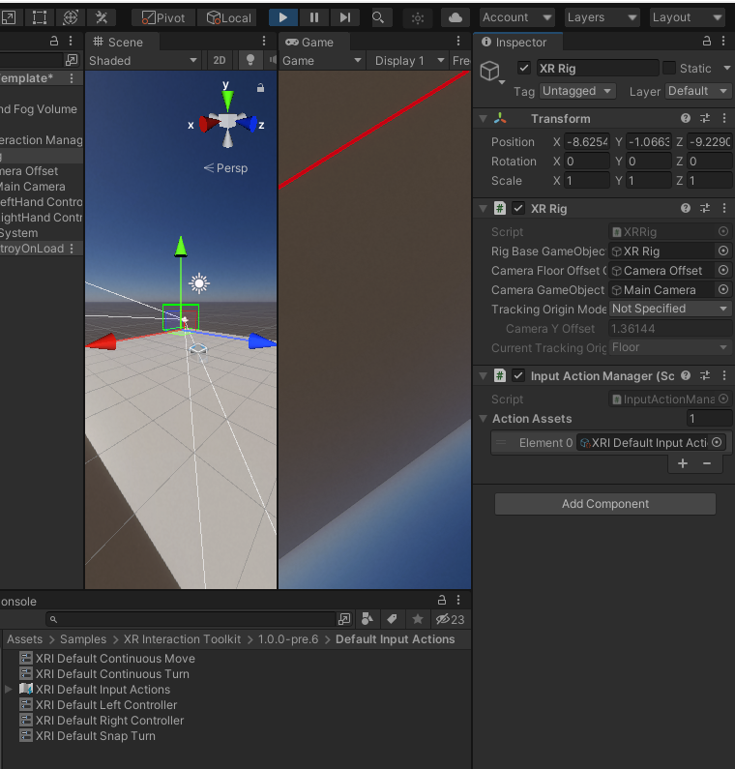

Slide 9
