Slide 1




Masaryk Univ.
한국어
^{7th} week
Korean 2

Slide 2






To Do
Week 7
01
Quiz – Review / Watching video
02
Learn Korean – week 6
03
Conversation & Exercise
04
Coined word

Slide 3



Quiz – Review of last class
Read QR code or access “Kahoot.it” and insert the game pin

Slide 4
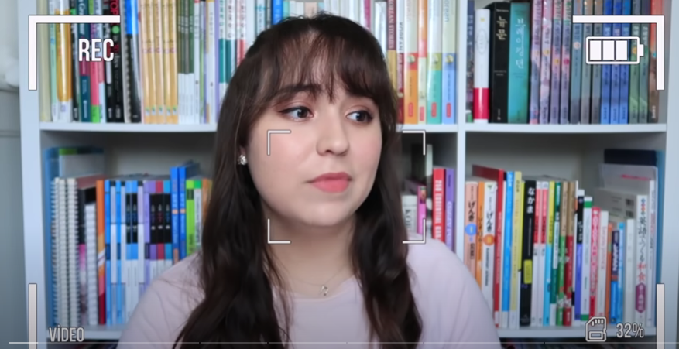
Watching Video

Slide 5


01
Pronouns
English has an extensive list of pronouns: I (me, my, mine), You (your, yours), he (him, his), she (her, hers), it (its), we (us, our, ours) and they (them, their, theirs).
Korean has its own list of pronouns as well, but its usage is much limited with different usage rules.
Generally speaking, pronouns are used much less in korean than in English.
In Korean, any contextually understood sentence elements ( including the subject and the object) are often omitted.

Slide 6
01
Pronouns
수영아 점심 먹을래?
-> (수영아) 점심 먹을래?
(Do you want to have lunch?)
현우야 오늘 학교에 갔었니?
-> (현우야) 오늘 학교에 갔었니?
(Did you go to school today?)

Slide 7
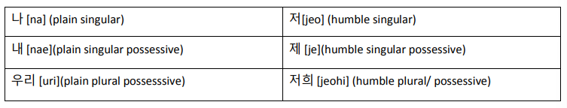
01
Pronouns (The First person Pronoun)

Slide 8

01
Pronouns (The First person Pronoun)
Example)
저는 오늘 파스타를 먹었습니다.
->(I ate pasta today.)

Slide 9

01
Pronouns (The First person Pronoun)
저희(우리) 형이 뉴욕에 있습니다.
-> Our(my) older brother is in New York.
제(내) 형이 뉴욕에 있습니다.
-> My older brother is in New York.
Actually, “저희” is for plural.

Slide 10
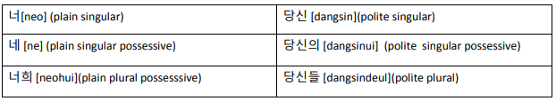
02
Pronouns (The second person Pronoun)
The use of Korean second person pronoun is much more limited than that of English.

Slide 11
02
Pronouns (The second person Pronoun)
Example)
“너”
-> a child, a childhood friend, one’s younger sibiling, one’s son/daugther and so forth.
“당신”
-> mostly used between spouses.

Slide 12
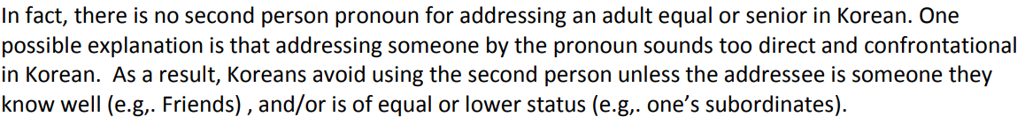
02
Pronouns (The second person Pronoun)
Then, How Koreans actually address someone?

Slide 13
02
Pronouns (The second person Pronoun)
If unavoidable, the best alternative is to use addressee terms as second person pronouns.
Korean has many ways to address someone.
When using an address term, a speaker has to know the addressee’s social status as well as the relationship with the speaker him/herself.

Slide 14
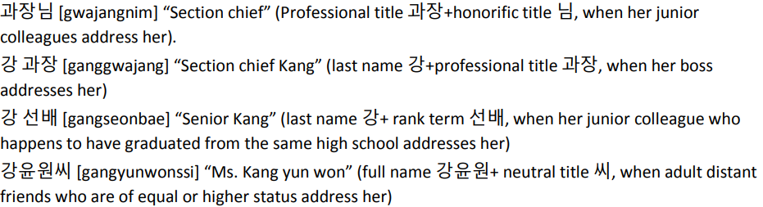
02
Pronouns (The second person Pronoun)
A businesswomen ‘강윤원’ can be addressed in her work place at least in the following ways:

Slide 15
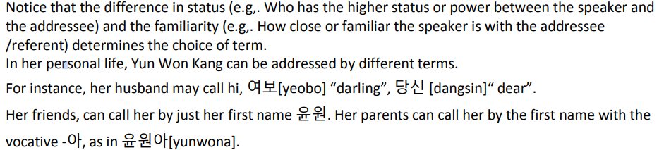
02
Pronouns (The second person Pronoun)
You can address someone in store or restaurant by saying
“여기요(저기요)”, ＂실례합니다.”
“here(hello)”, “excuse me”

Slide 16
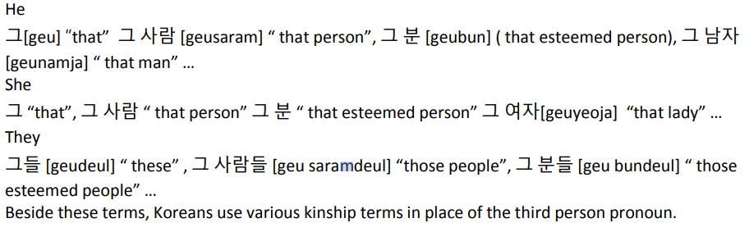
03
Pronouns (The third person Pronoun)

Slide 17
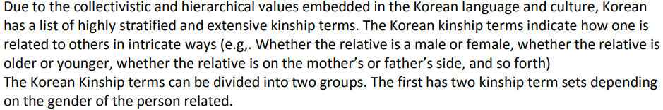
04
Pronouns (Kinship terms)

Slide 18
04
Pronouns (Kinship terms)
Please look at the print.

Slide 19
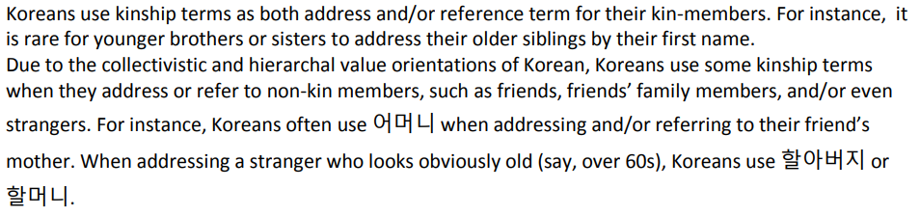
04
Pronouns (Kinship terms)

Slide 20
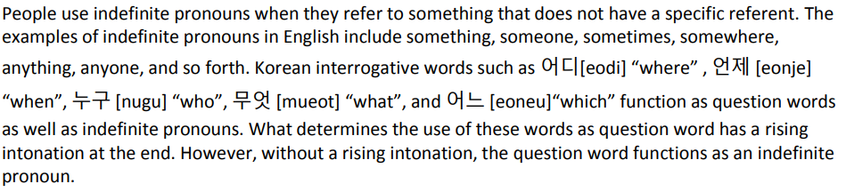
05
Indefinite pronouns

Slide 21
05
Indefinite pronouns
Example)
As a question word : “누가 와요?”(with a rising intonation)
->”Who is coming?”
As an indefinite pronoun : “누가 와요.”(with a falling intonation)
->”Someone is coming.”

Slide 22
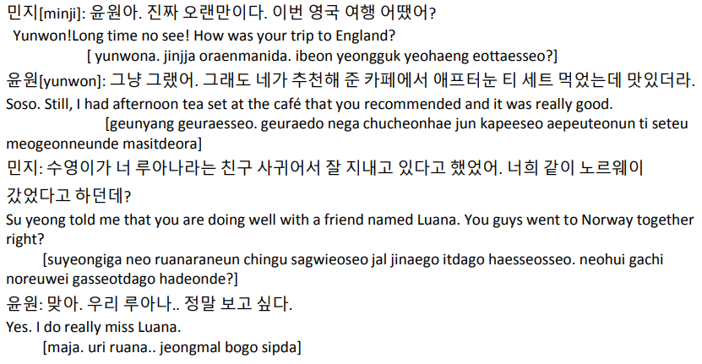
01
Conversation A

Slide 23
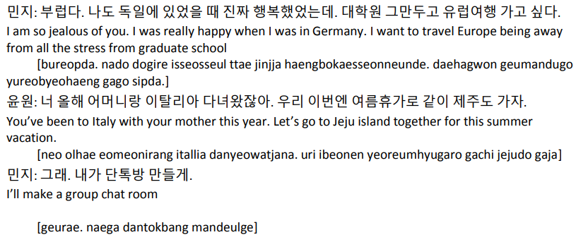
01
Conversation A

Slide 24
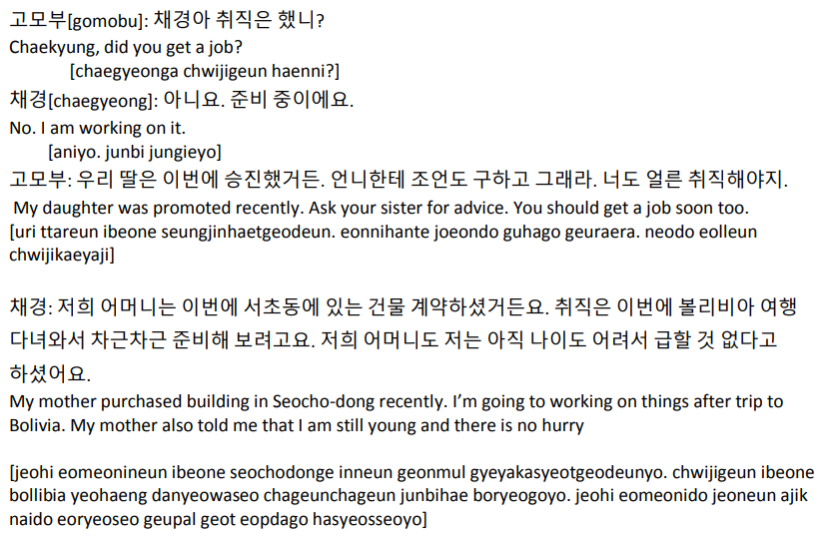
02
Conversation B

Slide 25

03
Exercise
Choose the appropriate first person pronoun for each situation:
1. A brother talking to his younger brother (나, 저)
2. A student talking to her/his teacher (나, 저)
3. A boss talking to her/his employees (in public speaking) (나, 저 )
4. Employees talking to their boss (우리, 저희)
5. Teenagers talking to their peers (우리, 저희)

Slide 26
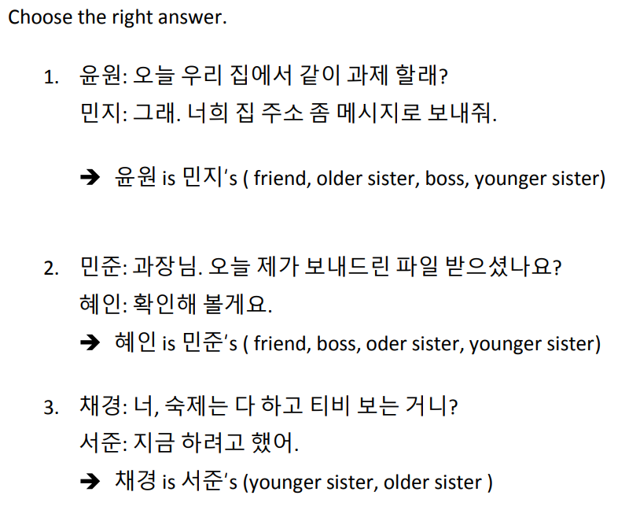
03
Exercise
Yoon-won: Do you want to do homework together at my house today? Min-ji: Okay. Send me your home address by message.
MJ: Manager, did you receive the file I sent you today? Hye-in: Let me check.
Chae-kyung: Are you watching TV after finishing your homework? SJ: I was going to do it now.

Slide 27
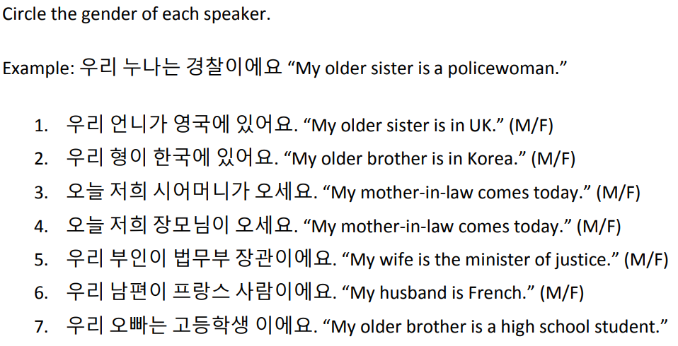
03
Exercise
(M/F)

Slide 28
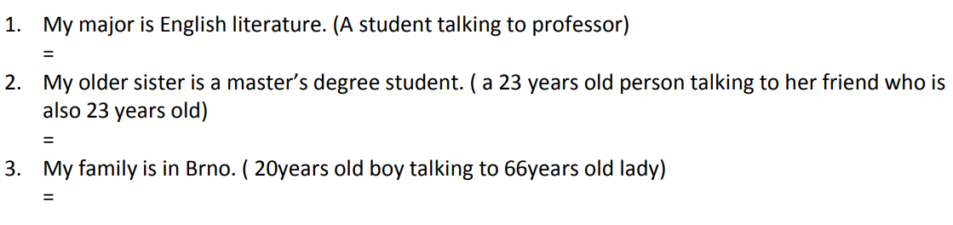
03
Exercise
Translate the following into Korean.
제 전공은 영문학 입니다./이에요.
우리 언니는 석사생 이야/대학원생 이야.
제 가족은 브루노에 있어요./있습니다.

Slide 29

04
Coined Word
뽀시래기

Slide 30
04
Coined Word
뽀시래기
“Bbosiraegi” is from dialect “부스러기(Bushuragi)” which is used to call powder.
(For example bread crumbs, flocks, fragments...)
So it's a kind of slang which means something looks a little fooslish and trivial but that foolishment looks veeery cute and lovely.

Slide 31
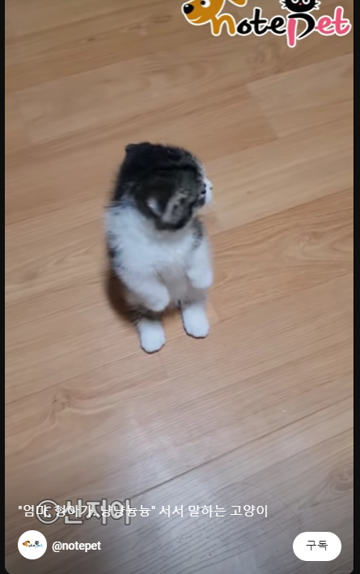
04
Coined Word
Shorts Title mean
"Mom, my brother..."
A cat with something to say.

