Slide 1
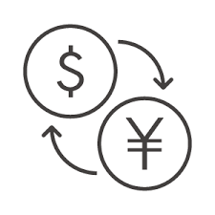

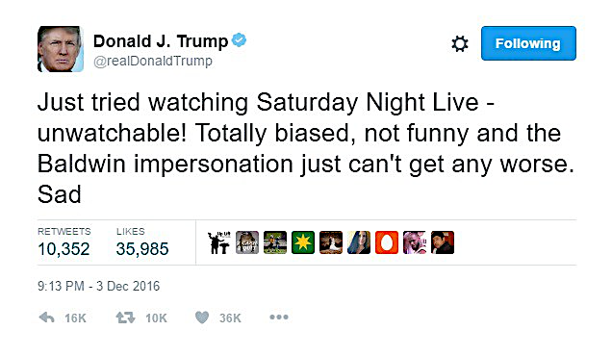
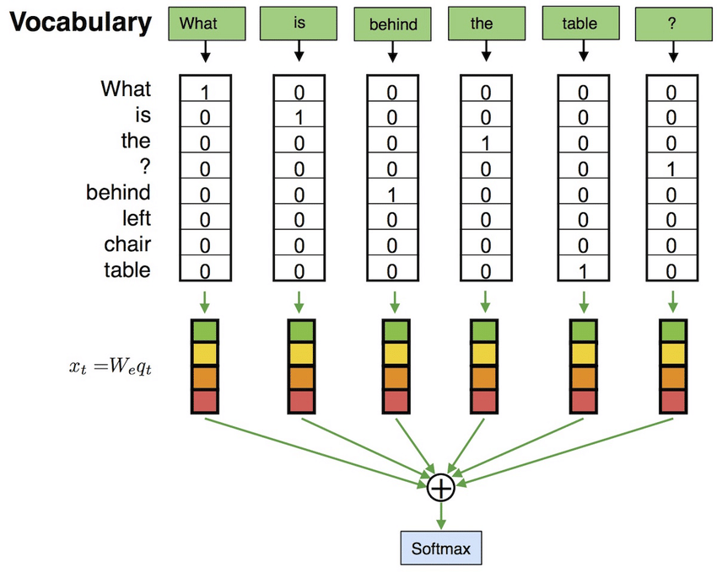

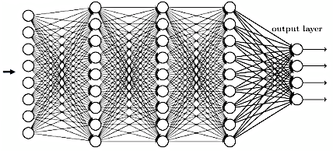
FX Deep Leaning with NLP(Trump Tweet)
Global Software : 2017315051
Munesato Tanaka
President of the United States
Important FX nouns(bag of words)
Words related to FX
Web scraping
Text mining (pos +1, neg -1)
➕
LSTM
LSTM(maxLen5) -t(MA5)→t(MA5)→+t(MA5)
MA5 = 5days moving average
Open | High | Low | Close
108.76 | 108.21 | 107.90 | 107.99
Time Column Data
Accuracy : 81 %

