Slide 1
COMP3121 Social and Collaborative Computing
Dan Wang
Department of Computing,
The Hong Kong Polytechnic University

Slide 2
Two key elements
People & Network
If there are people, there will be network
The Hong Kong Polytechnic University

Slide 3
People and Network
費孝通先生（1947,1985: 23）：源與眾
（中國人的社會關系）好像是把一塊石頭丟在水面上所發生的一圈圈推出去的波紋。每個人，都是他社會影響所推出去的圈子的中心，被圈子的波紋做推及的，就發生聯系。每個人在某一時間某一地點所動用的圈子是不一定相同的
林南先生（2004:37）：網絡
一個特定的網絡可以自然地形成，也可以有對一個特定的共同關註的焦點或關註一種資源利益的社會性建構
The Hong Kong Polytechnic University

Slide 4
In Nature
There are also networks in nature
C. S. Elton (1927), different species: prey and predators also form a network, they form a food chain (大魚吃小魚，小魚吃蝦米)
A material network: the water system: from surface to stream to river to lake, to evaporation, to rain (precipitation)
The Hong Kong Polytechnic University

Slide 5
All kinds of network
The Hong Kong Polytechnic University

Slide 6
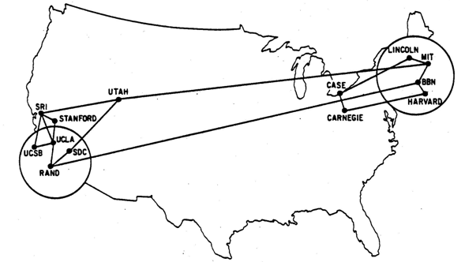
Arpanet (1979, 13 nodes)
The Hong Kong Polytechnic University

Slide 7
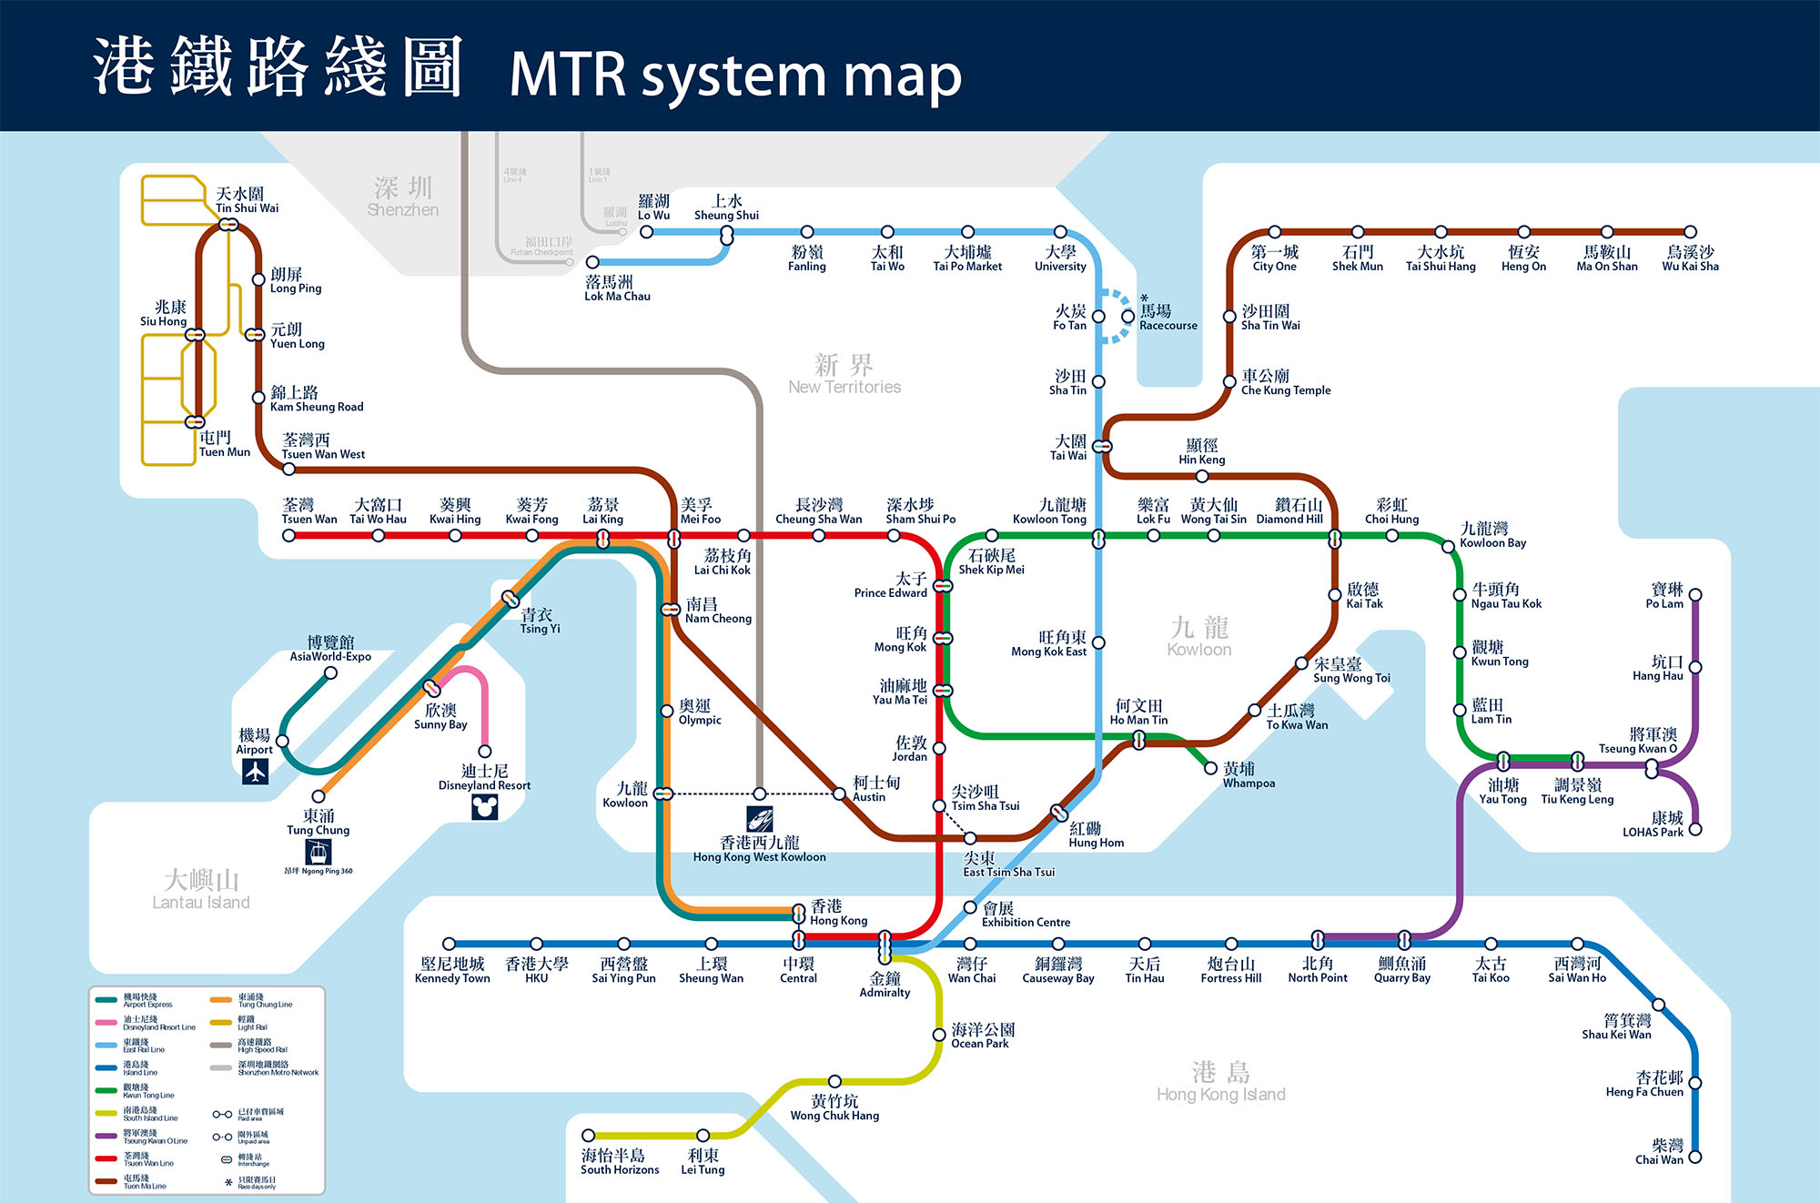
Hong Kong MTR
The Hong Kong Polytechnic University

Slide 8
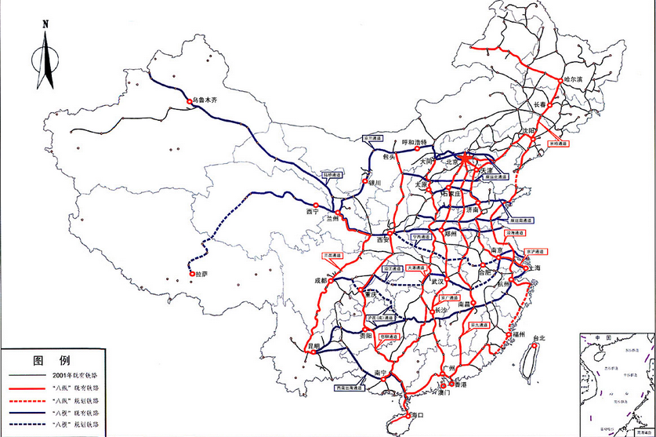
China Railways
The Hong Kong Polytechnic University

Slide 9
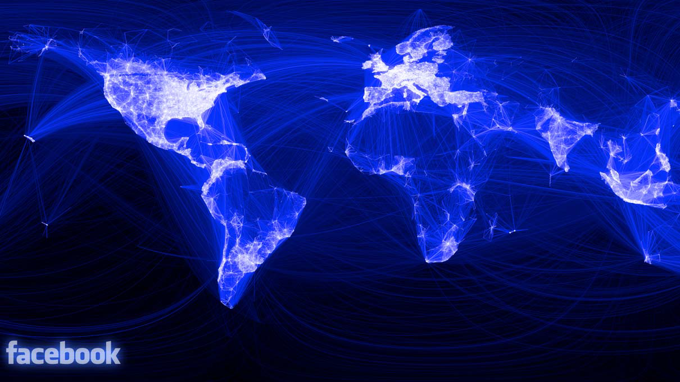
Facebook users
The Hong Kong Polytechnic University

Slide 10
All kinds of networks
Transportation, Postal services, Telecommunication, Internet, WWW
Social networks, Finance networks
Wireless, Smart Grids, Sensor networks
Neural network, food chain
…
Weibo, QQ
The Hong Kong Polytechnic University

Slide 11
The dependency of networks
Internet – physical, technical dependency
WWW – information dependency
Weibo – online social dependency
Social network – in old time, the dependency comes from geography. That is, geographically closer people have higher chances to build a social network in ancient times.
The Hong Kong Polytechnic University

Slide 12
The impact of ICT
Information and computing technology makes the network improves substantially
The scale becomes larger, the domain becomes wider
New forms of networks show up, e.g., network of common interest, one-to-one communication, one-to-many communication, etc.
There are richer and more complex networks
The Hong Kong Polytechnic University

Slide 13
ICT creates more opportunities
Transportation: expedia, ctrip
Social network: QQ, WeChat
Finance: BoC, Paypal, Taobao
Big data: uber
The Hong Kong Polytechnic University

Slide 14
ICT creates more opportunities
ICT makes it possible to analyze the structure and evolution of large scale network
Paradata – the behavior trace can be (or are) all recorded
They form big data
The Hong Kong Polytechnic University

Slide 15
ICT creates more opportunities
The development of storage and processing capabilities by ICT
In the past, with social sciences, only ~100 nodes can be processed
Now we are capable to process 100 million nodes
The Hong Kong Polytechnic University

Slide 16
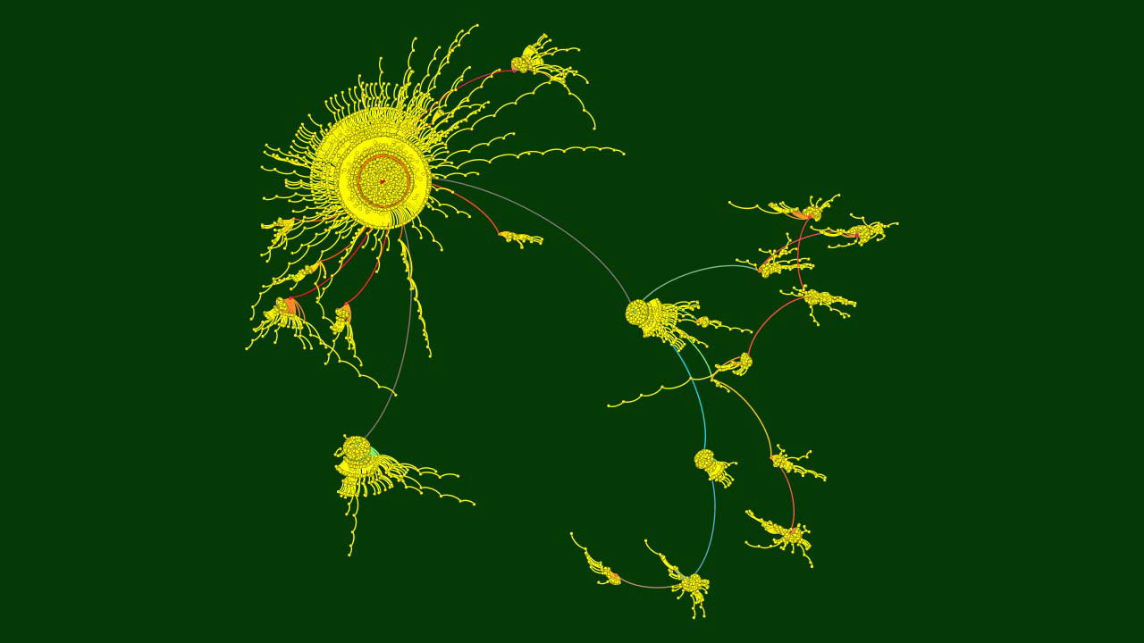
Weibo, Jingming Guo 郭敬明
The retransmission of the topic: movie: tiny times/小時代, 100,000 nodes/weibo
The Hong Kong Polytechnic University

Slide 17
A summary
Network is not a phenomenon today. In both nature and in human society, it forms long ago
As long as there are people, there are network
Network is everywhere and in many forms
ICT creates new meanings and opportunities
Richer and more complex networks
Better processing capability of networks
The Hong Kong Polytechnic University

Slide 18
Network and Graph
The Hong Kong Polytechnic University

Slide 19
Graph
When we think about a network, we think about:
Object + Connection/Relationship
Node, also called vertex
Link, also called edge
The Hong Kong Polytechnic University

Slide 20

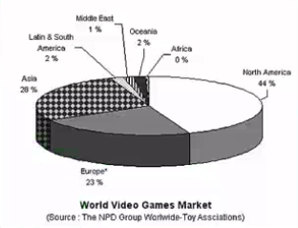
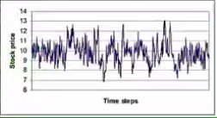
Graph?
The Hong Kong Polytechnic University

Slide 21
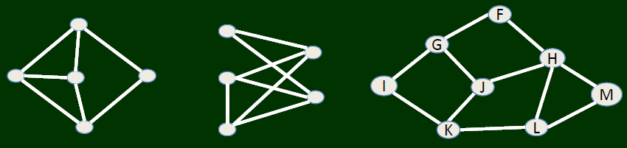
Graph = object + connection
With nodes and links
The Hong Kong Polytechnic University

Slide 22
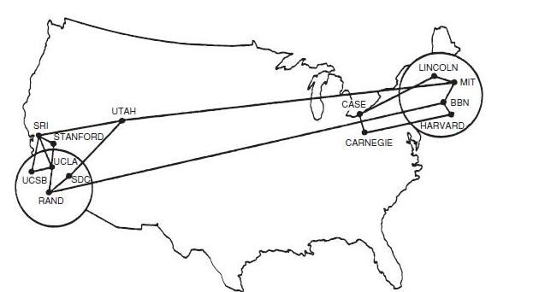
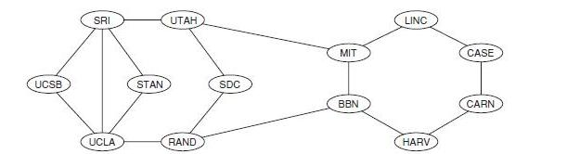
Graph
The Hong Kong Polytechnic University

Slide 23
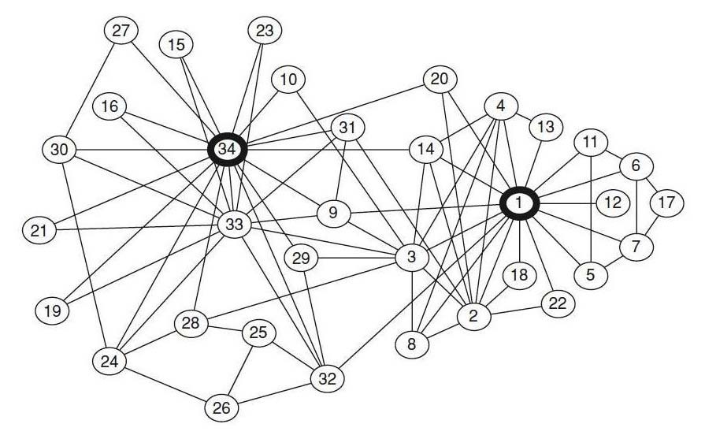
Graph
1 is coach, 34 founder
The Hong Kong Polytechnic University

Slide 24
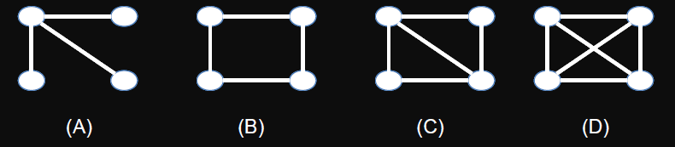
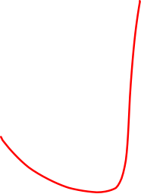
Question
In a class, there are four students, A, B, C, D. A is a friend of B and C. B is a friend of A and a friend of C and D. C and D are also friends.
Which of the following graph describes such relationship
The Hong Kong Polytechnic University

Slide 25
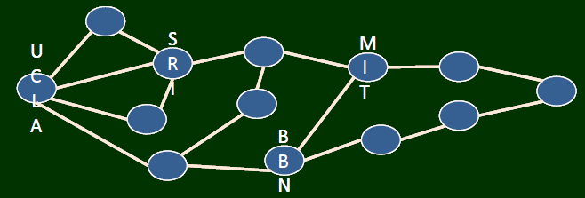
Graph
The Hong Kong Polytechnic University

Slide 26
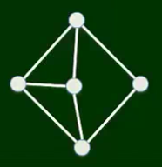
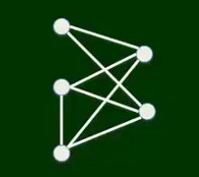
Graph
The Hong Kong Polytechnic University

Slide 27
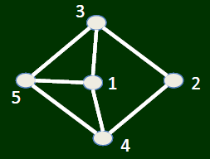
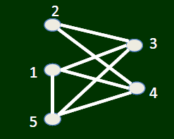
Graph
Labeling
The intrinsic structure of the two graphs are the same, only presented in different drawing
In graph theory terminology: Isomorphism
The Hong Kong Polytechnic University

Slide 28
A summary
Graph is an abstract of network information; it describe the relationship of nodes in the network
We emphasize on Graph, NOT Image/figure, Nodes (Objects) + Links (Connection)
One graph can have many different ways in drawing
The Hong Kong Polytechnic University

