Slide 1
COMP3121: Social and Collaborative Computing
Dan Wang
Department of Computing,
The Hong Kong Polytechnic University

Slide 2
Path, Connected Graph, Connected Component
The Hong Kong Polytechnic University

Slide 3
Path, Shortest path, Distance
How to describe indirect relationship between two people?
The Hong Kong Polytechnic University

Slide 4
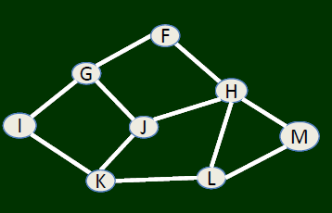
Path, Shortest path, Distance
A path is simply a sequence of nodes with the property that each consecutive pair in the sequence is connected by an edge
The path between F and L
F-H-J-K-L,
F-H-L
F-G-J-K-L,
F-H-J-G-I-K-L
Shortest path: F-H-L
Distance: 2
The Hong Kong Polytechnic University

Slide 5
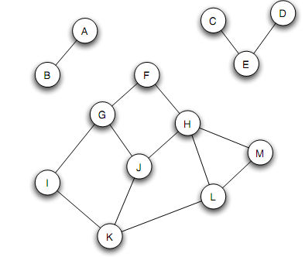
Connected graph, Connected Component
Nodes are connected
If there is a path between them
Connected component
Every node in the subset has a path to every other
The subset is not part of some larger set with the property that every node can reach every other
The Hong Kong Polytechnic University

Slide 6
A summary
Path is one of the most important concepts in graph theory; we can study the interaction of two non-neighboring nodes
Connected component emphasizes on its “maximal” property; this makes it possible for us to more accurately discuss problems
The Hong Kong Polytechnic University

Slide 7
Bipartite graph
Gentleman 1
Lady 1
Gentleman 2
Lady 2
Gentleman 3
Lady 3
Student 1
University 1
Student 2
University 2
Student 3
The Hong Kong Polytechnic University

Slide 8
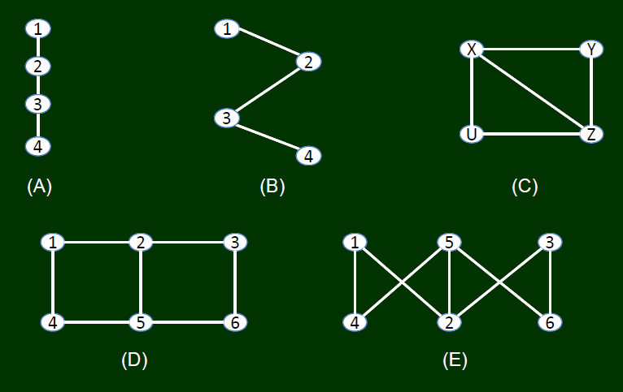
Bipartite graph
The Hong Kong Polytechnic University

Slide 9
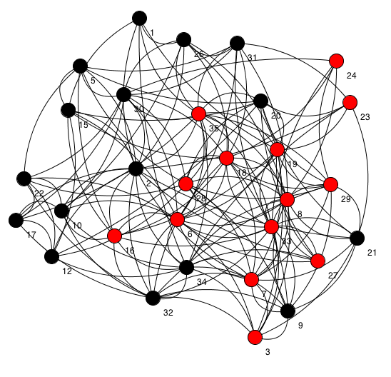
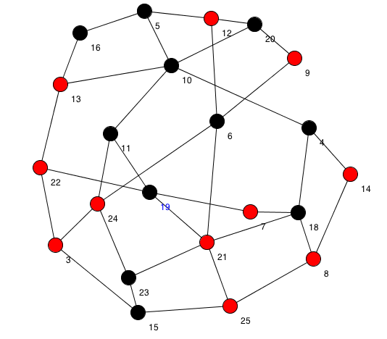


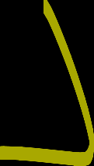
How to decide if it is bipartite graph?
The Hong Kong Polytechnic University

Slide 10
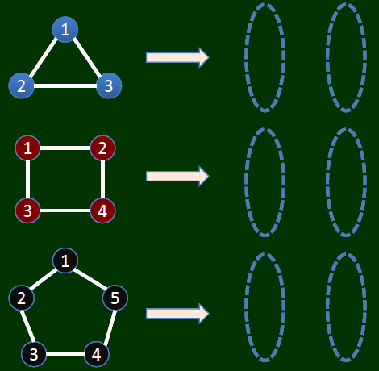
Bipartite graph
The Hong Kong Polytechnic University

Slide 11
Bipartite graph
It does not contain cycle with an odd number of nodes
The Hong Kong Polytechnic University

Slide 12
Bipartite graph
How to judge whether there is a cycle of odd number of nodes or not?
The Hong Kong Polytechnic University

Slide 13
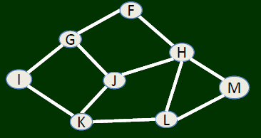
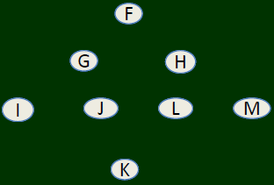
Breadth first search (Computer Science)
Starting from any node, enumerate all the nodes one by one following links (algorithm)
The Hong Kong Polytechnic University

Slide 14
Breadth first search
Starting from any node, use breadth first search. If you can find two nodes from the same layer having links, there must be a cycle of odd number of nodes
The Hong Kong Polytechnic University

Slide 15
A summary
We have learned some basics (definitions) of graph
Graph elements, node, link
Path, connected graph, connected component
We learned some basic modeling of the real world relationship into graphs (e.g., student relationship)
We also learned some problem solving skills (develop an algorithm, i.e., breadth first search)
Search from one node to another
The Hong Kong Polytechnic University

Slide 16
The general study methodologies
We will gradually study more properties of the nodes, links, graphs
We will gradually study how real world problems can be transformed into graphs (with properties)
We will study how to do inference from the properties (and finally solve problems)
The Hong Kong Polytechnic University

Slide 17
Clustering Coefficient
The Hong Kong Polytechnic University

Slide 18
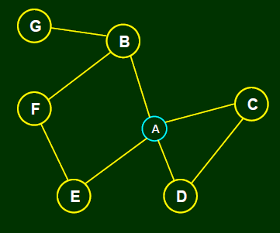
How to describe the property of a node?
For example, the importance of certain node
The Hong Kong Polytechnic University

Slide 19
The property of a node
Clustering coefficient of A = the probability of any two nodes who are neighbors of A are also neighbors = the friend-pairs of A / total pairs
The Hong Kong Polytechnic University

Slide 20
The property of a node
Clustering coefficient of A = the probability of any two nodes who are neighbors of A are also neighbors = the friend-pairs of A / total pairs
Pairs = {BC, BD,
BE, CD, CE, DE}
Friend pairs = {CD}
The clustering coefficient of
A is 1/6
The Hong Kong Polytechnic University

Slide 21
The property of a node
The interpretation of cluster coefficient, from social science point of view, is how coerce this person can be
The Hong Kong Polytechnic University

Slide 22
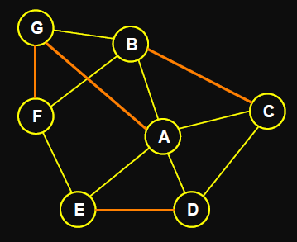
Question
What is A’s clustering coefficient?
The Hong Kong Polytechnic University

Slide 23
Triadic Closure
The Hong Kong Polytechnic University

Slide 24
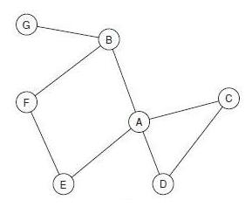
An angle to look
Consider not only a snapshot, but evolution
time
The Hong Kong Polytechnic University

Slide 25
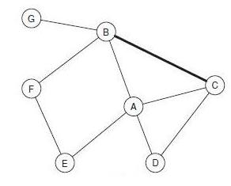
An angle to look
Consider not only a snapshot, but evolution
time
The Hong Kong Polytechnic University

Slide 26
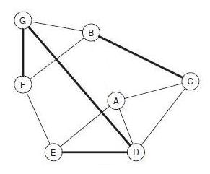
An angle to look
Consider not only a snapshot, but evolution
time
The Hong Kong Polytechnic University

Slide 27
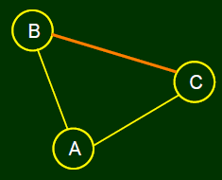
Triadic Closure
The possible reasoning from sociology: Anatole Rapoport, 1953
Triadic closure: if two people, who originally don’t know each other, have a common friend, they have an increasing chance to get to know each other
Opportunity
Trust of common friends，e.g.，宋江 / 水滸傳
Incentive
林南: 2004
A network can form by natural
Or formed by common interest
The Hong Kong Polytechnic University

Slide 28
A summary
In a graph, node in certain location can have different properties
Clustering coefficient is one way to describe this
The relationship between nodes can change along time
One structural mechanism, i.e., if there are two links among three nodes, it is likely to spin off another link
The Hong Kong Polytechnic University

Slide 29
A summary
In a graph, node in certain location can have different properties
Clustering coefficient is one way to describe this
The relationship between nodes can change along time
One structural mechanism, i.e., if there are two links among three nodes, it is likely to spin off another link
Really? Can we verify this, i.e., triadic closure?
The Hong Kong Polytechnic University

Slide 30
Triadic Closure Verification
using Big Data
The Hong Kong Polytechnic University

Slide 31
Two problems
Transforming triadic closure from qualitative statement to quantitative statement
Find an appropriate data set to verify
The Hong Kong Polytechnic University

Slide 32
Two Statements of Triadic Closure
Original statement
If two people in a social network have a friend in common, then there is an increased likelihood that they will become friends themselves at some point in the future
Can be transformed to:
If there is greater number of common friends of two people, who originally don’t know each other, then there is greater probability that they will become a friend.
The Hong Kong Polytechnic University

Slide 33
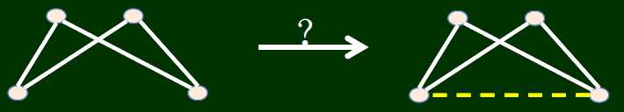
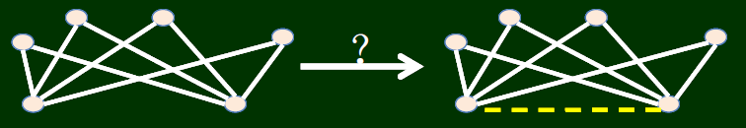
Triadic closure: which one is more likely?
now after some time
The Hong Kong Polytechnic University

Slide 34
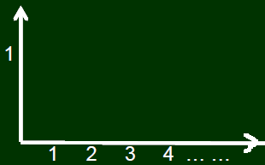
Transformed statement
If there is greater number of common friends of two people, who originally don’t know each other, then there is greater probability that they will become a friend.
Probability to be friends
The number of friends
The Hong Kong Polytechnic University

Slide 35
How to verify?
Email network ～ social network
The emails of the 20,000 students in a university
Only cares of who emailed who, do not need to care about the email contents
The Hong Kong Polytechnic University

Slide 36
How to measure such probability?
Assume there are 100 node pairs, and there are no links between them. Also assume that each pair of them have 5 common friends.
If, in a month, 20 node pairs have communications, we say that the probability that two people who do not know each other become friends is 20%.
The Hong Kong Polytechnic University

Slide 37
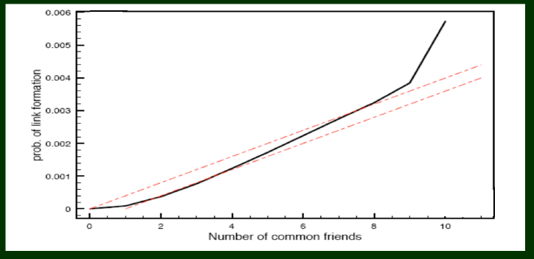
How to measure such probability?
“Empirical Analysis of an evolving social network,” Science 2006
The Hong Kong Polytechnic University

Slide 38
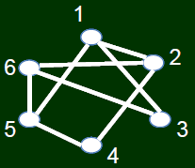
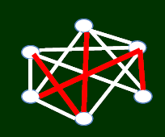
How to measure such probability?
at different time
The Hong Kong Polytechnic University

Slide 39

How to measure such probability?
at different time
The Hong Kong Polytechnic University

Slide 40
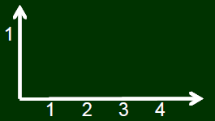
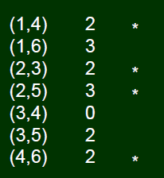
How to measure such probability?
at different time
Common friends | 0 | 1 | 2 | 3 | 4
Probability to become friends | 0 | - | 0.75 | 0.5 | -
The Hong Kong Polytechnic University

Slide 41
A summary
We have studied the property of nodes
The social interpretation of the properties of nodes and links
The relationship of nodes changes along time
Triadic closure and its validation through big data
From social principles → qualitative description → quantitative description
Find appropriate data sets, and a systematic verification process
The Hong Kong Polytechnic University

Slide 42
Review:
This considered whether links will be formed between nodes along time.
We discuss more on node and also link properties
At one point of time
After some time
time
The Hong Kong Polytechnic University

Slide 43
Structural Holes
The Hong Kong Polytechnic University

Slide 44
Review: clustering coefficient
Clustering coefficient of A = the probability of any two neighboring nodes of A are friends
The Hong Kong Polytechnic University

Slide 45
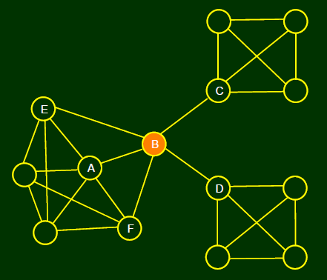
Structural hole
Another way to describe the property of a node
The node, after removing of which, makes the network become multiple connected components
See B
The Hong Kong Polytechnic University

Slide 46
The interpretation of structural hole
B has early access to information originating in multiple, non-interacting parts of the network
Standing at one end of a “bridging link” can amplify its influence
Social “gate-keeping”, it regulates the access of both C and D
The less redundancy, the more social capital it has
The Hong Kong Polytechnic University

Slide 47
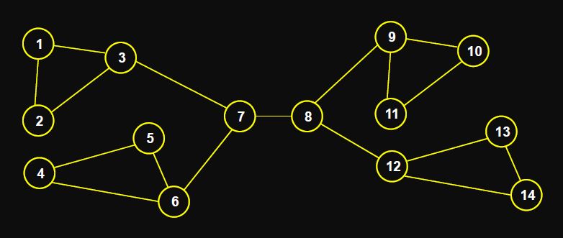
Question: Which are structural holes?
The Hong Kong Polytechnic University

Slide 48
Embeddedness
The Hong Kong Polytechnic University

Slide 49
Embeddedness
The concept
Karl Polanyi (1944) first proposed in “The Great Transformation”, behavior is embedded in the social structure
Granovetter (1985) proposed the relationship between economic behavior and social structure. He proposed that economic behavior is embedded in social structure, and is one kind of social behavior
Embeddedness was introduced to analyze network structure
The Hong Kong Polytechnic University

Slide 50
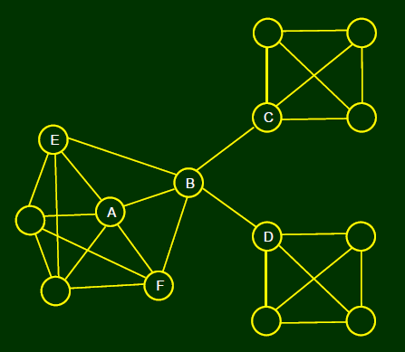
Embeddedness: the property of links
Embeddedness
The common neighbors of a link
Common neighbors of link (A, B), are E and F
The embeddedness of (A, B) is 2
From a social point of view
The higher the embeddedness, the higher the trust between the two
The higher the embeddedness, the more the social capital
The Hong Kong Polytechnic University

Slide 51
A summary
We studied more properties of a graph
For a node, we can not only use clustering coefficient, but also structural hole to evaluate it
Embeddedness can be one property of a link
The Hong Kong Polytechnic University

Slide 52
Strong tie, Weak tie
The Hong Kong Polytechnic University

Slide 53
Passive engagement
How many contacts do you use in you phone book?
Triadic closure indicate that, along with time
People may be passively engaged into a network
The study of Twitter by Huberman et al. 2009, even that people have over 500 friends, the active contacts are 10 – 20 and passive contacts are usually less than 50
The property of links are thus very important
The Hong Kong Polytechnic University

Slide 54
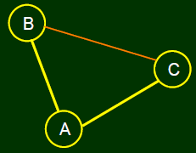
The property of a link
At the time that B, C construct a link
The closeness of (B, C) should not be the same as (A, B), (A, C)
How to describe this formally?
Granovetter (1973) propose:
Strong – Weak
This is a simple 0-1 description.
We can investigate more
The Hong Kong Polytechnic University

Slide 55
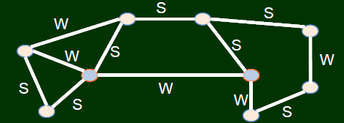
Strong tie and weak tie vs. Triadic Closure
Assume people can name whether its connection with another node is strong or weak
From triadic closure, if (A, B), (A, C) have strong ties, it is unlikely that B and C has no relationship at all
The Hong Kong Polytechnic University

Slide 56
The Strong Triadic Closure Property
If a node A has edges to nodes B and C, then the (B, C) edge is especially likely to form if A's edges to B and C are both strong ties.
Or Granovetter suggested a more formal version
We say that a node A violates the Strong Triadic Closure Property if it has strong ties to two other nodes B and C, and there is no edge at all (either a strong or weak tie) between B and C. We say that a node A satisfies the Strong Triadic Closure Property if it does not violate it.
The Hong Kong Polytechnic University

Slide 57
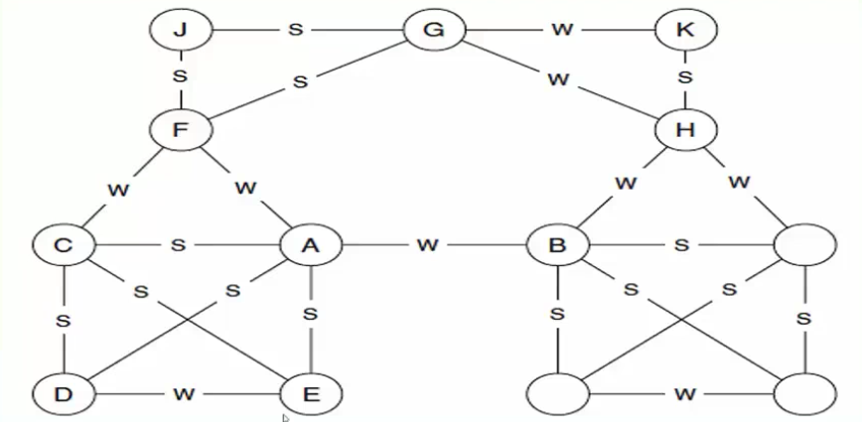
Which node violates the strong triadic closure property?
The Hong Kong Polytechnic University

Slide 58
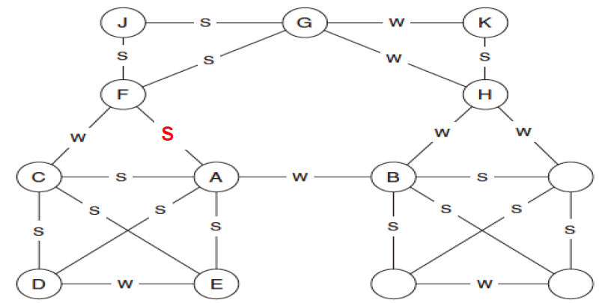
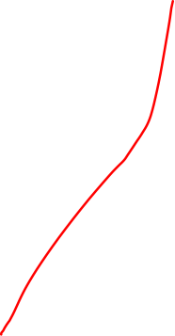
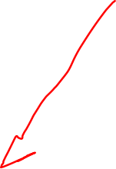
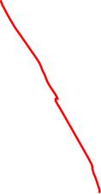


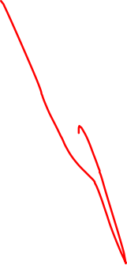

Which node violates the strong triadic closure property?
The Hong Kong Polytechnic University

Slide 59
Validation of strong triadic closure property from big data
The Hong Kong Polytechnic University

Slide 60
Validation of strong triadic closure property from big data
The spirit of strong triadic closure property:
No common friend → weak ties
Quantitative description: the more common friends, the higher the strength of the connection
i.e., we expect to see the strength of the connection is proportional to the number of common friends
Find appropriate data set
One example in book chapter 3.3
The Hong Kong Polytechnic University

Slide 61
Short cut
The Hong Kong Polytechnic University

Slide 62
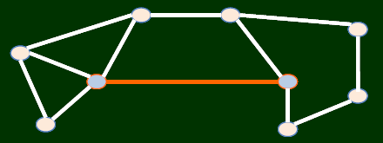
Short cuts
There are links connecting two nodes, without which will lead to a long distance (a distance of at least 3)
The Hong Kong Polytechnic University

Slide 63
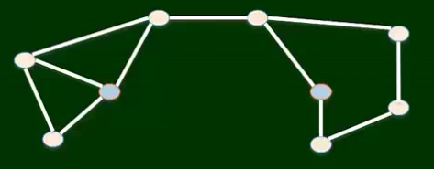
Short cuts
There are links connecting two nodes, without which will lead to a long distance (a distance of at least 3)
The Hong Kong Polytechnic University

Slide 64
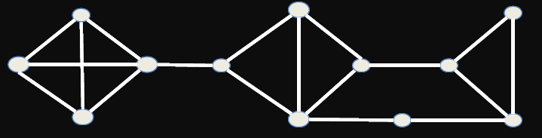
Question: bridge and short cut
Two important definitions in graph theory on special links
Bridge: after removal, the number of connected components increases
Short-cut:
Which links are short cuts? Which links are bridges?
The Hong Kong Polytechnic University

Slide 65
Bridge vs. weak ties
Theorem: If A conforms to strong triadic closure, and has two strong tie neighbors ➔
Then any bridge connecting to A must be weak tie.
proof: by contradiction:
assume bridge is strong
A connection between bridge of Graph Theory from Math with Weak ties from Sociology
The Hong Kong Polytechnic University

Slide 66
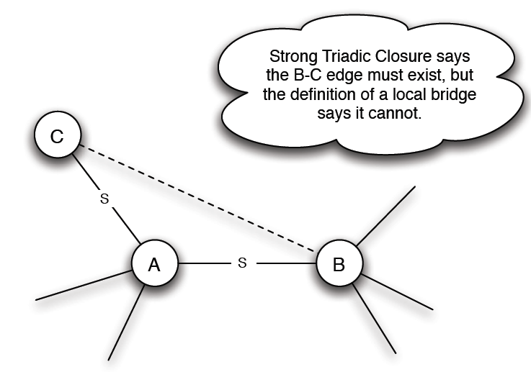
Bridge vs. weak ties
Theorem: If A conforms to strong triadic closure, and has two strong tie neighbors ➔
Then any bridge connecting to A must be weak tie.
A connection between bridge of Graph Theory from Math with Weak ties from Sociology
The Hong Kong Polytechnic University

Slide 67
A Summary
We studied properties in graph theory, and sociology
We saw different properties can be linked together, i.e., from one property to another property
We studied from social science problems → abstract into graph and → study its properties (with new definitions) → validation from big data
This is a procedure you need to learn and practice
The Hong Kong Polytechnic University

