Slide 1
COMP3121: Social and Collaborative Computing
Dan Wang
Department of Computing,
The Hong Kong Polytechnic University

Slide 2
Homophily (同質性)
The Hong Kong Polytechnic University

Slide 3
Homophily
We focus on one property between nodes, homophily, and discuss many interesting problems related to it
A phenomenon and
What influence this phenomenon
What this phenomenon influences
The Hong Kong Polytechnic University

Slide 4
Homophily
Plato (柏拉圖): similarity begets friendship
Aristotle (亞裏士多德): love those who are like themselves
Proverbs: birds of a feather flock together
夫妻相，
物以類聚人以群分乎？近朱者赤近墨者黑乎？
The Hong Kong Polytechnic University

Slide 5
Lazarsfeld and Merton
Berger, et al. 1954. Freedom and Control in Modern Society
Society, people and individuals
State and society
Lazarsfeld and Merton (1954) distinguished
Status homophily: people with the same social status
Value homophily: people with the same value systems
The Hong Kong Polytechnic University

Slide 6
Miller McPherson, et al. 2001
“Birds of a feather”, introduces the mechanism of homophily
The basic ecological processes that link organizations, associations, cultural communities, social movements, and many other social forms;
The impact of multiplex ties on the patterns of homophily;
The dynamics of network change over time through which networks and other social entities co-evolve.
The Hong Kong Polytechnic University

Slide 7
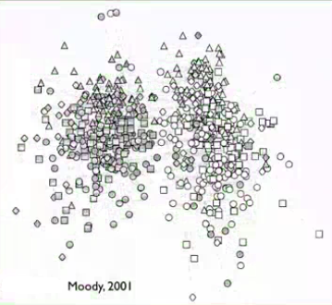
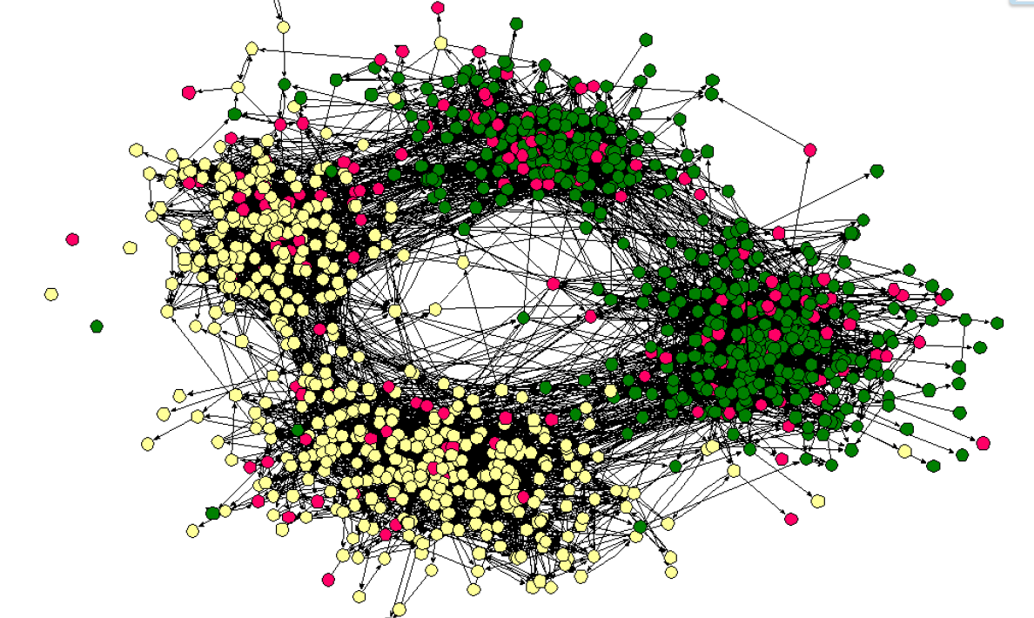
James Moody 2001
Friendship of high school students
Dark: Black, White: White
Circle: grade 9, Square: grade 10, Diamond: grade 11, Triangle: grade 12
The Hong Kong Polytechnic University

Slide 8
Homophily and Friendship
The Hong Kong Polytechnic University

Slide 9
Friendship
For an individual, he has two types of characteristics
Intrinsic: gender, race, mother tongue, etc
Changeable: where he lives, expertise, what he likes, etc
Homophily is the external reason for the creation of social networks
Common in race, locations, expertise, interests
One key question in social sciences
Commonality → friendship ? (selection)
Friendship → commonality ? (social influence)
The Hong Kong Polytechnic University

Slide 10
Discussion
Facts:
Hong Kong has a lot of universities
Students are coming from different high schools at different places (maybe around the worlds)
Assume a few students from the same high school enter HK PolyU
Discussion:
At the time these students graduate, what do their friendship (social structure) look like
The Hong Kong Polytechnic University

Slide 11
Measuring Homophily
The Hong Kong Polytechnic University

Slide 12
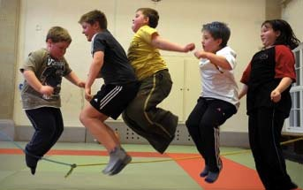
Homophily in social networks
Friend ~ Similar
The definition of similarity can be different in different problems
The Hong Kong Polytechnic University

Slide 13
How to measure the degree of similarity?
Given a social network where the nodes have only two properties: red and white
The information we can have:
The number of nodes (n), the number of links (e)
The ratio of different colors: p, q = 1 – p
The number of links (s) where the two end nodes have the same color
The Hong Kong Polytechnic University

Slide 14
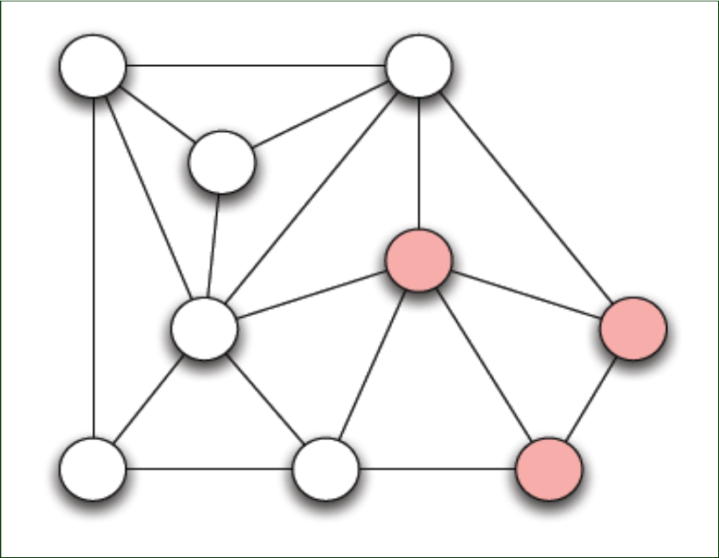
How to measure the degree of similarity?
The number of nodes n =
The number of links e =
The ratio of red nodes p =
The ratio of white nodes q =
The number of links where the two end nodes have the same color s =
The Hong Kong Polytechnic University

Slide 15
How to measure the degree of similarity?
The number of nodes n = 9
The number of links e = 18
The ratio of red nodes p = 1/3
The ratio of white nodes q = 2/3
The number of links where the two end nodes have the same color s = 13
The Hong Kong Polytechnic University

Slide 16
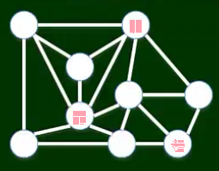
How to measure the degree of similarity?
Insights: the more links with the same color end-nodes, the higher the homophily
The Hong Kong Polytechnic University

Slide 17

How to measure the degree of similarity?
Insights: the more links with the same color end-nodes, the higher the homophily
How high is high? Is there a benchmark?
The Hong Kong Polytechnic University

Slide 18
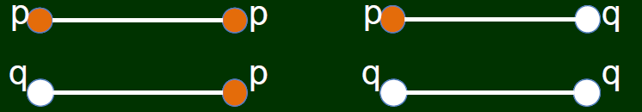
How to measure the degree of similarity?
Use random probability as a benchmark
Assume, red ratio is p, white ratio q,
In random, the probability of a node is red is p, the probability of a node is white is q →
The probability that a link has the same-color end-nodes is p^2 + q^2
The Hong Kong Polytechnic University

Slide 19

How to evaluate the degree of similarity?
The number of nodes n = 9
The number of links e = 18
The ratio of red nodes p = 1/3
The ratio of white nodes q = 2/3
The number of links where the two end nodes have the same color s = 13
13/18 vs. (1/3)^2 + (2/3)^2
The Hong Kong Polytechnic University

Slide 20
A summary
A quantitative description of homophily in social network
Next to come
Selection vs. social influence
The Hong Kong Polytechnic University

Slide 21
Review
We introduced homophily
We know two important factors affecting homophily: selection and social influence
We also study one method to compute the degree of homophily (i.e., how to measure similarity)
The Hong Kong Polytechnic University

Slide 22
Selection vs. Social Influence
The Hong Kong Polytechnic University

Slide 23
Selection
Plato (柏拉圖): similarity begets friendship
物以類聚，人以群分
The Hong Kong Polytechnic University

Slide 24
Selection
Aristotle (亞裏士多德): love those who are like themselves
物以類聚，人以群分
There are exceptions, e.g., 一山不容二虎
The Hong Kong Polytechnic University

Slide 25
Theory
Lazarsfeld and Merton (1954)
Status homophily: common social status, races
Value homophily: common believes, value systems
The core is “selection” of similar group of people
The Hong Kong Polytechnic University

Slide 26
Interpretation
Why social status and value systems may influence the homophily of social networks
Giddens, 1984; 1991, people have the incentive and freedom to join
Example, your friend brings a friend (to you, he is a stranger)
People also have the freedom to leave
Example: Club members, add-drop subjects
Homophily is a self-selection; it is a dynamic process
The Hong Kong Polytechnic University

Slide 27
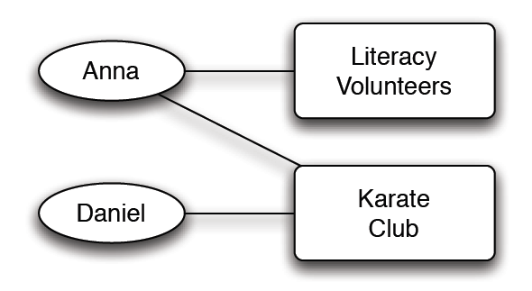
Interpretation
Example
Become friend because of common interests
The Hong Kong Polytechnic University

Slide 28
Interpretation
Example
Become friend because of common interests
Anna – karate club – Daniel form a closure
The Hong Kong Polytechnic University

Slide 29
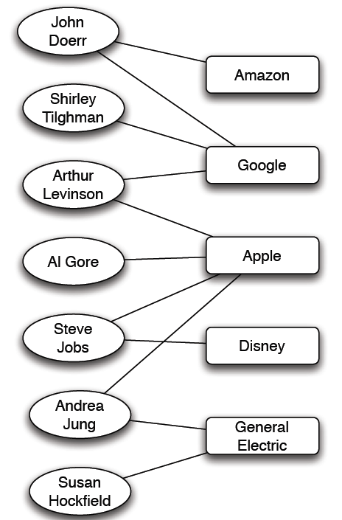
Interpretation
Real world example
Affiliation network: the memberships of people on corporate boards of directors
A very small portion of this network (as of mid-2009) is shown here
It usually helps to analyze the construction of the board
The Hong Kong Polytechnic University

Slide 30
Selection and friendship
Primarily a proactive process, you can create opportunities
A passive join is possible (embeddedness)
The Hong Kong Polytechnic University

Slide 31
Selection vs. Social Influence
The Hong Kong Polytechnic University

Slide 32
Social Influence
孟母三遷
近朱者赤，近墨者黑
先結婚，後戀愛
These are phenomena; we need to abstract them into theory
The Hong Kong Polytechnic University

Slide 33
Miller McPherson, et al. 2001
“Birds of a feather”, introduces the mechanism of homophily
The basic ecological processes that link organizations, associations, cultural communities, social movements, and many other social forms;
The impact of multiplex ties on the patterns of homophily;
The dynamics of network change over time through which networks and other social entities co-evolve.
Emphasize that affiliations are also important
The Hong Kong Polytechnic University

Slide 34
Social Influence
Become friend because of common interests
Anna – karate club – Daniel form a closure
The Hong Kong Polytechnic University

Slide 35
Social Influence
Two people don’t know each other, get to know each other in karate club, become friends,
Daniel even join literacy volunteers
The Hong Kong Polytechnic University

Slide 36
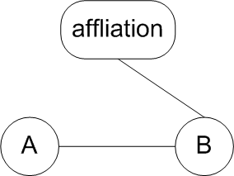
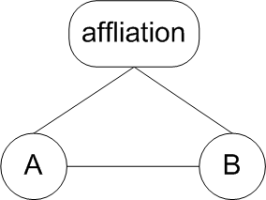
Social Influence
after some time
A closure, but not because of a common friend, but because of influence by a friend
The Hong Kong Polytechnic University

Slide 37
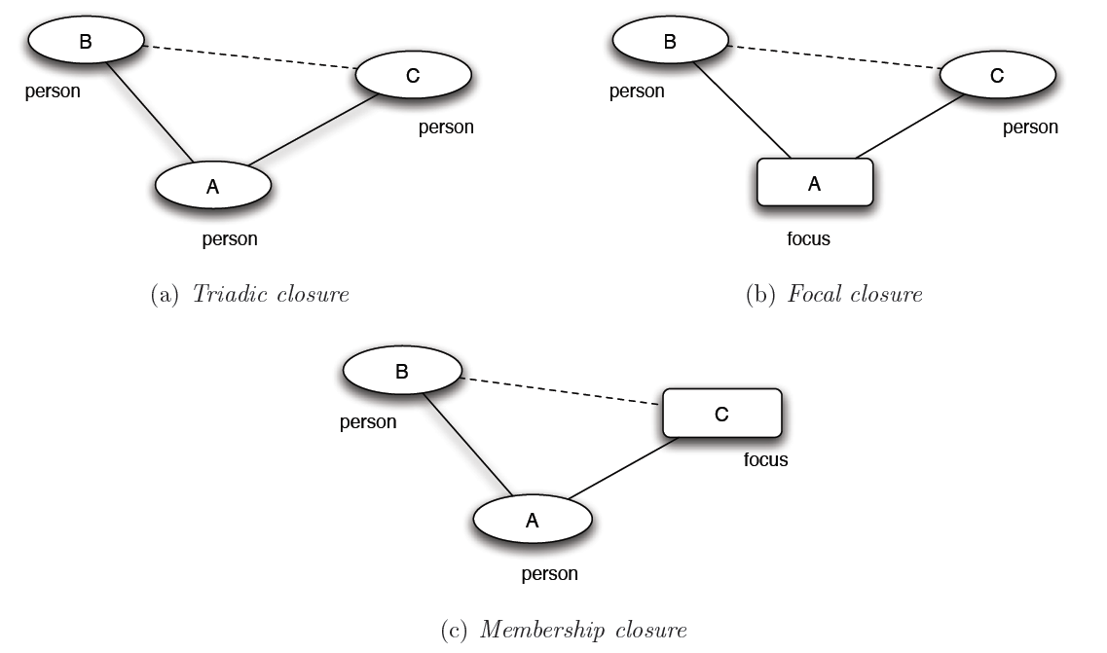
Three types of closure
Selection → focal closure
Social influence → membership closure
The Hong Kong Polytechnic University

Slide 38
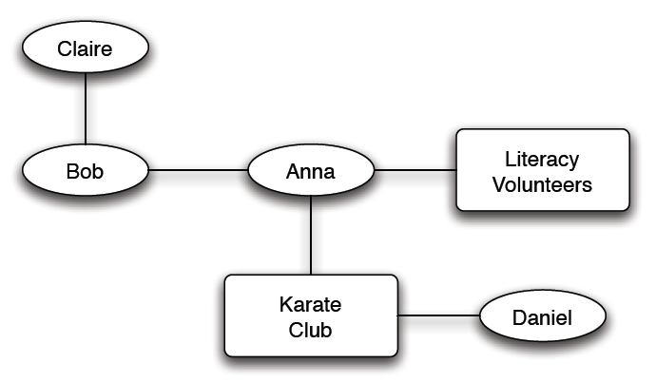
Co-evolution of social and affiliation network
The Hong Kong Polytechnic University

Slide 39
Validation of focal closure
Recall how we validate triadic closure
The Hong Kong Polytechnic University

Slide 40
Validation of focal closure
Focal closure
Connection is established when working on the same “focus”
The more shared foci, the higher the chance of connections (selection), i.e., establishing an edge in the graph
The Hong Kong Polytechnic University

Slide 41
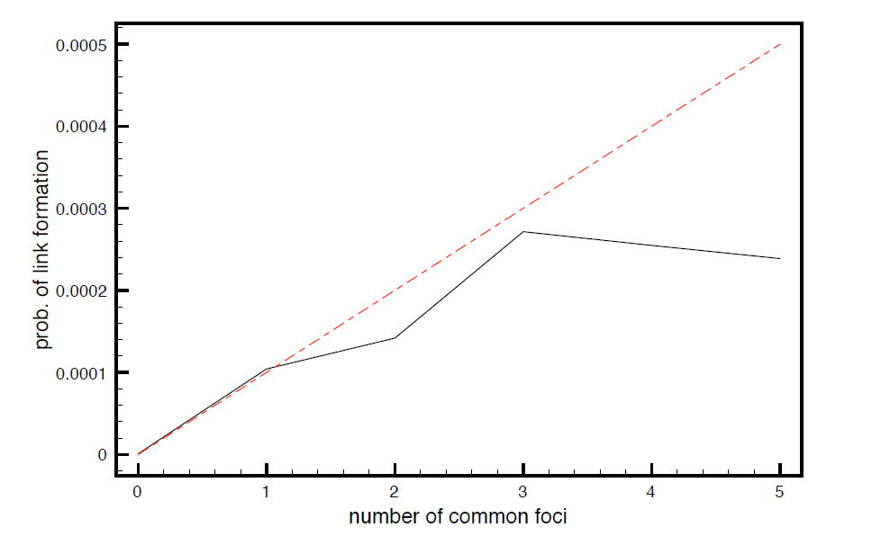
Validation of focal closure
Joint subject selection, the more common subjects, the higher the probability that they are connected (i.e., sending emails)
Details see the book
The Hong Kong Polytechnic University

Slide 42
Validation of membership closure
The Hong Kong Polytechnic University

Slide 43
Validation of membership closure
Membership closure
Because a friend has certain “focus” → join the focus
The Hong Kong Polytechnic University

Slide 44
Validation of membership closure
Membership closure
Because a friend has certain “focus” → join the focus
The more friends are in a focus, the higher probability one will join this focus (get influenced)
The Hong Kong Polytechnic University

Slide 45
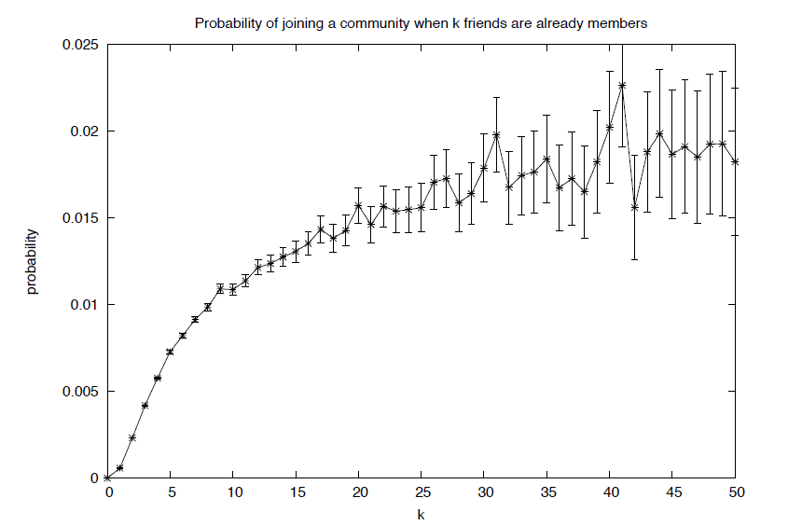
Validation of membership closure
The plot shows the probability of joining a LiveJournal community as a function of the number of friends who are already members
Details see the book
The Hong Kong Polytechnic University

Slide 46
A summary
We studied a topic, homophily, a special property of social networks
The mechanism underlying homophily: selection and social influence
The Hong Kong Polytechnic University

Slide 47
Discussion
Interplay of the following groups in Hong Kong
triadic closure, membership closure, focal closure
Hong Kong resident, visitors from mainland and foreign countries, immigrants from mainland and foreign countries
Age, and affiliations, etc
The Hong Kong Polytechnic University

