Slide 1
COMP3121: Social and Collaborative Computing
Dan Wang
Department of Computing,
The Hong Kong Polytechnic University

Slide 2
Subject Information
Lecture:
Venue: Y304
Time: Monday 15:30 – 17:20
Tutorials: starts at week 3
Monday 17:30 – 18:20
Subject info is available on
https://learn.polyu.edu.hk/

Slide 3
Subject lecturers
Name: Dan WANG
Office: PQ708, Phone: 27667267
Email: dan.wang@polyu.edu.hk
Office hour: Monday 14:30 – 15:20
Email is the best way to contact me
TAs:
Liang Rui: 23126004r@connect.polyu.hk
Yang Yijie: yyjie6@gmail.com
The Hong Kong Polytechnic University

Slide 4
Textbook
Title: Networks, Crowds, and Markets:
Reasoning About a Highly Connected World
Authors: David Easley and Jon Kleinberg
Publisher: Cambridge University Press (2010)
Online available:
http://www.cs.cornell.edu/home/kleinber/networks-book/

Slide 5
Schedule and Assessments
Homework x 6: 30%
Tutorial attendance: 5%
Midterm: 25%
Final exam: 40%
Rubric -- A 85, B 65, C 45 (rough) no curve
No late homework

Slide 6
Schedule and Assessments
Jan 13th (2H): Lecture 1 Overview, Introduction, Graph
Jan 20th (3H): Lecture 2 Graph, big data verification, Homophily, – H1
Jan 27th : Chinese New Year break
Feb 3rd (2H): Lecture 3 Homophily, (1H) Tutorial 1 – H2
Feb 10th (2H): Lecture 4 Small World, (1H) Tutorial 2
Feb 17th (2H): Lecture 5 Small World, Directed Graph, Web Structure, (1H) Tutorial 3 – H3
Feb 24th (2H): Lecture 6 PageRank, Game Theory, (1H) Tutorial 4
Mar 3rd (2H): Midterm Exam (up to PageRank)
Mar 10th (2H): Lecture 7 Game Theory, (1H) Tutorial 5 – H4
Mar 17th (2H): Lecture 8 Game Theory (1H) Tutorial 6 – H5
Mar 24th (2H): Lecture 9 Network Traffic, Auction (1H) Tutorial 7
Mar 31st (2H): Lecture 10 Matching market, Sponsored search market (1H) Tutorial 8
Apr 7th (2H): Lecture 11 Sponsored search market (1H) Tutorial 9 – H6
Apr 14th (2H): Lecture 12 Sponsored search market, Review Tutorial 10

Slide 7
What is this subject?
The Hong Kong Polytechnic University

Slide 8
What this subject is NOT
How to Facebooking
How to Blogging
How to Microblogging a.k.a Weiboing
How to WeChatting
How to WhatsApping
How to Twittering
How to Flickring
How to YouTubing
The Hong Kong Polytechnic University

Slide 9
What this subject is
From the teaching point of view:
We study insights
But more on the fundamentals
Quantification: a.k.a, Math

Slide 10
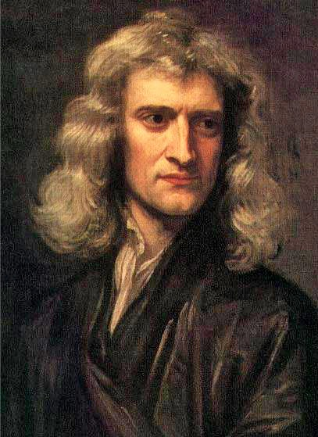
Why fundamentals?
For example, why study physics?

Slide 11

Why fundamentals?
Why study physics?

Slide 12
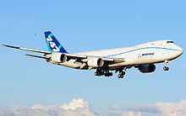

Why fundamentals?
Why study physics?

Slide 13

Example 1: Insights
WeChat (微信) from Tencent (騰訊)

Slide 14



Example 1: Insights
First generation
Second generation

Slide 15
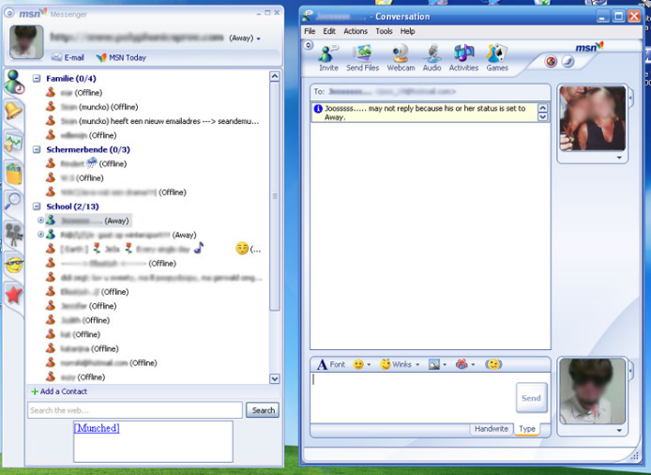
Example 1: Insights
First generation

Slide 16
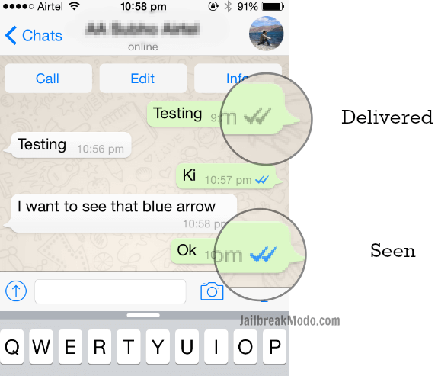
Example 1: Insights
Second generation

Slide 17
Example 1: Insights
WeChat (微信) from Tencent (騰訊)

Slide 18
Example 2: Quantification
If you are a company, how MUCH do you want to pay for your advertisement on YouTube?

Slide 19
Example 2: Quantification
王安石 (宋)《泊船瓜洲》
京口瓜洲一水間，鐘山只隔數重山。
春風又綠江南岸，明月何時照我還？

Slide 20
Example 2: Quantification
王安石 (宋)《泊船瓜洲》
京口瓜洲一水間，鐘山只隔數重山。
春風又綠江南岸，明月何時照我還？
到 → 過 → 入 → 滿 → 綠

Slide 21
What this subject is
From the discipline point of view:
Social sciences
Computer sciences

Slide 22
What this subject is
From the mathematical tool’s point of view:
Graph Theory
Game Theory

Slide 23
Acknowledgement and terms of usage
Prof. Xiaoming Li of Peking University for a lot of materials used in this subject
Academic use ONLY
You can NOT disclose the materials used in this subject to others; the materials are only for you.

