Slide 1




What is the topic of our today’s lesson?
Notes:
亮亮图文旗舰店https://liangliangtuwen.tmall.com

Slide 2
Colours

Slide 3
What colours do you know?

Slide 4



BLUE
BROWN
GREY

Slide 5


GREEN
RED
BLACK

Slide 6



WHITE
ORANGE
PURPLE

Slide 7
PINK
YELLOW

Slide 8
Let’s play a game!

Slide 9
What colours can you see on the picture?

Slide 10

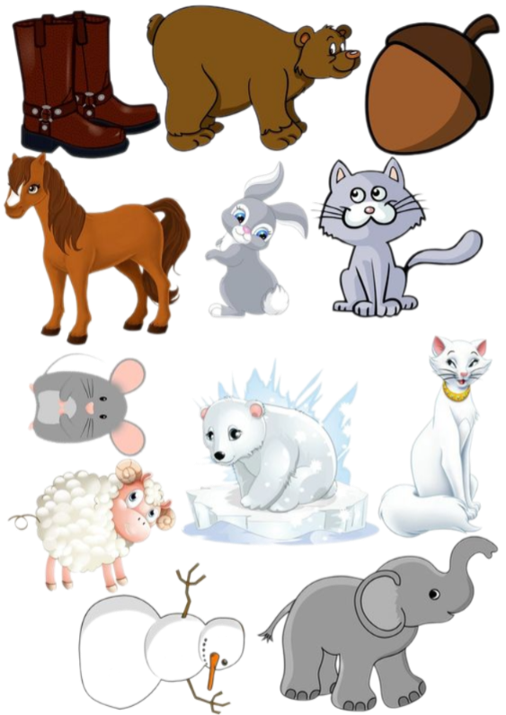

Slide 11


Slide 12
Thank you for your attention!

