Slide 1

BUSINESS CONTINUITY
AND DISASTER RECOVERY
GRC205 - INCIDENT MANAGEMENT AND BUSINESS CONTINUITY
WEEK 21 | DECEMBER 8-14
INTERNATIONAL CYBERSECURITY AND DIGITAL FORENSICS ACADEMY

Slide 2

Building Organizational Resilience Through BC/DR Planning
WEEK 21 CONTEXT
LEARNING OBJECTIVES
This week transitions from reactive incident response to proactive business continuity and disaster recovery planning. While incident response addresses security events after they occur, BC/DR ensures organizations can maintain critical operations during any disruption and recover quickly when systems fail.
The distinction is crucial: incident response focuses on cybersecurity threats, while BC/DR addresses all potential disruptions including natural disasters, technology failures, supply chain interruptions, and human errors.
Understand the relationship between business continuity, disaster recovery, and incident response within the broader GRC framework
Master the Business Impact Analysis (BIA) methodology to identify critical business functions and establish recovery priorities
Define and apply Recovery Time Objectives (RTO) and Recovery Point Objectives (RPO) to guide recovery strategy selection
Develop comprehensive BC/DR plans aligned with NIST SP 800-34 and ISO 22301 standards
Implement effective testing and exercise programs to validate BC/DR capabilities
KEY FRAMEWORKS
NIST SP 800-34
ISO 22301
FEMA CONTINUITY PLANNING

Slide 3

Business Continuity and Disaster Recovery Serve Complementary But Distinct Purposes
BUSINESS CONTINUITY
DISASTER RECOVERY
SCOPE & FOCUS
SCOPE & FOCUS
Ensures the entire organization can continue delivering products and services during and after a disruption. Extends beyond IT to encompass all business functions including operations, supply chain, human resources, facilities, and communications.
Focuses specifically on recovering IT systems, data, and infrastructure after a disaster has occurred. Limited to technology components including servers, networks, applications, databases, and data centers.
TIMING
TIMING
Outlines the process to respond to an event when it occurs and restore normal operations. Timing begins after disruption has occurred and focuses on recovery execution.
Maintains functional level of operations before, during, and after an event through proactive planning and continuous execution throughout the incident lifecycle.
PRIMARY GOAL
PRIMARY GOAL
Restoring IT systems and infrastructure to enable business operations to resume with minimal data loss and downtime.
Sustaining mission-critical business processes to minimize operational and financial impact across the entire organization.
KEY RELATIONSHIP
Disaster recovery is a critical subset of business continuity. Effective business continuity cannot exist without robust disaster recovery capabilities, but disaster recovery alone is insufficient for comprehensive organizational resilience. Modern BC/DR programs integrate both disciplines into a unified framework addressing all potential disruptions.

Slide 4

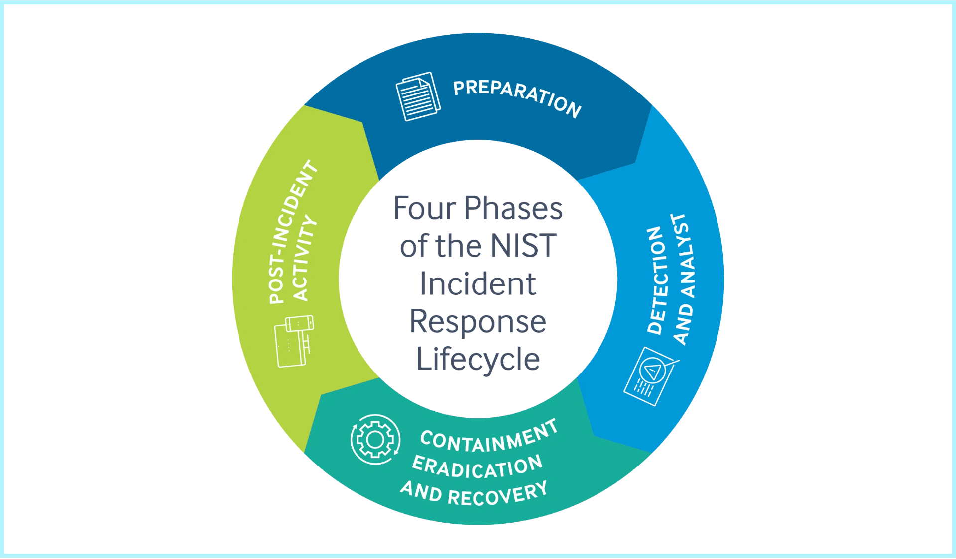
NIST Provides Seven-Step Methodology for Information System Contingency Planning
NIST Special Publication 800-34 Revision 1 establishes the authoritative framework for contingency planning in federal information systems, widely adopted across public and private sectors. The framework encompasses the entire lifecycle from policy development through ongoing maintenance.
STEP 1
Develop Contingency Planning Policy Statement
Establish formal policy defining contingency objectives, roles, resources, training, testing schedules, and maintenance requirements.
STEP 2
Conduct Business Impact Analysis (BIA)
Identify critical IT systems by correlating them to mission/business processes and determine impact of disruptions to establish recovery priorities.
STEP 3
Identify Preventive Controls
Implement cost-effective controls to reduce likelihood and impact of disruptions including redundant systems, UPS, backup generators, and security controls.
STEP 4
Create Contingency Strategies
Develop strategies to recover IT systems based on BIA findings, balancing cost against recovery speed through alternate sites, backup methods, and recovery approaches.
STEP 5
Develop Information System Contingency Plan (ISCP)
Document detailed procedures for recovering information systems including activation, notification, recovery, reconstitution procedures, and supporting appendices.
STEP 6
Ensure Plan Testing, Training, and Exercises (TT&E)
Test plans regularly to identify gaps, validate procedures, and ensure personnel know their roles. Testing progresses from tabletop to full-scale exercises.
STEP 7
Plan Maintenance
Review and update plans at least annually to remain current with organizational changes, technology updates, personnel changes, and lessons learned from tests and incidents.

Slide 5

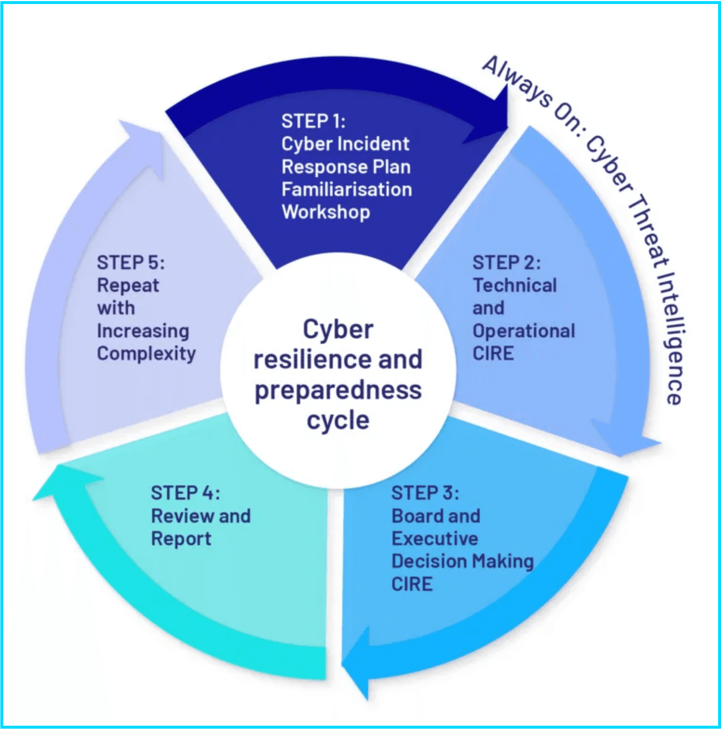
Business Impact Analysis Identifies Critical Functions and Establishes Recovery Priorities
The Business Impact Analysis (BIA) is the cornerstone of effective BC/DR planning, providing the data-driven foundation for all recovery strategies and resource allocation decisions. A BIA predicts the consequences of disruptions to business operations and gathers information needed to develop recovery strategies.
PHASE 1: IDENTIFY CRITICAL FUNCTIONS
PHASE 2: DETERMINE IMPACTS
Quantify operational impacts (lost sales, increased expenses, regulatory fines) and financial impacts (revenue loss, legal costs, long-term implications).
Document all business processes, categorize by criticality, map to supporting IT systems, and identify dependencies between functions.
PHASE 3: ESTABLISH RTO
PHASE 4: ESTABLISH RPO
Define maximum acceptable downtime for each function considering timing, duration, seasonal patterns, and cumulative effects over time.
Define maximum acceptable data loss measured in time, driving backup frequency requirements and data protection strategies.
PHASE 5: IDENTIFY RESOURCES
PHASE 6: PRIORITIZE RECOVERY
Document personnel, technology, facilities, third-party services, and critical documentation needed to recover each function.
Rank business functions by criticality, establish recovery sequence, identify critical path activities, and balance needs with constraints.
TIMING CONSIDERATIONS
The point in time when disruption occurs significantly affects impact severity. Organizations must consider seasonal variations, business cycles, duration thresholds, and cumulative effects over time.

Slide 6

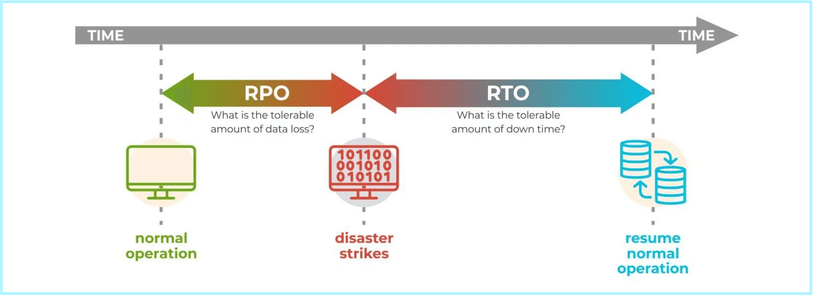
Recovery Objectives Define Acceptable Downtime and Data Loss Thresholds
RTO
RPO
MTD
Recovery Time Objective
Recovery Point Objective
Maximum Tolerable Downtime
Maximum acceptable downtime from disruption to full restoration; drives recovery speed and strategy.
Maximum acceptable data loss in time; defines the recovery point and backup frequency.
Absolute maximum outage before irreparable harm; includes RTO plus recovery and validation time.
PRACTICAL EXAMPLES
E-COMMERCE PLATFORM
RTO: 1 hour | RPO: 15 min | MTD: 4 hours | Strategy: Hot site with real-time replication
EMAIL SYSTEM
RTO: 4 hours | RPO: 1 hour | MTD: 24 hours | Strategy: Warm site with hourly backups
DOCUMENT ARCHIVE
RTO: 5 days | RPO: 24 hours | MTD: 30 days | Strategy: Cold site with daily cloud backups
Cost-Benefit Balance
Aggressive RTO/RPO can cost 10x+; balance needs vs budget with tiered objectives: T1 mission-critical, T2 important, T3 non-critical.

Slide 7

Alternate Site Selection Balances Recovery Speed Against Cost
HOT SITE
WARM SITE
COLD SITE
MOBILE SITE
MIRRORED
(ACTIVE-ACTIVE)
RTO
RTO
RTO
RTO
Minutes to 1-2 hours
Hours to 1-2 days
Days to weeks
1-3 days + transport
RTO
RPO
RPO
RPO
RPO
Near zero
Near zero
Hours to 1 day
Days
Varies
RPO
COST
COST
COST
COST
Zero
Highest
Moderate
Lowest
Moderate
COST
BEST FOR
BEST FOR
BEST FOR
BEST FOR
Highest
Mission-critical systems requiring 99.99%+ uptime. Financial trading, emergency services, e-commerce platforms.
Important systems with moderate downtime tolerance. ERP systems, CRM platforms, corporate email.
Non-critical systems with high downtime tolerance. Development environments, archival systems, administrative apps.
Organizations with multiple locations or unpredictable disaster scenarios. Portable recovery facility.
BEST FOR
Critical infrastructure requiring continuous availability. Healthcare systems, core banking, telecommunications.
CLOUD-BASED DISASTER RECOVERY (DRaaS)
SITE SELECTION CRITERIA
Cloud platforms provide scalable recovery without physical sites. Flexible RTO/RPO based on configuration, pay-as-you-go pricing, geographic distribution across regions. Eliminates physical site management while offering warm or hot recovery capabilities.
Evaluate based on: geographic distance from primary site (outside disaster zone), connectivity and bandwidth (sufficient for replication), environmental controls and security, cost and contract terms, testing and access policies.

Slide 8

Effective Backup Strategies Ensure Data Availability for Recovery
FULL BACKUP
INCREMENTAL
DIFFERENTIAL
CDP
BACKUP TIME
BACKUP TIME
BACKUP TIME
BACKUP TIME
Longest (hours for large datasets)
Fastest (minimal data)
Moderate (increases over time)
Continuous (real-time)
RESTORE TIME
RESTORE TIME
RESTORE TIME
RESTORE TIME
Fastest (single operation)
Slower (full + all incrementals)
Moderate (full + last differential)
Any point in time
STORAGE
STORAGE
STORAGE
STORAGE
Highest (complete copy)
Lowest (only changes)
Moderate (cumulative changes)
Highest (all changes)
FREQUENCY
FREQUENCY
FREQUENCY
FREQUENCY
Weekly or monthly
Daily or multiple times per day
Daily between full backups
Real-time continuous protection
3
2
1
Maintain at least THREE copies of data
Store backups on TWO different media types
Keep ONE backup copy offsite
(Production + 2 backups)
(Disk and tape, or disk and cloud)
(Protected from site-specific disasters)
INDUSTRY BEST PRACTICE: THE 3-2-1 BACKUP RULE
Protects against hardware failure, media-specific failures, and site disasters through redundancy and geographic distribution
BACKUP TESTING
CLOUD BACKUP
Regular testing validates data integrity, restore procedures, and recovery time. Test quarterly for critical systems, annually for all systems.
Offers geographic redundancy, scalability, automation, and cost efficiency. Consider bandwidth, compliance, encryption, and vendor lock-in.

Slide 9
ISO 22301 Provides International Framework for Systematic BC Management
ISO 22301:2019 is the international standard for Business Continuity Management Systems (BCMS), providing a structured framework for organizations to plan, establish, implement, operate, monitor, review, maintain, and continually improve their business continuity capabilities.
BCMS VS TRADITIONAL BC/DR
Holistic, organization-wide scope (not just IT systems)
Integrated with overall risk management and business strategy
Continuous improvement cycle (Plan-Do-Check-Act methodology)
ISO 22301 STRUCTURE (10 CLAUSES)
Addresses all types of disruptions beyond technology failures
CLAUSE 1-3
CLAUSE 8
Focus on maintaining critical business functions across entire organization
Scope, references, definitions
Operation (BIA, strategies,
CLAUSE 4
Context of organization
plans)
BENEFITS OF CERTIFICATION
CLAUSE 5
Leadership and commitment
CLAUSE 9
Performance evaluation
Demonstrated commitment to resilience (third-party validated)
CLAUSE 6
Planning and risk
CLAUSE 10
Improvement and corrective
Competitive advantage and market differentiation
management
action
Improved stakeholder confidence (customers, regulators, investors)
CLAUSE 7
Support and resources
Regulatory compliance (meets many industry requirements)
Enhanced organizational resilience through systematic approach
IMPLEMENTATION APPROACH
KEY CLAUSE 8: OPERATION
Gap analysis → Planning → BIA and risk assessment → Strategy development → Plan development → Testing and exercises → Certification audit → Continuous improvement
Core BC activities including Business Impact Analysis, risk assessment, BC strategies and solutions, and BC plans and procedures. Transforms planning into operational capability.

Slide 10
Comprehensive BC/DR Plans Provide Clear Guidance During Disruptions
EXECUTIVE SUMMARY & PURPOSE
COMMUNICATION PLANS
Plan purpose, scope, and applicability. Defines what the plan covers, which business functions or systems it addresses, and when it should be activated. Enables quick understanding for executives and stakeholders.
Internal and external communication during disruptions. Stakeholder identification and requirements, communication templates for common scenarios, approval workflows for external communications, media management and regulatory notification requirements.
ROLES & RESPONSIBILITIES
BC/DR team structure, specific roles (incident commander, communications lead, technical recovery lead), decision-making authority and escalation paths, contact information for all team members including alternates.
RESOURCE REQUIREMENTS
Personnel (skills, numbers, availability), technology (hardware, software, licenses, credentials), facilities (alternate sites, workspace, utilities), vendors and service providers (contact information, contracts, SLAs), supplies and equipment.
ACTIVATION & NOTIFICATION
Activation criteria and decision authority, notification procedures for team members and stakeholders, communication methods (primary and backup channels), initial assessment and situation reporting procedures.
TESTING & MAINTENANCE
Testing schedule and methodologies, maintenance procedures and update frequency, version control and change management, distribution and access procedures, training requirements for plan users.
RECOVERY PROCEDURES
Detailed step-by-step recovery procedures organized by system or business function. Include prerequisites and dependencies, expected outcomes and validation criteria, estimated time requirements, and rollback procedures if recovery fails.
APPENDICES & SUPPORTING INFO
System inventories and configurations, network diagrams and architecture documentation, vendor contact information and contracts, regulatory requirements and compliance obligations, forms and templates, glossary of terms.

Slide 11

Regular Testing Validates Plans and Builds Team Capability
TABLETOP EXERCISE
LOW RISK
TESTING BEST PRACTICES
Discussion-based session where team members talk through responses to scenario. No actual system changes. Frequency: Quarterly. Best for: Plan review, team coordination, identifying gaps.
Test Many Scenarios: Vary failure types, times, and scopes. Don't test same scenario repeatedly.
Test Regularly: Establish schedule and adhere to it. Test after significant environment changes.
WALKTHROUGH TEST
LOW-MODERATE
Document Everything: Record procedures, results, issues, corrective actions, and performance metrics.
Step-by-step review of plan procedures with team members simulating actions verbally. May review documentation and verify resources. Frequency: Semi-annually. Best for: Procedure validation, role clarification.
Keep Everyone Updated: Communicate schedule in advance, provide status updates, share results with stakeholders.
Measure Performance: Track actual vs. target RTO/RPO, test success rate, issues identified, resolution time.
SIMULATION EXERCISE
MODERATE
Realistic scenario with time pressure requiring team to respond as if real incident. Some system testing in isolated environments. Frequency: Annually. Best for: Decision-making practice, stress testing procedures.
Learn and Improve: Update plans based on findings, remediate issues, enhance procedures, track improvement trends.
KEY TESTING METRICS
PARALLEL TEST
MODERATE-HIGH
Coverage: % of critical systems tested, % of procedures tested
Recovery systems activated alongside production systems. Validates recovery capability without risking production. Frequency: Annually. Best for: Technology validation, performance testing.
Performance: Actual vs. target RTO/RPO, test success rate
Compliance: Tests completed vs. scheduled, audit findings
COMMON CHALLENGES
FULL INTERRUPTION TEST
HIGH RISK
Business Resistance: Demonstrate value, minimize disruption. Resource Constraints: Prioritize critical systems, leverage tabletops. Complex Dependencies: Map dependencies, test incrementally.
Production systems actually shut down with complete failover to recovery systems. Rarely performed due to business impact. Frequency: Every 2-3 years (if at all). Best for: Complete validation, regulatory compliance.

Slide 12

Effective BC/DR Requires Clear Governance and Defined Roles
BC/DR GOVERNANCE STRUCTURE
RACI MATRIX FOR BC/DR
EXECUTIVE STEERING COMMITTEE
ACTIVITY
R
A
C
I
Senior leadership provides strategic direction, approves BC/DR strategies and budgets, ensures alignment with business objectives, reviews program performance. Includes CEO, CFO, CIO/CISO, COO, General Counsel. Meets quarterly.
Plan Development
BC Coord
Prog Mgr
BU
Exec
BIA Conduct
Prog Mgr
BU Lead
Process
Exec
BC/DR PROGRAM MANAGER
Testing Execution
DR Team
Prog Mgr
BU
Exec
Day-to-day leadership and coordination, develops and maintains BC/DR program, coordinates BIA and risk assessment, oversees plan development and maintenance, manages testing and exercise program, reports to steering committee.
Plan Activation
Inc Cmd
Exec Spon
Prog Mgr
All Staff
R
=Responsible |
A
=Accountable |
C
=Consulted |
I
=Informed
BUSINESS CONTINUITY COORDINATORS
GOVERNANCE PROCESSES
Each business unit designates BC coordinator responsible for unit-specific BC planning, conducting BIA for their area, developing and maintaining unit BC plans, coordinating testing, serving as liaison to program manager.
PROGRAM PLANNING & BUDGETING
RISK & PERFORMANCE MONITORING
Annual planning establishes objectives, priorities, resources. Program manager develops plan, steering committee approves, budget allocated, progress tracked.
Ongoing monitoring through KPIs, risk assessments, audit findings, incident and test results analysis ensures program effectiveness.
DISASTER RECOVERY TEAM
DR Team Lead coordinates all DR activities. System administrators restore specific systems. Network engineers restore connectivity. Database administrators restore and validate databases. Application specialists restore and test applications. Security specialists ensure security during recovery.
CONTINUOUS IMPROVEMENT
COMMUNICATION & REPORTING
CRISIS MANAGEMENT TEAM
Lessons learned from tests and incidents, benchmarking, maturity assessments, program enhancements drive continuous improvement.
Quarterly steering committee meetings, monthly program status reports, annual board review, ad-hoc updates for significant events.
Handles overall incident management and strategic decisions. Incident Commander (overall authority), Communications Lead (internal/external), Legal Counsel (regulatory/legal), HR Representative (personnel/safety), Facilities Manager (physical site/logistics).

Slide 13
Metrics Drive BC/DR Program Maturity and Effectiveness
KEY PERFORMANCE INDICATORS
BC/DR MATURITY ASSESSMENT MODEL
AVAILABILITY & RELIABILITY
LEVEL 1: INITIAL (AD HOC)
System uptime % (99.9%, 99.99%, 99.999%) • Mean time between failures (MTBF) • Mean time to repair (MTTR)
BC/DR activities reactive and informal. No formal plans. Recovery relies on individual heroics. Success unpredictable. High risk.
RECOVERY PERFORMANCE
Actual RTO vs. target RTO • Actual RPO vs. target RPO • Recovery success rate • Data loss incidents
LEVEL 2: DEVELOPING (REPEATABLE)
Basic BC/DR plans exist for critical systems. Some testing but not regular. Roles defined but not always followed. Variable success.
TESTING & EXERCISES
Number of tests per year • Test success rate • Issues identified during testing • Time to resolve findings
LEVEL 3: DEFINED (STANDARDIZED)
Comprehensive BC/DR program with documented processes. Regular testing across critical systems. Clear governance. Consistent recovery success.
COMPLIANCE & GOVERNANCE
Plan update frequency • Training completion rate • Audit findings • Regulatory compliance status
LEVEL 4: MANAGED (MEASURED)
BC/DR driven by metrics and data. Proactive gap identification and remediation. Integration with enterprise risk management. Continuous improvement.
FINANCIAL METRICS
BC/DR costs as % of IT budget • Cost per protected system • Cost of downtime avoided • ROI of investments
LEVEL 5: OPTIMIZING (CONTINUOUS IMPROVEMENT)
BC/DR is core organizational competency. Innovation in recovery approaches. Industry leadership and best practices. Resilience embedded in culture.
CONTINUOUS IMPROVEMENT PROCESS
Quarterly program reviews • Annual maturity assessment • Lessons learned integration • Benchmarking against industry peers
MATURITY ADVANCEMENT
Organizations should assess current maturity level, identify gaps to next level, develop roadmap for advancement, and track progress through metrics and benchmarking.

Slide 14

Incident Response and BC/DR Form Complementary Resilience Framework
INCIDENT RESPONSE SCOPE
BC/DR SCOPE
Focus: Cybersecurity Incidents
Focus: All Disruptions
Addresses malware infections, unauthorized access, data breaches, denial of service attacks, and insider threats. Primary goal: minimize security impact and restore secure operations through detection, analysis, containment, eradication, and recovery.
Addresses natural disasters, technology failures, supply chain interruptions, facility access issues, and cybersecurity incidents. Primary goal: minimize business impact and restore normal operations while maintaining critical business functions.
INTEGRATION POINTS
SHARED ACTIVATION
COORDINATED TEAMS
UNIFIED GOVERNANCE
Major cybersecurity incidents trigger both IR and BC/DR. Ransomware requires IR (threat containment) and DR (system recovery). DDoS requires IR (attack mitigation) and BC (alternate service delivery).
Unified command structure with clear decision authority, shared communication and coordination procedures, joint exercises and training, and maintained shared situation awareness.
Common governance ensuring alignment, shared resources and budget, consistent policies and standards, and integrated risk management across both disciplines.
CASE EXAMPLE: RANSOMWARE ATTACK COORDINATED RESPONSE
HOUR 0-4: DETECTION & INITIAL RESPONSE
HOUR 4-24: CONTAINMENT & INVESTIGATION
HOUR 24-72: RECOVERY & RESTORATION
IR Team: Detects ransomware, initiates incident response, contains affected systems, preserves evidence.
IR Team: Investigates attack vector, identifies scope of compromise, eradicates attacker access.
IR Team: Validates environment is clean and secure, monitors for re-infection.
BC/DR Team: Assesses business impact, activates business continuity procedures, communicates with stakeholders.
BC/DR Team: Activates alternate processing, maintains critical operations, coordinates customer communication.
BC/DR Team: Restores systems from clean backups, validates data integrity, returns to normal operations.
Post-Incident: Joint IR and BC/DR lessons learned session identifies improvements to both capabilities, updates plans and procedures, implements preventive measures.

Slide 15

BC/DR Enables Organizations to Survive and Thrive Through Disruptions
CORE PRINCIPLES OF EFFECTIVE BC/DR
BUSINESS-DRIVEN
RISK-BASED
TESTED & VALIDATED
BC/DR aligns with business objectives and priorities. BIA identifies critical processes. Recovery strategies balance needs and cost.
Prioritize high-impact scenarios. Not all systems need the same protection. Use tiers based on criticality and risk.
Plans must be tested regularly. Exercises reveal gaps and build capability, from tabletop to full-scale.
CONTINUOUSLY IMPROVED
INTEGRATED
PEOPLE-FOCUSED
Learn from tests, incidents, and change. Update plans routinely. Advance maturity through metrics and benchmarking.
Integrate BC/DR with incident response, risk management, and architecture. Unified governance maximizes effectiveness.
Technology enables recovery, people execute it. Define roles, train teams, and foster a resilience culture.
KEY SUCCESS FACTORS
COMMON PITFALLS TO AVOID
✓
Executive Sponsorship:
Visible leadership support and adequate funding
✗
IT-Only Focus:
BC/DR is business program, not just IT backup
✓
✗
Stale Plans:
Outdated documentation is worse than no documentation
✗
Insufficient Testing:
Annual testing is minimum; critical systems need more
✓
Appropriate Strategies:
Recovery approaches matched to RTO/RPO requirements
✗
Unrealistic RTOs:
Recovery objectives must be achievable and tested
✓
Clear Documentation:
Accessible, actionable plans with step-by-step procedures
✗
Single Points of Failure:
Dependencies and key personnel create vulnerabilities
✓
Regular Testing:
Frequent validation builds confidence and identifies gaps
✗
Compliance-Only Mindset:
Checkbox approach misses resilience goal
✓
Skilled Team:
Trained personnel who know their roles and responsibilities
✗
Ignoring Dependencies:
Third-party and supply chain risks often overlooked
✓
Metrics & Accountability:
KPIs drive performance and continuous improvement

