Slide 1
SOC FINAL - UART FIFO
第14組
111061560 吳俊鋌
111061534 陳白翀

Slide 2
Outline
BLOCK DIAGRAM
FIRMWARE
UART.C OPTIMIZATION
Minimum FIFO DEPTH
CPU time
Total time
Quality of result
*baud rate 9600

Slide 3
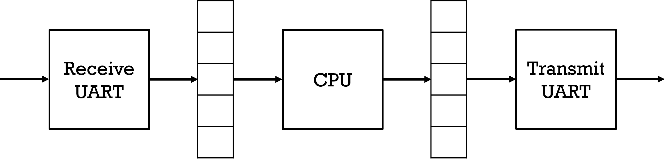
BLOCK DIAGRAM
RX FIFO
TX FIFO

Slide 4
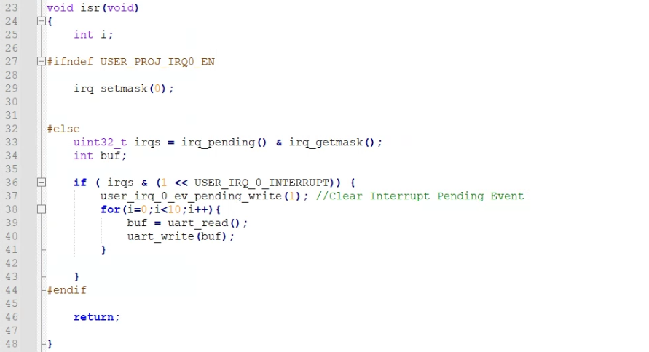
FIRMWARE
Interrupt is trigger ones the RX FIFO is full.
CPU starts to read out data from RX FIFO and than write it into TX FIFO.

Slide 5
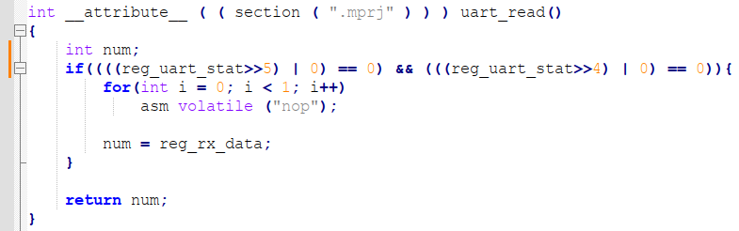
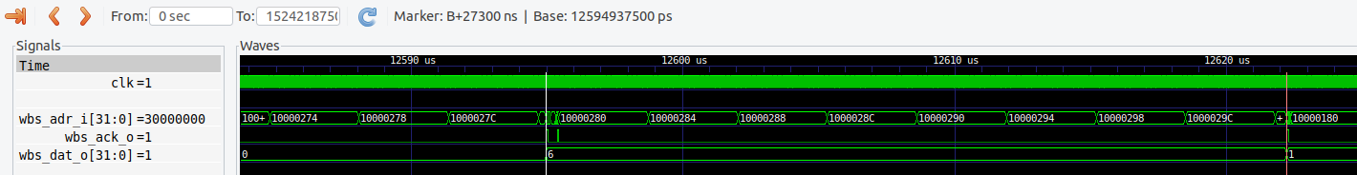
UART.C OPTIMIZATION
CPU read out reg_uart_stat twice if using following code :

Slide 6
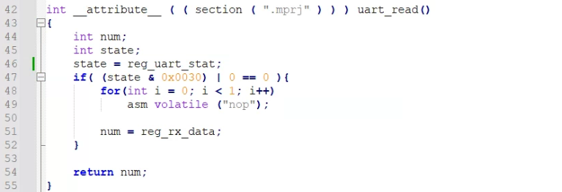
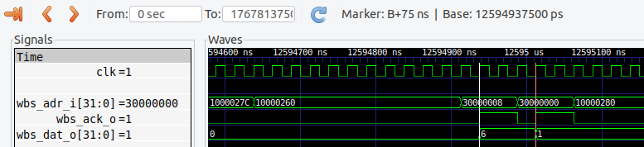
UART.C OPTIMIZATION
Using a integer to store reg_uart_stat can reduce 1089 cycles.

Slide 7
FIFO DEPTH
RX FIFO can receive next data after RX FIFO is empty.
Since RX FIFO & TX_FIFO has same depth and the time of CPU read/write is a lot faster than UART.
Depth of TX FIFO can be less than RX FIFO.
5
4
3
2
1
0
5
4
3
2
1
0
5
4
3
2
1
5
4
3
2
1
CPU
CPU
CPU

Slide 8
FIFO DEPTH
Improve from previous design, we let UART receive data while RX FIFO is not full.
UART can also receive/transmit data while CPU is read/write data.
So the whole system can transmit X data while the FIFO DEPTH is less than X.
5
4
3
2
1
0
5
4
3
2
1
0
6
5
4
3
2
1
7
6
5
4
3
2
CPU
CPU
CPU

Slide 9
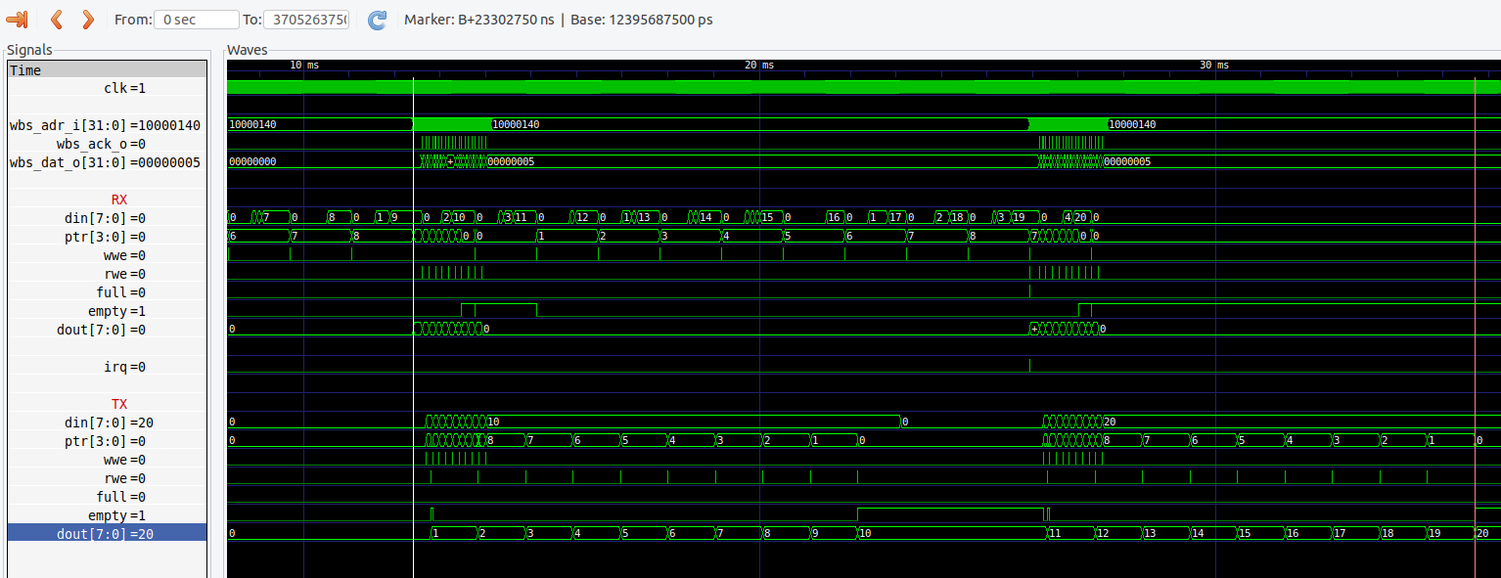
FIFO DEPTH
After interrupt, CPU read/write 10 data while UART finish transmit 1 data, so the FIFO DEPTH can be 9 while it can actually transmit 10 data.
Transmit 20(1~20) data with only 2 Interrupt & 9 length FIFO.

Slide 10
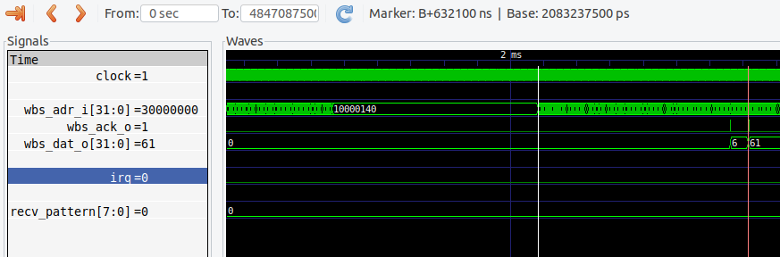
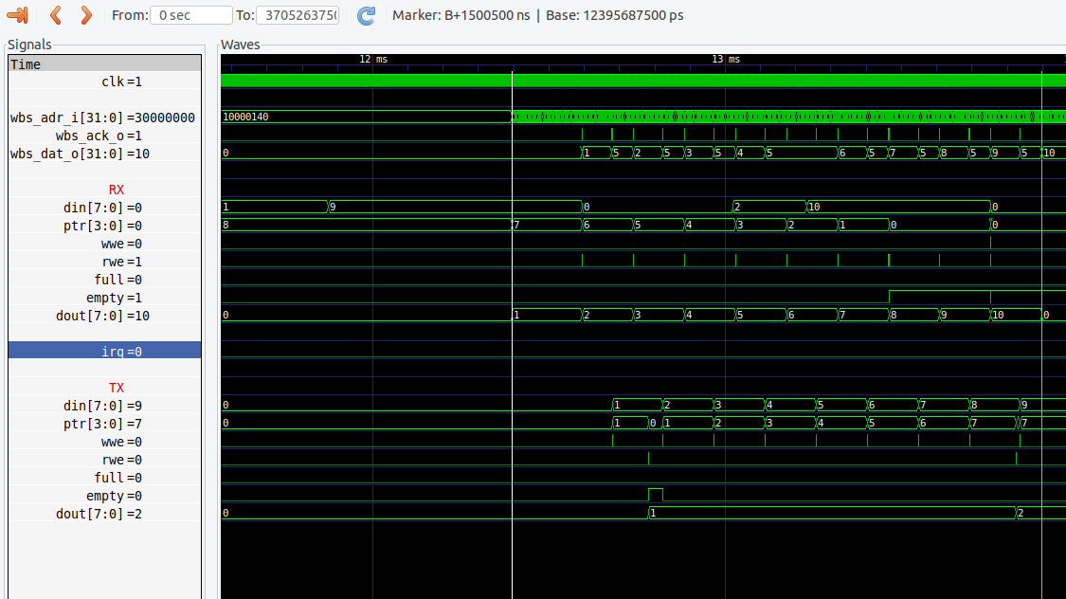
Baseline :
CPU time : ISR time + read/write time = 25284 cycles per data
Our work :
CPU time : ISR time + read/write time*10 = 60020 cycles = 6002 cycles per data.
(four times improve)

Slide 11
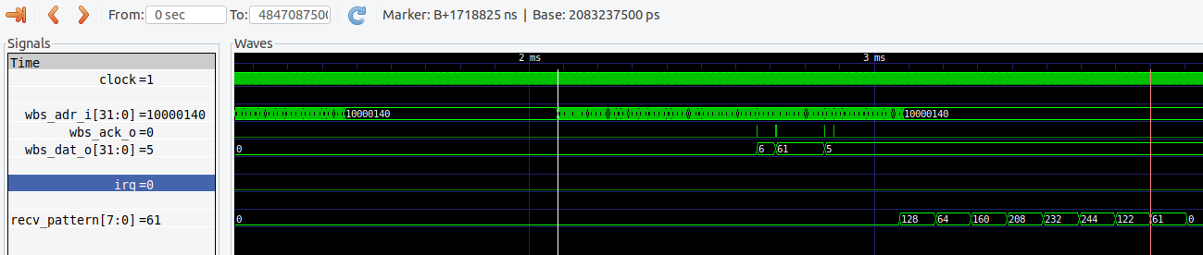
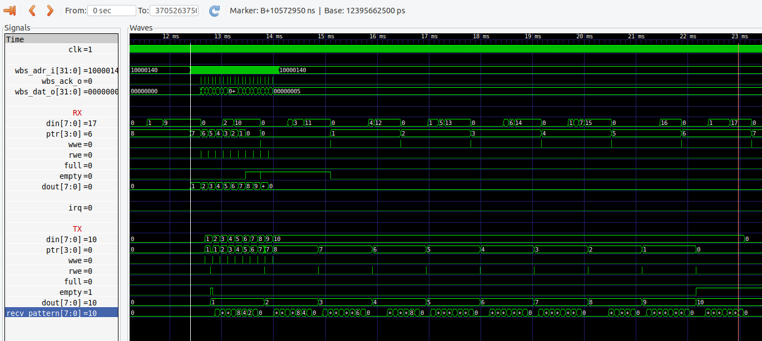
Baseline :
UART time : ISR time + Transmission time = 68753 cycles per data
Our work :
UART time : ISR time + Transmission time*10 = 422918 cycles = 42291 cycles per data.
ISR time
Transmission time
ISR time
Transmission time

Slide 12
Quality of result
baud rate 9600
Message length: 512
Baseline :
Latency = (68753*512*25)/1000 = 880038.4 us
Metric = 880038.4 us – 512*(1/9600) = 826705.066 us
Our work :
Latency = (42291*512*25)/1000 = 541324.8 us
Metric = 541324.8 us - 512*(1/9600) = 487991.466 us

Slide 13
Q&A
Q: Explain the detail of FIFO working mechanism

Slide 14
END

