Slide 1
HW4
Backpropagation
Deadline : 2020/01/10 23:55:00
TA email address: kartglin.iie07g@nctu.edu.tw

Slide 2
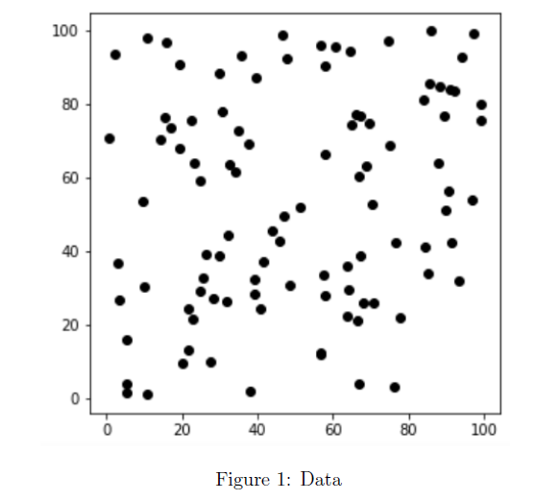
Write a backpropagation program

Slide 3
Rules
Implementing a two hidden-layer neural network.
Two inputs(x,y).
One output(label). If x>y, label = 0. If x<y, label = 1.
You must use backpropagation in this neural network.
You can only use Numpy and other python standard library, so you can’t use libraries like Scikit-Learn.

Slide 4
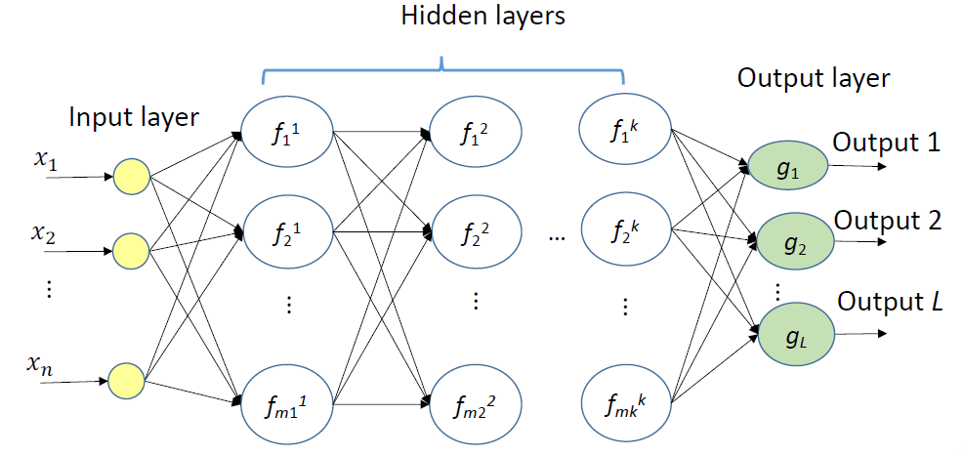
Design your model

Slide 5
Flow
Read data
Create model
Forward(Sigmod activation)
Repeat n times or until convergence
Backward
Update weights

Slide 6
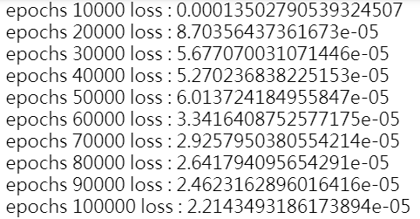
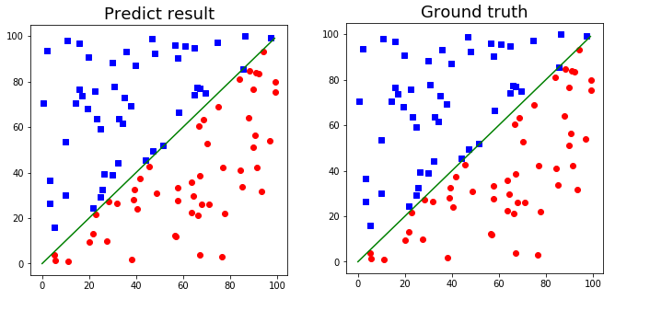
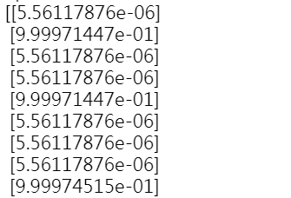
Result

Slide 7
Reference
http://speech.ee.ntu.edu.tw/~tlkagk/courses_ML17_2.html

