Slide 1
Predict what you use when backing home / travel
組員
陳昱銘
黃立銘
古瀚

Slide 2
What we predict
We collect a lot of data which contains one’s age, back home frequency, job, and other which may affect what transportation one person choose in backing home.
The target has three items, cheap one(train or bus), expensive one(HSR), and drive by oneself.
Note: someone’s hometown and location of work/school is at the same place, so they choose the data of traveling

Slide 3
Original data
The features include 12 items, which is hometown/travel, age, job, frequency, location of two, distance of two, relationship of friends and family, financial situation, gender, have married and so on.
The picture is on the next page
We collect about 1300 samples from ptt, Bahamut, Facebook users, and so on. And we have some rewards for attracting people to fill in the questionnaire.

Slide 4
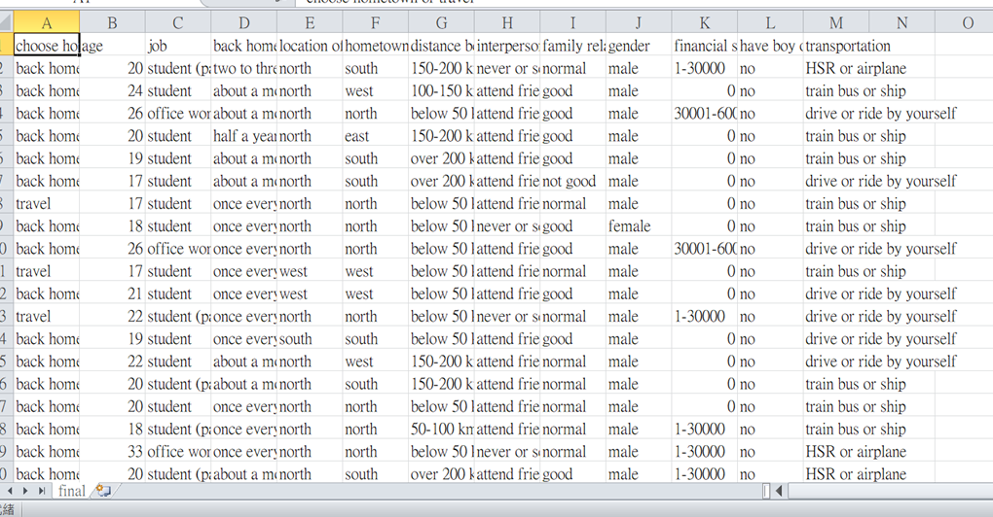
The original data
There are 1352 samples, others are in the final.csv and original.xlsx

Slide 5
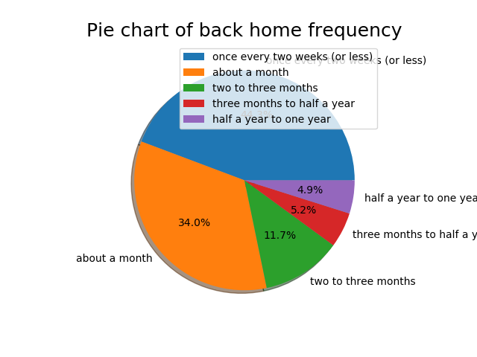
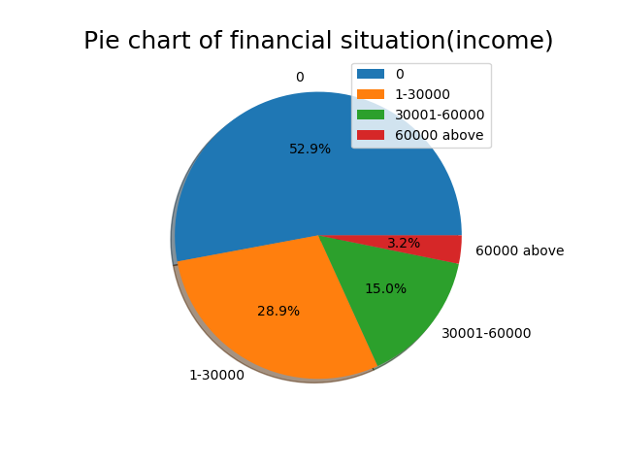
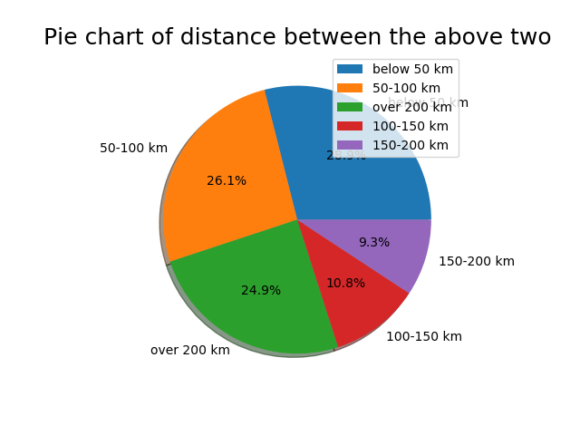
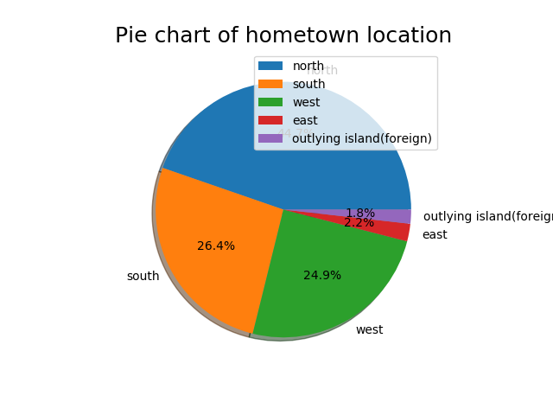
The distribution of data(feature)
Too many, just place four as representatives, others are in the picture folder.

Slide 6
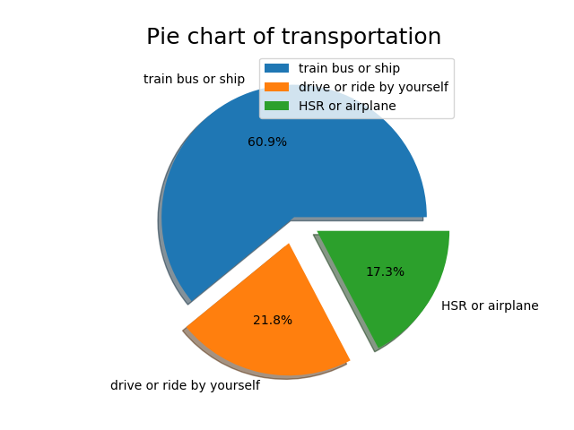
The distribution of data(target)

Slide 7
Data processing and Model
Fill the missings with mode. Then transform them into numeric data to fit in sklearn.
在gender欄位，本來是出於尊重，多了一個其他選項，結果有人亂填(像:大雞雞人、男的啾咪???、史萊姆?)，害我找錯誤找很久，因為那些中文沒有被翻成英文，導致python讀檔錯誤…
Five models are created, which are Decision tree, Random forest, Naïve bayes, SVM, and Logistic. We implement our model first, but the result is worse than sklearn. Therefore, we choose to use sklearn.

Slide 8
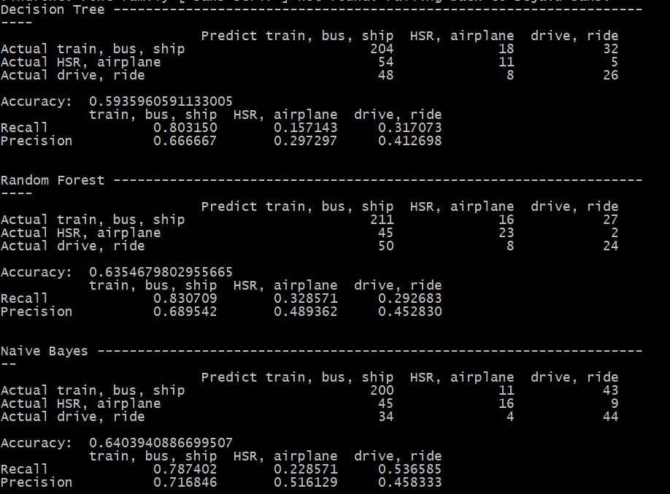
Predict result(first 3)

Slide 9
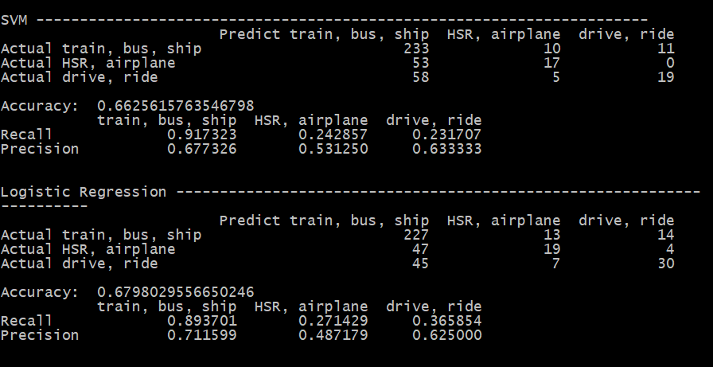
Predict result(last 2)

Slide 10
Some explanation
As the picture, Decision tree has the lowest accuracy, and logistic is the highest, but the prediction has too many on train and bus, this also decrease other two’s recall.

Slide 11
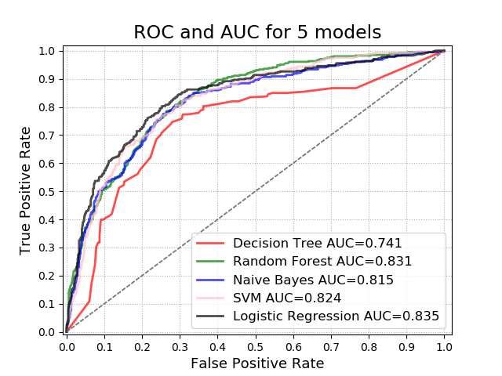
The ROC curve
The ROC curve shows that Decision tree is the worst one, and random forest and logistic are better.

