Slide 1
Escape
You only get one chance to live, don’t spend it locked away
Arnoud Jonkers, Jordi Hessels, Mike Koch, Tim de Boer & Xander de Ronde

Slide 2
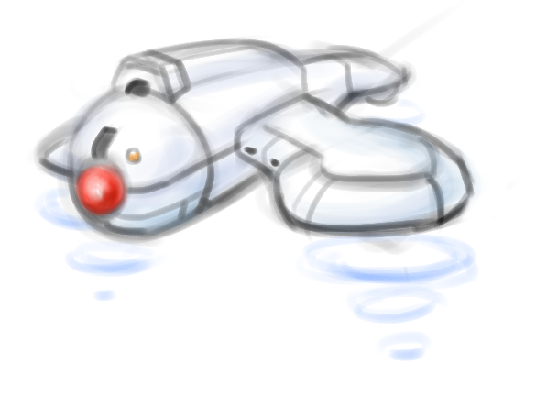
Table of Contents
Procedural Generation
Guards
Second Screen
Play the Game!

Slide 3
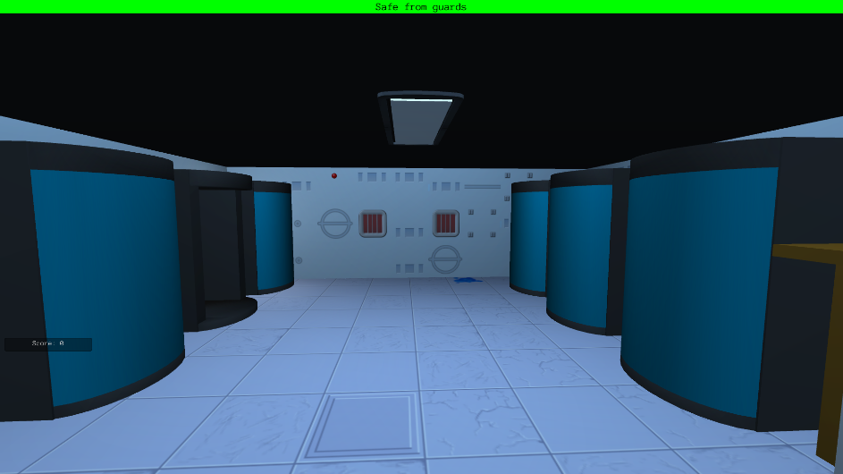
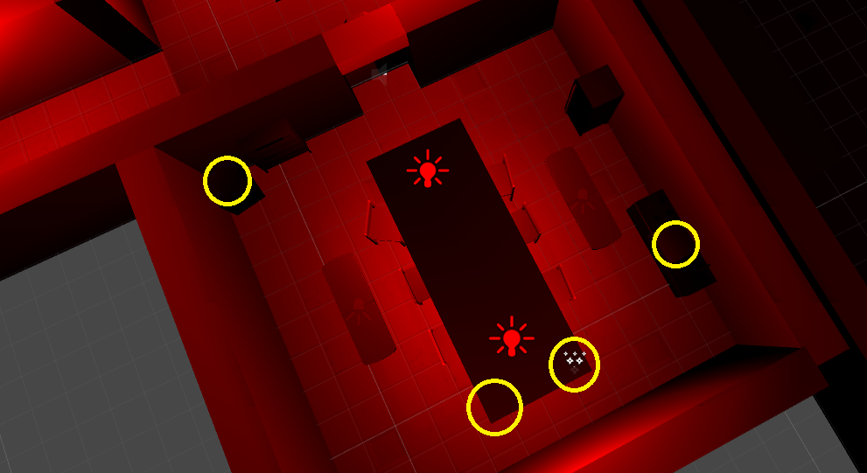
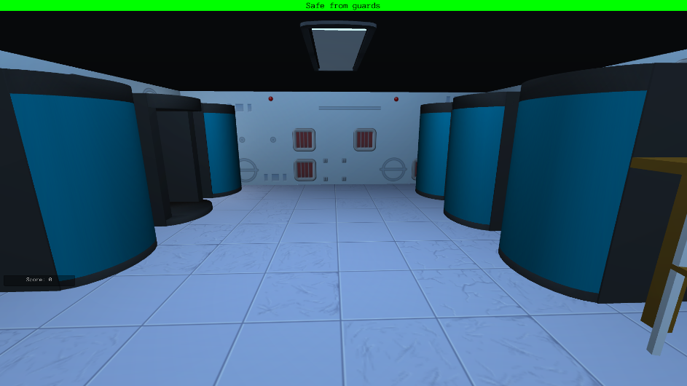
Procedural Generation
Procedural Generation Guards Second Screen Play the Game!

Slide 4
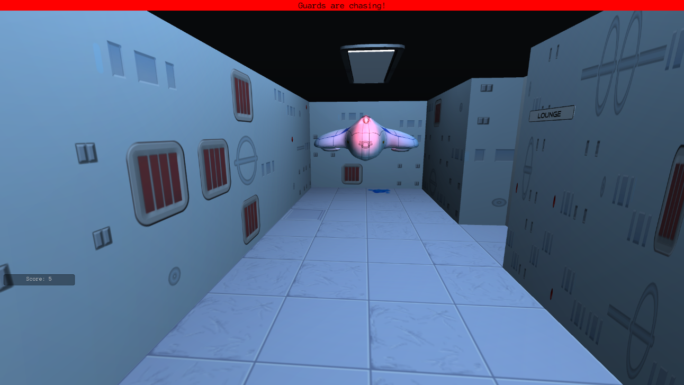
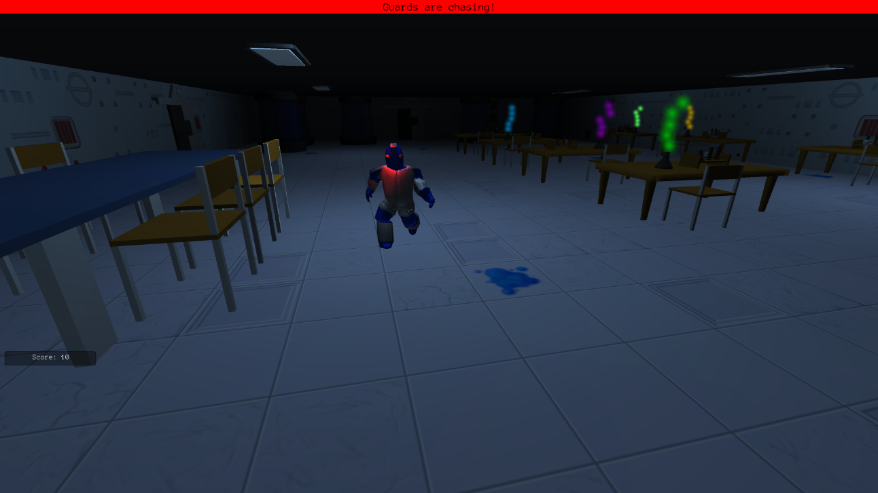
Guards
Procedural Generation Guards Second Screen Play the Game!

Slide 5
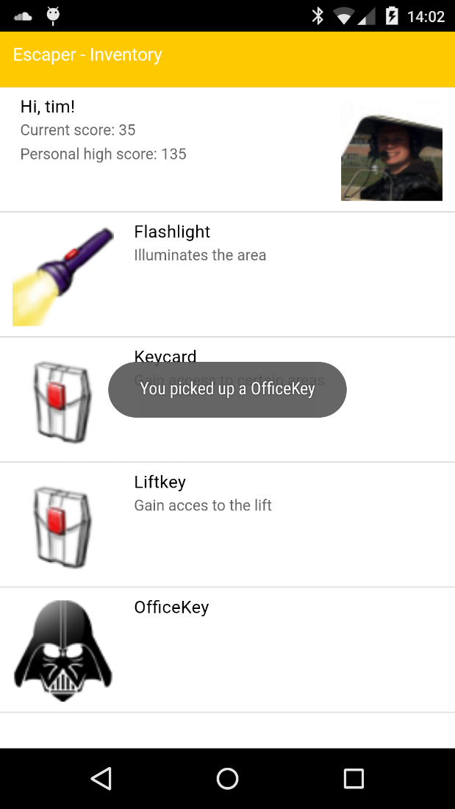
Second Screen
Procedural Generation Guards Second Screen Play the Game!

Slide 6
Play the Game!
Procedural Generation Guards Second Screen Play the Game!

Slide 7
?
Questions

