Slide 1
testCase03

Slide 2
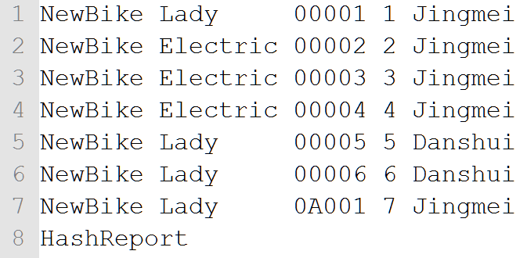
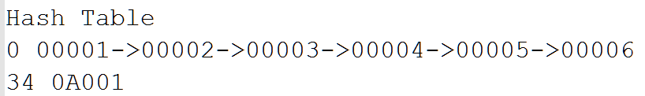
Jingmei
Danshui
Lady
Lady
7
6
1
5
Electric
4
2
3

Slide 3
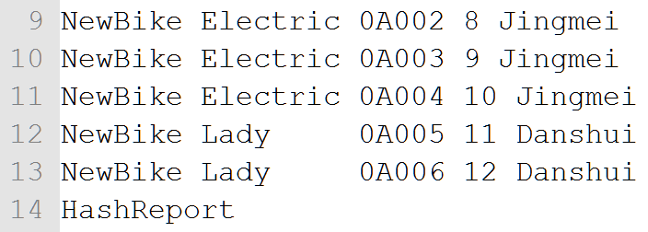
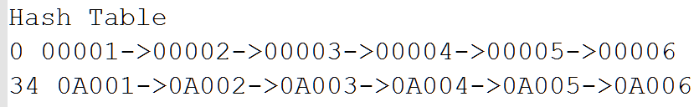
Jingmei
Danshui
Lady
Lady
7
12
1
11
6
5
Electric
10
8
9
2
4
3

Slide 4
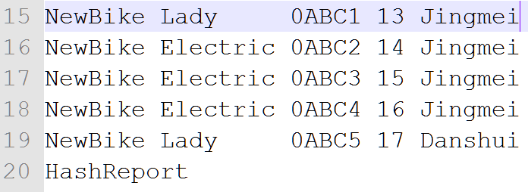
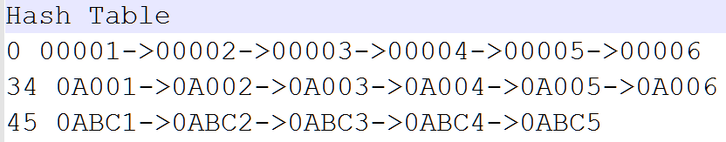
Jingmei
Danshui
Lady
Lady
13
17
1
7
12
6
5
11
Electric
16
15
10
14
4
3
9
2
8

Slide 5
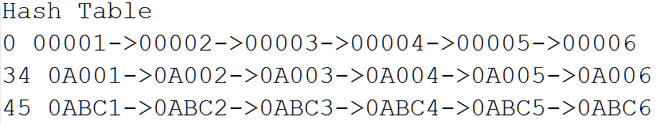

Jingmei
Danshui
Lady
Lady
13
18
1
7
12
17
5
11
6
Electric
16
15
10
14
4
3
9
2
8

Slide 6
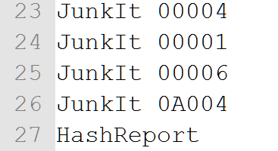
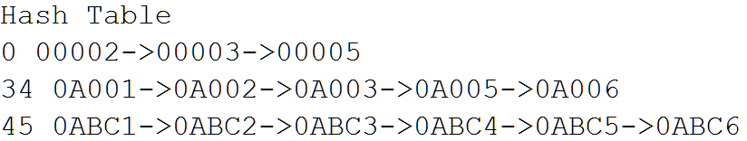
Jingmei
Danshui
Lady
Lady
13
18
7
12
17
5
11
Electric
16
15
9
14
8
3
2

Slide 7
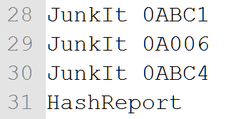
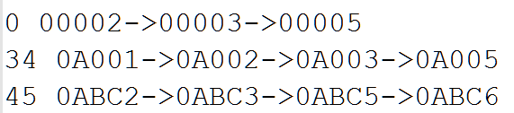
Jingmei
Danshui
Lady
Lady
7
18
11
17
5
Electric
15
14
9
2
8
3

Slide 8
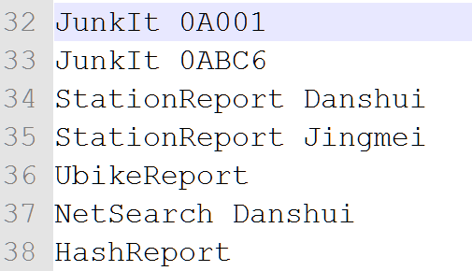
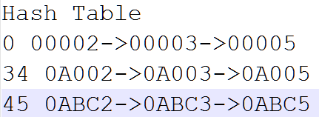
Jingmei
Danshui
Lady
Lady
17
11
5
Electric
15
14
9
2
8
3

