Slide 1
Hiragana Recognition with CNN
Ting-Wei Chang

Slide 2

Dataset
1000 handwritten Hiragana images
  50 Hiragana characters, each character having 20 images.
  The dataset is produced by Matheus Inoue.
Extract labels from filenames
  Each filename contains the romanji corresponding to each Hiragana, e.g. “kanaA0.jpg” indicates “a” (あ).
  Regex is used to extract the file name.
Training data and testing data
  Data is split into 800 training data and 200 testing data.

Slide 3
Augmentation
Augmentation is used to generate more data.
  Images are slightly rotated, stretched in height and width to imitate real-life handwriting.

Slide 4
CNN Model
A CNN model is constructed with several layers
  Two convolutional layers to extract the features in the images.
  A pooling layer (max pooling) to extract the most important features.
  Two dense layers to categorize each image into each label.

Slide 5
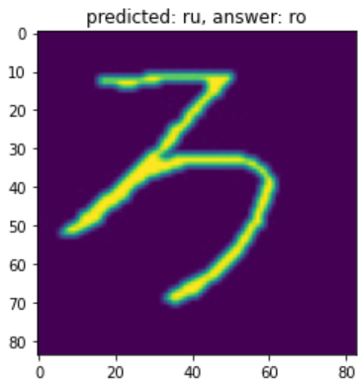
Training Result
200 testing data are kept for validation. They are not included in the training process.
The accuracy of the trained model is 99.5%, i.e., only one incorrect within 200 samples.
The wrong result:
  る (ru)
  ろ (ro)

