Slide 1
IoT-Hackathon 2017 Team Beacon
Lecture„IoT“, 18.01.2017

Slide 2
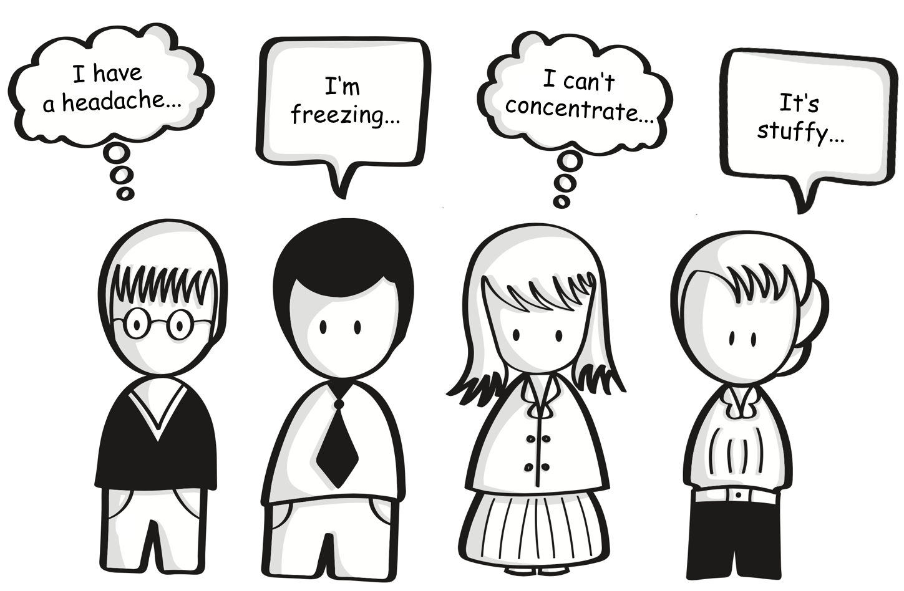

Slide 3
Project goal
Design a service utilizing beacon technology with a value proposition for students and lecturers.

Slide 4
Service design
Sensor network as part of an IoT-Architecture
Measure climate conditions (e.g. temperature and humidity)
Beacon provides Eddystone URL to access web UI
Implementation of MVP in room 125
„Get an app, fetch the beacon URL and access sensor data.“

Slide 5
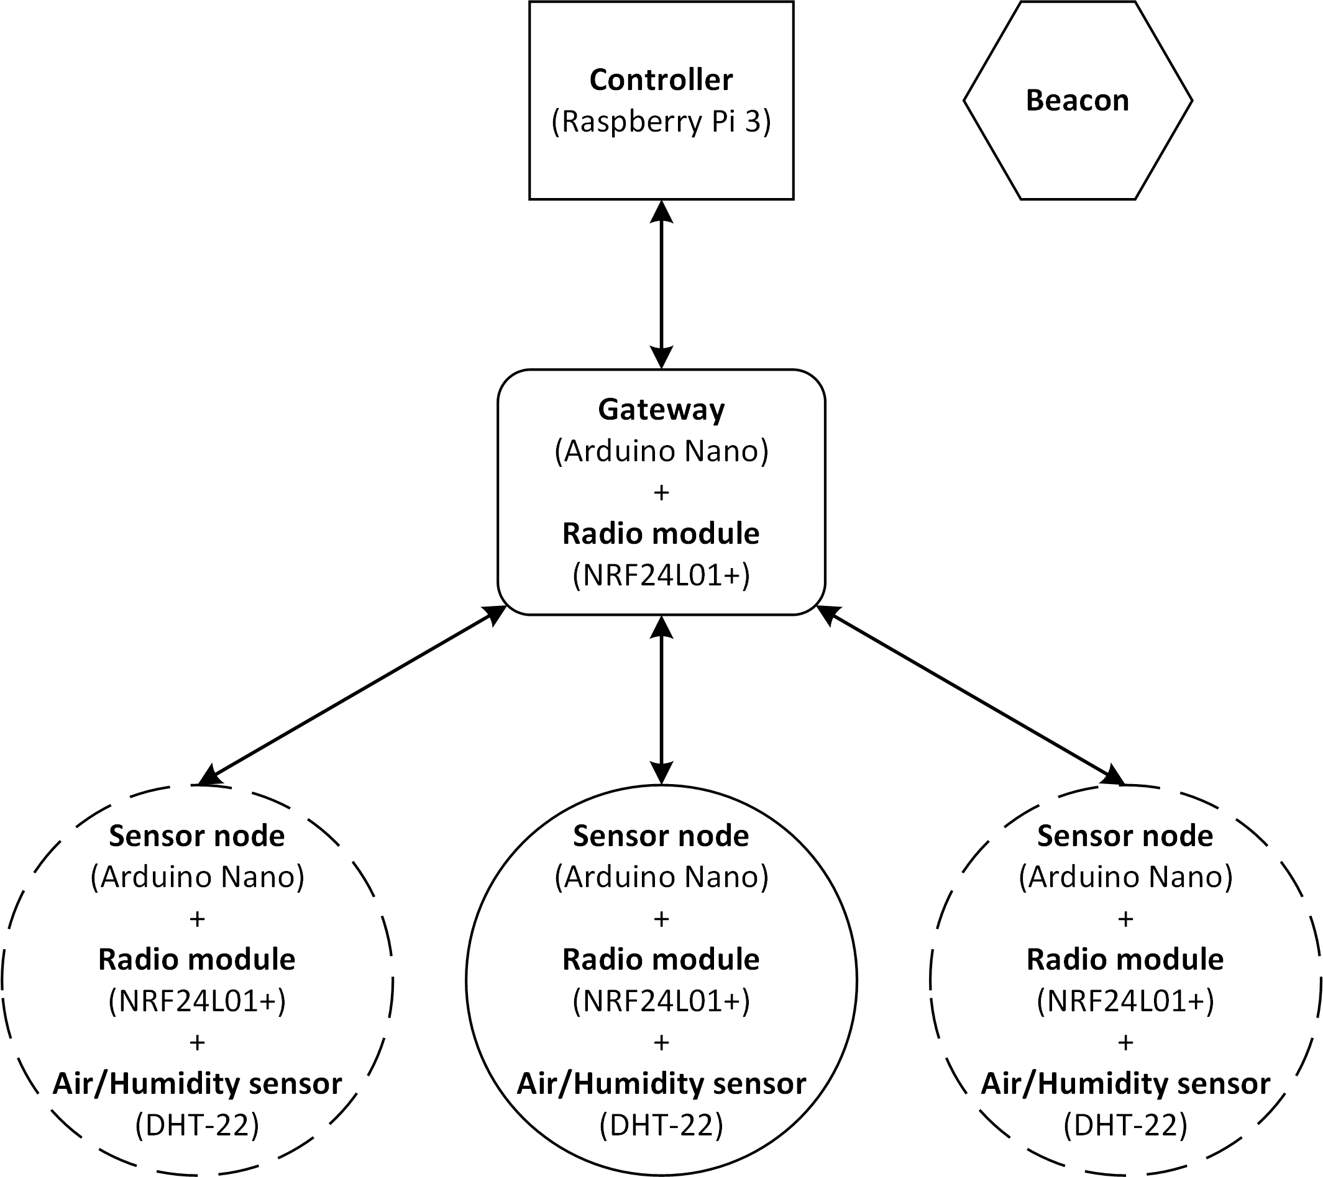
Architecture

Slide 6
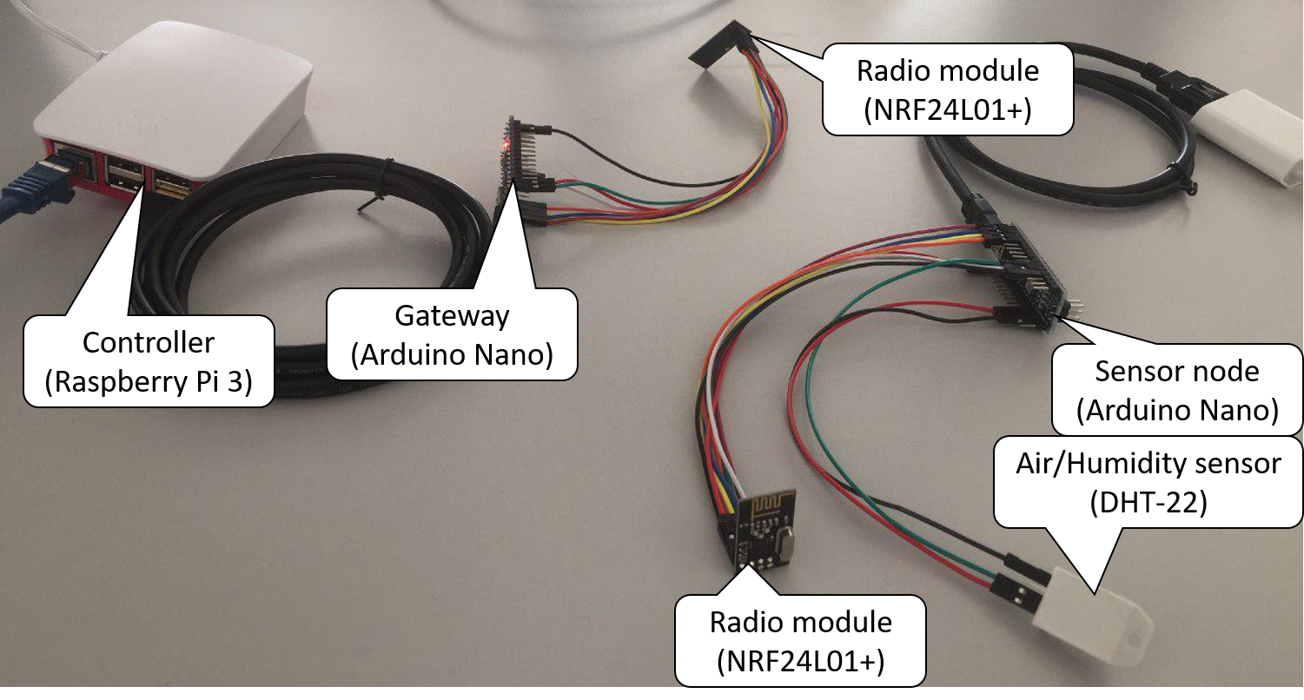
Architecture

Slide 7
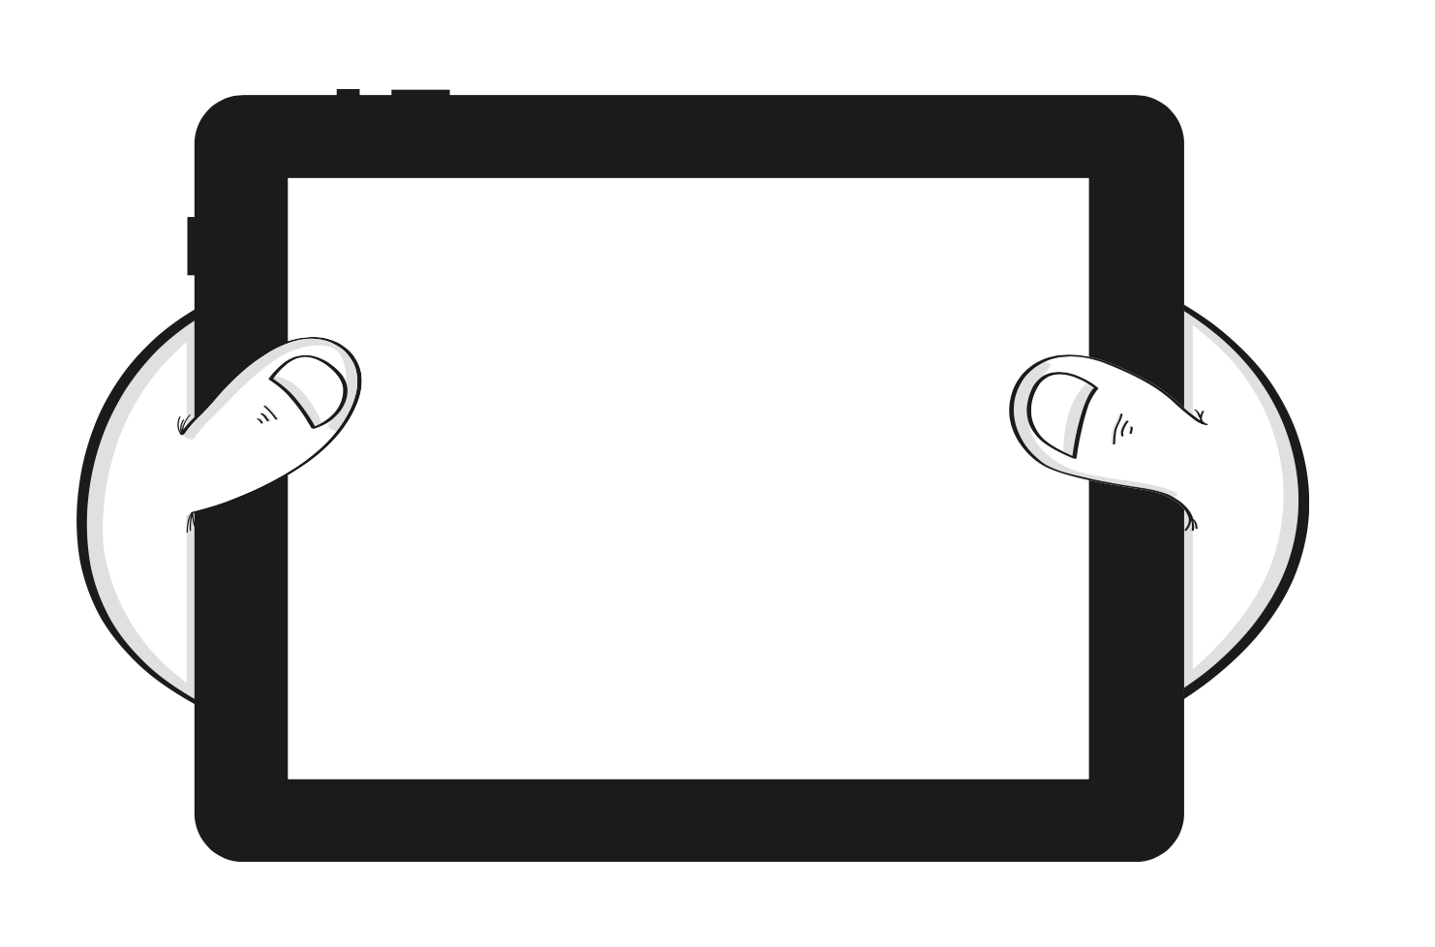
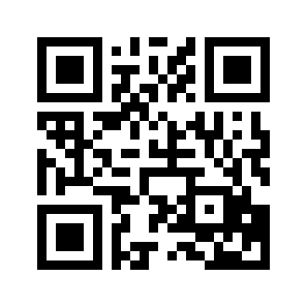

See it for yourself
bit.ly/2jYiL5v

Slide 8
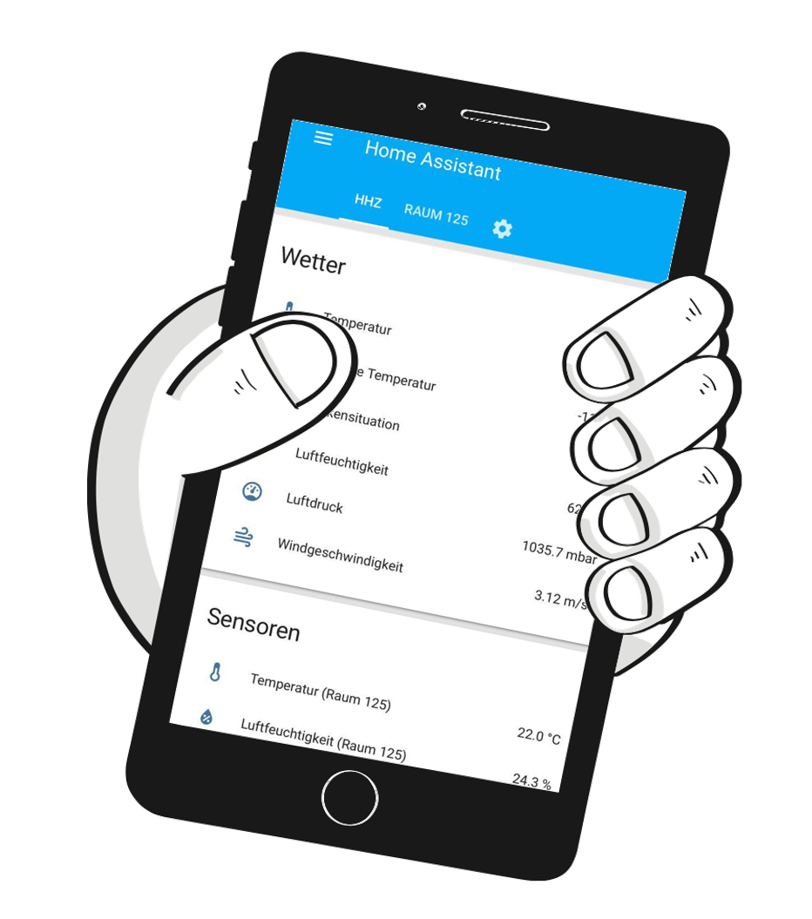
See it for yourself

Slide 9
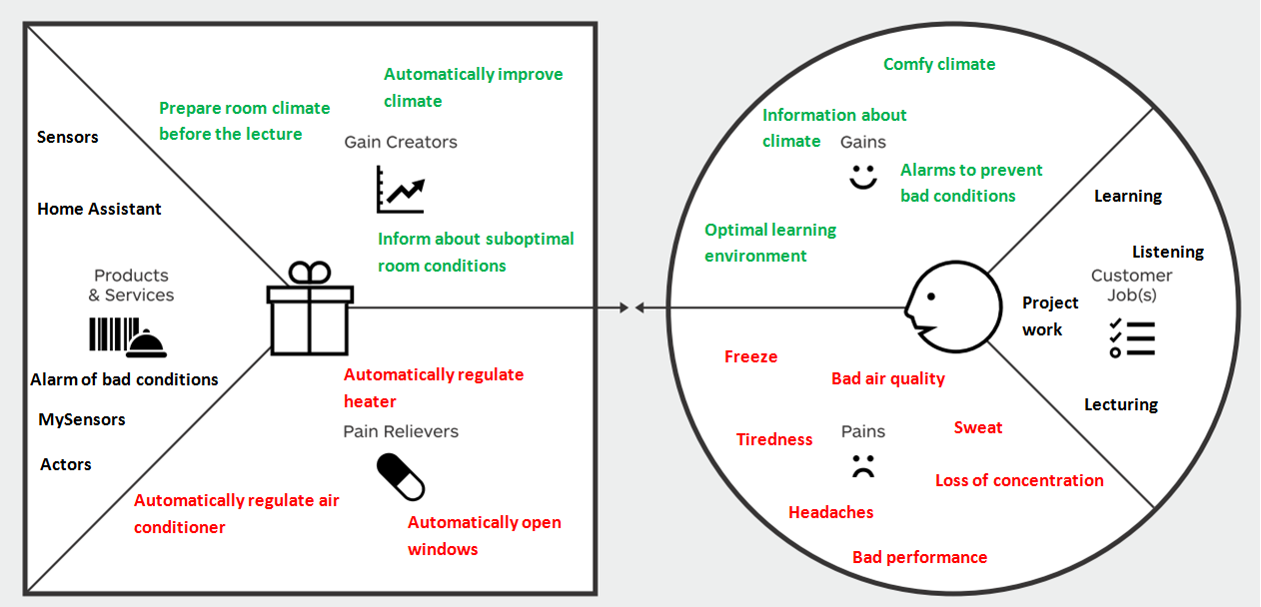
Value Proposition Design

Slide 10

Thanks!

