Slide 1
MEMS sensor
MSP432
Launchpad
Computer
Mechanical Fixing
Vibration
Generator
Signal Generator
Data collection and processing
Data visualisation and storage

Slide 2
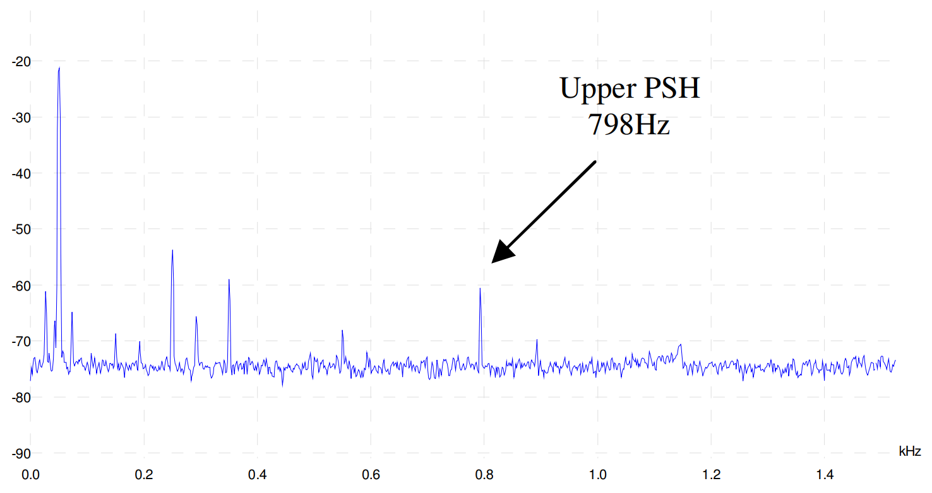
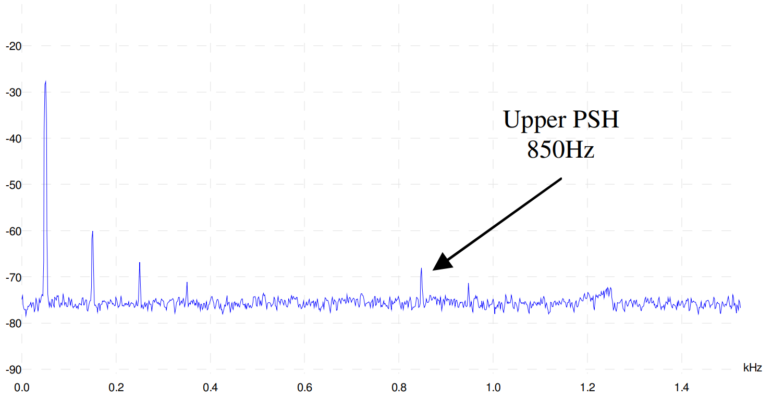
dB
a)
dB
b)

