Slide 1
MEMS sensor
MSP432
Launchpad
Computer
Mechanical Fixing
Vibration
Generator
Signal Generator
Data collection and processing
Data visualisation and storage

Slide 2
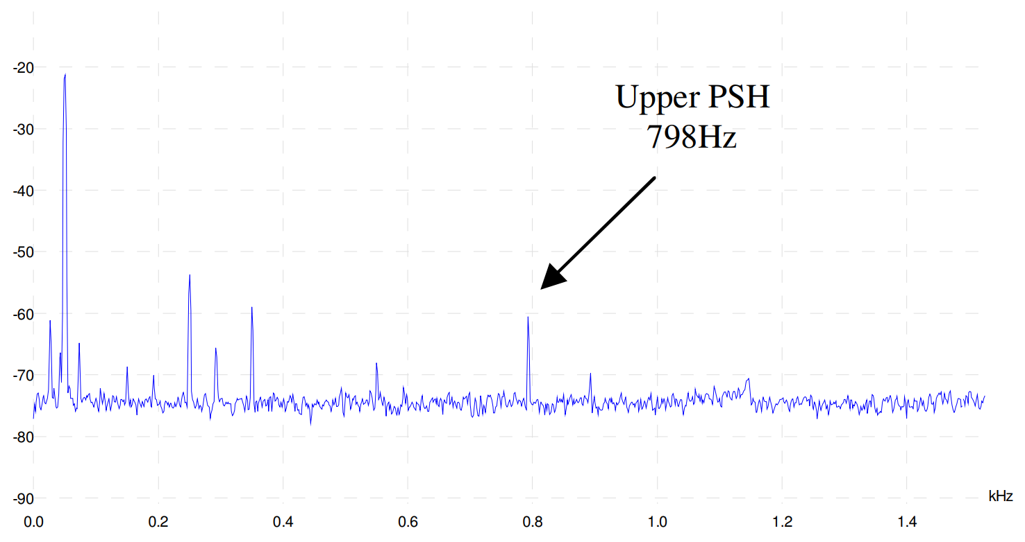
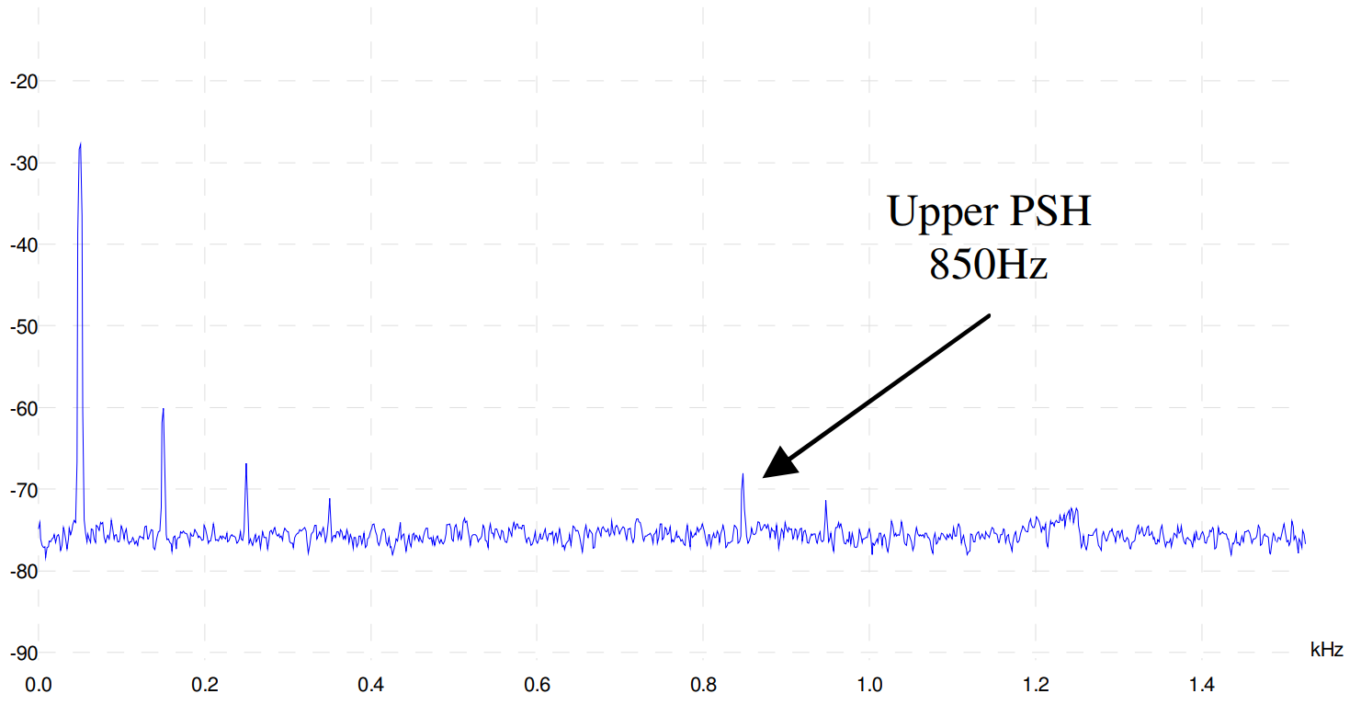
dB
a)
dB
b)

Slide 3
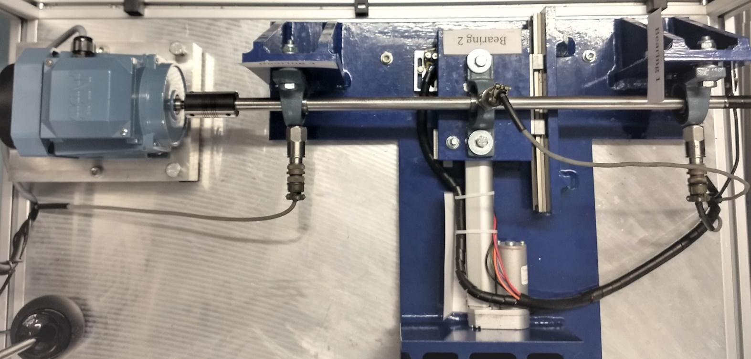
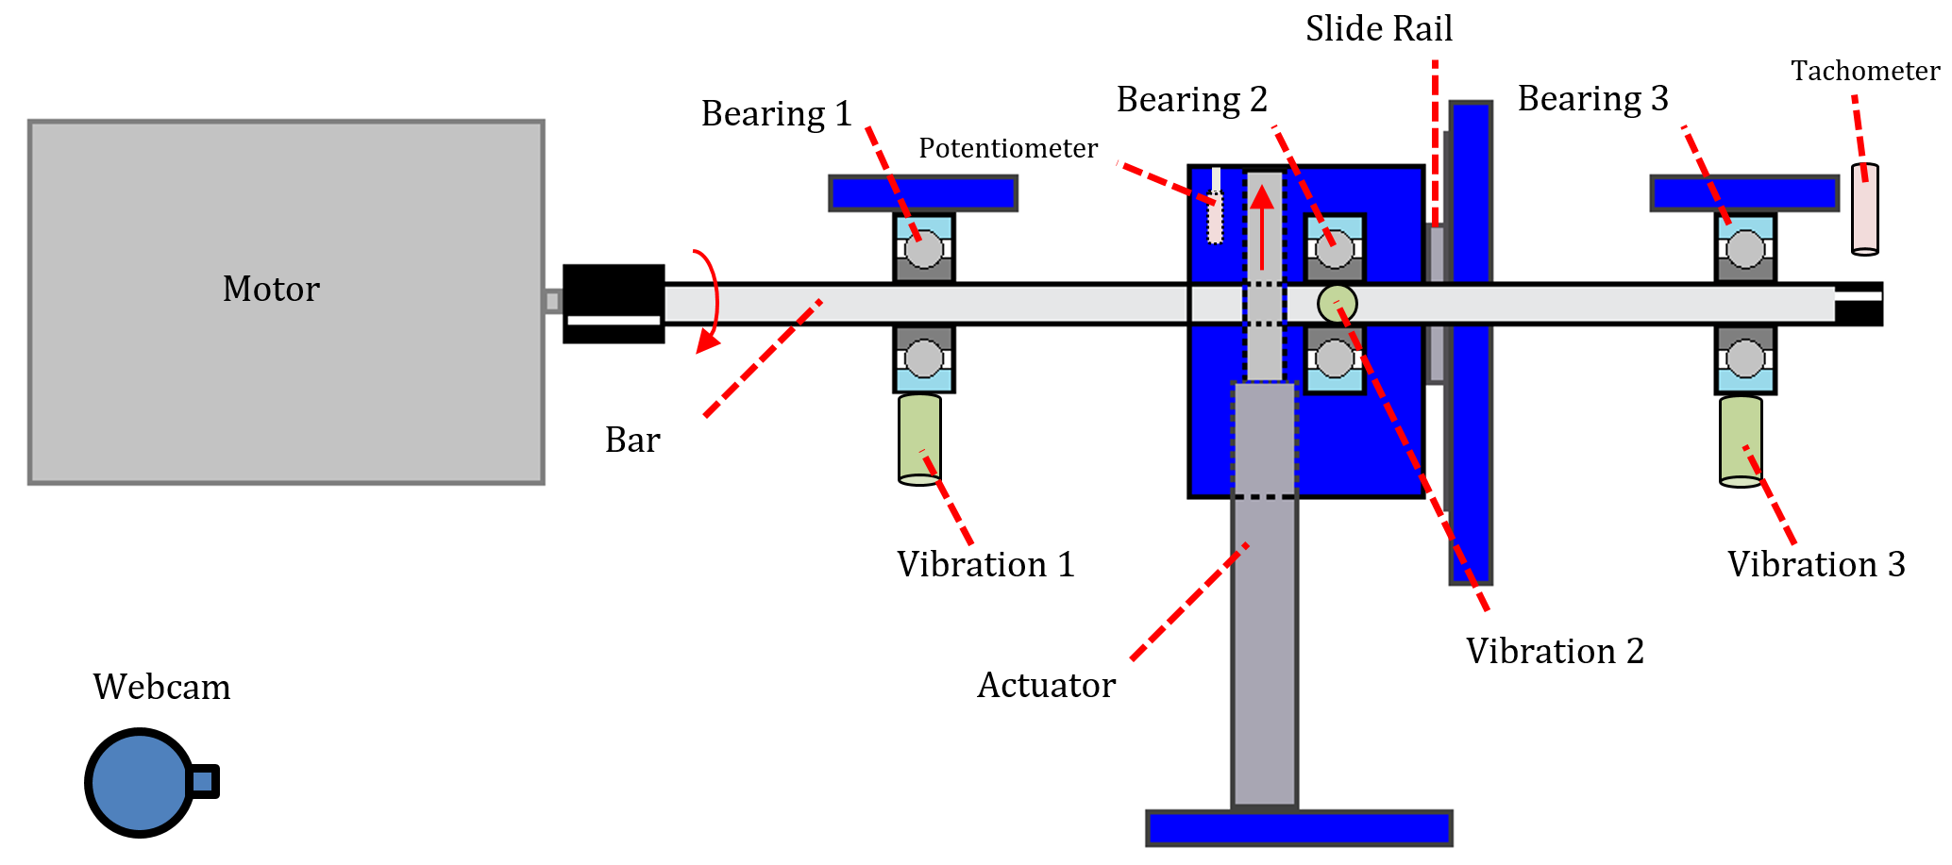
a)
b)
Bearing 3
Bearing 1
Vibration 3
Vibration 1

Slide 4
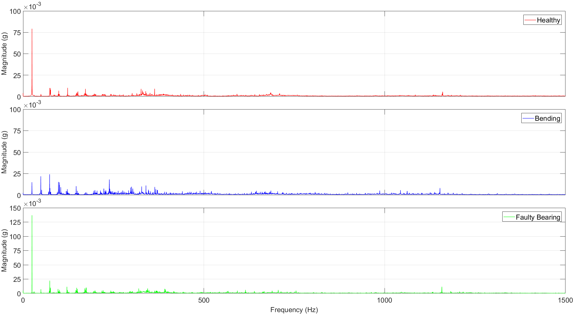
f_{r}
Harmonics with low magnitude
f_{r} with reduced magnitude
Increasing harmonics indicating bending
Very noisy
f_{r} with increased magnitude
Distinct peak at high frequency

Slide 5

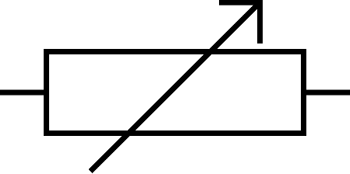
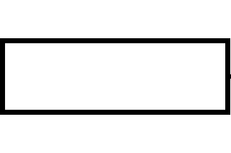

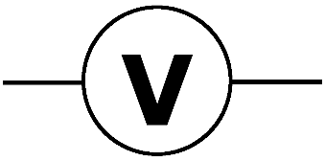
Current Source
Computer
MSP432
Launchpad
Current Transducer
R₂
R₁
Calibrated Ammeter

