Slide 1
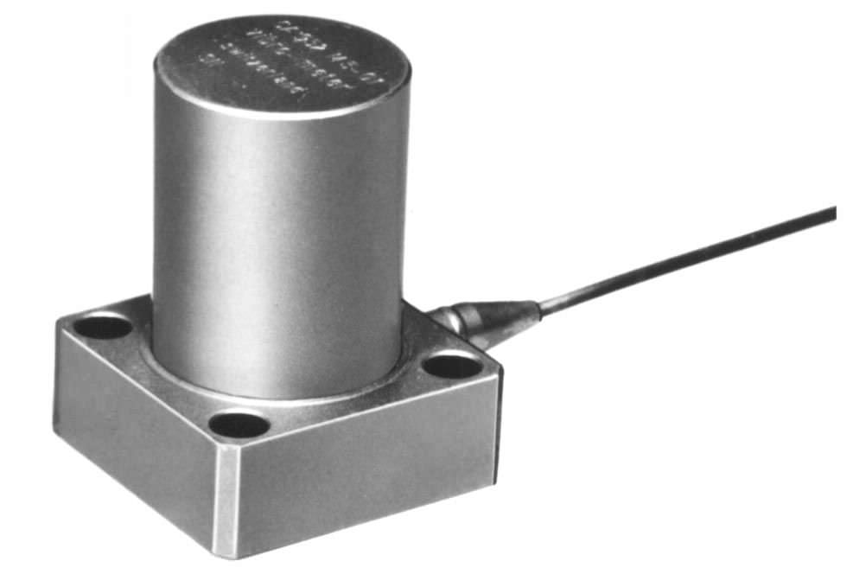
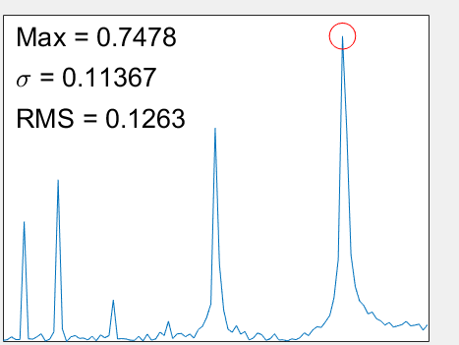
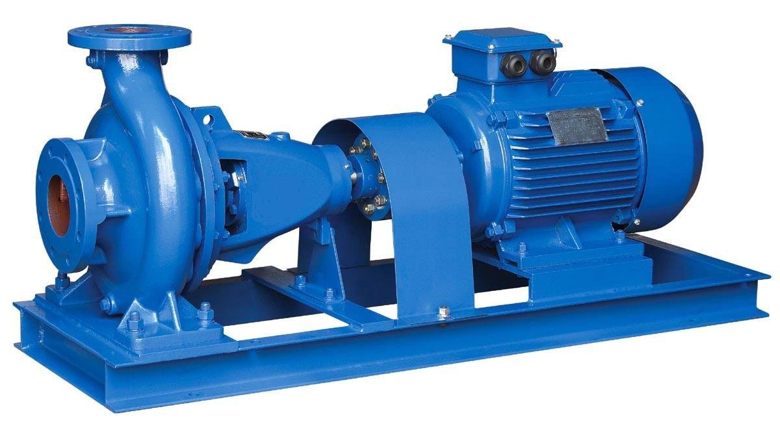
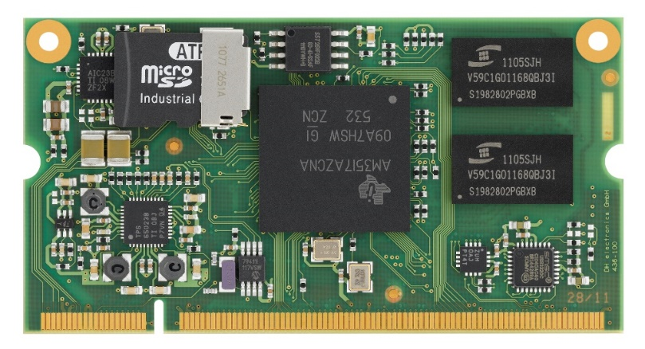
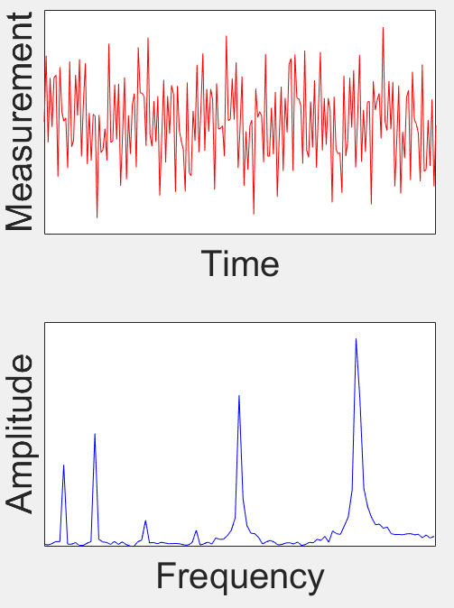
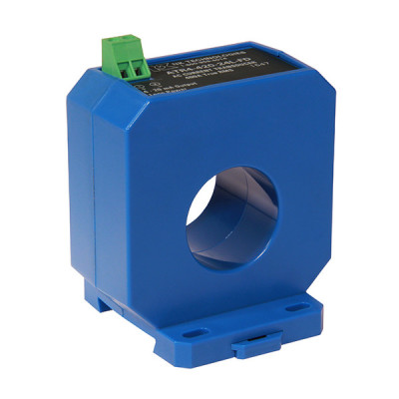
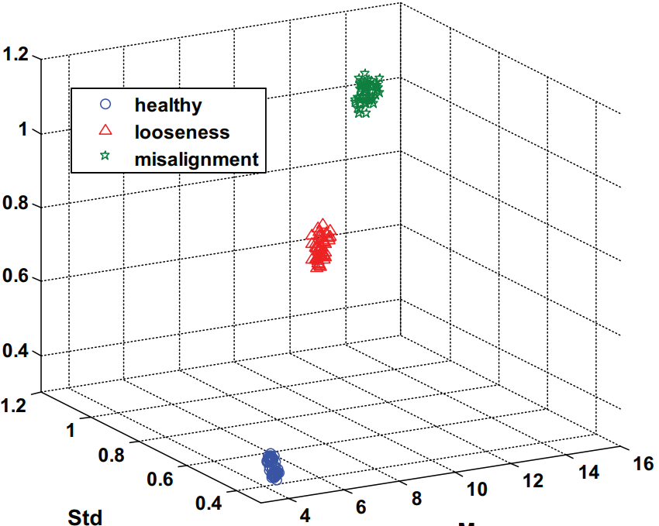
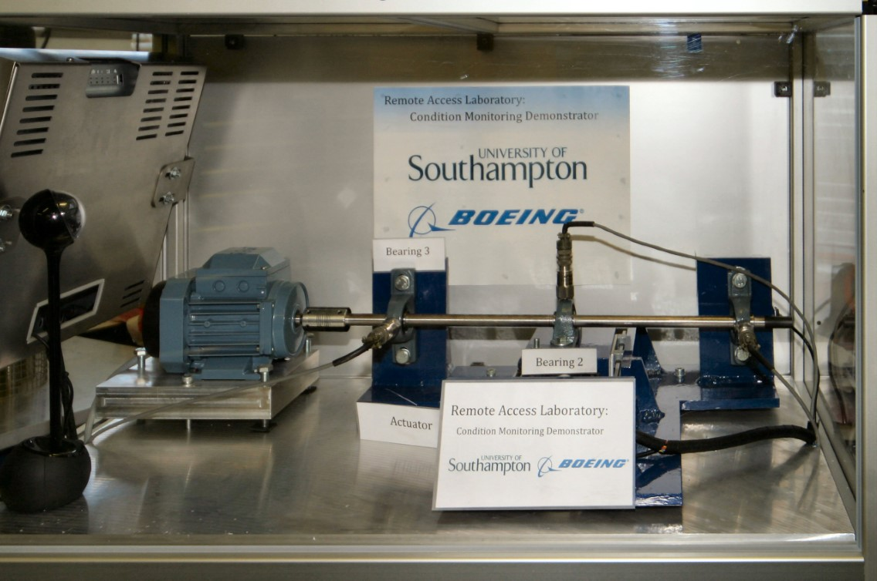
EMBEDDED SYSTEM FOR CONDITION MONITORING OF MARINE PUMPS
Timothy Guite (MSc Embedded Systems) Supervisor: Dr Alex Weddell
Aims
Build a functioning embedded system which monitors the condition of a marine pump
Collect data and perform on board processing
Use data to provide basic diagnostics of the pump
Evaluate sensors from different price points
Why?
Time and money is wasted repairing pumps on a fixed schedule or only once they have failed [1]
Providing cheap monitoring systems would allow Condition-Based Maintenance of these pumps
Current solutions are not viable due to their high cost
Condition-Based Maintenance (CBM)
CBM describes measuring data during operation to accurately estimate the health of a machine or individual component [1]
Shown to successfully reduce maintenance costs across a range of industries and minimise shutdown time [2]
Machines are worked closer to their predicted lifetime and repairs can be targeted towards specific faults [3]
Indirect damage as a result of failure during operation is avoided
Essential for efficiently operating autonomous ships in the future
Condition Monitoring Methods
Vibration analysis
Most prevalent method [2]
Measure with accelerometer or velocity transducer
Detects mechanical faults
Requires measuring high frequencies ~10 kHz [3]
Sensor placement is important
Motor Current Signature Analysis (MCSA)
Detects both electrical faults and mechanical faults
Measure stator current using Hall Effect Current Transducer
Lower frequency range ~5kHz [4]
Very noisy measurements [3]
Embedded System Diagram
Accelerometer
Measurement
Amplitude
Transmit data
Marine Pump
Time
Frequency
Fit sensors to pump
Processor Board
Collect sensor data at regular intervals
Transfer to frequency domain an extract features for diagnosis
Current Sensor
Measurements and Diagnostics
Currently, many pumps on board ships operate without any record of their condition or performance
This system will transmit the runtime and operating speed of pumps, along with simple statistical features
Such data is immediately useful to workers who maintain pumps, and provides the basis for data-driven learning, predicting remaining lifetime and environmental effects
Testing and development
Computation will be tested by sending data to the embedded system over a communication channel and comparing the output with an offline implementation
Sensor data will then be verified by comparison with sensors on the Remote Access Laboratory (RAL)
RAL is an existing setup with motor, shaft, multiple bearings and accurate condition monitoring equipment
Even small numbers of features such as maximum, root mean square and standard deviation of the frequency spectrum can detect and diagnose faults [2]
Healthy and faulty conditions will be diagnosed on-board
Direct comparison of system performance
Multiple fault types can be induced, including damaged bearings and shaft bending
Long term tests to simulate live environment
RMS
Std
Maximum
Diagnosis of system from basic statistical features [2]
Remote Access Laboratory available in Tribology department at UoS
References
[1] Z. Hameed, S. Ahn and Y. Cho, "Practical aspects of a condition monitoring system for a wind turbine with emphasis on its design, system architecture, testing and installation", Renewable Energy, vol. 35, no. 5, pp. 879-894, 2010
[2] A. Moosavian et al., "Fault diagnosis and classification of water pump using adaptive neuro-fuzzy inference system based on vibration signals", Structural Health Monitoring: An International Journal, vol. 14, no. 5, pp. 402-410, 2015
[3] R. Randall, Vibration-based condition monitoring, Hoboken, N.J.: Wiley, 2013
[4] F. Bonnardot, R. Randall and J. Antoni, "Enhanced Unsupervised Noise Cancellation using Angular Resampling for Planetary Bearing Fault Diagnosis", The International Journal of Acoustics and Vibration, vol. 9, no. 2, 2004

Slide 2

Accelerometer
Amplitude
Transmit data
Marine Pump
Frequency
Fit sensors to pump
Processor board
Collect sensor data at regular intervals
Transfer to frequency domain an extract features for diagnosis
Current Sensor
Measurements and Diagnostics
Currently, many pumps on board ships operate without any record of their condition or performance.
This system will transmit the runtime and operating speed of pumps, along with simple statistical features.
Such data provides the basis for data-driven learning, performed on powerful computers, and is immediately useful to workers who maintain pumps.
Even small numbers of features such as maximum, root mean square and standard deviation of the frequency spectrum can detect and diagnose faults [2].
RMS
Std
Maximum
Diagnosis of system from basic statistical features [2]

