Slide 1
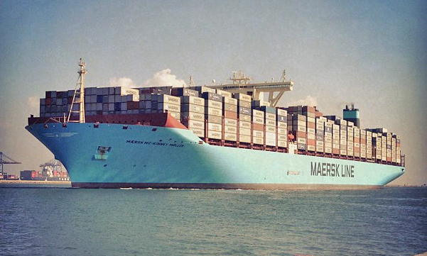
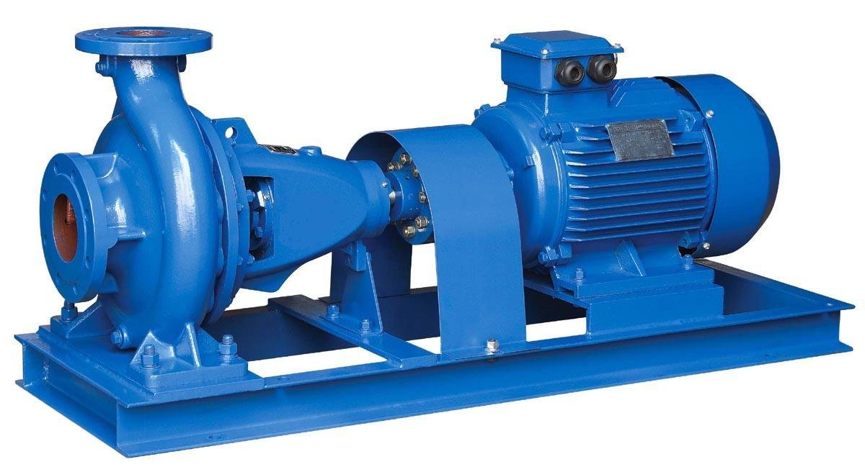
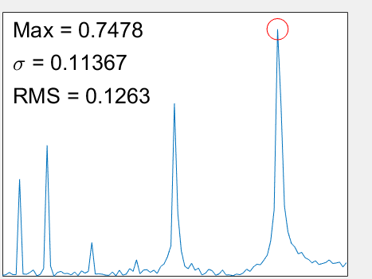
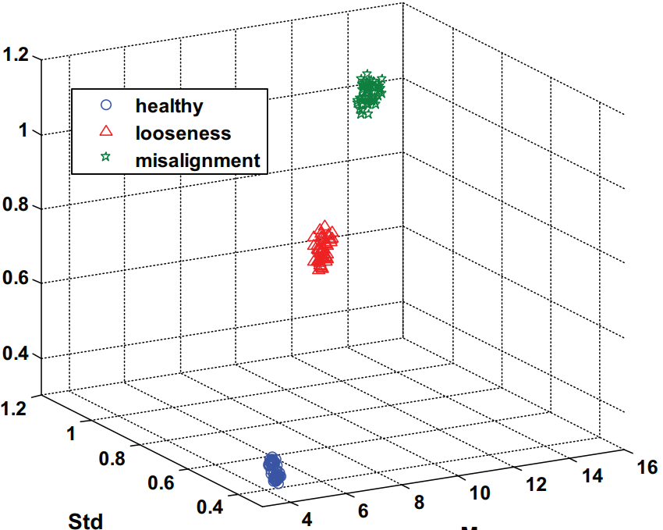
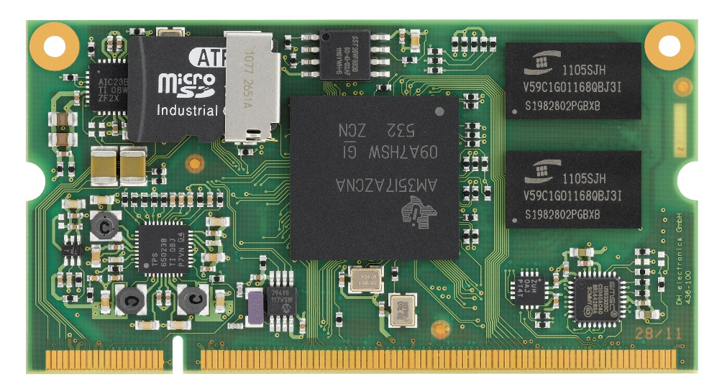
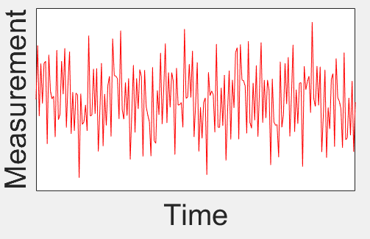
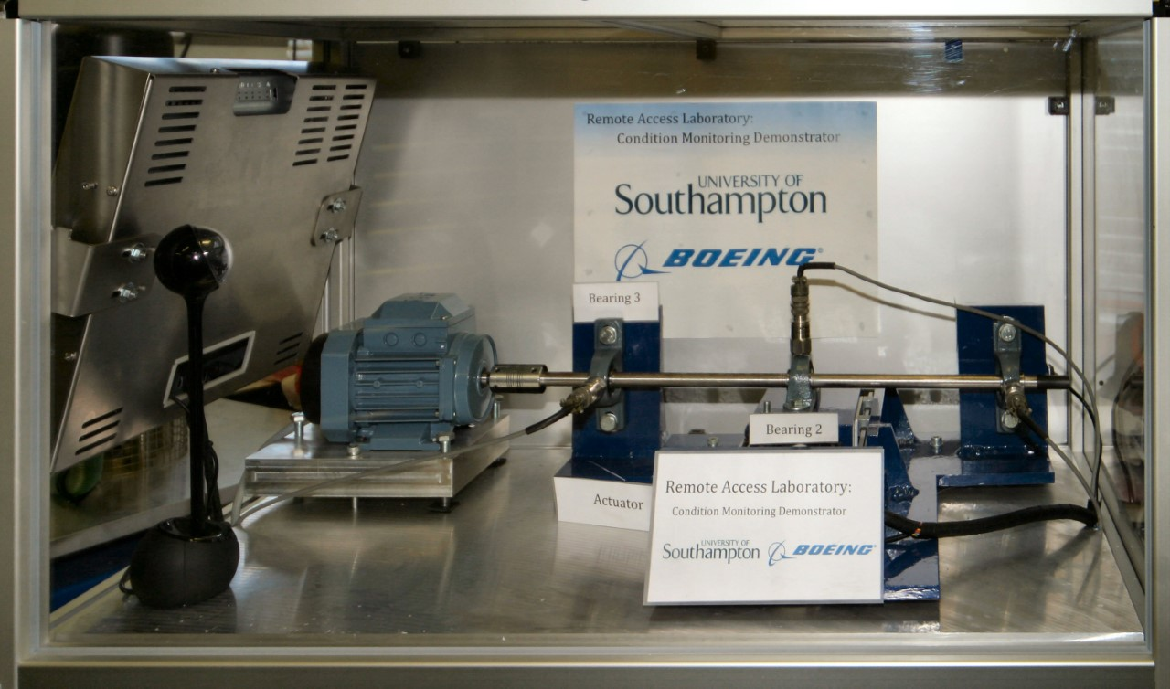
EMBEDDED SYSTEM FOR CONDITION MONITORING OF MARINE PUMPS
Timothy Guite (MSc Embedded Systems) Supervisor: Dr Alex Weddell
Aims
Build a functioning embedded system which can measure data from a pump
On board processing of the data to extract information about the condition of the pump
Transmit information to another system
Demonstrate system in a live environment
Why?
Present condition monitoring systems on ships are too expensive for non-vital components
Time and money is wasted repairing them on a fixed schedule or only once they have failed [1]
Providing a cheap solution would allow Condition Based Maintenance of these pumps and pave the way for Autonomous Shipping
Data Collection
Data Processing
Amplitude
RMS
Frequency
Std
Maximum
Large ships can have hundreds of pumps on board
Maximum, Root Mean Square and Standard deviation of frequency spectrum used for diagnosis [2]
Modern diagnosis methods can identify specific faults but run on powerful, expensive computers
On board processing will transfer the time-based data to the frequency domain where it is more useful
Even simple features such as maximum, RMS and standard deviation can detect faults
Runtime and operating speed are simple and useful features that are not currently recorded
Combining statistics such as mean time to failure with information about operating conditions, enables data driven prognostics tools to predict remaining lifetime of components
Modern embedded systems can collect accurate data at a much lower price point than existing solutions
Vibration analysis
Widely used for industrial machinery
Detects faults on mechanical components
Requires measuring high frequencies ~10 kHz [3]
Motor Current Signal Analysis (MCSA)
Detection of electrical and mechanical faults
Lower frequency range ~ 5kHz [4]
Very noisy measurements [3]
Testing
Motor, shaft, bearings and accelerometers
Healthy, faulty bearings and shaft bending
Long term tests to simulate live environment
Commercialisation
Industrial Partnership with Lloyd’s Register
New monitoring options to offer clients
Smart Shipping and Autonomous Shipping
Requires detailed information about components
Will require better models to estimate failure rates
Sensor vendors or integrated solutions
Possible legal issues facing autonomous vehicles
Remote Access Laboratory available in Tribology department at University of Southampton
References
[1] Z. Hameed, S. Ahn and Y. Cho, "Practical aspects of a condition monitoring system for a wind turbine with emphasis on its design, system architecture, testing and installation", Renewable Energy, vol. 35, no. 5, pp. 879-894, 2010
[2] A. Moosavian et al., "Fault diagnosis and classification of water pump using adaptive neuro-fuzzy inference system based on vibration signals", Structural Health Monitoring: An International Journal, vol. 14, no. 5, pp. 402-410, 2015
[3] R. Randall, Vibration-based condition monitoring, Hoboken, N.J.: Wiley, 2013
[4] F. Bonnardot, R. Randall and J. Antoni, "Enhanced Unsupervised Noise Cancellation using Angular Resampling for Planetary Bearing Fault Diagnosis", The International Journal of Acoustics and Vibration, vol. 9, no. 2, 2004

Slide 2
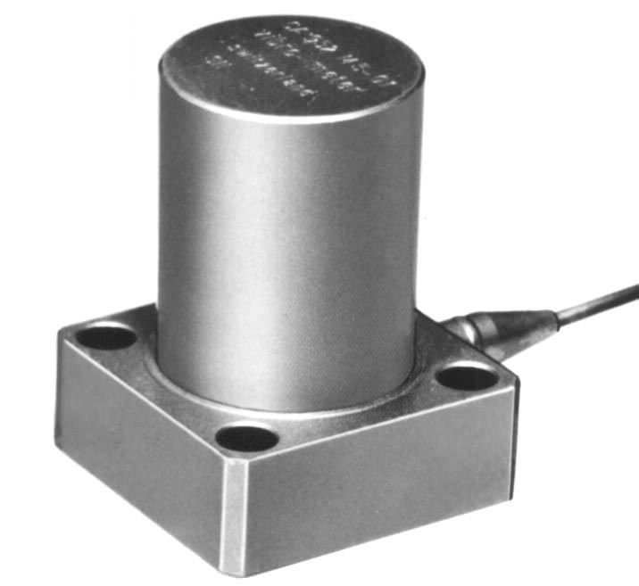

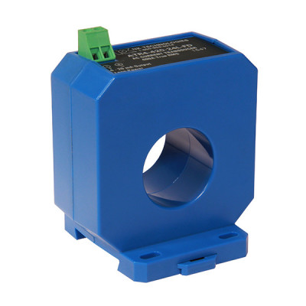
Accelerometer
Amplitude
Transmit data
Marine Pump
Frequency
Fit sensors to pump
Processor board
Collect sensor data at regular intervals
Transfer to frequency domain an extract features for diagnosis
Current Sensor

