Slide 1
MEMS sensor
MSP432
Launchpad
Computer
Mechanical Fixing
Vibration
Generator
Signal Generator
Data collection and processing
Data visualisation and storage

Slide 2
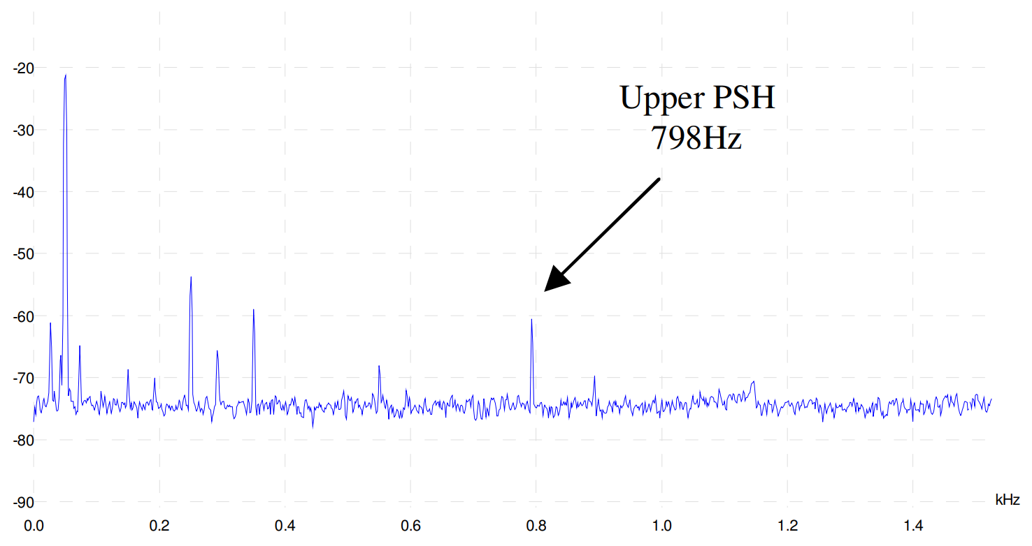
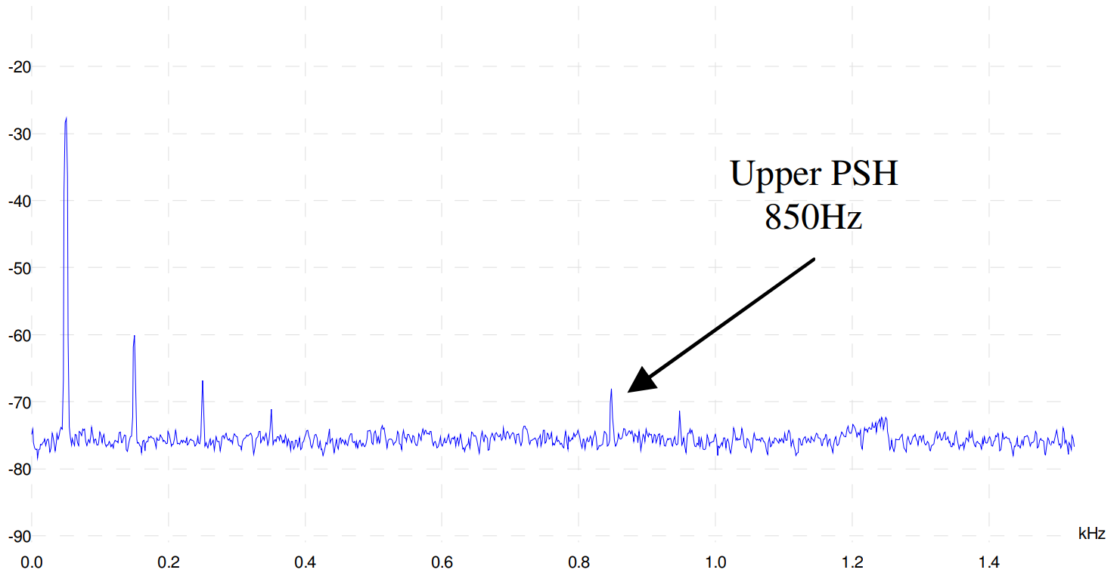
dB
a)
dB
b)

Slide 3
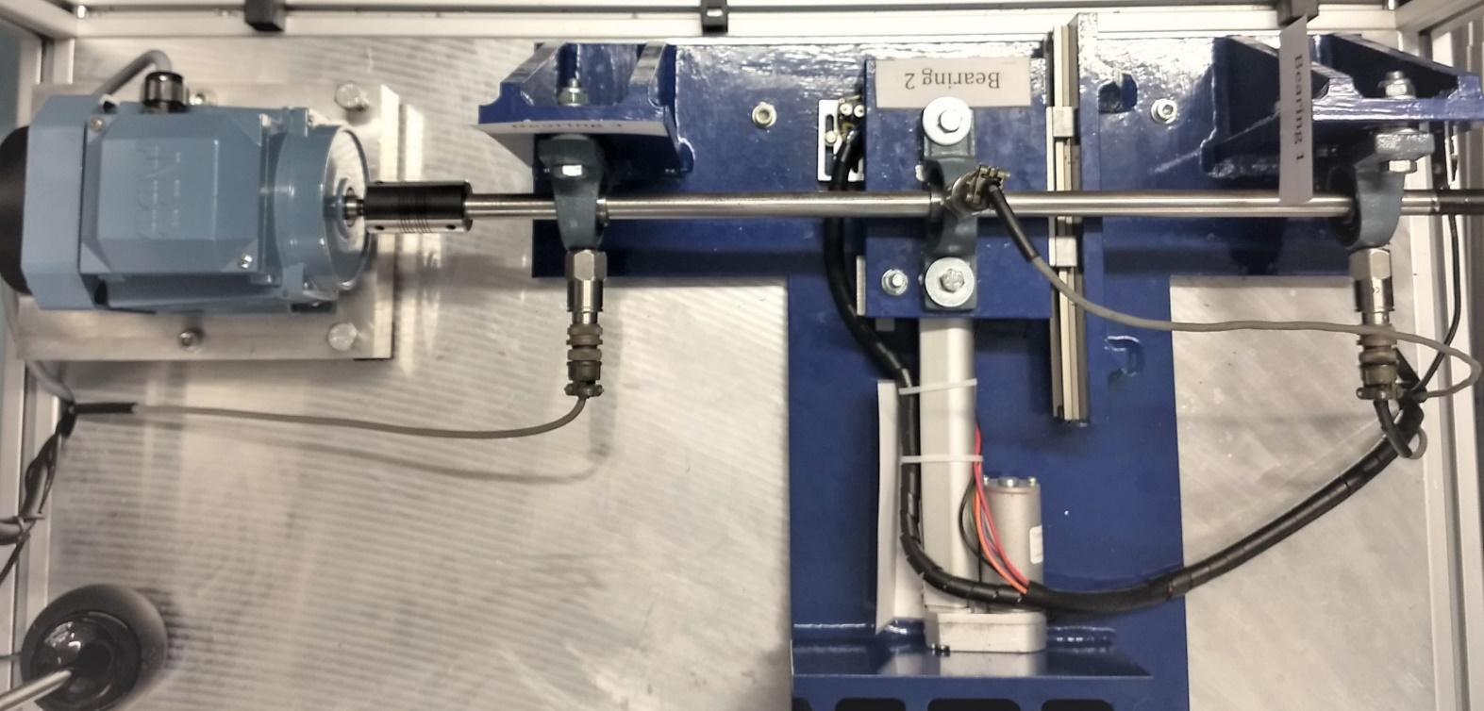
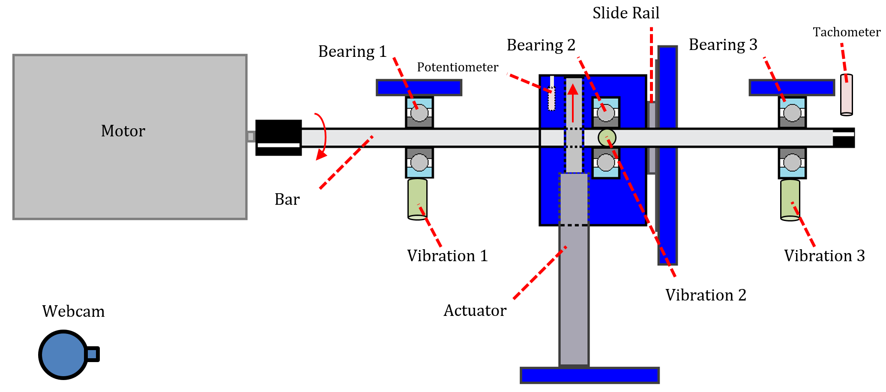
a)
b)
Bearing 3
Bearing 1
Vibration 3
Vibration 1

Slide 4
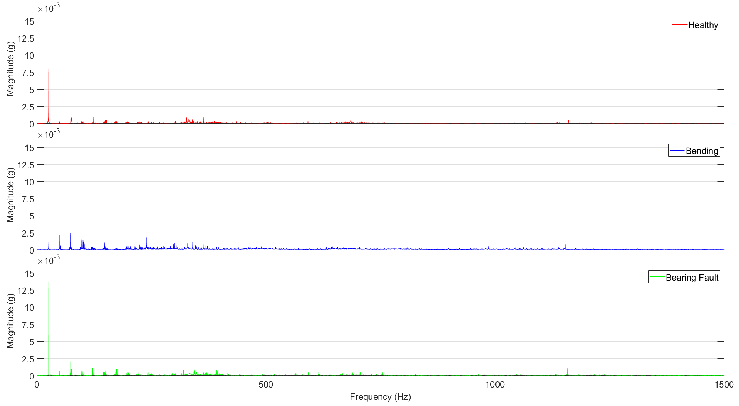
f_{r}
Harmonics with low magnitude
f_{r} with reduced magnitude
Increasing harmonics indicating bending
Noisy range
f_{r} with increased magnitude
Distinct peak at high frequency

Slide 5


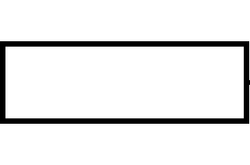

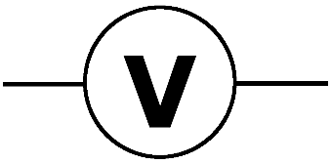
Current Source
Computer
MSP432
Launchpad
Current Transducer
R₂
R₁
Calibrated Ammeter

Slide 6
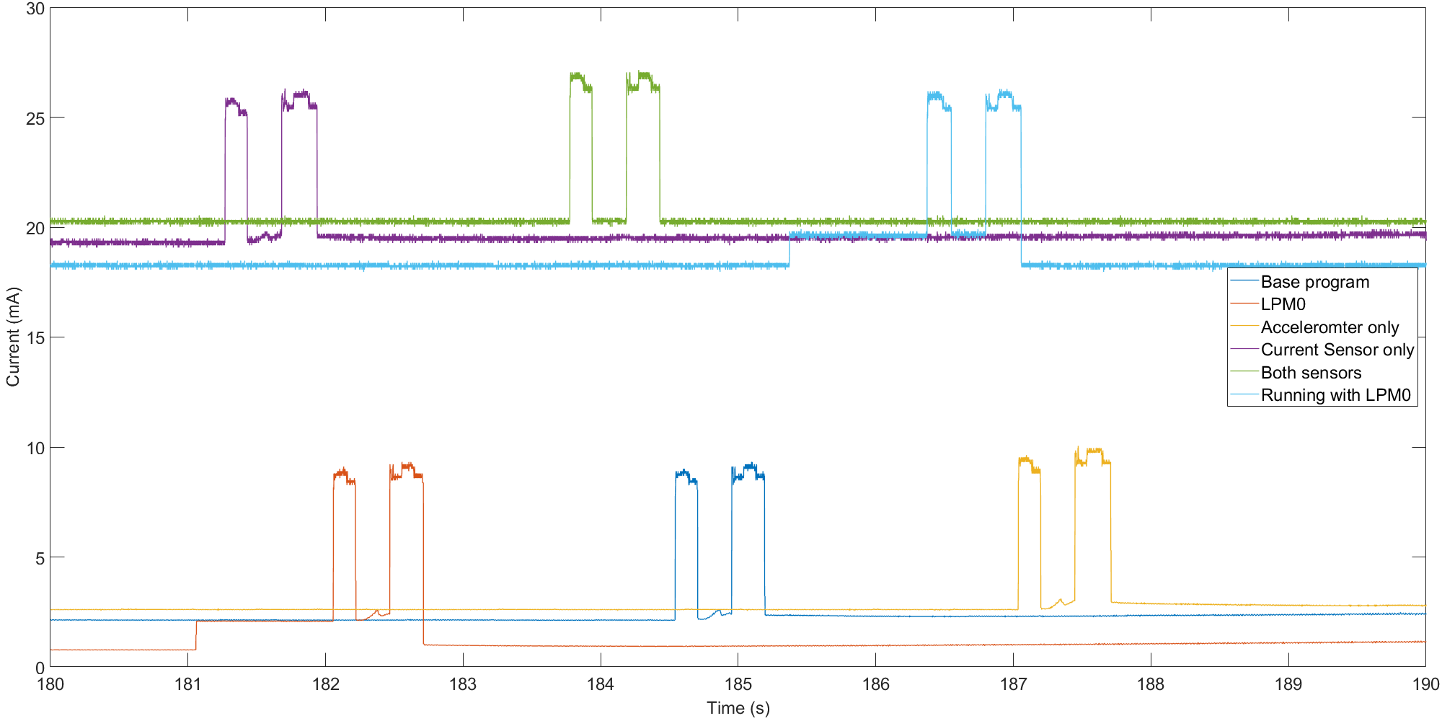
Noise in current consumption of current sensor
ADC has constant current use when both sensors are connected
Returns to LPM0 after transmission
Exits LPM0 during read from ADC
Reading and transmission of current analysis
Reading and transmission of vibration analysis
Transmission
FFT, Frequency domain
Time domain
Transmission
Reading ADC for vibration analysis
Move from LPM0 to active mode

Slide 7
Computer
MSP432
Launchpad
MEMS sensor
Current Transducer
Mechanical Fixing
Motor
Bearing 2
3 Phase Power Supply
Bearing 3
Linear Actuator
Bearing 1

Slide 8
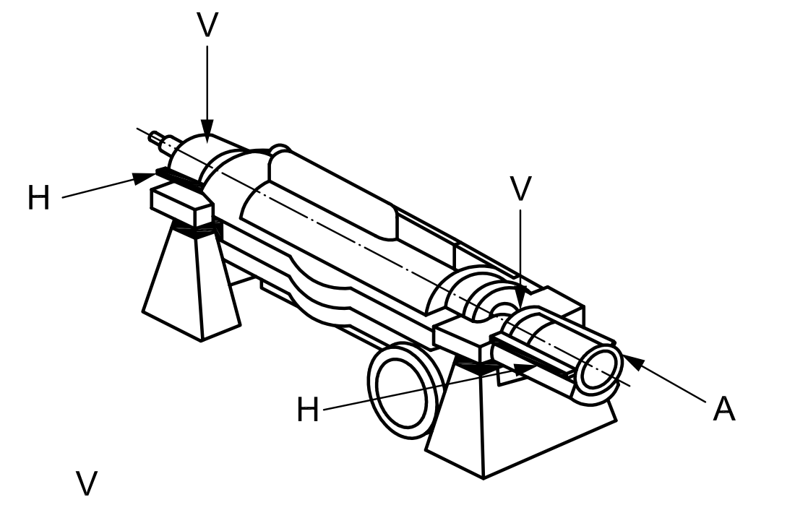
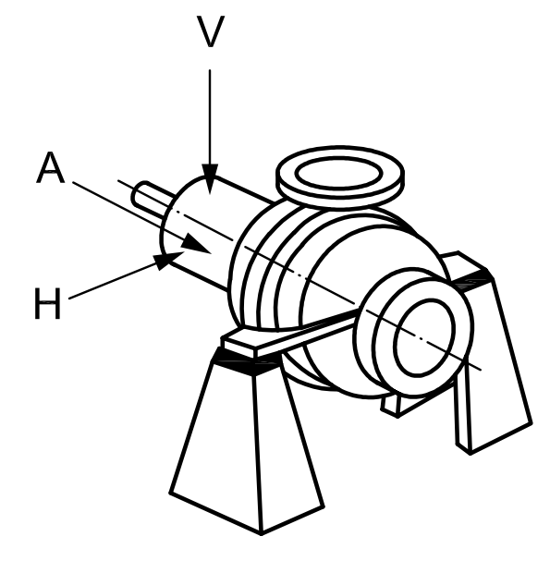
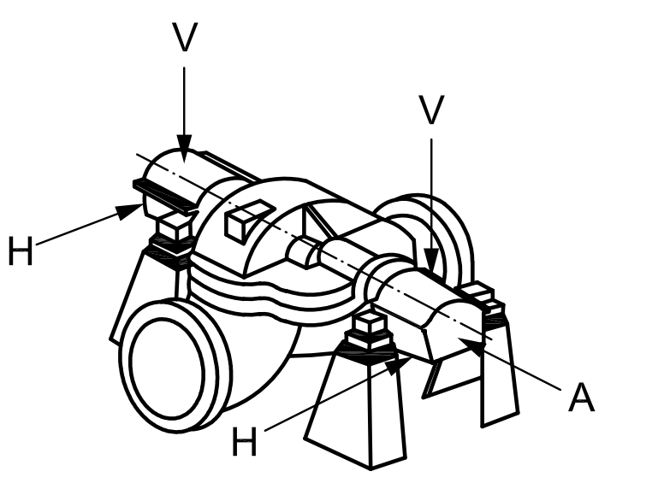

Slide 9
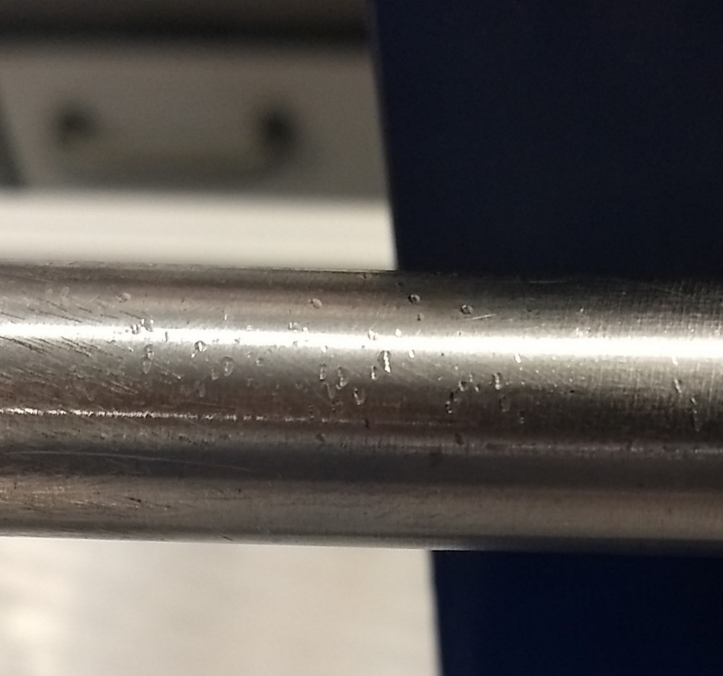
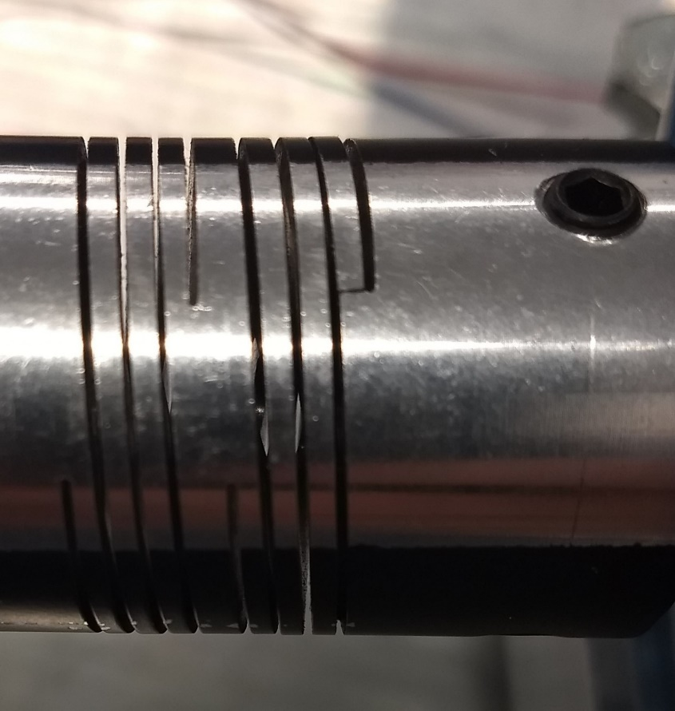

Slide 10
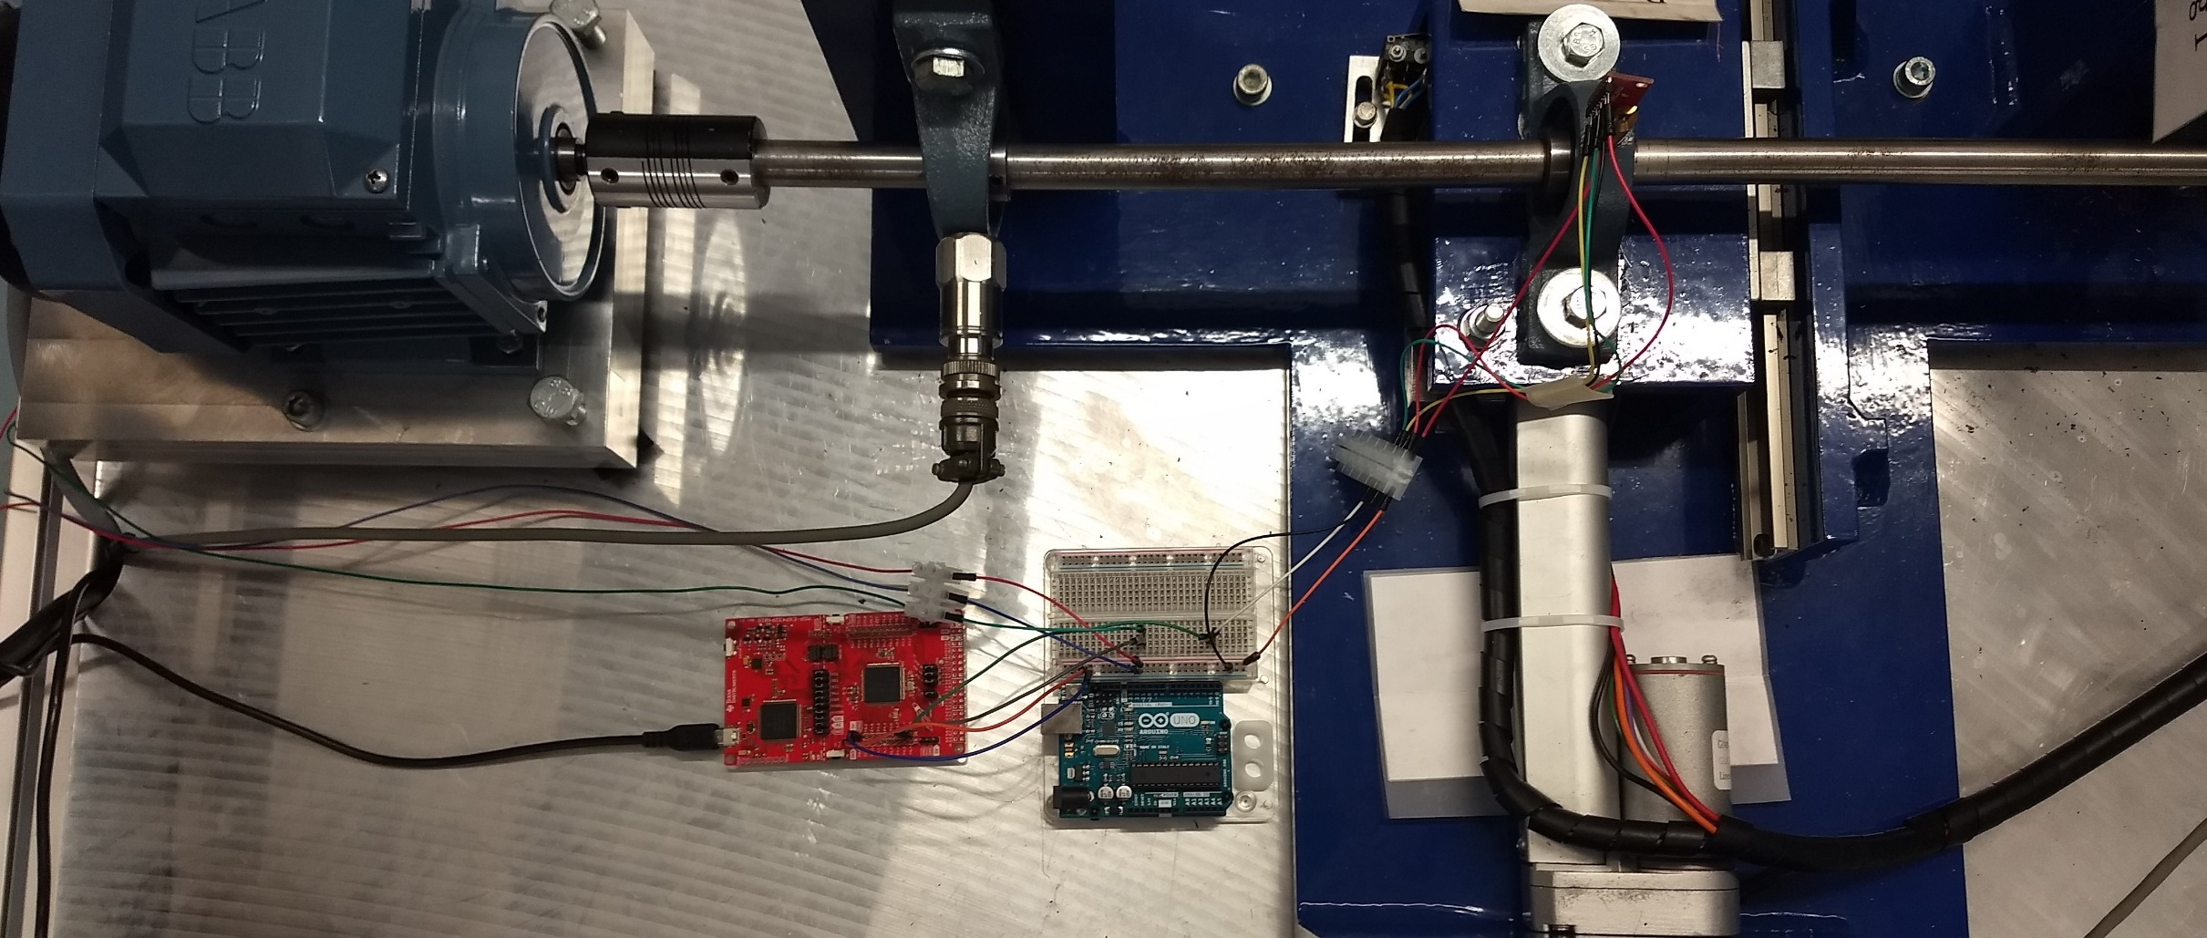
MEMS A
Breadboard for wiring
Connection to CT
Power and communication
MSP432 Launchpad
Arduino not used

Slide 11
Vibration Analysis
Accelerometers, mounting point, fixing
Microcontroller
Communication of condition and useful statistics
MCSA
Current Transducer, access to power supply
Data collection, processing and condition decision

