Slide 1
Optimization Approaches for Self-Adaptive Systems
Tim Engbrocks
17.06.2021

Slide 2

“The looming software crisis” – IBM, 2001
- IBM released a paper in 2001 which talked about a looming software crisis, because of the ever increasing complexity of software.
- A lot has happened to software since 2001
  Find data to support this statement, like growth of internet usage
  Maybe the what happens in a minute of the internet chart
Goal: Establish the need for autonomous management
Motivation
Foundation
Related Work
Approach
Evaluation
Summary

Slide 3
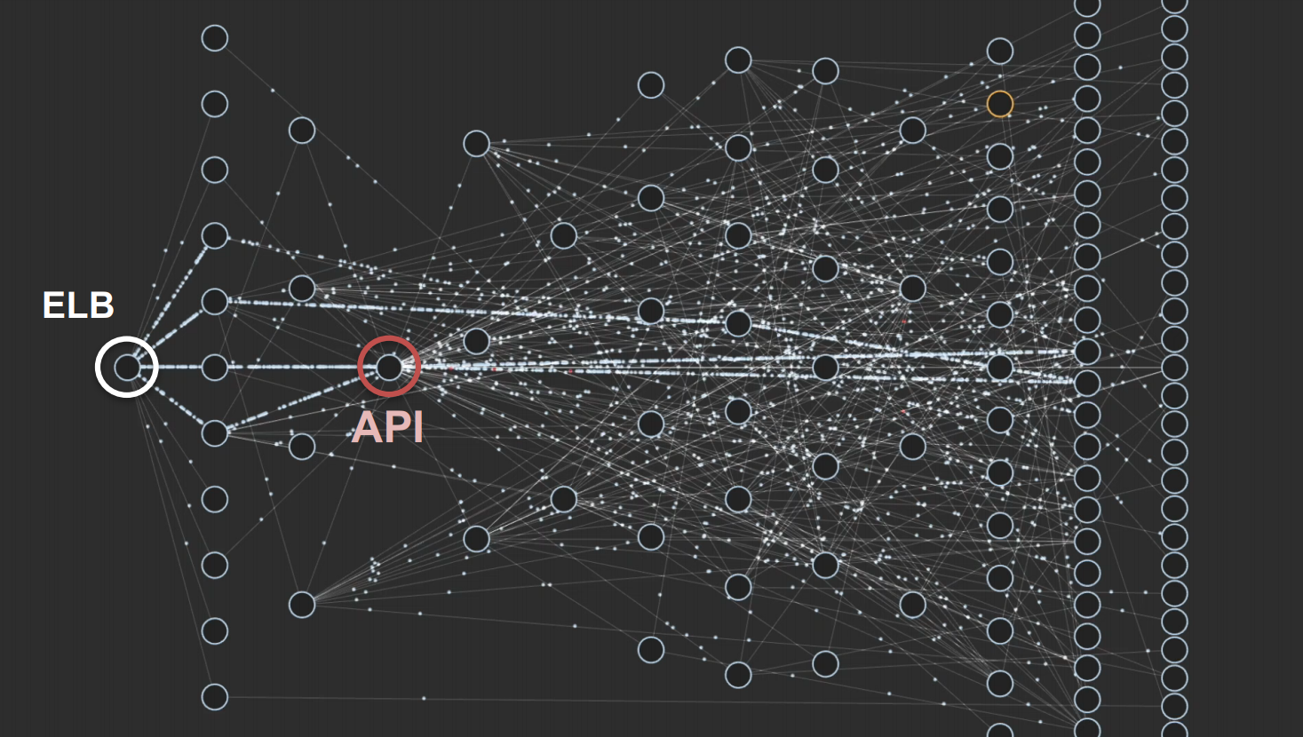
Netflix Microservice Architecture
Josh Evans CTO@Netflix,
QCon 2016
Motivation
Foundation
Related Work
Approach
Evaluation
Summary

Slide 4
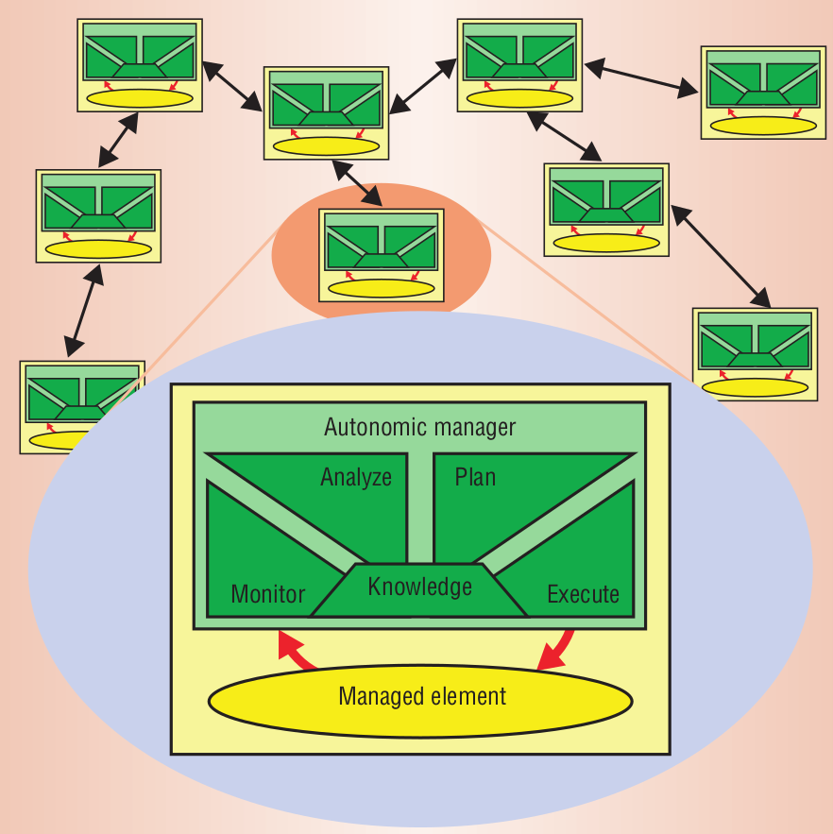
The Solution: Autonomous Management
MAPE-K feedback loop
By Kephart and Chess, 2003
Motivation
Foundation
Related Work
Approach
Evaluation
Summary

Slide 5
Self-Adaptive Systems
What are Self-Adaptive Systems
Where and why are they used:
  Software with a lot of parameters: like Robotics or large scale Web Deployments
  More efficient management of complex software
Goal: The audience should have a basic understanding of Self-Adaptive Systems
Transition to next slide: Why should SAS be classified?
Motivation
Foundation
Related Work
Approach
Evaluation
Summary

Slide 6
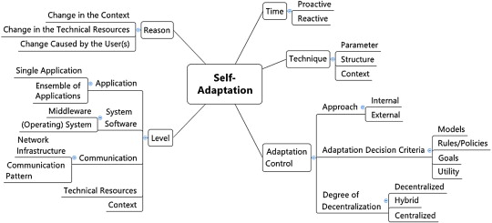
Classifying Self-Adaptive Systems
Krupitzer et al., 2015
Motivation
Foundation
Related Work
Approach
Evaluation
Summary

Slide 7
Limits of Self-Adaptive Systems
- Static rules
- Enviroment changes that were not predicted – uncertainty
Goal: Establish a need for Optimization Approaches
Motivation
Foundation
Related Work
Approach
Evaluation
Summary

Slide 8
Optimizations for Self-Adaptive Systems
- What can be optimized?
- What are some established approaches?
  FUSION
Motivation
Foundation
Related Work
Approach
Evaluation
Summary

Slide 9
Developing a classification for OA for SAS
- 5W+1H questions by Salehie and Tahvildari, 2009
  What, Why, Who, Where, When and How
- Reflective Computation by Weyns et al., 2012 (FORMS)
- Briding the gap between SAS and their OA
Goal: On which principles is the proposed classification based
Motivation
Foundation
Related Work
Approach
Evaluation
Summary

Slide 10
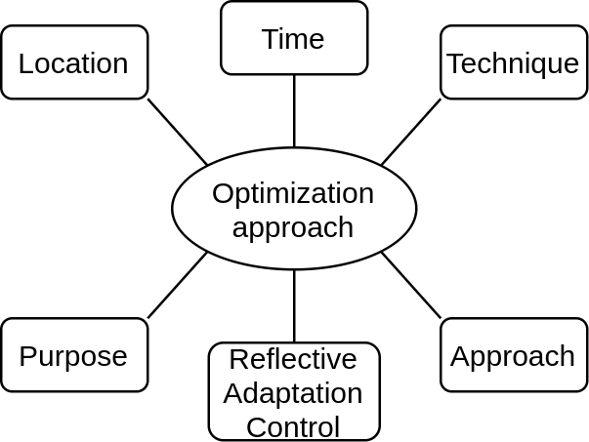
Classifying Optimization Approaches
Motivation
Foundation
Related Work
Approach
Evaluation
Summary

Slide 11
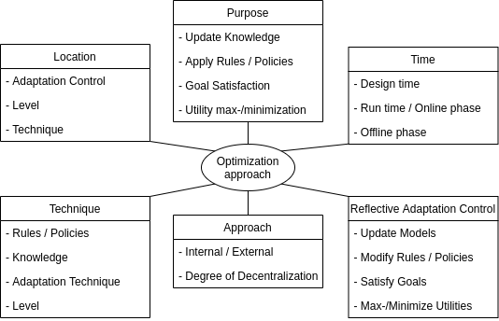
Classifying Optimization Approaches
Motivation
Foundation
Related Work
Approach
Evaluation
Summary

Slide 12
Existing Approaches
- Present existing approaches for Optimization Approaches
Goal: Present approaches that can be used as an example
Motivation
Foundation
Related Work
Approach
Evaluation
Summary

Slide 13
Applying the classification
- Classify the present approaches
Goal: Providing usage examples for the classification
Motivation
Foundation
Related Work
Approach
Evaluation
Summary

Slide 14
Future research directions
- Recommend future research directions
  Applying the classification to more approaches
  Finding new approaches that have not yet been explored
Motivation
Foundation
Related Work
Approach
Evaluation
Summary

Slide 15
Sources
Motivation
Foundation
Related Work
Approach
Evaluation
Summary

