Slide 1
JSX spread attributes, Merge destructured props with other values
By Tymur Mikava

Slide 2

Spread Attributes is a feature of JSX. It's a syntax for providing an object's properties as JSX attributes.

Slide 3
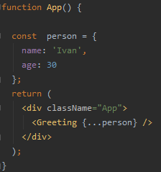
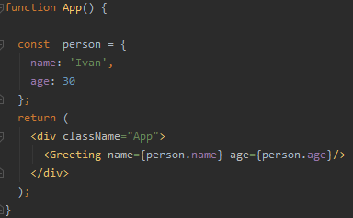
We can use the ES6 Spread operator to pass props to a React component.
Let's take an example for a component that expects two props:

Slide 4

We can spread restProps over our <Counter>.
This makes Greeting super flexible. We can pass DOM attributes to Greeting and trust that they’ll
be passed through to Counter.

Slide 5
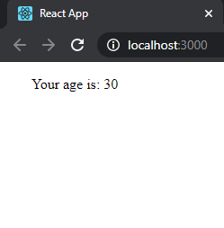

Everything is working!

Slide 6
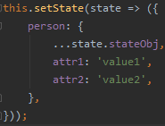

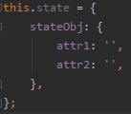
Using the Spread Operator with setState() for Setting the Nested State
Let's suppose, we need to use the setState() method to update your component state. Since the setState() may work asynchronously in manu cases for performance reasons. We
would need to write the following code:
We can use the Spread syntax to update
the nested state object.
The state1 variable which is part of our component state will be incremented by one.
Now, let's suppose we have a state with a nested object in our component:

Slide 7
This is a clean syntax but in some cases it may be considered an
anti-pattern which means you need to avoid using it. But Why?

Slide 8
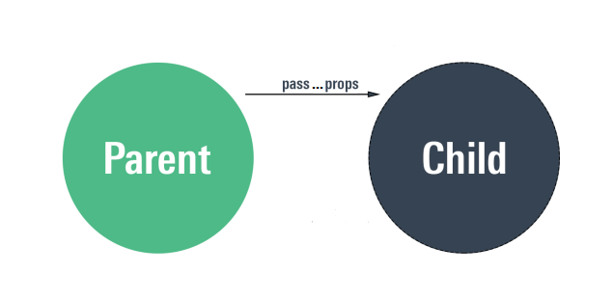
When we use the ...props syntax, we actaully expand the props
object from the parent component, which means all its attributes are passed down the child component that may not need them all.
This will make things like debugging harder.

Slide 9
Also according to the docs:
Spread attributes can be useful but they also make it easy to pass
unnecessary props to components that don’t care about them or to
pass invalid HTML attributes to the DOM. We recommend using this
syntax sparingly.

Slide 10

Merge destructured props with other values
Components are abstractions. Good abstractions allow for extension.

Slide 11

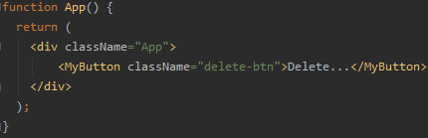
Consider this component that
uses a class attribute for style
a button.
This works great until we try
to extend it with another class.
In this case, delete-btn replaces btn.

Slide 12

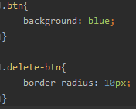
.btn does not work…

Slide 13

Order matters for JSX spread attributes. The props.className being spread is overriding the
className in our component.
We can change the order but now the className will
never be anything but btn.

Slide 14
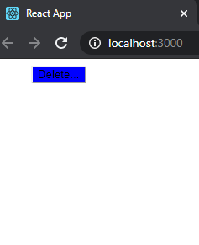
.delete-btn does not work…

Slide 15
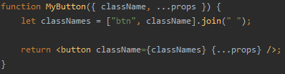
We need to use destructuring assignment to get the incoming
className and merge with the base className. We can do this simply by adding all values to an array and
joining them with a space.

Slide 16
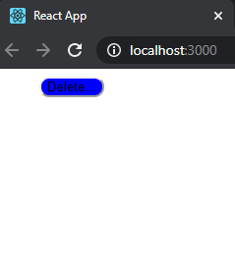
.btn and .delete-btn are working both!

Slide 17

To guard from undefined showing up as a className, Use default values.

Slide 18
Reference
https://reactpatterns.com/#jsx-spread-attributes
https://frontendmasters.com/courses/react/using-the-spread-operator-in-jsx/
https://morioh.com/p/80eb3b813784
https://morlay.gitbooks.io/react-patterns/en/react-patterns/jsx-spread-attributes.html

Slide 19



The End!

Slide 20


