Slide 1
WELCOME TO THE FUTURE
By Tymur Mikava

Slide 2

CSS Flexible Box Layout, commonly known as Flexbox, is a CSS3 web layout model. It is in the W3C's candidate recommendation (CR) stage.
The flex layout allows responsive elements within a container to be automatically arranged depending upon screen size (or device).

Slide 3
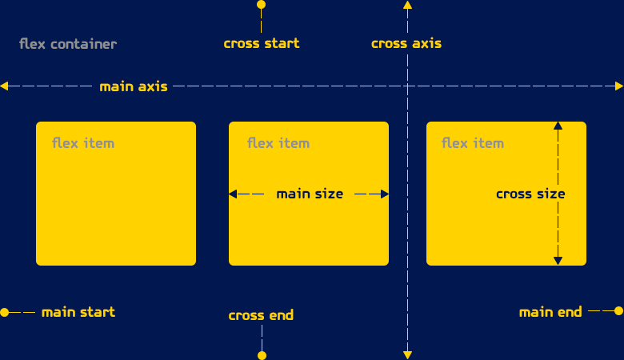
Flex container

Slide 4
The main axis is the axis running in the direction the flex items are being laid out in (e.g. as rows across the page, or columns down the page).The start and end of this axis are called the main start and main end.
The cross axis is the axis running perpendicular to the direction the flex items are being laid out in. The start and end of this axis are called the cross start and cross end.
The parent element that has display:flex set on is called the flex container.
The items being laid out as flexible boxes inside the flex container are called flex items.

Slide 5

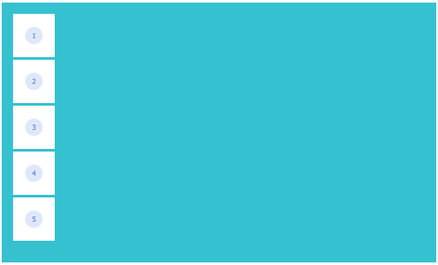
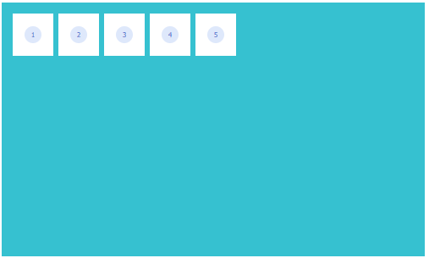
Flexible box layout
.container{
}
.container{
display: flex;
}

Slide 6




Flex-direction
Defines how flexbox items are ordered within a
flexbox container. default flex-direction: row;
The flexbox items are ordered the same way as the text direction,
along the main axis.
column
column-reverse
row
row-reverse
flex-direction: row | row-reverse | column | column-reverse

Slide 7
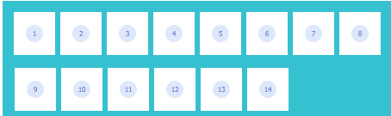
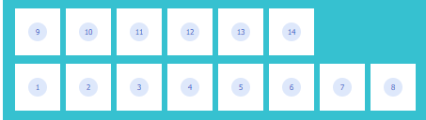

Flex-wrap
Defines whether the flex items are forced in a single line or can be flowed into multiple lines. If set to multiple lines, it also defines the cross-axis which determines the direction new lines are stacked in.
wrap
wrap-reverse
nowrap
flex-wrap: wrap | nowrap| wrap-reverse

Slide 8
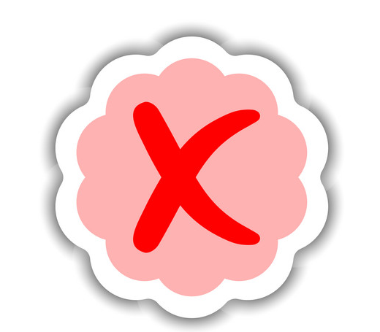

Flex-flow
The flex-flow property is a sub-property of the Flexible Box Layout module. It is a shorthand for flex-direction and flex-wrap.
.container {
display: flex;
flex-flow: column wrap;
}
.container {
display: flex;
flex-direction: column;
flex-wrap: wrap;
}
flex-flow = flex-direction + flex-wrap

Slide 9
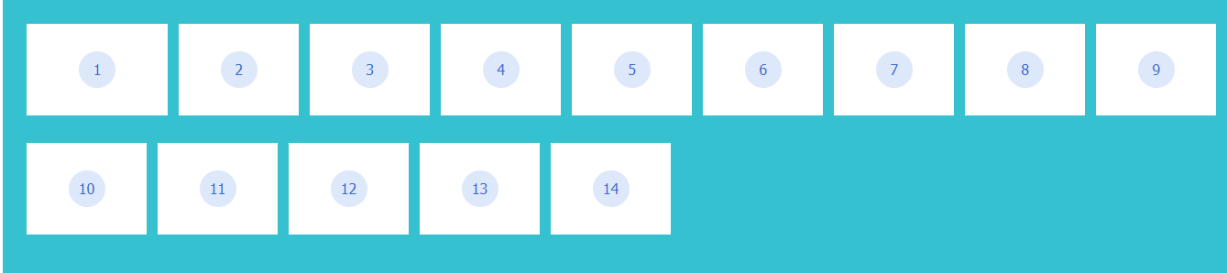
Flex-grow
Defines the ability for a flex item to grow if necessary. It accepts a unitless value that serves as a proportion. It dictates what amount of the available space inside the flex container the item should take up.
.box-1{
flex-grow: 1;
}
flex-grow = <number>

Slide 10
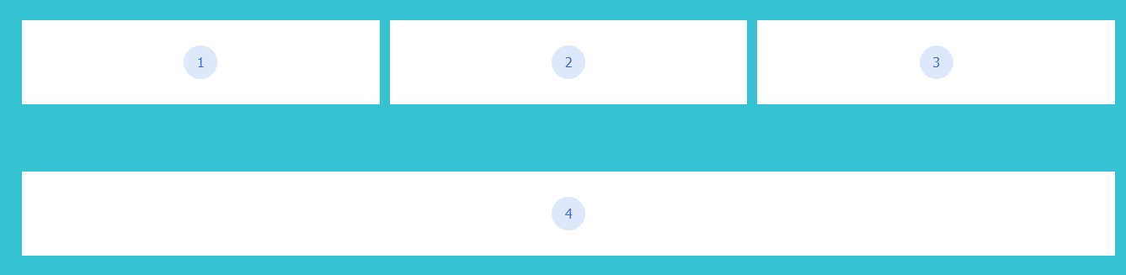
Flex-basis
Defines the initial size of the flex item, before any available space is distributed according to the flex factors. When omitted from the flex shorthand, its specified value is the length zero.
.box{
flex-grow: 1;
flex-basis: 400px;
}
flex-grow = <number>

Slide 11
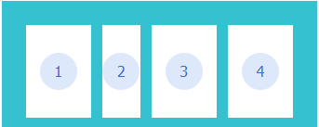
Flex-shrink
The flex-shrink property defines how the item will shrink relative to the rest of the flexible items inside the same container.
.box-2{
flex-shrink: 2;
}
flex-shrink = <number>

Slide 12
Flex
The flex property in CSS is the combination of flex-grow, flex-shrink, and flex-basis property. It is used to set the length of flexible items. The flex property is much responsive and mobile friendly. It is easy to positioning child elements and the main container.
.box {
flex-grow: 1;
flex-shrink: 1;
flex-basis: 100px;
}
.box {
flex: 1 1 100px;
}
flex = flex-grow + flex-shrink + flex-basis

Slide 13
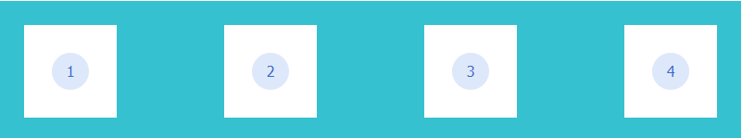
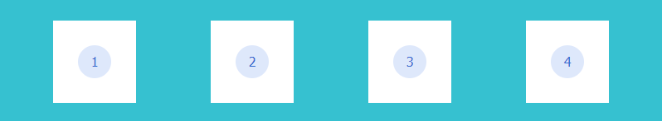
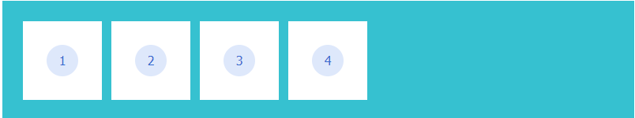

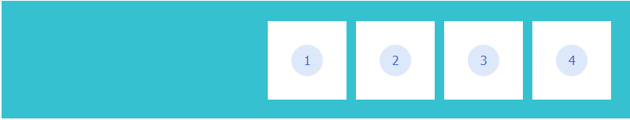
Justify-content
Defines the alignment along the main axis. It helps distribute extra free space leftover when either all the flex items on a line are inflexible, or are flexible but have reached their maximum size.
space-between
space-around
flex-start
center
flex-end
justify-content: flex-start | flex-end | center | space-between | space-around

Slide 14
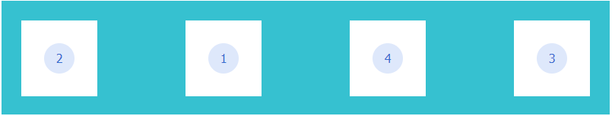
Order
Flex items are displayed in the same order as they appear in the source document by default. The order property can be used to change this ordering.
.box-4{
order: 3
}
.box-3{
order: 4
}
.box-1{
order: 2
}
.box-2{
order: 1
}
order: <number>

Slide 15
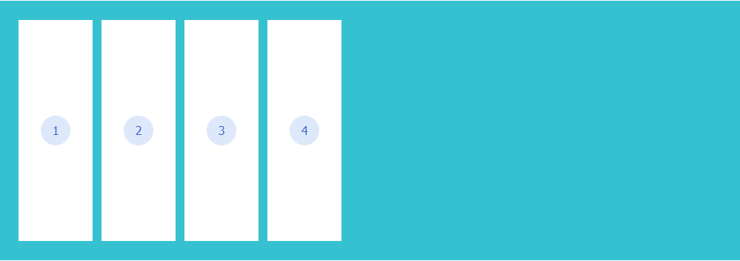
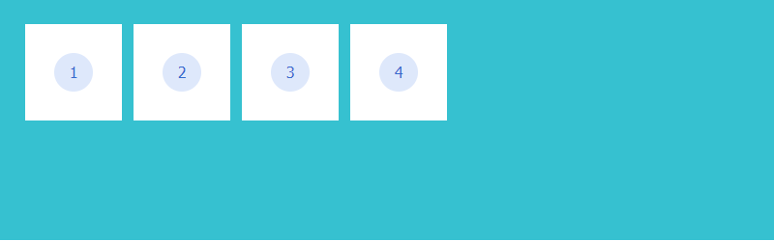
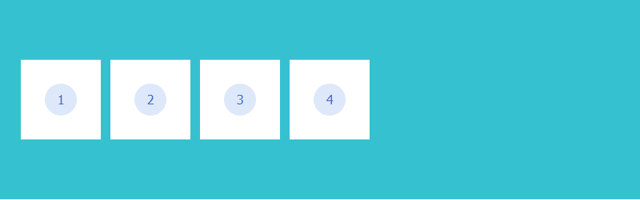
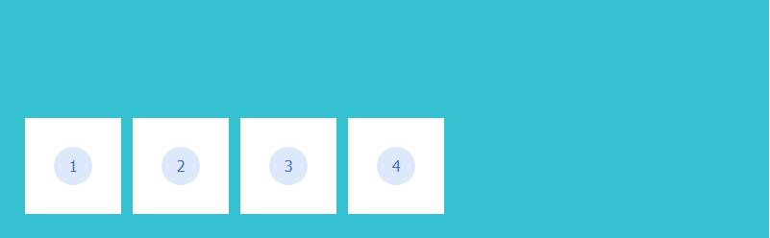
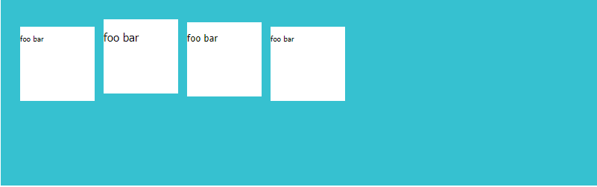
Align-items
stretch
The align-items property defines the default behavior for how items are laid out along the cross axis (perpendicular to the main axis).
flex-start
center
flex-end
baseline
align-items: stretch | flex-start | flex-end | center | baseline

Slide 16
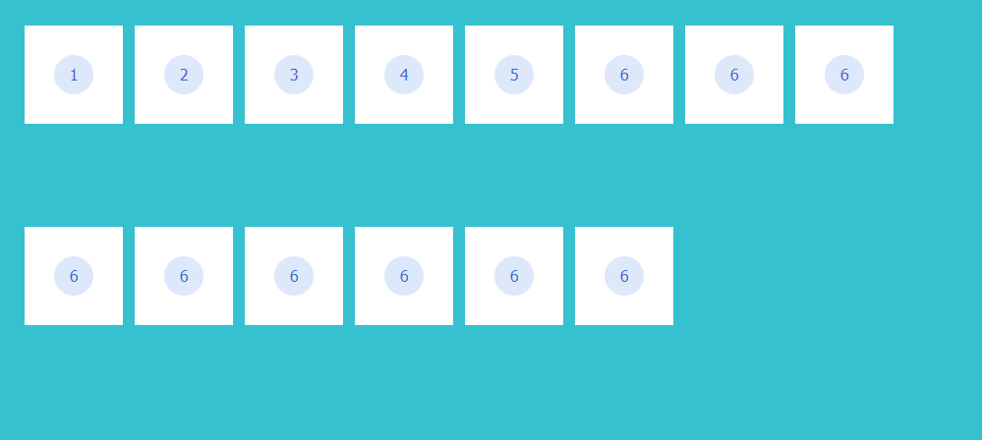
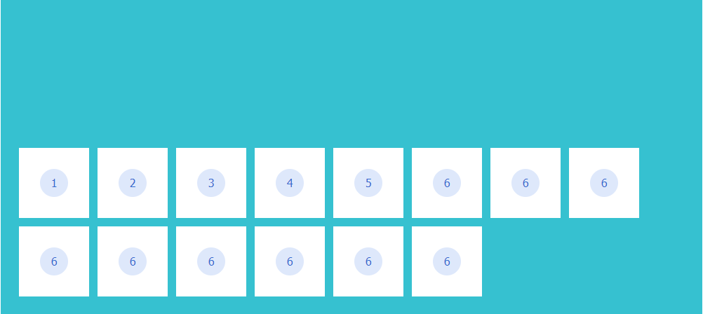
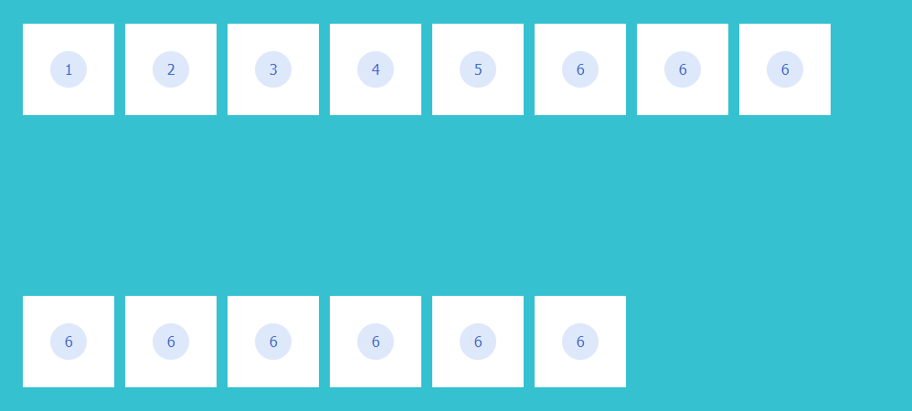
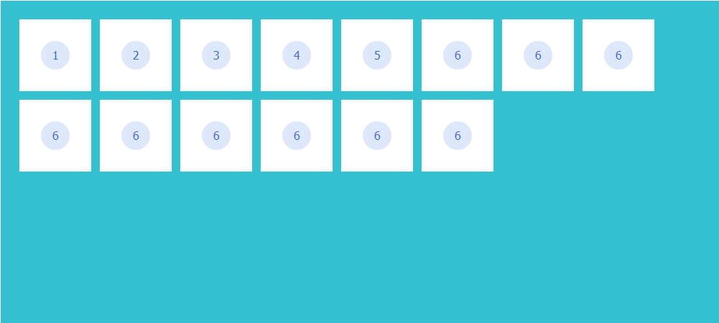
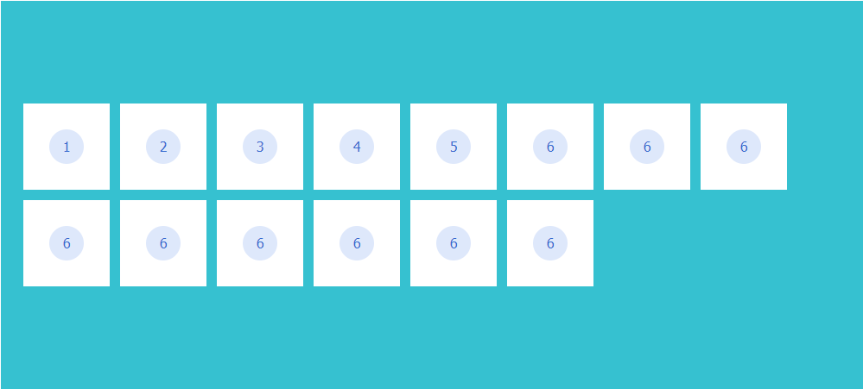
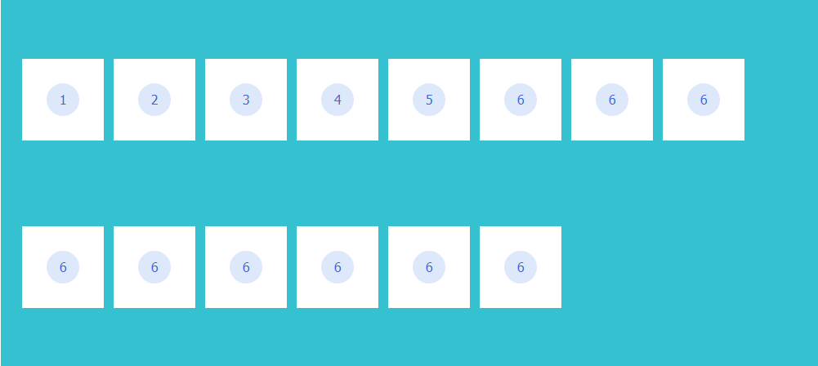
Align-content
The align-content property modifies the behavior of the flex-wrap property. It is similar to align-items, but instead of aligning flex items, it aligns flex lines.
stretch
flex-end
space-between
flex-start
center
space-around
align-content: stretch | flex-start | flex-end | center | space-between | space-around

Slide 17
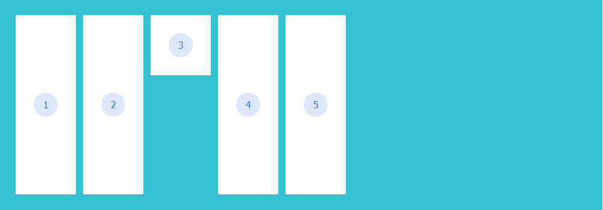
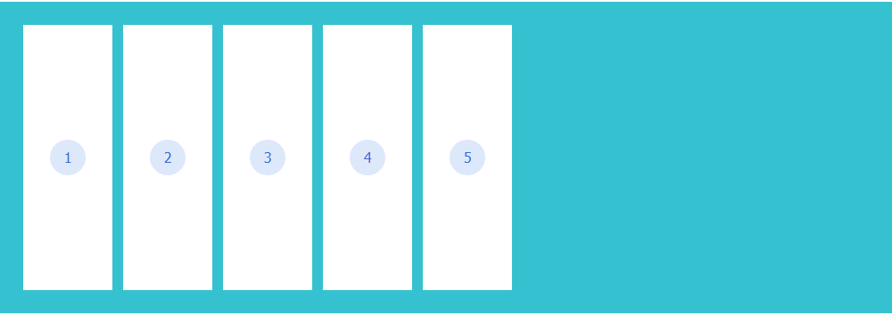
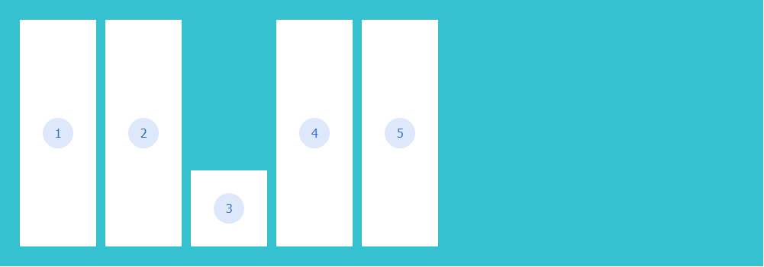
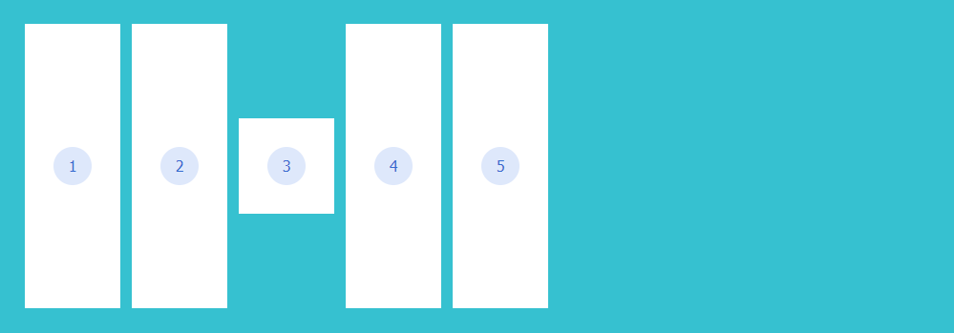
Align-self
The align-self property specifies the alignment for the selected item inside the flexible container.
.box-3{
align-item: flex-start;
}
.box-3{
align-item: stretch;
}
.box-3{
align-item: center;
}
.box-3{
align-item: flex-end;
}
align-self: auto| flex-start | flex-end | center | stretch | baseline

Slide 18
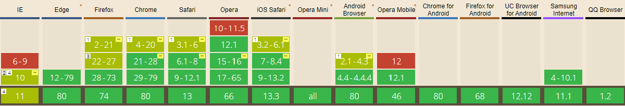
Browser support

Slide 19
Reference
https://www.w3.org/TR/css-flexbox-1/
https://css-tricks.com/snippets/css/a-guide-to-flexbox/
https://philipwalton.github.io/solved-by-flexbox/
https://caniuse.com/

Slide 20


The End

Slide 21


