Slide 1

Learn to Code:
Python
Timothy Hoang
June 17th, 2021

Slide 2
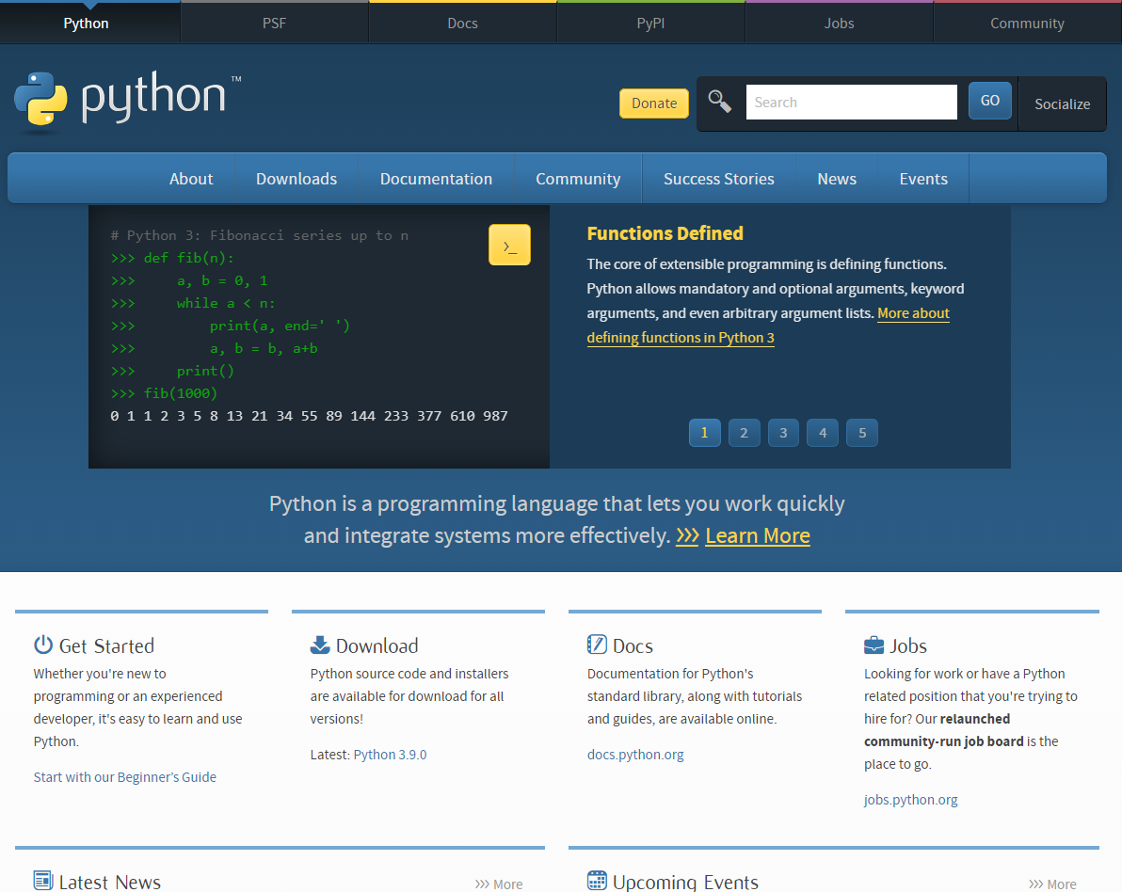
Presentation Layout
python.org
Slides, Github, Youtube provided
What is Python & Syntax
Why learn Python
Python & Other Languages
Running Python
Basic Syntax
Python Strings
Python Functions
Python Classes
Starting OOP Concepts
Resources
Action Steps
Closing

Slide 3
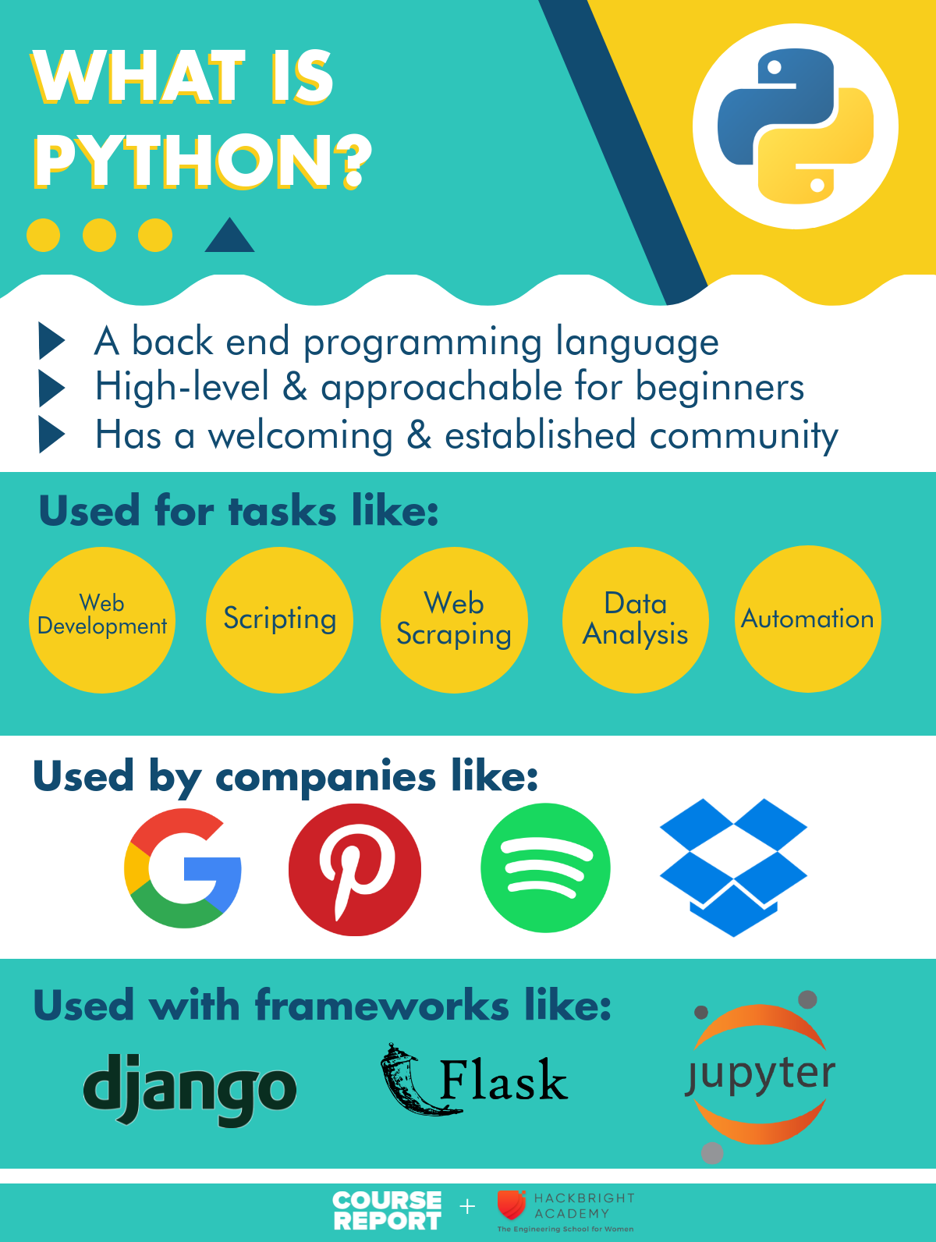

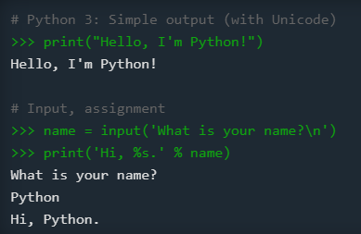
What is Python
Object oriented, back-end language
Simple language for rapid development
Released in 1991 by Guido van Rossum
Name from being “a big fan of Monty Python's Flying Circus”
Most recent version is Python 3
Python 2 is still popular, end of life on 1/1/2020
wikipedia.org
python.org
coursereport.com

Slide 4
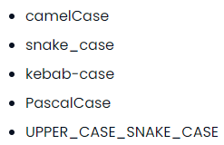
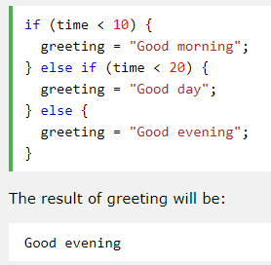
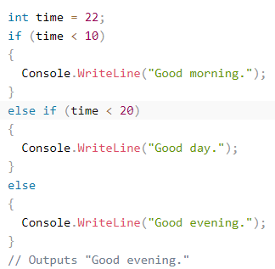
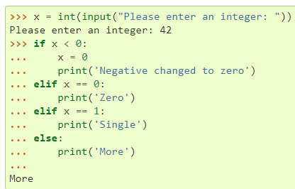
What is Python Syntax
Uses lines and indentation, instead of semicolon or parentheses
Focuses on object/classes, has members and methods
“Partial” OOP language with concepts like APIE (abstraction, polymorphism, inheritance, encapsulation)
Uses PEP-8 style guidelines and snake_case typing
chaseadams.io
Python
JavaScript
C#
docs.python.org
w3schools.com
w3schools.com

Slide 5
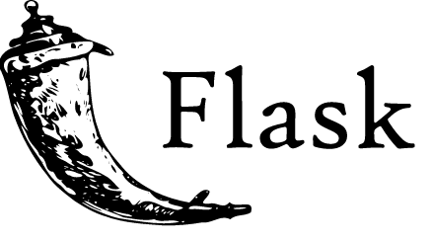
Why Learn Python
Simplicity, readability, and easy to learn (Zen of Python, use import this)
“Batteries included” language with large standard library
Supports modules for extensibility
Large community, established knowledge base, open-source
Used in web development, data analysis, scientific computing, machine/deep learning, internet of things
Works on many platforms (Windows, Mac, Linux, Raspberry Pi)
Supports many paradigms: procedural, object-oriented, or functional
Web Development Frameworks: Django (2005), Flask (2010)
Has garbage collection. Yay!
flask.palletsprojects.com

Slide 6

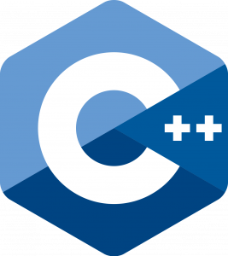


Python and Other Languages
Top 5 Languages 2020 from hackr.io
One of the more well-known languages
Use the language that best suits your purpose
Consider frameworks and libraries on top of these languages
Looking for a job? Google for top languages of <current year>
Web development? Try JavaScript (React, Node, Electron, React Native)
Game development? Try C++
Enterprise applications? Try Java or C#
Language closer to the hardware? Try C
Data Analysis/Machine Learning? Try R
Aiming for Google? Try GoLang
Blockchain/Cryptocurrency? Solidity or Plutus

Slide 7
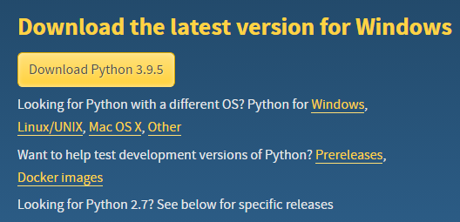
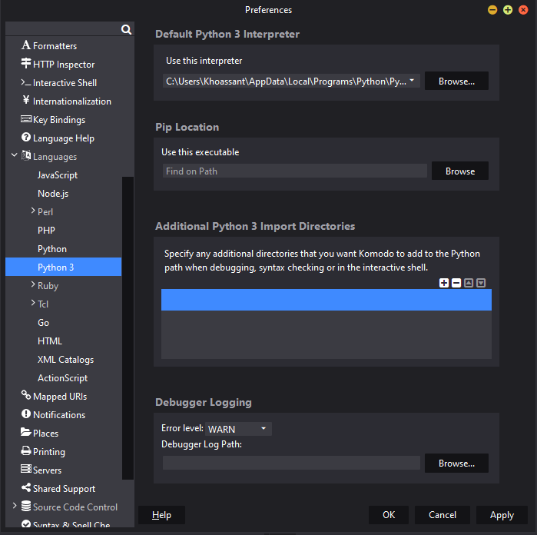
Running Python
python.org
Python 3.9.5
IDEs: Thonny, Komodo, and PyCharm
1.Downloaded Python 3.9.5 for Windows
2.Downloaded Komodo IDE
3.Registered for free Active State account
4.Run Komodo and choose interpreter: python.exe
5.Run python in the terminal
6.Check out the Python Docs and Resources
Choosing Komodo debugger
docs.activestate.com

Slide 8
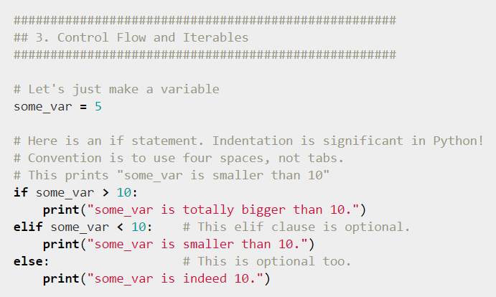
Running commands
7.Try Py terminal commands
  py - runs the py terminal
  import this - runs the Zen of Python
  Shift enters makes a new line
  Enter submits a line
  exit() - exits the py terminal
  cls - clears the windows terminal
  Try an if-elif-else loop
  Try a li = [] (list) and use li.append(), len(li), li.pop() and looping through a list
  Try importing the math module (import math) and use math.pi, math.ceil, math.floor
8. Use X in Y Minutes to learn more language syntax
learnxinyminutes.com

Slide 9
Basic Syntax
Common usage
  # - Single line comments
  Three “ - Multi line strings
  True, False – booleans (note: capitalized), True and False are actually 1 and 0
  == - comparison operator, no triple equals
  // - Round down division
  ** - exponents
  f"She said her name is {name}." - f-strings or formatted string literals
  0, “”, [], {}, () - falsy values
  None – is a object
  "yay!" if 0 > 1 else "nay!" # => "nay!" - ternary operator
  Lists, tuples, dictionaries
  As of 3.7 and beyond, dictionary insertion order is maintained
  filled_dict.keys(), filled_dict.values() - like JS Object.keys() and Object.values(), no Object.Entries()
  1 in filled_dict - JS includes() or C# contains()
  filled_dict.get(), filled_dict.setdefault()
  Can do intersection (&), unions (|), difference (-), symmetric difference (^) with Sets

Slide 10
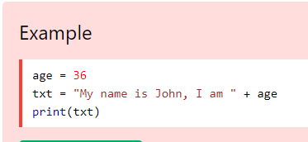
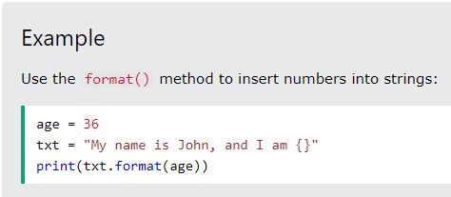
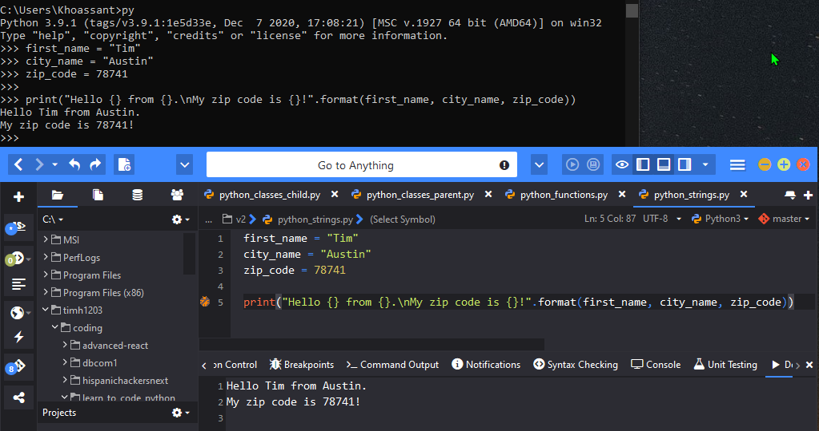
Code Example #1: Strings
Tip: Can’t add numbers to strings
unless you use .format()
Strings display info
and helps with debugging
Old way to write strings
(line 5)
“\n” is a line break. (line 5)
Terminal introduction
Komodo introduction
See github repo for code
Tip: Create a new file with the Python3 template.

Slide 11
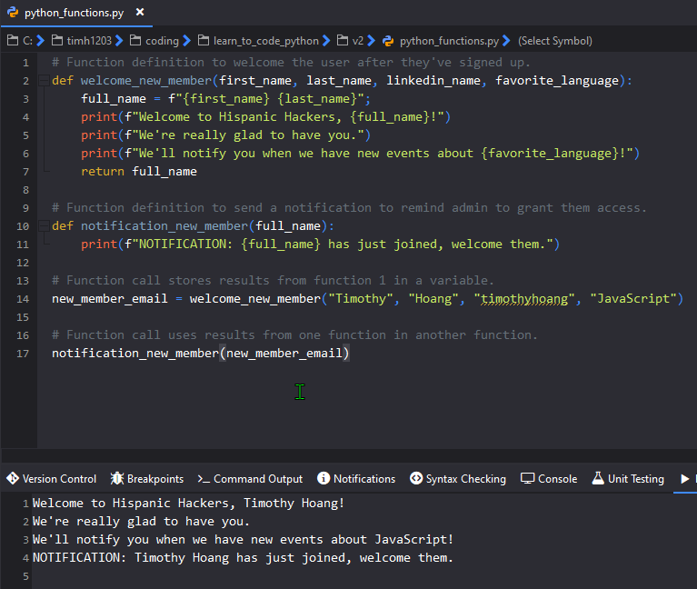
Code Example #2: Functions
Imagine a backend app...
Welcome new members
Send admin a reminder
Store member name in variable to use in reminder function and possibly grant permissions
Definitions declarations (2,10)
Definition Calls (14,17)
Tip: F-strings or formatted
string literals is an easier way
to write strings. (lines 4, 5, 6, 11)

Slide 12
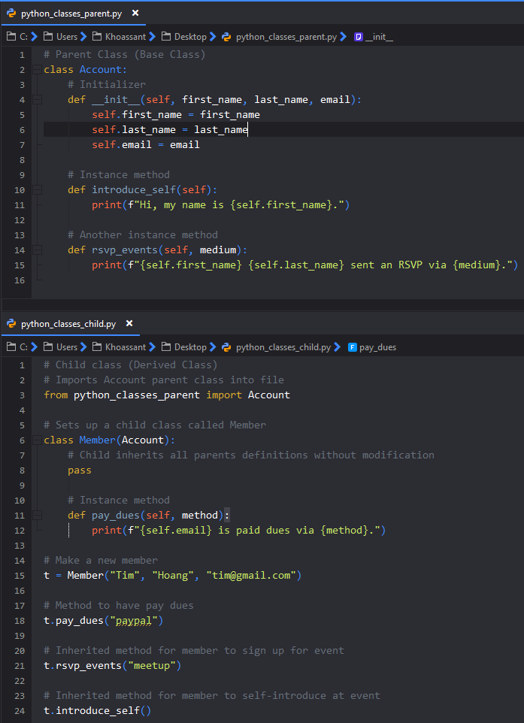

Code Example #3: Classes
Use Inheritance when working with classes
Set up a parent class called Account
  Properties: first_name, last_name, email
  Methods: introduce_self, rsvp_events
Set up a child class called Member
  Receives all properties and methods
  from parent
  Use pass to inherit without modification
  Own method: pay_dues
Results:

Slide 13
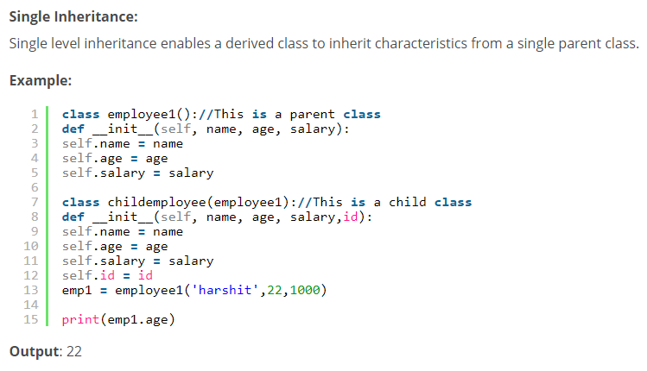
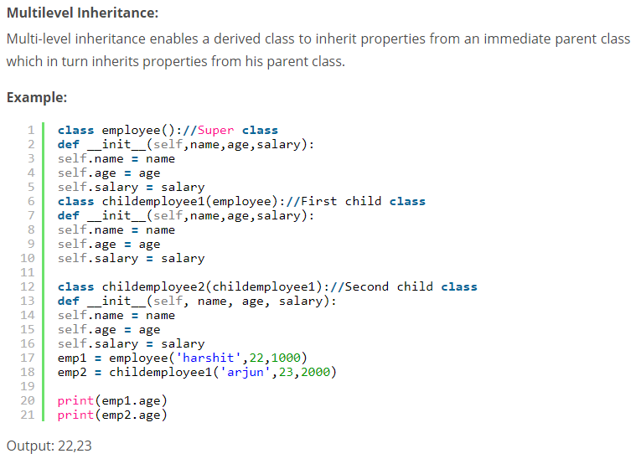
Getting into OOP Concepts
Use OOP concepts in Python
A PIE mnemonic
Abstraction,
Polymorphism,
Inheritance,
Encapsulation
Python has single and a variety of inheritance
  Multilevel Inheritance Gparent => Parent => Child
  Hierarchical Inheritance Parent => Siblings
  Multiple Inheritance Dad & Mom => Child
Edureka.co

Slide 14



Getting into OOP Concepts
I did the I in APIE, I’ll leave you to go ape on APE.
Polymorphism
  Methods under the same name
  Compile-time, static polymorphism, method overloading
    Different objects can have different fxn’s with same name
  Run-time/dynamic polymorphism, method overriding
Encapsulation
  Restricting access outside a class
  No private keyword in Python but can use __ (dunder)
Abstraction
  Can’t create class, for inheriting functionalities only
You’re not ready for this one!!!

Slide 15
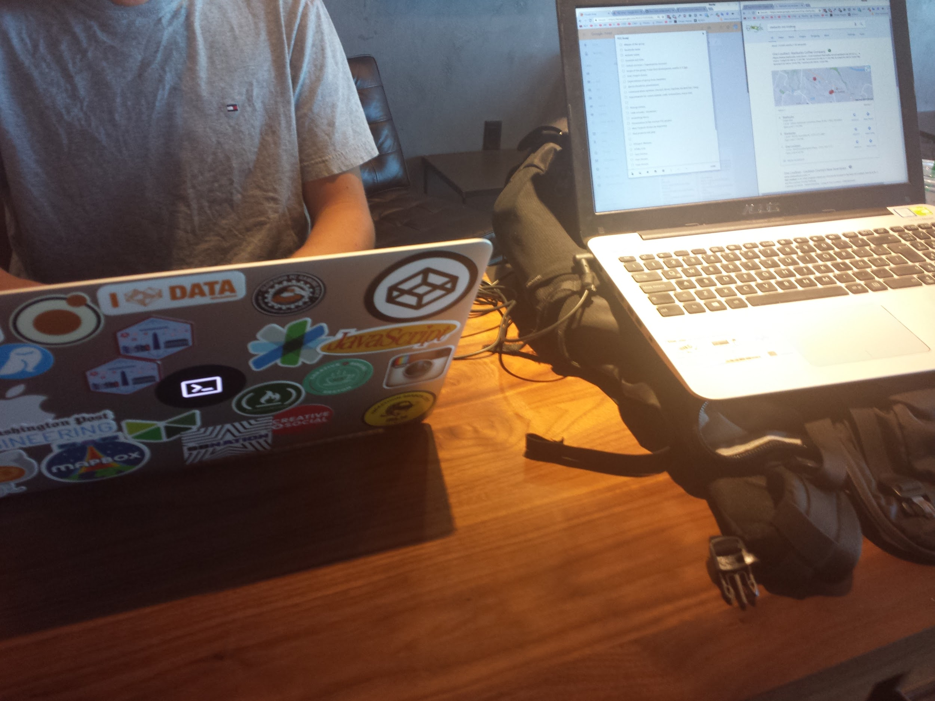
Resources
Official Python
Austin Python Meetup
Python Ecosystem 2020
https://learnxinyminutes.com/docs/python/

Slide 16

Action Steps
Sometimes it feels like...
Sign up for a free course
  Google’s Python Class
  Crash Course on Python by Google
  Python 3 Programming Specialization by U of Michigan
  Python for Everybody Specialization by U of Michigan
Set up your Integrated Development Environment
(Thonny, Komodo, PyCharm)
Set up a github account and version control your code
Build toys and projects as you learn to add to your portfolio
Learn the language deeply, avoid coding polyglotism initially
Learn more tools in the ecosystem and take your skills to the moon

Slide 17

Thanks for your time!
Professional Links
  Hispanic Hackers Home
  Connect with me professionally: LinkedIn
Personal Links
  Thoughts, Code School, Travels
  Web Development & Portfolio
  DeFi, Cryptocurrency, Finances
  Ping me and I’ll send you the links.
Parting thoughts…
  Learn in public and share freely.
  Always be a student.
  Journal more.

