Slide 1
Productivity™- The tool to end procrastination
Tim Zelikovsky, Austin Beal, Jordan Miller, Conrad Persowski

Slide 2
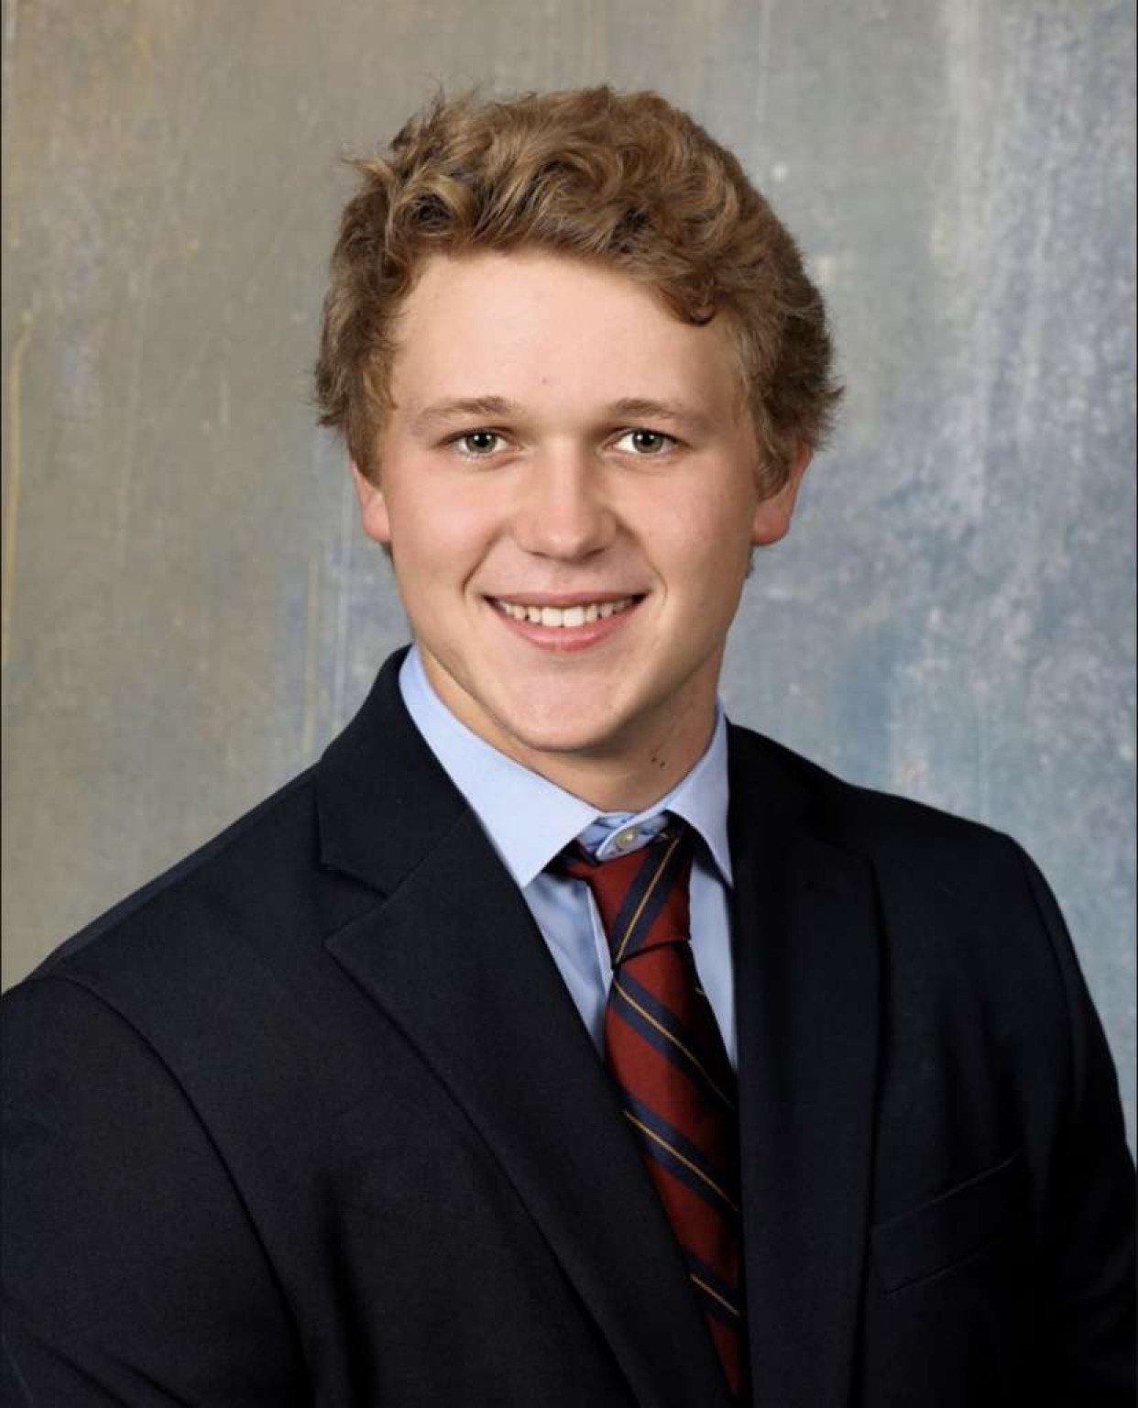
The Productivity™ Team
Austin Beal:
Class of 2024
Computer Science & Math Double Major
Roles
Project Owner
Core Developer
Tasks
Productivity™ GUI
Admin and User login
Timer reset/pause/start functionality
Integration of team members’ code into main interface

Slide 3
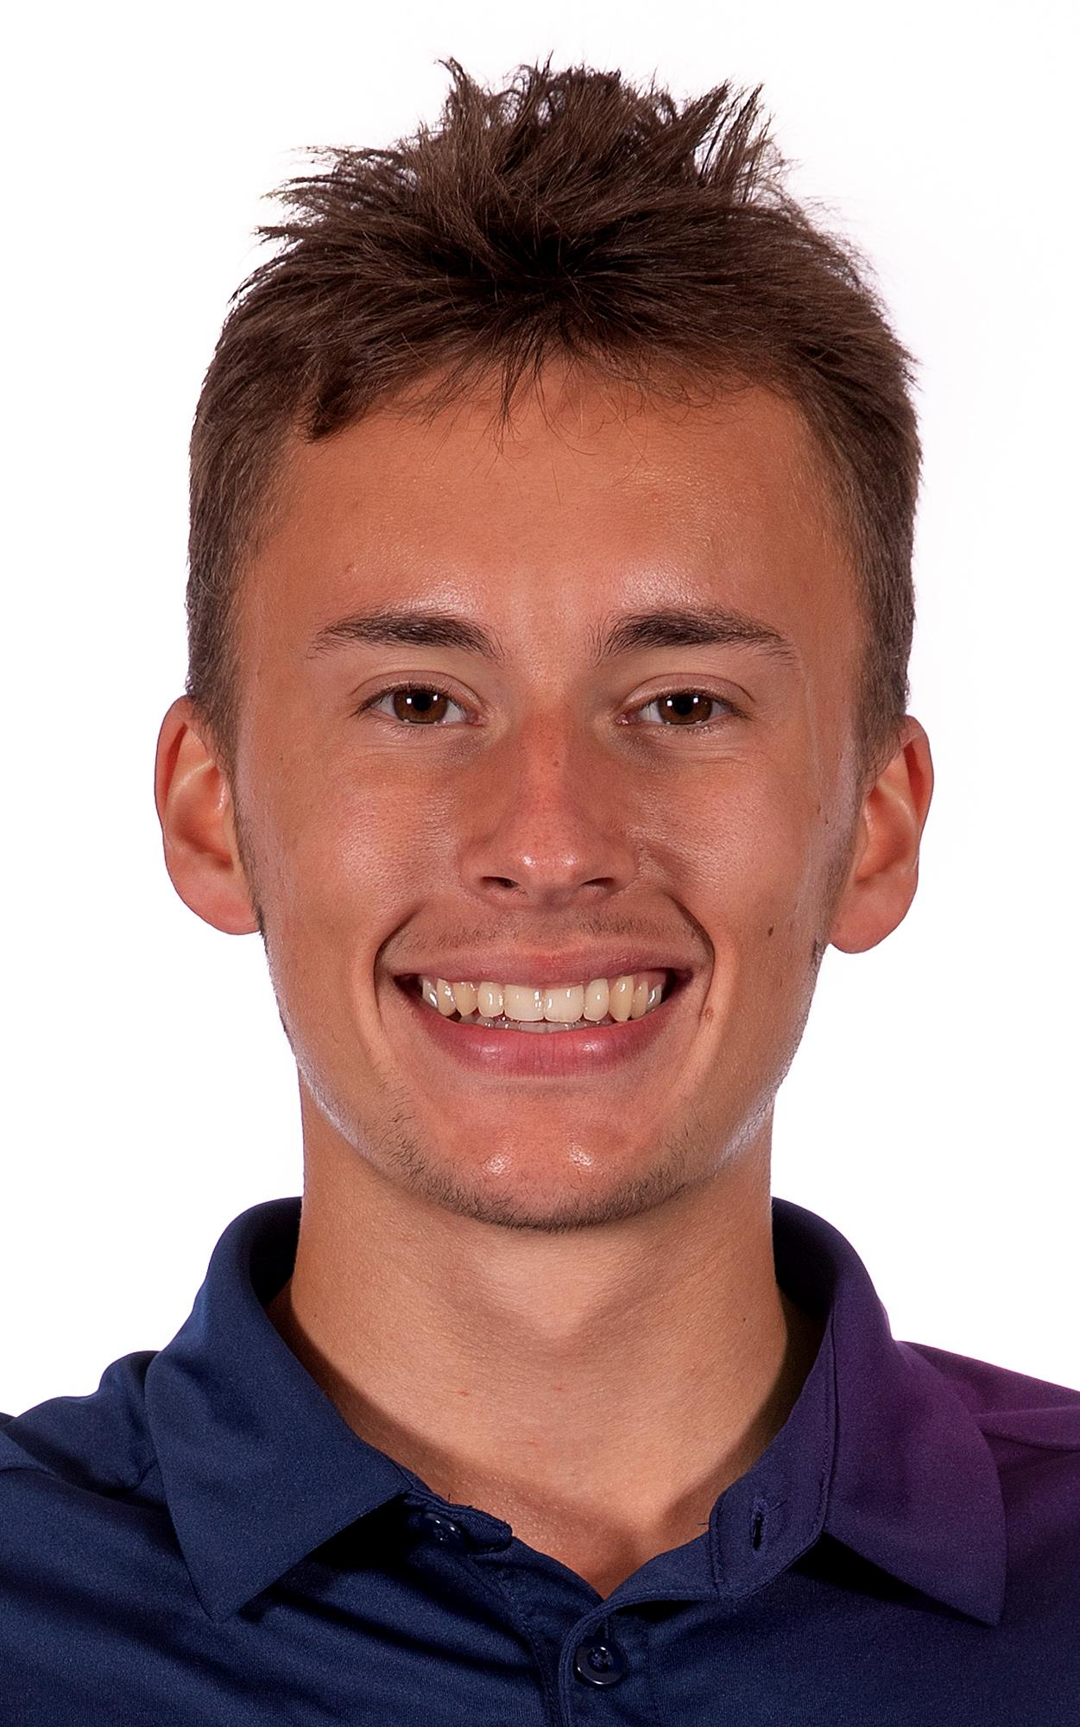
The Productivity™ Team
Tim Zelikovsky:
Class of 2024
Varsity Men’s Tennis
Computer Science Major
Roles
Scrum Master
Tasks
Gitlab Maintenance (hours spent, assigned tasks, updating issues)
Timer Functionality

Slide 4
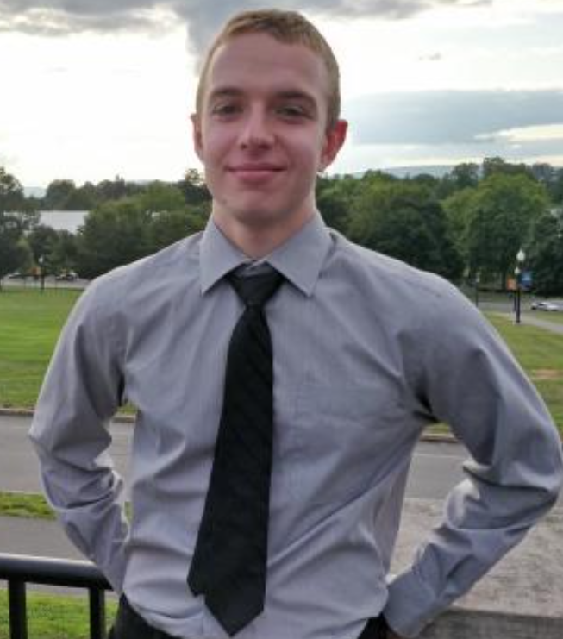
The Productivity™ Team
Conrad Persowski:
Class of 2023
Computer Science Minor
Roles
Project Co-Owner
Developer
Tasks
Task completion GUI
Manual Input of Time

Slide 5
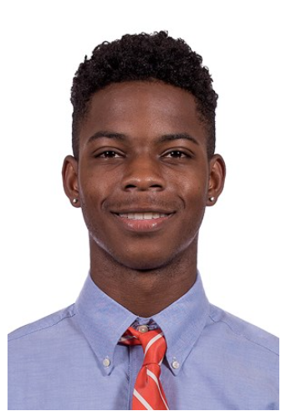
The Productivity™ Team
Jordan Miller:
Class of 2024
Varsity Men’s Soccer
Computer Science Major
Roles
Client Manager
Tasks
Create GUI interfaces
Create Bar Chart for average productivity
Create UML and CRC cards

Slide 6
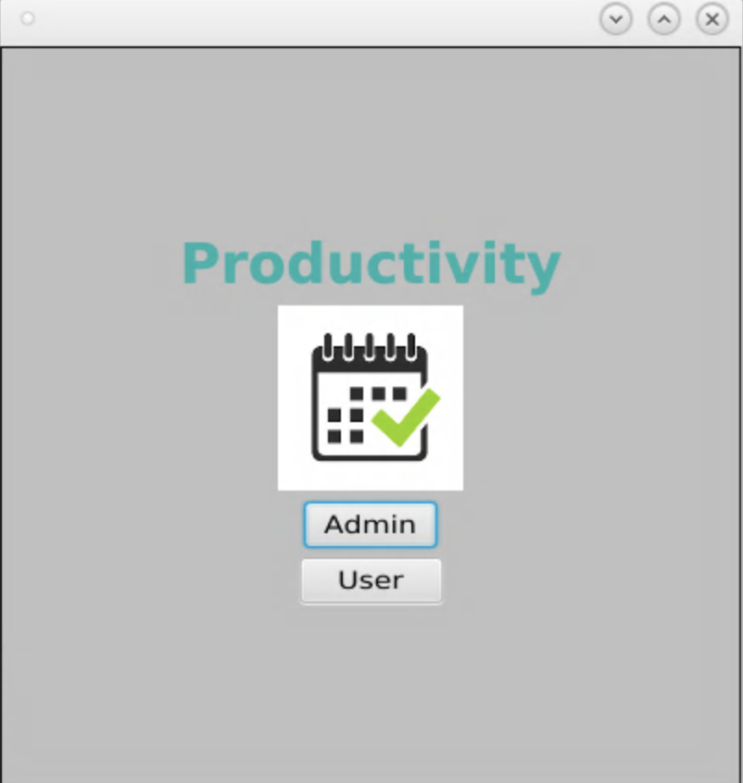
The Productivity Scheduling App
We designed an app that would allow our users to keep track of different tasks they had and help them become more productive.
We felt this could be used well in a college student’s life who normally has multiple tasks and needs to be as productive as possible.
The app has a user and admin option. We had specific objectives we wanted to implement for both options.
Notes:
The greatest problem most students they’

Slide 7
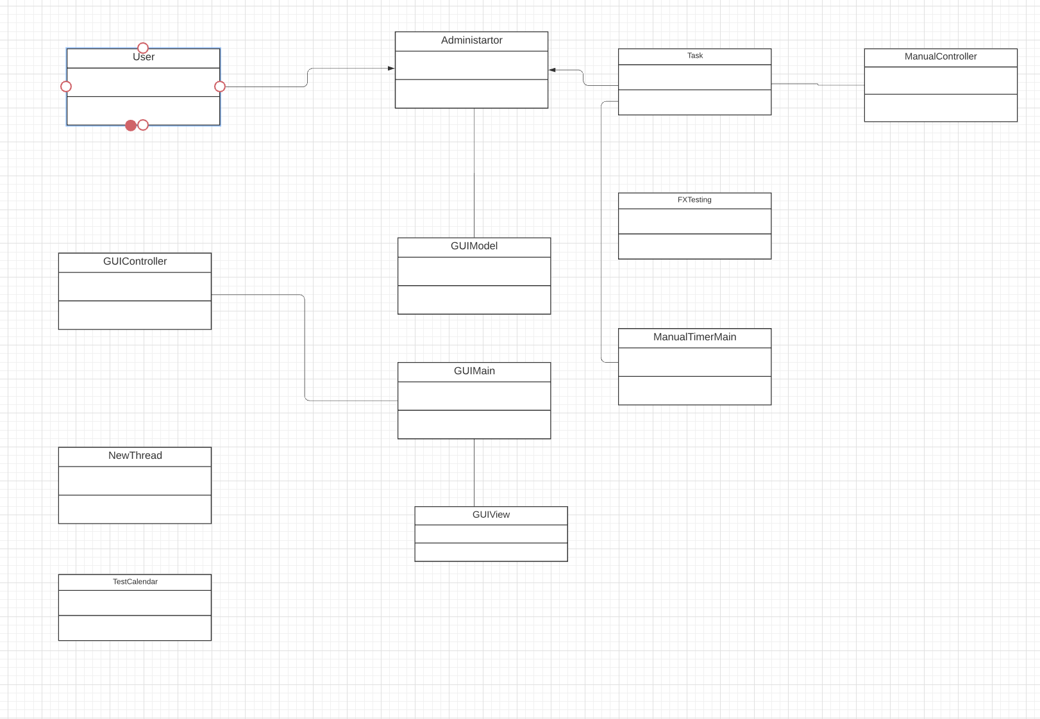
Design - UML Diagram
Object Oriented Design
Classes had specific jobs
Good Coupling and Cohesion
We thought that using an MVC design pattern would be the best
  Model contain all of the data about the users and program
  View - what the user will see
  Control - line of communication between view and model.

Slide 8
Implementation
Overall, the implementation of our program is simple, yet effective
Several simple object classes
Our MVC
  Model contains the object classes
  View contains the GUI and event handlers
  Controller combines them and makes them work in tandem
  Main runs everything
Some FXML classes as well, can be found in resources

Slide 9
Implementation - Features
GUI is done in JavaFX and FXML
There is inheritance - the Administrator inherits from User
Interesting Data Structures
  BarChart object for our Bar Graph
  Observable List for our Dropdown menus (new Admin, task type)
For design, we used several different types of panes
  Wanted to make it look nice

Slide 10
Implementation - Algorithms
Most of our tasks were able to be completed with very basic syntax
  If/else, for, etc
  Enhanced for loops
  Basic Method calls
Wanted to try multithreading
  Couldn’t figure it out, if we had more time, would’ve loved to do this
Used Timer and Timelines instead

Slide 11
Implementation - Packages
Not too many packages
JavaFX and FXML
JUnit was used for testing
Again, very basic packages and APIs
Would have also liked to implement online features
Implement serializable

Slide 12
Reflection
Scrum
Scrum allowed for easy task assigning and iterative development
Helped us organize with work.
Overall, we are happy with the product that we have created
A mostly functional app that is able to differentiate between different types of users, and perform tasks based on this
Accomplishments
Timer functionality
  Allowing user to start a timer to work on a task
  Creates urgency to complete the task at hand in the given time
Set time
  Allows a user to set time spent on a task
  Visualizes how time is being spent on tasks

Slide 13
Reflection
Major Challenges
Disparity in coding abilities among team members
  Code with me would be utilized, but often major code sections would be written by one strong programmer
Time estimates were significantly overestimated, creating an inaccurate burndown chart and hours
Major Successes
Functioning app with various working components
Agreement of product outlook and view among team
Gitlab
Had troubles pushing and pulling at first
  Lost our files several times early on
Eventually got better, and were quite successful at it by the end

Slide 14
Conclusion
Version 2.0?
  Implement tasks that we did not have time to implement (alert system, more productivity graphs, etc)
  Expanded features for users and administrators
  A ‘create new’ feature (there isn’t immediately an admin if no data has been entered)

