Slide 1
Fake News Stance Detection with Siamese CNN
Yuqi Liu / 301355758
Xinyue Ma / 301297142
Yufei Wang / 301338190

Slide 2
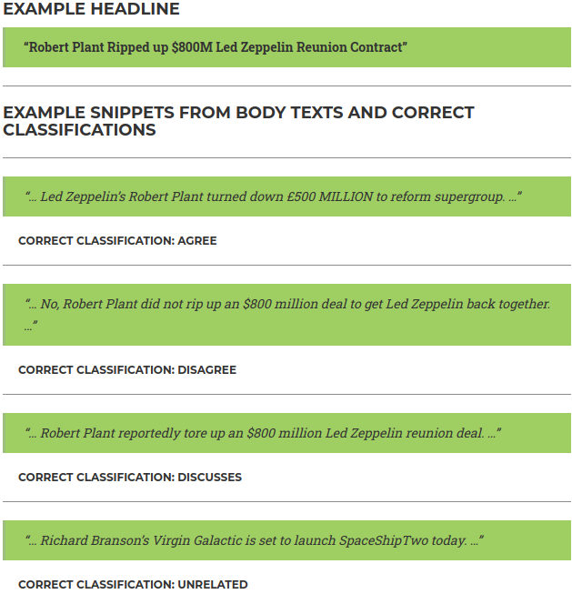
Problem
Relationships between
headlines and body texts
Agree
Related
Disagree
Discuss
Unrelated
Score1 = Accuracy_{Related, Unrelated}
Score2 = Accuracy_{Agree, Disagree, Discuss}
Score = 0.25 * Score1 + 0.75 * Score2

Slide 3
Data
Body text example:
Body ID: ... | (Body text)
Body ID: 54 | A nun living in an Italian convent has given birth to a surprise baby after complaining of stomach pains, according to the Italian press. ...
Body ID: ... | (Body text)
Headline-body pair example:
Headline | Body ID | stance
Police find mass graves with at least '15 bodies' near Mexico town where 43 students disappeared after police clash | 712 | unrelated

Slide 4
Data
 | Number of headline-body pairs in the dataset
 | Agree | Disagree | Discuss | Unrelated
Training dataset | 3678 | 840 | 8909 | 36545
Test dataset | 2600 | 697 | 4484 | 18349
Train-validation split
 | Number of headline-body pairs in the dataset
 | Agree | Disagree | Discuss | Unrelated
Training dataset | 2916 | 678 | 7109 | 29647
Validation dataset | 762 | 162 | 1800 | 6898
Test dataset | 2600 | 697 | 4484 | 18349

Slide 5

Approach
Baseline (can be found on http://www.fakenewschallenge.org/)
Gradient boosting classifier
with 10-fold cross validation
Score1 = Accuracy_{Related, Unrelated}
Score2 = Accuracy_{Agree, Disagree, Discuss}
Score = 0.25 * Score1 + 0.75 * Score2

Slide 6
Approach
1. Sentence embeddings
word embeddings
Length of texts
Dimensions of word embeddings
Police | find | ...
0.00768... | ... | ...
... | ... | ...
InferSent
sentence embeddings
4096-dimensional vectors

Slide 7
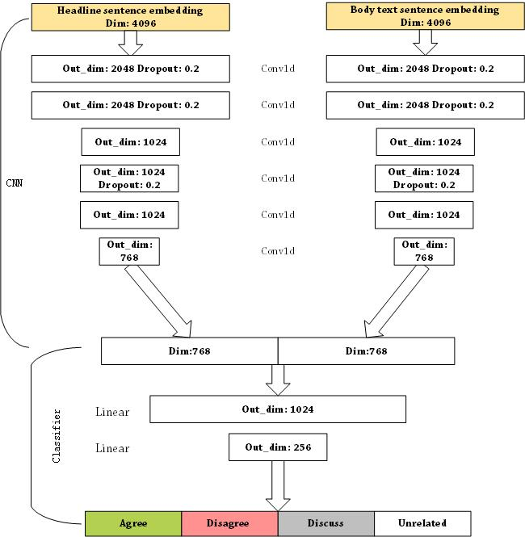
Approach
2. Siamese Model

Slide 8
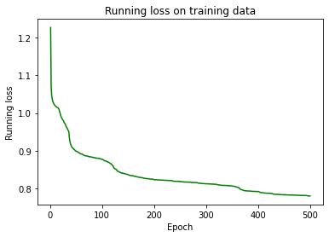
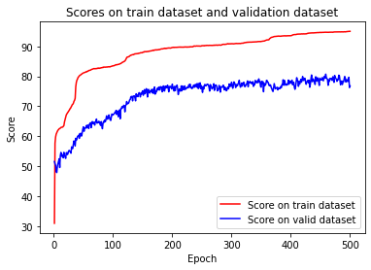

Results & Analysis
Score1 = Accuracy_{Related, Unrelated}
Score2 = Accuracy_{Agree, Disagree, Discuss}
Score = 0.25 * Score1 + 0.75 * Score2

Slide 9
Conclusions
Conclusion1: An unbalanced dataset can be biased and is not good for training models.
Conclusion2: Sentence embeddings may not be a good choice for this task since some word can be exclusively important to decide the relationship between headlines and body texts, such as “deny” and “doubts”.
Future work: Our next task will be using word embeddings to improve the performance of our model in fake news instance detection. Using word embeddings is a good idea to avoid losing important information of specific words, but the problem is how to build the available data loader as the input of CNN.

Slide 10
References
Conneau, Alexis, et al. "Supervised learning of universal sentence representations from natural language inference data." arXiv preprint arXiv:1705.02364 (2017).
Pomerleau , Dean, and Delip Rao. The Fake News Challenge: Exploring How Artificial Intelligence Technologies Could Be Leveraged to Combat Fake News., 2017, www.fakenewschallenge.org/. Accessed: 2017-10-20.
Largent, William. “Talos Targets Disinformation with Fake News Challenge Victory.” Cisco Talos Intelligence Group - Comprehensive Threat Intelligence: Talos Targets Disinformation with Fake News Challenge Victory, 20 June 2017, blog.talosintelligence.com/2017/06/talos-fake-news-challenge.html.
Bromley, Jane, et al. "Signature verification using a “siamese” time delay neural network." International Journal of Pattern Recognition and Artificial Intelligence 7.04 (1993): 669-688.

