Slide 1






What if a dog went to space to explore the outer life?
For sure it would be a Rover!

Slide 2

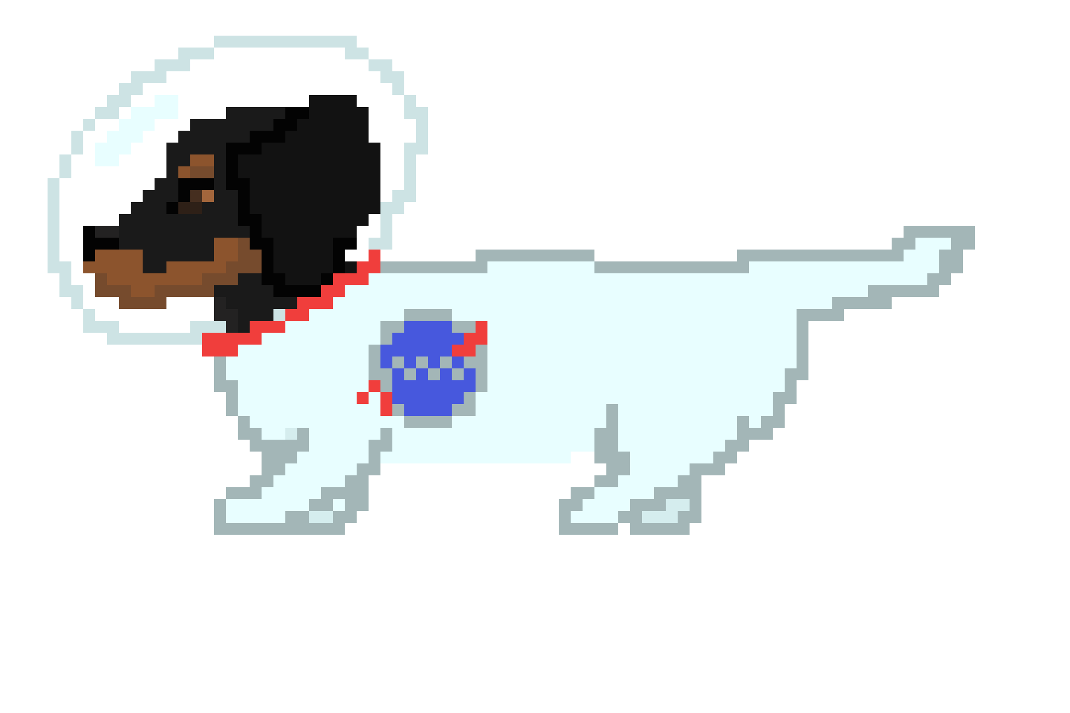
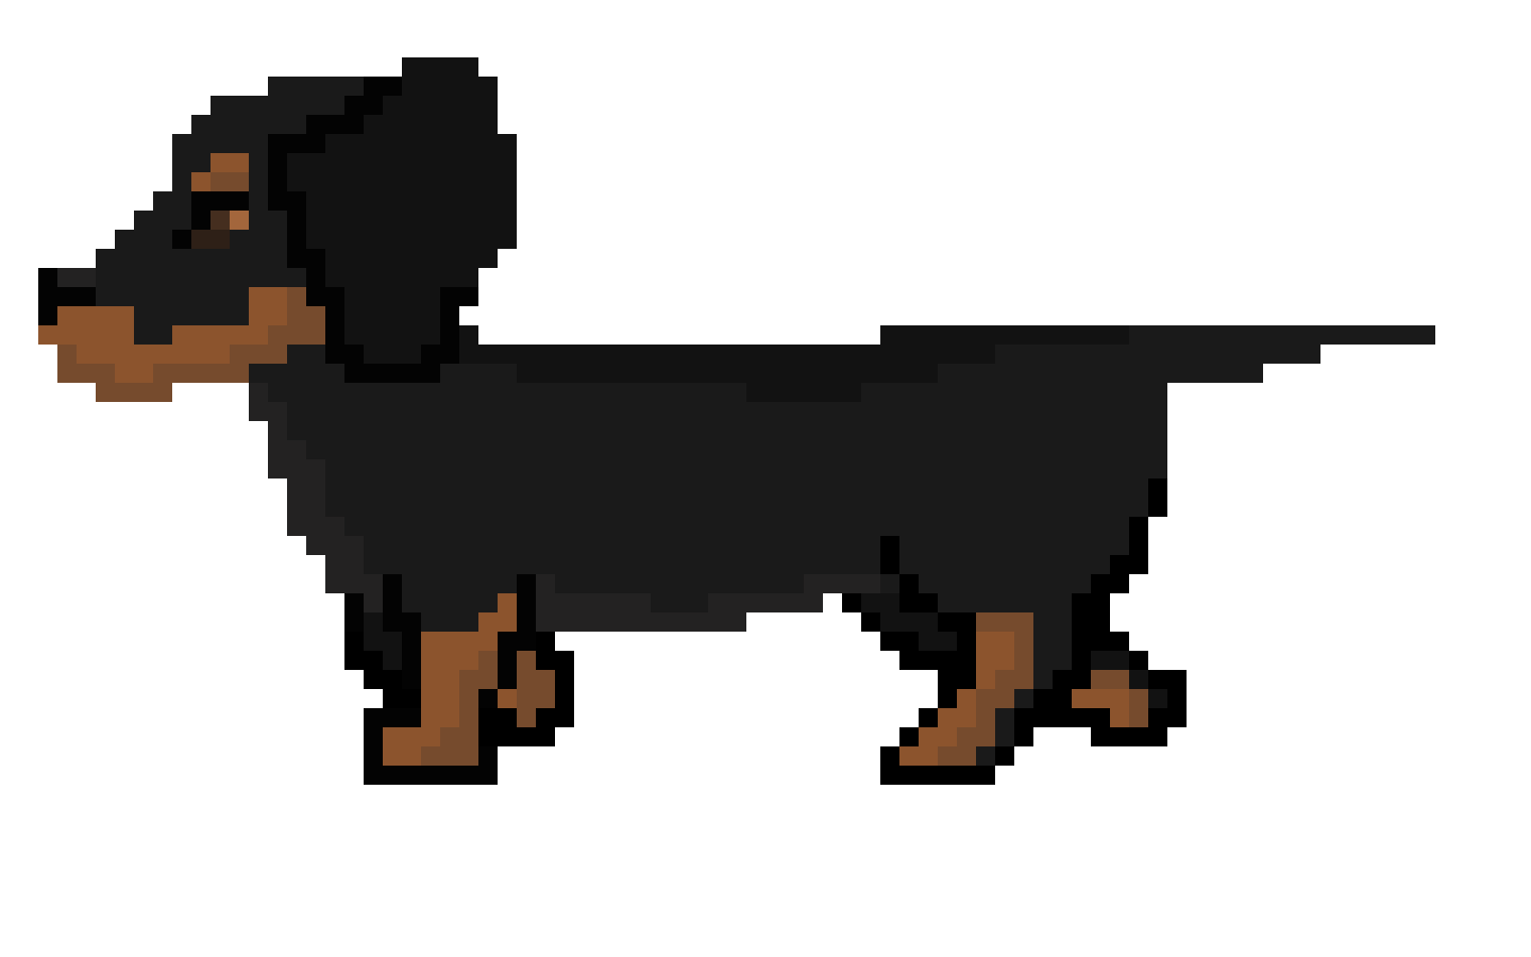
Meet the Rover! (yes, it’s his real name)
This cute puppy is heading right into the space! He’ll find himself flying through the planets or even landing on one. Being an adventurer Rover is, he will seek for the sighs of life beyond the Earth!

Slide 3
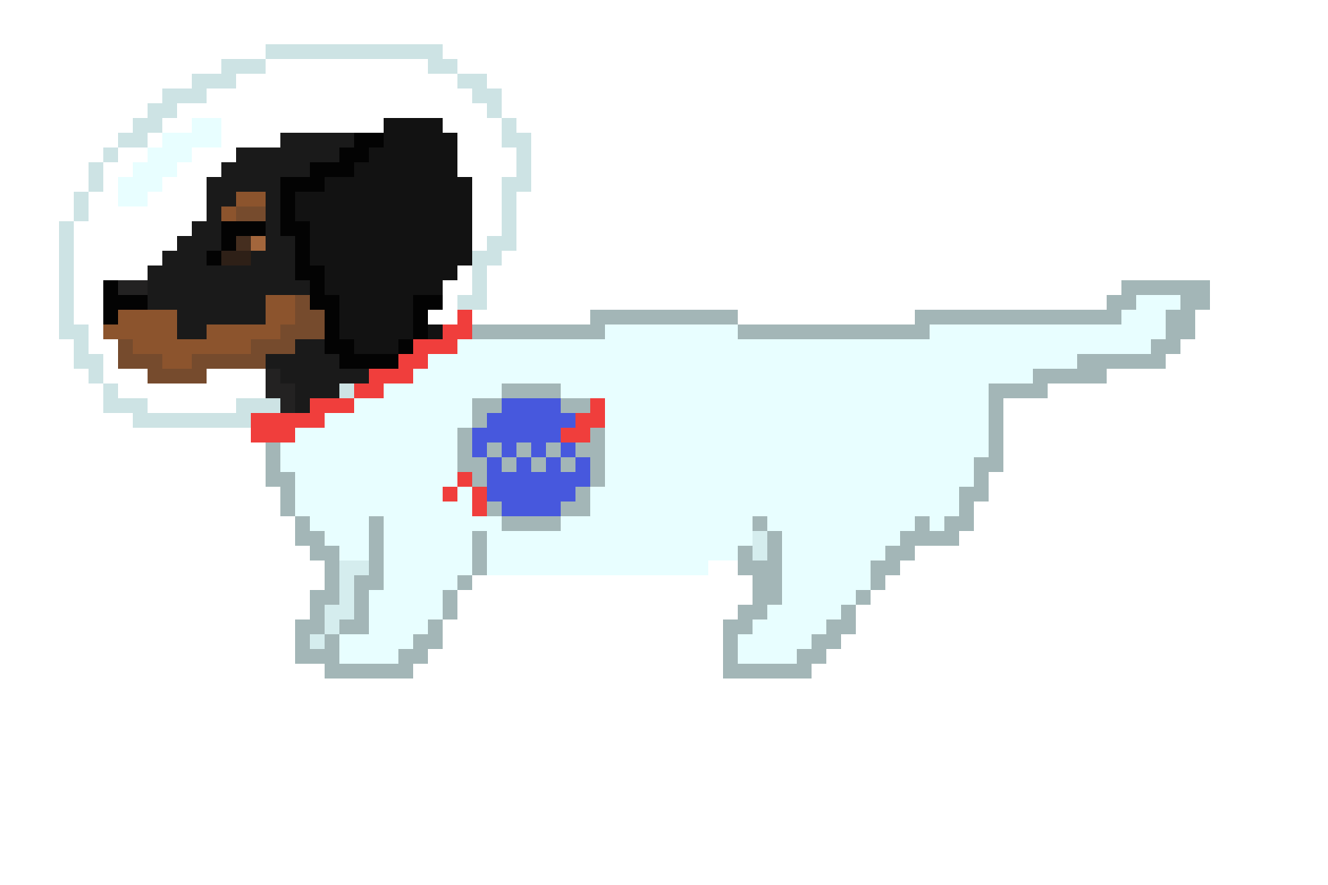
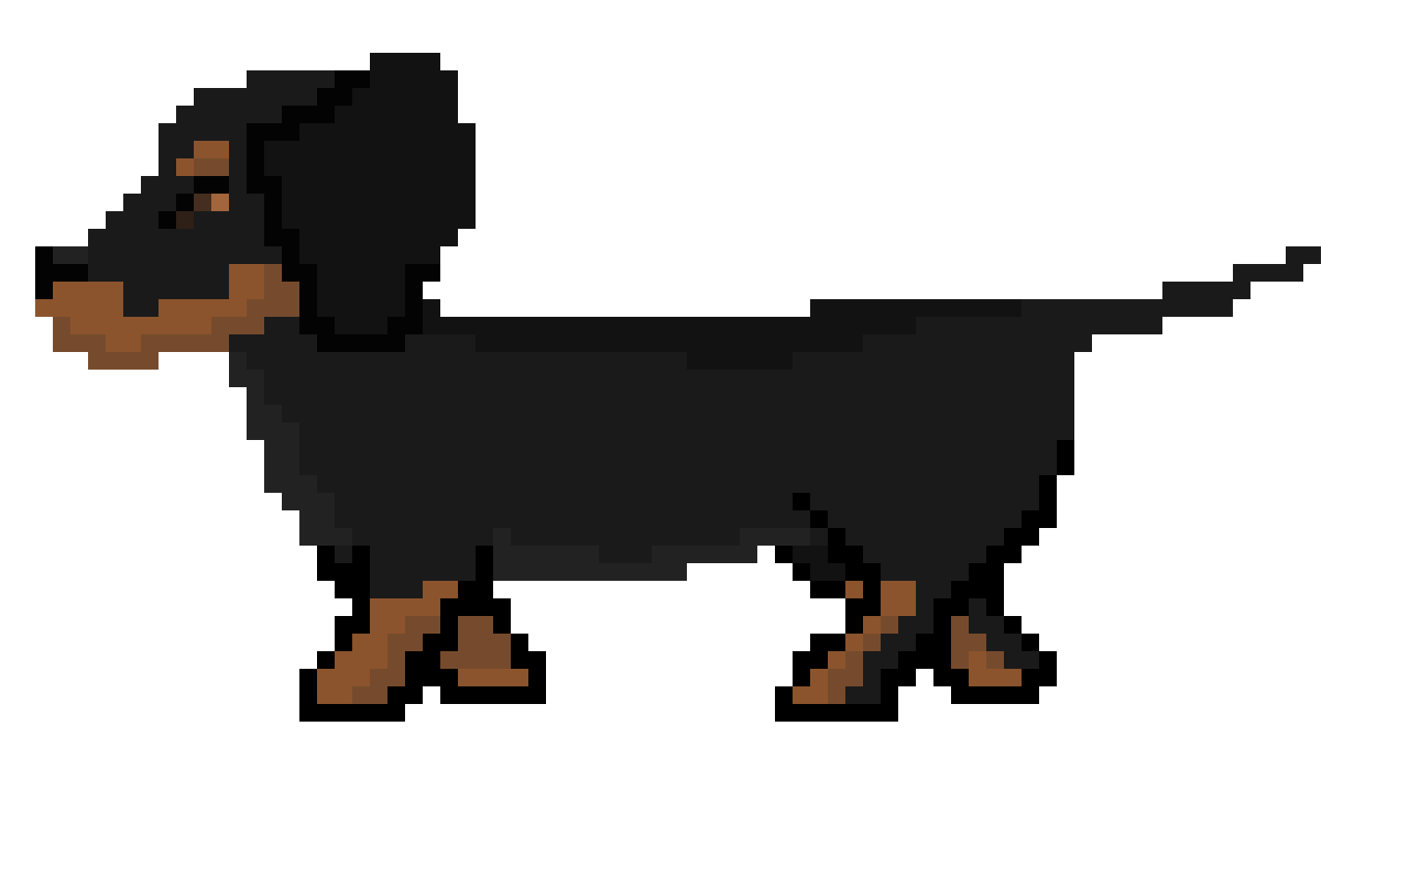
Will you help him in his journey?

Slide 4


Based on real events.

