Slide 1
CME 102 MATLAB Review
Tim Anderson

Slide 2


What is your background?
Math background
Math 51? Other math class at Stanford?
Math class outside of Stanford?
Programming background
Java (CS106A)? Python? C++ (CS106B/X)? R?
Forgot over break? Didn’t really learn in CME100?
Just a bad relationship with MATLAB?

Slide 3
What is MATLAB?
Short for “matrix laboratory”
Developed in mid-1980s
Designed as easy environment for doing matrix computations
Does calculus-related stuff very well too
Used a lot in education and industry
Jonathan Rosenberg (advisor to Larry Page): “If you want to work at Google, make sure you can use MATLAB”

Slide 4
Basics
Variables/Data types/Scope
Mathematical operations
Vectors (not exactly the same as in CME100)
Matrices
Vector operations
Plotting
Loops
Functions/Scripts

Slide 5
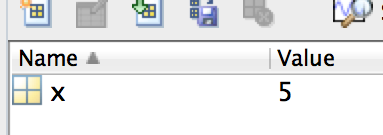
Variables
Way to store and call up a value
Declare variable “x” and assign value 5 as:
x = 5;
Omit semicolon if you want to output value:
x = 5
And this outputs:
x =
5

Slide 6
Variables
Lets you call up the variable:
EDU>> x
x =
5
And you can reassign the value as-needed:
EDU>> x = 4
x =
4

Slide 7
Mathematical Operations
You can perform mathematical operations on variables. Examples:
EDU>> exp(x)
ans =
54.5982
EDU>> log(x)
ans =
1.3863
Basically, MATLAB can work like a really good calculator

Slide 8
Vectors
Not the same as in CME100
CME100: Vector = quantity with direction and magnitude
Matlab: linear algebra version of vector
Basically n-length array of numbers
Good for storing series of numbers such as data values

Slide 9
Vectors
Examples: Let’s create a couple vectors
Type (if you have MATLAB open on your laptop):
x = [1 4 5 8];
y = [2 13 9 4]’;
z = [1; 16; 10; 3];
Can index into the vector as:
y(4) = 4

Slide 10
Vectors
Output:
x =
1 4 5 8
y =
2
13
9
4
“Row vector”
z =
1
16
10
3
“Column vector”

Slide 11
Vectors
Examples:
x = [1 4 5 8];
y = [2 13 9 4]’;
z = [1; 16; 10; 3];
“Row vector”
Apostrophe stands for “transpose” – flips from row to column vector or vice versa
“Column vector”
Semicolons separate rows when entering data

Slide 12
Matrices
2-D arrangement of data
Ex:
A = [1 4 5 8; 2 13 9 4; 1 16 10 3];
Gives 3 x 4 matrix A:
A =
1 4 5 8
2 13 9 4
1 16 10 3
Matrix dimensions given as rows x columns

Slide 13
Matrices
Can also be viewed as stacked row vectors:
Ex: B = [x; y’; x];
B =
1 4 5 8
2 13 9 4
1 4 5 8
Or side-by-side column vectors:
Ex: B = [x’ y x’];
B =
1 2 1
4 13 4
5 9 5
8 4 8
Putting vectors together like this is called concatenation

Slide 14
Vector Operations
Operators such as log, exp, etc. act on vectors element by element
Ex:
exp(x) =
1.0e+03 *
0.0027 0.0546 0.1484 2.9810
Whatever type of vector (row or column) you put into an operator will come out of it

Slide 15
Vector Operations
Operations between vectors must be done on vectors with the same dimension
Addition and subtraction are done element-by-element (just like in CME100)
Ex: x + y’ =
[3 17 14 12]

Slide 16
Vector Operations
Multiplication/division can be a vector operation (outer/inner product) or element-by-element operation
Outer/inner products are from linear algebra and not needed for CME102
To do multiplication, division, and exponentiation element-by-element, you must write .* , ./ , or .^
The period tells MATLAB that it’s an element-by-element operation

Slide 17
Vector Operations
Examples:
y.*z =
2
208
90
12
y./z =
2.0000
0.8125
0.9000
1.3333
y.^z =
1.0e+17 *
0.0000
6.6542
0.0000
0.0000
y(4)*z(4)
y(4)/z(4)

Slide 18
Clearing Data
Can clear a single variable/vector/matrix:
clear x
Or you can clear everything:
clear all

Slide 19
Plotting
Plot two vectors of equal length as:
plot(x,y)
If you need equally spaced data (you usually will for the x-axis variable), make it with either:
x = 0:0.1:10;
Vector from 0 to 10 spaced by 0.1; 101 elements long
or x = linspace(0,10,100);
100 evenly-spaced points from 0 to 10

Slide 20
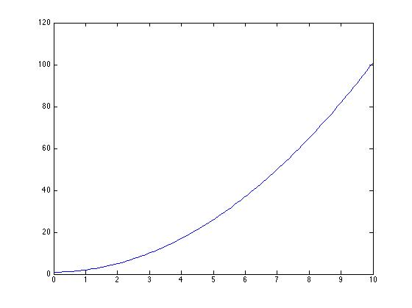
Plotting
We can generate a y variable by
y = x.^2 + 1;
Then plot as:
plot(x,y)

Slide 21
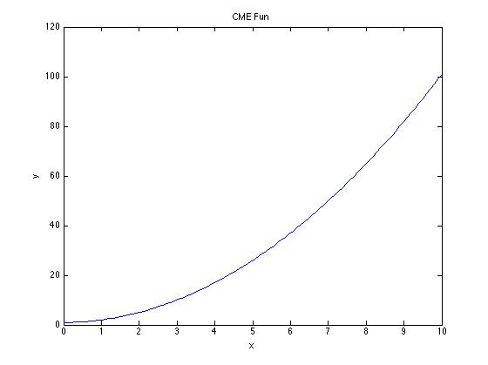
Plotting
Label plot using:
xlabel(‘x’); ylabel(‘y’); title(‘CME Fun’)

Slide 22
Plotting
Make new plot using “figure”
Can plot multiple things with
hold on or hold all
“on” plots everything in the same color (default = blue), “all” plots each line with a different color
Can switch between plots with
figure(1), figure(2), etc.
Close plots with:
“close all” or “close figure(1)”

Slide 23
Loops
Loops used when you have to do something repeatedly
E.g. running a function for a changing parameter, getting something to converge below an error, etc.
MATLAB has for loops and while loops

Slide 24
Loops
for loop:
for i = 1:5
x = x + 1;
end
while loop:
x = 2;
while x < 6
x = x + 1;
end
Loop increments counter variable on each iteration over an interval
In MATLAB, must always terminate loops with “end”
Loop continues until condition is met— “while true” condition gives infinite loop
Terminate loop with “end”

Slide 25
Loops with Conditionals
Can break out of loop prematurely using break statement with if statement:
for i = 1:5
x = x + 1;
if x > 5
break
end
end
Code inside if statement executes if and only if condition is met
When “break” executes, it will only break the loop it is in, not all loops

Slide 26
Functions
MATLAB functions come in two flavors: “library/built-in functions” and “user-created functions”
Built-in/library functions are things like plot(), exp(), log(), sum(), etc.
Making your own function can sometimes be useful for solving some problems
Numerically solving ODEs in MATLAB requires you to make your own functions

Slide 27
Functions
You hand a functions some parameters and it will return a value or vector of values
Ex:
function m = sum_it_up(a,b)
m = a + b;
end
Use function as:
c = 1; d = 2;
x = sum_it_up(c,d);
Output: x = 3

Slide 28
Functions
Variable where you store whatever you want the function to return
Function declaration
Function declaration
function m = sum_it_up(a,b)
m = a + b;
end
Parameters being passed to the function
Assign something to m, so then m is returned by the function
Terminating end statement

Slide 29
Functions and Scope
In MATLAB, variables are not global
Ex.: If you have variable “a” in your main script, using “a” in a function will not call up the same “a” as in the original script
E.g. problematic if your function evaluates a derivative of a function (something you’ll do a lot in this course) and you need to pass a parameter to the function
There are work-arounds for this issue, but we will cover them later when needed

Slide 30
Scripts
Calling up other scripts within MATLAB is pretty easy (compared to doing other stuff)
You save a MATLAB script as a .m file
Call up a script in the command prompt or within another script by just writing the name of the script you want to call within the script you’re writing
Can be useful for loading datasets or subroutines
Note: calling external scripts/datasets won’t be needed much (if at all) in CME102

Slide 31
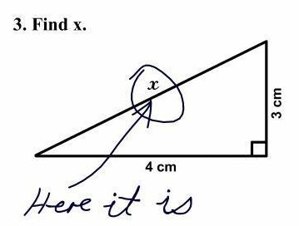
Questions?

Slide 32
Wrap-up
This presentation owes credit to Dr. Eric Darve and Dr. Hung Lê for their development of CME102, and Dr. Vadim Khayms’s CME100 MATLAB workbook
Contact: timmya@stanford.edu
If you need to learn how to do something new or troubleshoot your code, www.mathworks.com is a tremendous resource
MATLAB is a great skill, learn it early and it will help a ton in your future engineering classes.

