Slide 1
Privacy in Centralized Systems
Ian Martiny
Notes:
Hello My name is Ian Martiny and today I’m going to talk about: Providing Privacy to Centralized Systems and Measuring Decentralized Systems

Slide 2
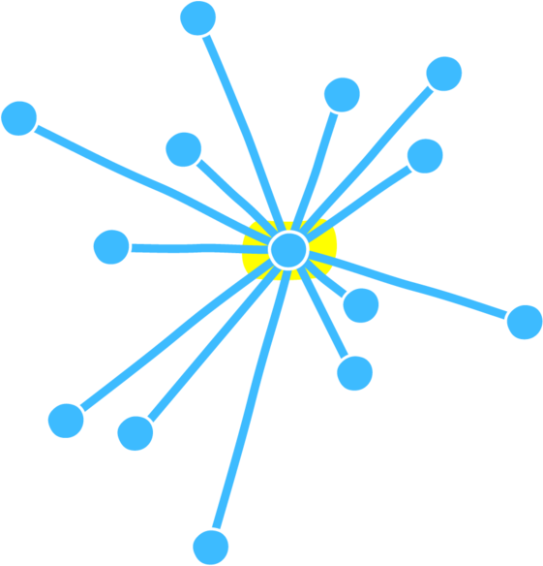
Centralized Systems
Almost every popular service
  WhatsApp/Signal
  Twitter
Many clients connecting to a singular service provider
Notes:
I’ll begin with an overview of Centralized and Decentralized Systems:
Centralized Systems are widely used across the world, this is how most online services are run, there is a central service you connect to for use.
The key feature is many clients talk to a singular service. This doesn’t mean there is only one node, there may be many for localization, but they will talk back to the quote/unquote “service”.
There are many common examples, of relevance for this talk are Twitter, a centralized service hosting short messages, i.e., tweets and WhatsApp and Signal, both centralized End-to-End Encrypted Messengers

Slide 3
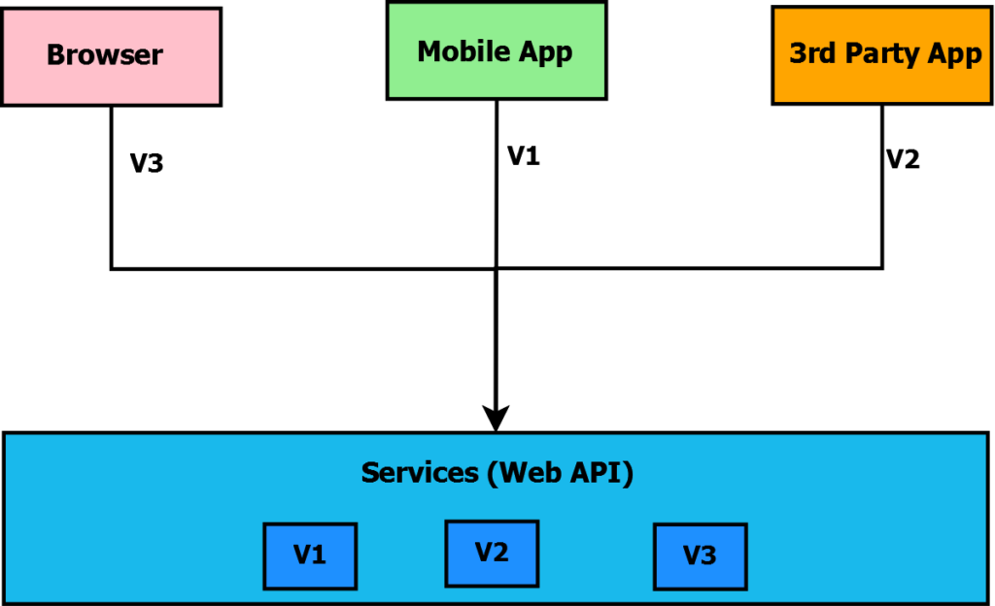
Centralized Systems
Almost every popular service
  WhatsApp/Signal
  Twitter
Many clients connecting to a singular service provider
Simple to make unilateral design choices
Notes:
This design of Centralized Systems is easy to provide updates to, a service provider controls all the service nodes and can choose directly how to respond to queries with any type of versioned API.
This makes studying Centralized Systems easy: their API is consistent across localization nodes, behaving identically. Anomalous behavior is unlikely and usually due to hardware issues rather than unusual service behavior.

Slide 4
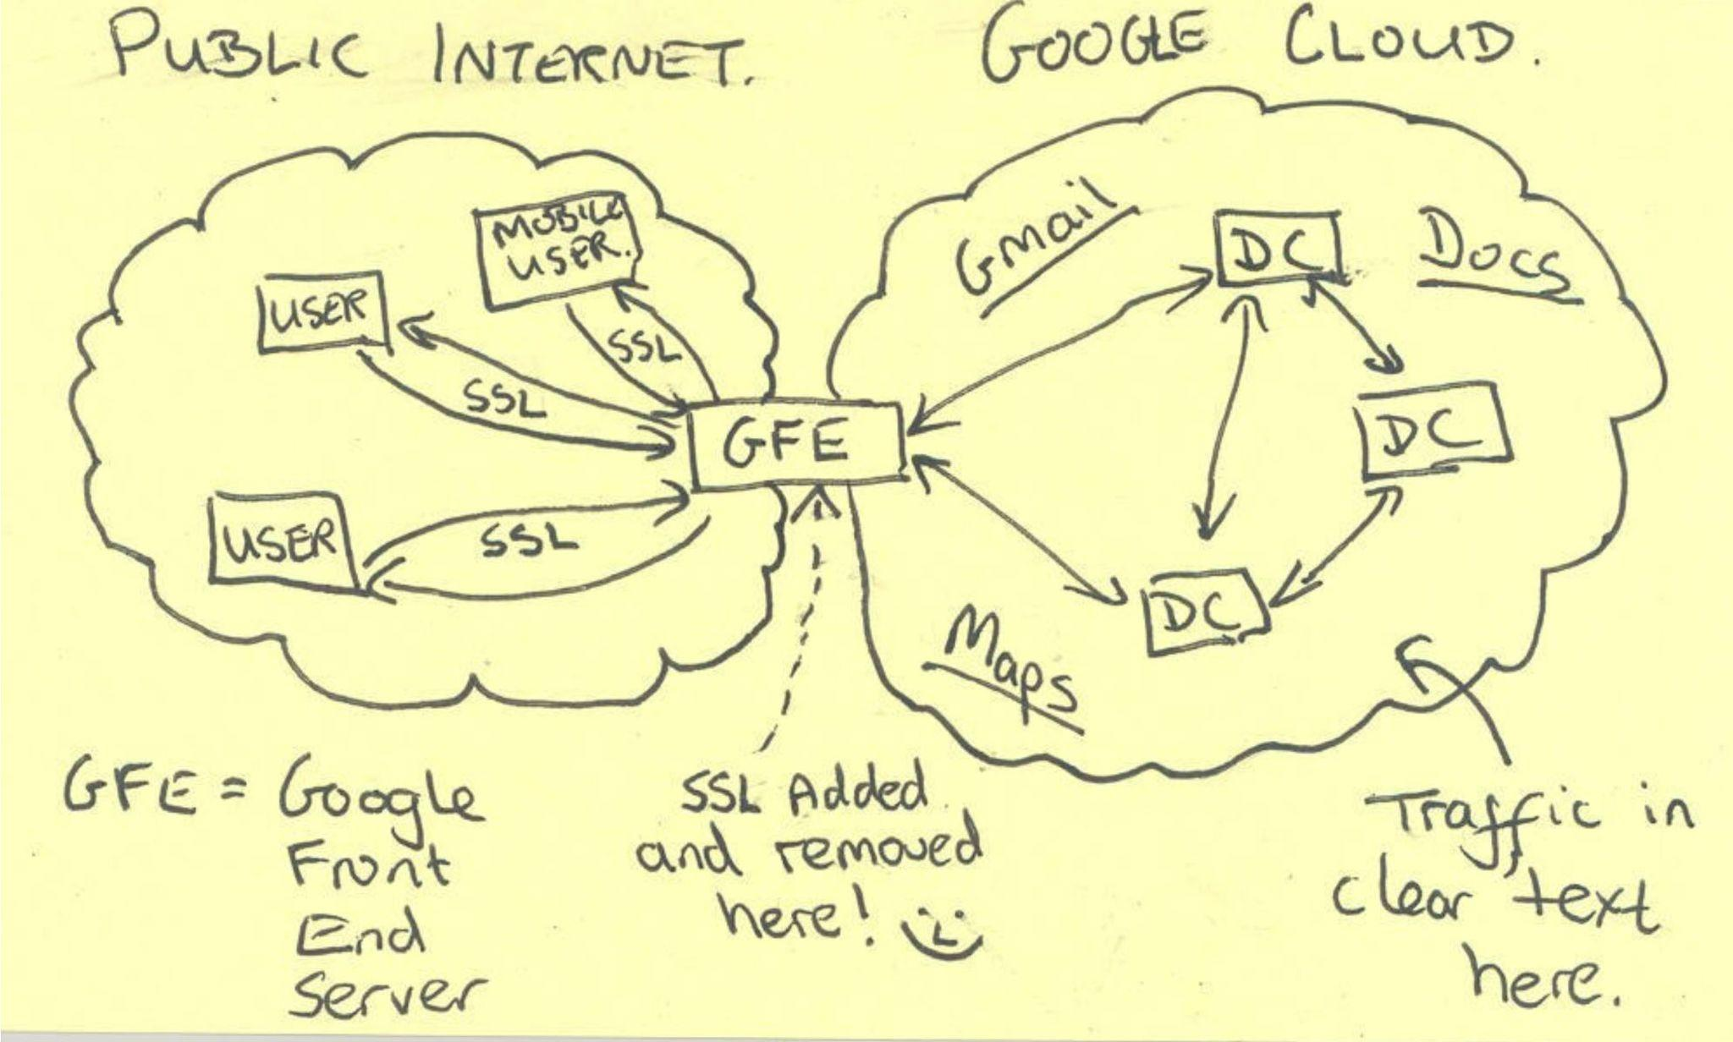
Centralized Systems
Almost every popular service
  WhatsApp/Signal
  Twitter
Many clients connecting to a singular service provider
Simple to make unilateral design choices
Single node security
Notes:
In a centralized system there is only one quote/unquote “vulnerable” communication, the client connecting to the service, which is often protected with TLS, all internal communications are not the clients responsibility, and are usually internally handled by the service only.
This means that there are often no guarantees on how your data is handled once it is given to the service. Every website will say your data is handled with care once you give it to them but there are no provable guarantees on how your data is actually handled.
A significant portion of this talk will be geared towards providing mechanisms for centralized systems to provide provable privacy in relation to data given to such a service.

Slide 5
Centralized Systems
Almost every popular service
  WhatsApp/Signal
  Twitter
Many clients connecting to a singular service provider
Simple to make unilateral design choices
Single node security
Requires complete trust that system behaves honestly
Notes:
Additionally, there is no inherent verification of correctness in centralized systems. For example, sending a text through WhatsApp or Signal, you inherently trust they are doing what they say on the tin up to Open Source, reproducible builds, etc. But even then you usually need to place trust that the server is behaving as prescribed.

Slide 6
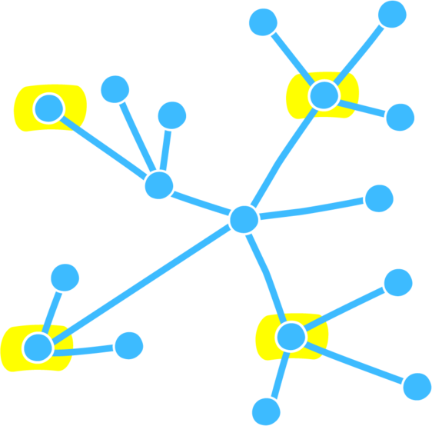
Decentralized Systems
Less desirable for companies
  DNS: domain name resolution
  Tor/Onion Routing/Mixnets
  Torrenting
Notes:
Decentralized systems are less common for online services, services that function as decentralized systems have less control over user information and usage. In fact in the cases presented here, we see protocols and systems that are inherently user run.

Slide 7
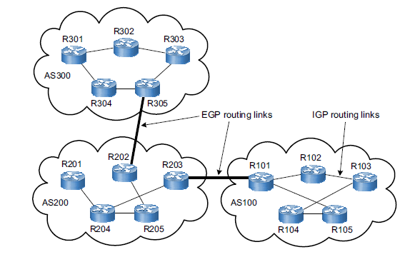
Decentralized Systems
Less desirable for companies
  DNS: domain name resolution
  Tor/Onion Routing/Mixnets
  Torrenting
Many clients connecting to many service providers
Notes:
The defining feature of decentralized systems is that there are many nodes which provide services independent of a central service, and clients can freely choose which of the many service providers they wish to use.
For example, of particular interest to this talk is domain name resolution, a user may ask any publicly available DNS resolver to resolve a domain name.
In many cases service providers can be run by individuals, instead of companies.
Because of this there is usually inherent, built-in privacy guarantees for clients, even if you don’t trust a random node operator clients can use the service without fear.

Slide 8
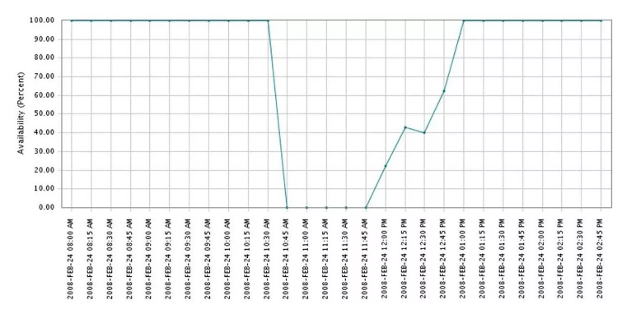
Decentralized Systems
Less desirable for companies
  DNS: domain name resolution
  Tor/Onion Routing/Mixnets
  Torrenting
Many clients connecting to many service providers
Multiple points of vulnerability
Notes:
Decentralized Systems allow for multiple points of failure, a bug or vulnerability in a system must be patched to all service providers, which may update infrequently, if ever.
In the case of DNS BGP routing, in 2008 Pakistan was able to deny service to Youtube.com across the world for over an hour by censoring youtube in their country, Pakistan announced they had the quickest access to youtube, which routers readily believed.
This exemplifies a complication in decentralized systems: unexpected operator behavior can vastly affect the system as a whole.
Because individual node operators can act independently this also makes answering questions about decentralized systems difficult: is the behavior of this one DNS resolver anomalous or is it the expected behavior? My proposed work will address this issue.

Slide 9
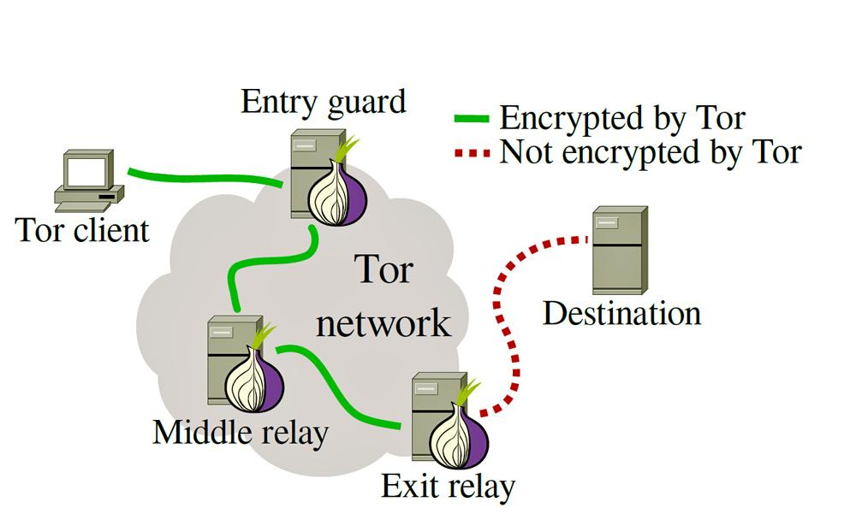
Decentralized Systems
Less desirable for companies
  DNS: domain name resolution
  Tor/Onion Routing/Mixnets
  Torrenting
Many clients connecting to many service providers
Multiple points of vulnerability
Systems are built upon inherent distrust and privacy
Notes:
As mentioned before the many service providers may be run by individuals thus there is inherent distrust of the service providers and privacy guarantees for clients are built in to the system design.
For example, the design goal of Tor is to provide privacy between the client and any MitM. It does this by injecting independent routers in the middle which are explicitly untrusted: i.e., do not possess both source and destination IP

Slide 10
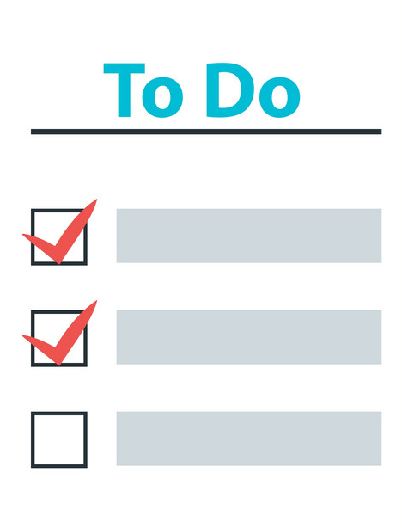
Goals
Companies are unlikely to adapt to use decentralized systems
Provide security guarantees to users of centralized systems
Provide frameworks for answering reliability questions on decentralized systems
Notes:
There is rarely an incentive to use a decentralized system for companies, due to updates and consistency of service, companies tend to favor centralized systems
However, there are incentives, mainly social ones, to provide a measure of provable privacy. Signal’s occasional publication of Court Orders and their responses, as well as their blog posts on privacy systems do not provide provable privacy but go a long way to gain the confidence of the public that they have the privacy of its users in mind.
Today I will discuss projects geared towards providing provable privacy in centralized systems
And in the reverse some systems are inherently decentralized, which can make answering questions about that system complicated. I will present ongoing research into providing a formal method of determining reliability of a decentralized system.

Slide 11
  Proof-of-Censorship: Enabling Centralized Censorship-resistant Content Providers
    Ian Martiny, Ian Miers, and Eric Wustrow
    In Proc. of the 22nd Intl. Conference on Financial Cryptography and Data Security (FC 2018), February 2018.
  ExSpectre: Hiding Malware in Speculative Execution
    Jack Wampler, Ian Martiny, and Eric Wustrow
    In Proc. of Network and Distributed Systems Security Symposium (NDSS 2019), February 2019.
  Improving Signal's Sealed Sender
    Ian Martiny, Gabriel Kaptchuk, Adam Aviv, Dan Roche, and Eric Wustrow
    In Proc. of Network and Distributed Systems Security Symposium (NDSS 2021), February 2021.
  Measuring DNS censorship Methodically
    Ongoing work
Notes:
We’ll discuss three different projects in this talk.
First Proof of Censorship, a method of allowing centralized content providers, such as Twitter, to prove they are not censoring requests for content, using Private Information Retrieval,
Second we’ll examine Signal’s Sealed sender and how naive privacy implementations do not necessarily provide the desired level of privacy, and examine a simple cryptographic method to provide stronger guarantees in a centralized messaging service
Finally we will conclude with ongoing work using an inherently decentralized system: DNS, and discuss methodology to answer questions such as “is China blocking access to Google at the DNS level” systematically.
Not covered in this talk is my work on ExSpectre, using Speculative Execution to hide malware.

Slide 12


Proof of Censorship
Enabling centralized censorship-resistant content providers
Ian Martiny, Ian Miers, Eric Wustrow
Notes:
We start with Proof of Censorship.
This was joint work with Eric Wustrow and Ian Miers while he was at John’s Hopkins University. It was published at Financial Crypto 2018

Slide 13
Content Provider Censorship
In 2016 Twitter received 9,465 take-down requests from governments or police entities (and complied with 17% of them)
Notes:
This talk focuses on content provider censorship.
As a motivating example consider that in 2016 Twitter received almost 9.5 thousand take down requests from governments and complied with 17% of them.

Slide 14

Notes:
One such example of this is a tweet comparing then Mayoral candidate Rafael Greca to a Batman villain. Twitter complied with the Brazilian Government’s request to have this tweet taken down.
This style of censorship is particularly nefarious because it is hard to detect, Twitter is still available as a service, even if a particular tweet is not.

Slide 15
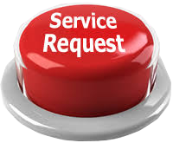


Prior Attempt: Proof of Retrievability
Client
Server
Notes:
A previous attempt to address content censorship is Proof of Retrievability.
After a client uploads content to a service…
That same client or other independent verifiers occasionally request access to specific subsets of stored data
As long as the service doesn’t censor data, verifiers can locally put data back together, proving a service is not censoring access to a particular file

Slide 16


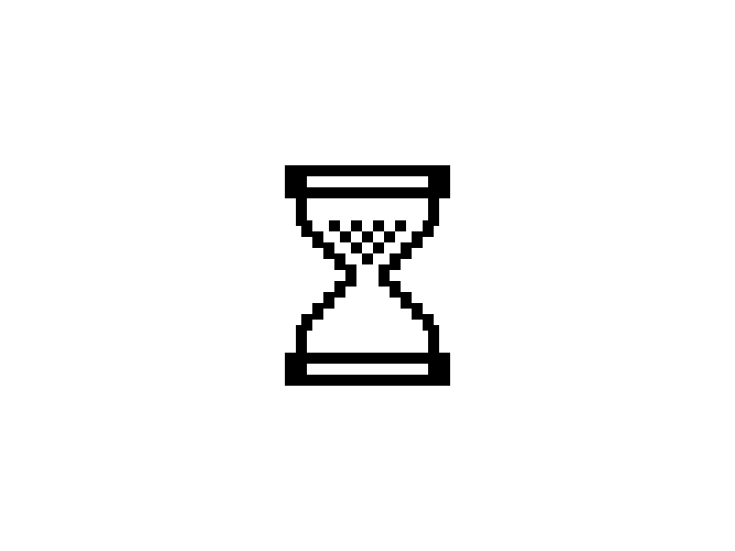
Prior Attempt: Proof of Retrievability
Client
Server
Client
Client
Notes:
However there are flaws in this idea, one such issue is that clients and verifiers must announce which file they’re requesting.
A service wishing to censor access to a certain file can choose to not respond to requests for subsets of that file.
Note that there is no proof of wrong doing in this case, there is simply silence, for a particular file. The service can behave normally to other requests.
This behavior is also adaptable, if a verifier announces that the service is not responding to certain queries – as others attempt to perform requests, the service can modify its behavior, and start responding to queries.
The service can easily claim any issues are not censorship, simply service outages.
This is Proof of Retrievability working in action, Popular files are able to have the backing of a multitude of verifiers.

Slide 17
Proof of Censorship
Cryptographic proof
Independently verifiable offline
Required for server to produce
Notes:
To address this issue and others, we introduce Proof of Censorship
This will create cryptographic proof whenever a service chooses to censor files. This allows services to also continue to be transparent about which files they do purposely censor access to.
The cryptographic proof of censorship is verifiable offline and is required for the service to produce

Slide 18
Security Goals
Non-deniability of targeted censorship
  Server automatically generates proofs
  when they censor
Unforgeability of proofs
  Attackers cannot forge a proof of censorship against honest providers
Notes:
Specifically the goals we are set are:
If servers choose to censor they must either: generate a proof that they are censoring a file OR deny the use of the whole service.
And secondly clients cannot claim an honest service is censoring

Slide 19
Background:
Private Information Retrieval
D(E(a)+E(b)) = a + b
D(E(a)·b) = a∙b
Notes:
To meet these goals, we use Private Information Retrieval (or PIR): Encryption that allows for simple computation on encrypted values
Namely Adding two encrypted values and decrypting the result will yield the addition of the unencrypted values
And multiplying an encrypted value by an unencrypted scalar and decrypting that yields the scalar multiplication of the two unencrypted values
Obviously much easier to read than say…

Slide 20
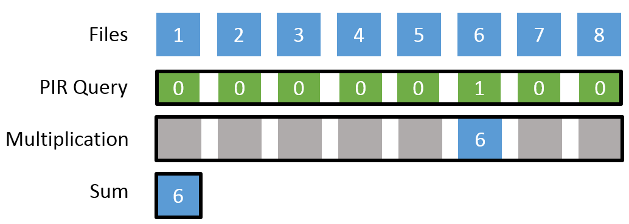
Background:
Private Information Retrieval
D(E(a)+E(b)) = a + b
D(E(a)·b) = a∙b
Notes:
Also easier to see with an example.
A service hosts 8 files, a client creates an encrypted PIR query with a 1 in the 6th spot and 0’s elsewhere
After PIR multiplication we have 8 encrypted values, but because most are multiplication by 0 they result in encrypted 0s.
Thus adding them all together results in an encrypted value of just the desired file.

Slide 21
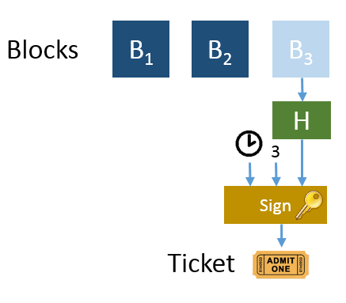
File Upload
Hash of uploaded file
Index (location) of file
Time of commitment
Notes:
Lets Examine the Proof of Censorship File upload protocol
When a user uploads a file, lets say Block 3, the server will hash the contents of Block 3, take the index of the file (in this case 3) and the time the file was uploaded and cryptographically sign this to produce a constant sized ticket

Slide 22
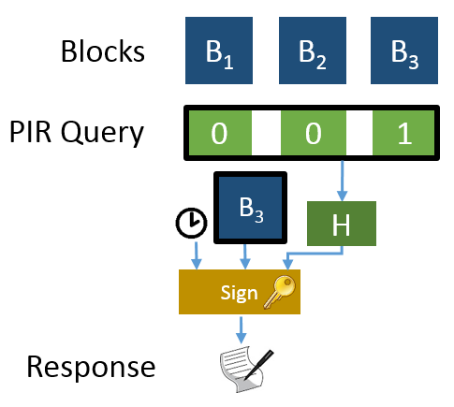
File Download
Hash of query
(Encrypted) result of query
Time of query
Notes:
Our last building block is the methodology to download a file
Clients will generate encrypted PIR queries which they send to the service.
The service will take the Hash of the encrypted query, the encrypted results of the PIR operations and the time of the query and cryptographically sign this combination to produce its response.
(Along with the encrypted result of the query)

Slide 23
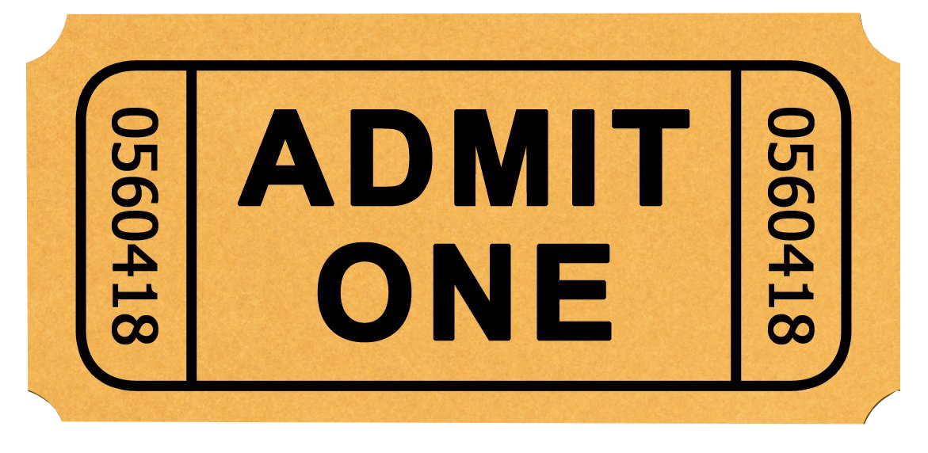


Server is honest
Client
Server
Client
Client
Notes:
Given how uploading and Downloading works lets examine these in action with an honest server
The client uploads a file to the service. The service takes the hash of this file, the time it was uploaded, and the location the file is stored and returns this constant sized ticket to the uploading client
The client can then distribute this ticket to others (which includes the location of the file so they can access it)
Any client can then create an encrypted PIR query for that file
The service receives this encrypted request and takes the encrypted results, the time of the query and the hash of the query and signs it and returns that to the querying client
The client can then decrypt the result to get the file

Slide 24


Server doesn’t respond
Client
Server
Client
Client
Notes:
Lets examine our previous example, where the service wishes to ignore requests for particular files.
When a client sends an encrypted PIR query to the service they cannot decipher what file is being requested.
The service can choose not to respond to queries, but if a second client issues an encrypted PIR query for a different file, the service cannot differentiate those requests, and must choose to not respond to any queries

Slide 25





Server modifies files
CENSORSHIP
Client
Server
Blocks
B₁
B₂
B₃
PIR Query
0
0
1
H
H
B₃
H
From ticket
Sign
Response
Notes:
Lets consider the case where a malicious service chooses to modify the files it stores.
When a client issues an encrypted PIR query for that file, the service is still unaware of what file has been requested, and computes the encrypted response, takes a hash of the query and time of the query and cryptographically signs those as part of its response.
The client can unencrypt the response and compare the hash of the file received to the hash of the file in the ticket.
Once it notices a difference it can announce it has proof the service has censored.

Slide 26



Proof is Transferable
(Ticket) before (Response)
Verify( , , , 3)
Verify( , , , )
Check =
Client
H
Verifier
B₃
H
H
Notes:
This proof is transferable to independent verifiers. Additionally the proof is offline, the server is not involved
All information is transferred to a verifier
Who then checks the upload time in the ticket is before the requested time in the response.
Verifies the signature of the ticket with its contents, which the service attested to
Verify the signature of the response, which the service attested to
And finally notice the hash mismatch between the file returned and the file uploaded

Slide 27
Proof is Transferable
(Ticket) before (Response)
Verify( , , , 3)
Verify( , , , )
Check =
Client
H
Verifier
B₃
CENSORSHIP
H
H
Notes:
The verifiers can then also announce that the service has censored a particular file.

Slide 28
PoC Implementation
Uses (modified) XPIR library
Database of 256 byte tweet-like messages
Notes:
We built a proof of concept implementation
A few hundred line modification to the XPIR library
Additionally we wrote a 500 line application using OpenSSL for signatures and hashes
Our testing set up consisted of a database of 1 million 256 byte messages

Slide 29
PoC Implementation
 | Size | Generation Time | Validation Time
Ticket | 120 bytes | 341 μs | 395 μs
Query | 3.8 Mbytes | 27 ms | N/A
Reply/Proof | 2.0 Mbytes | 967 ms | 45 ms
Notes:
As mentioned the ticket is constant sized and small.
Additionally it is quick to generate and verify

Slide 30
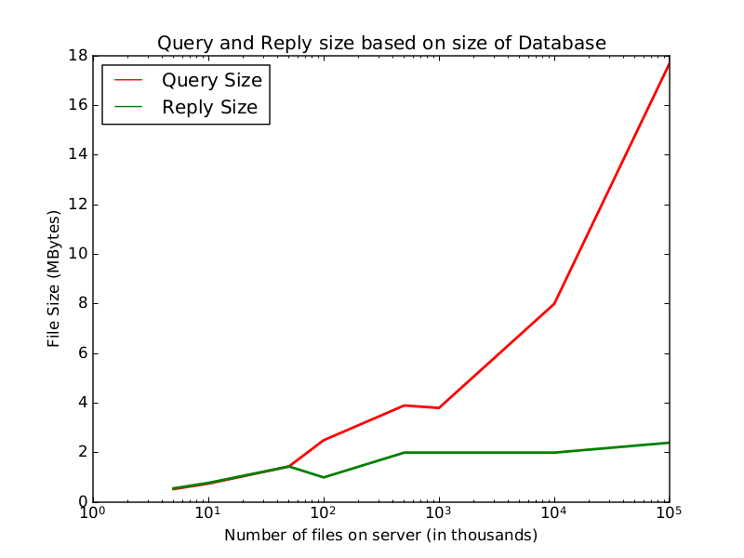
PIR (in)efficiencies
Notes:
Query size grows based on the number of files in the database, this is an inherent issue with PIR, not specific to Proof of Censorship.
As the number of files in the database grows the client must generate larger encrypted queries. Remember our example with 8 files, there were 7 0s and 1 1.
With a million files we’d need 999,999 0s and 1 1.
The reply size is relatively constant, being essentially just the encrypted file and the attested to response

Slide 31
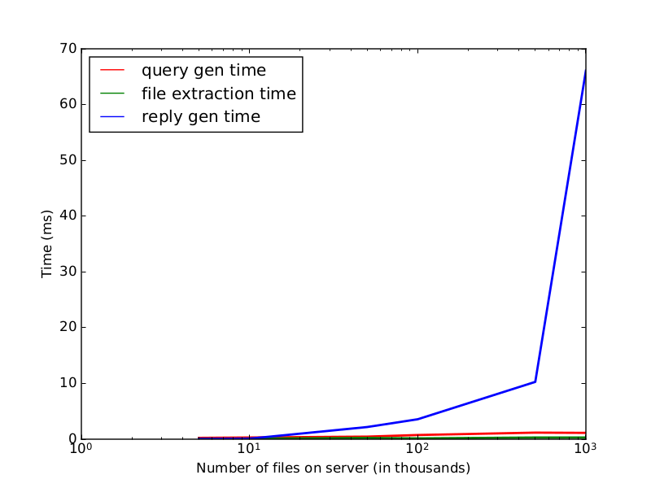
PIR (in)efficiencies
Notes:
Client side computations query generation and file extraction are quick
But server side computation is an order of magnitude heavier, as they bear the brunt of the public key PIR operations

Slide 32
Applications
Trust-able transparency reports
Penalties for Censored Files
  Smart Contracts
  ZKP slash and burn
PIR limitations
  Epochs
Transparency Applications
  CONIKS
  Certificate Transparency
Notes:
Proof of Censorship generates Trustable transparency reports. Services can prove they are not censoring access to files, OR publicly announce which files are purposely being censored due to undesirable content.
Services that wish to demonstrate their commitment to not censoring files could choose to back their promises to not censor with financial penalties using Smart Contracts
To address the inefficiencies of PIR a common method is to use epochs, or groups of a fixed size for data. This would cap the computation and bandwidth necessary for this protocol, but would identify which epoch a file is requested from, limiting the anonymity set of “what file was requested” to the epoch it is requested from.
Some possible applications for this are any application geared towards transparency, including key transparency for end users with CONIKS or Certificate Transparency which already leans on Proof of Retrievability.

Slide 33
  Proof-of-Censorship: Enabling Centralized Censorship-resistant Content Providers
    Ian Martiny, Ian Miers, and Eric Wustrow
    In Proc. of the 22nd Intl. Conference on Financial Cryptography and Data Security (FC 2018), February 2018.
  ExSpectre: Hiding Malware in Speculative Execution
    Jack Wampler, Ian Martiny, and Eric Wustrow
    In Proc. of Network and Distributed Systems Security Symposium (NDSS 2019), February 2019.
  Improving Signal's Sealed Sender
    Ian Martiny, Gabriel Kaptchuk, Adam Aviv, Dan Roche, and Eric Wustrow
    In Proc. of Network and Distributed Systems Security Symposium (NDSS 2021), February 2021.
  Measuring DNS censorship Methodically
    Ongoing work
Notes:
Now we’ll move on to discuss Improving Signal’s Sealed Sender

Slide 34




Improving Signal’s Sealed Sender
Ian Martiny, Gabriel Kaptchuk,
Adam Aviv, Dan Roche, Eric Wustrow
Notes:
I’m going to present a collaboration between myself Gabe Kaptchuk, Adam Aviv, Dan Roche, and my advisor Eric Wustrow on Improving Signal's Sealed Sender.

Slide 35
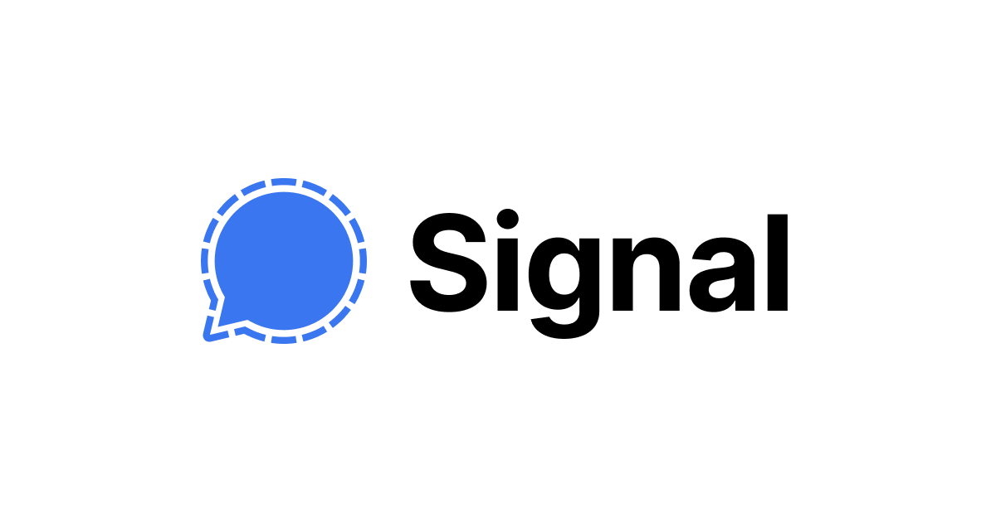
1 – Signal Background
Notes:
Signal is an end-to-end encrypted messenger. Users type text (or multi-media) messages and before they are sent to another Signal user the message is encrypted under a shared encryption key. This means that the content you send to another Signal user cannot be read by Signal or any other Man in the Middle.
While Signal is the focus of this talk, as they are the only messenger to have a Sealed Sender feature, the subject of this talk is platform agnostic, and any end-to-end encrypted messenger can adopt our protocol to implement one-way and two-way privacy.

Slide 36
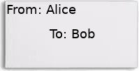
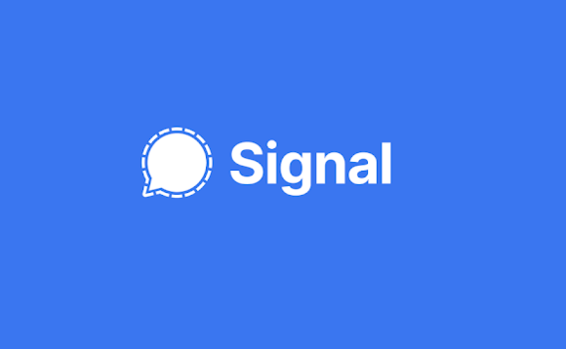
Alice encrypts message
Alice addresses envelope To: Bob
Alice addresses envelop From: Alice
Alice sends
2 – Signal Background
Notes:
The functionality of end-to-end encrypted messaging from Signal's point of view is that Alice will create a message as seen here by encrypting some text and addressing that message to Bob and putting the return address as themself. Alice sends the message. Upon receiving this message Signal will determine which device to send the message to, and when Bob receives it they can decrypt the message, read it and reply if desired.
In this talk we will focus on Signal identities, such as Alice or Bob, as users have the capability through Tor or Orbot of hiding their IP address from Signal if desired.

Slide 37

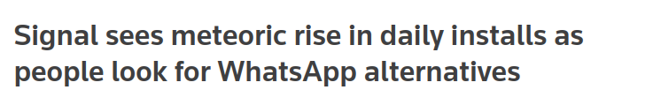

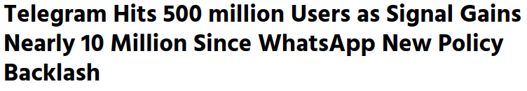
3 – Signal’s Influence
Notes:
In 2020 Signal saw a huge influx of users to the point where the registration text required to verify phone numbers was delayed up to an hour for some users.
This along with the fact that other end-to-end encrypted messengers, namely WhatsApp use the Signal protocol, demonstrates the incredible influence that Signal has in this market. Features and designs that Signal introduces have a major effect on the state of end-to-end encrypted messengers.

Slide 38
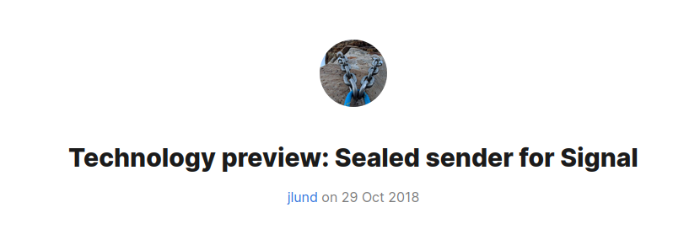
“We kill people based on metadata”
--Former NSA and CIA director Michael Hayden
4 – Metadata
Notes:
As alluded to before, this talk will focus on the metadata associated with Signal messages.
The power of metadata cannot be overstated, in fact Former NSA and CIA director Micahel Hayden explicitly stated that the US government kills people based on metadata.
You may have noticed in the motivating example that even though the message is encrypted Signal is still directly aware that Alice was messaging Bob.
To address this Signal introduced the idea of Sealed Sender in 2018. Lets look at the structure of Signal messages

Slide 39
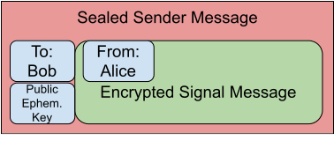
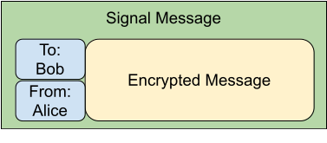
5 – Signal Message Structure
Notes:
A signal message has a simple structure, to, from, and encrypted content. The content is unreadable by Signal, but the To and From fields provide a direct link between Alice and Bob.
In a sealed sender message, the From field is moved inside the encrypted Message and a public ephemeral key is left on the outside to allow Bob to decrypt the message and determine Alice as the sender

Slide 40
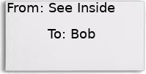
Alice encrypts message with Identity
Alice addresses envelope To: Bob
Alice sends
6 – Sealed Sender
Notes:
From Signal's point of view the functionality has not changed, they have no need to see who a message is coming from in order to deliver it.
So now, Alice encrypts their message and their identity, and on the outside of the Envelope addresses it to Bob (so that Signal can deliver it) and attaches a public ephemeral key that allows Bob to decrypt the message. Alice sends the message. Signal receives the message and delivers it to Bob
And thus Signal has solved the metadata problem and everything is perfect.

Slide 41
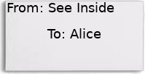
Alice encrypts message with Identity
Alice addresses envelope To: Bob
Alice sends
Bob responds
6 – Sealed Sender
Notes:
In fact if this is the only message that Signal receives it is perfect. However lets examine a more realistic scenario. Alice sends a sealed sender message to Bob, as before, which Signal delivers.
Immediately afterwards Bob replies to this message (also as a sealed sender message) which Signal delivers to Alice. There is now a correlation between these messages.
Given the quantity of messages that Signal receives this may not be an issue, especially if Bob takes a long time to reply to messages.
However lets look at one last component of Signal messages.

Slide 42
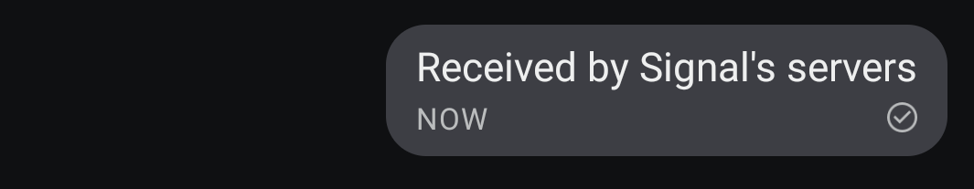
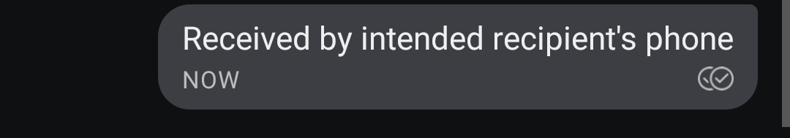

7 – Receipts
Notes:
There are three stages of a sent message in Signal and most messengers today:
* As Alice sends the message it will display with a single hollow checkmark signifying that Signal has received the message and is forwarding it to the recipient, Bob.
* When Bob's phone receives the message it will immediately send a delivery receipt back to Alice (which will be sealed sender, if enabled) which will show a second, hollow checkmark on Alice's phone
* When Bob actually opens their phone and reads the message they may send a Read Receipt (also sealed sender) that will fill in both of the checkmarks on Alice's phone.
Additionally there are certain event messages that are also sent Sealed Sender. In particular if users enable Typing notifications then "starting typing" and "ended typing" notifications will be sent.

Slide 43
7 – Receipts
Notes:
We will focus on the delivery receipts as read receipts can be disabled in Signal, but delivery receipts cannot. That is after every message sent to another Signal user that user's device will immediately reply with a delivery receipt, which will be a Sealed Sender message if enabled.

Slide 44
Attack:
  Targeted user Bob is sent a message
    Enter the Target Epoch
    Tally users who receive a message
User | Count
Charlie | 1
Dave | 1
Judy | 1
Henry | 1
Oliver | 1
Charlie | 1
Dave | 1
Alice | 1
Charlie | 1
Dave | 3
Eve | 1
Fred | 2
Greg | 1
Henry | 1
Judy | 7
8 – Statistical Disclosure Attack
Notes:
Lets examine a malicious or compelled Signal that wishes to identify who is communicating with Bob.
They will execute a simplified Statistical Disclosure Attack where they keep track of all users who receive a sealed sender message after Bob has been sent a one.
When Bob receives a message this begins the target epoch where Signal will listen for a time for all users that receive a Sealed sender message. As there are millions of users this table will grow quickly.
After the target epoch has closed Signal now has a long list of potential candidates who may have messaged Bob. We know the true sender (Alice in this case) is on the list, due to Delivery Receipts. But some popular users may have received multiple messages during the target epoch.

Slide 45
Cleanup phase
  Listen to messages
  Deduct messages from tally
User | Count
Alice | 1
Charlie | 1
Dave | 3
Eve | 1
Fred | 2
Greg | 1
Henry | 1
Judy | 7
Alice | 1
Charlie | 1
Dave | 1
Eve | 1
Fred | 0
Greg | 0
Henry | 1
Judy | 2
9 – SDA Cleanup Phase
Notes:
To address the issue of popular users obscuring who is actually messaging Bob, a malicious or compelled Signal enters the cleanup phase where they listen for another random epoch where Bob has not been sent a message.
The users that receive messages during the random epoch will be deducted from the table for each message they receive as their conversations are uncorrelated to Bob receiving a message.
After a single round of target epoch and random epoch we may not have a clear picture as to who messaged Bob. Thus we wait until Bob recieves another message and repeat until there is a clear frontrunner.

Slide 46
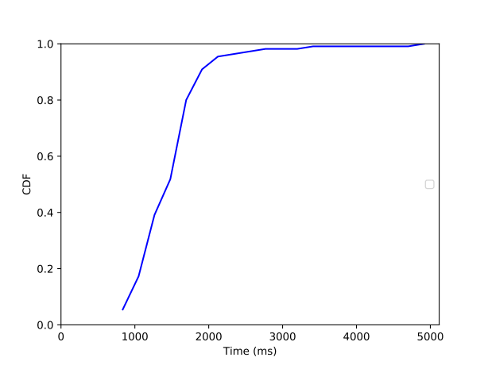
User | Count
Alice | 10
Charlie | 7
Dave | 0
Eve | 3
Fred | 2
Greg | 1
Henry | -1
Judy | -3
Delivery Receipt Timings
10 – Measurements
Notes:
The question is how many epochs are required to correctly identify Alice as the user who messaged Bob?
To begin answering this we first measured how long Signal would need to listen for a response from Bob. By timing on local phones the time between when a message is sent and the mandatory delivery receipt is received we found that the median time was just under a second and a half and 90% of delivery receipts were received in under 2 seconds.

Slide 47
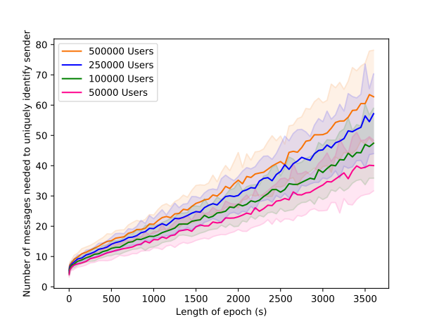
11 – Simulation Results
Notes:
We then ran simulations with reasonable guesses at user behavior and userbase size to estimate the number of epochs necessary to identify Alice as the sender.
As can be seen from the graph on the left, with a short amount of time between sending a message and receiving a delivery receipt (as we see in practice) we estimate only dozens of messages are necessary to identify Alice as the communicator with Bob.
Additionally we found that the number of epochs necessary to identify Alice scaled linearly with the length of the epoch, showing that introducing a delay in the sending of delivery receipts would be ineffective as a defense, while also nullifying the benefit of the delivery receipt.

Slide 48
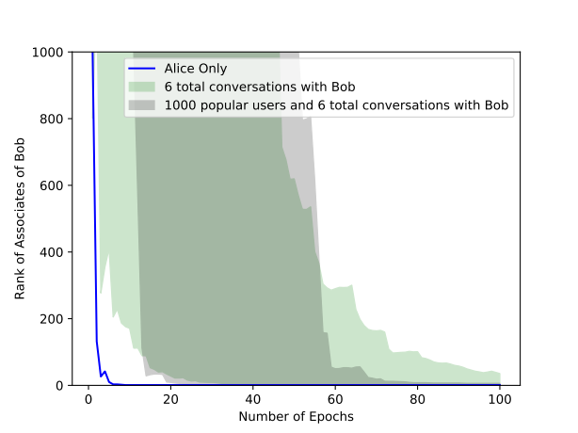
11 – Simulation Results
Notes:
We further examined the likely case that as a targeted individual Bob will receive messages from multiple users. What we found when we simulated Bob receiving messages from 6 total users was that while the range of ranks of users who messaged Bob after only a dozen messages may be large due to the individual who intiated a target epoch changing as seen in the green band of the graph on the right, some of the messagers will be identified as demonstrated by the lower part of the green band and in around 100 total messages to Bob all messagers will be identified.

Slide 49
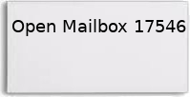
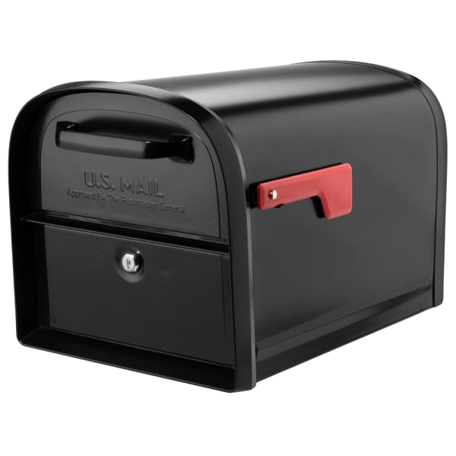
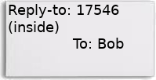
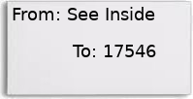
17546
Alice
Alice sends
Bob replies
One Way Privacy: The sender of a message is anonymous
12 – One Way Privacy
Notes:
The key component of this attack is that while the From field is obscured from Signal, users are still messaging long-term identities, such as Alice and Bob.
We present the following simple solution.
Alice opens an ephemeral mailbox anonymously using an e-cash like system of tokens alotted each day. Wherein they also register a push notification channel for the mailbox.
Alice then sends a message to Bob using Sealed sender where the From field (inside the encrypted content) is now a Reply-to field (also inside the encrypted content) listing the mailbox opened by Alice.
Bob's replies, including delivery receipts, typing notifications and read recipts are now sent to the mailbox.
As Alice's device is subscribed to the push notification channel for this mailbox it is forwarded to their device.
As the mailbox is ephemeral, where users can specify the length of time to use a given mailbox, and the proof necessary to open a mailbox is anonymous (which we'll discuss shortly) there is no tie between the mailbox and Alice
This creates one-way privacy, the goal of Sealed Sender, where messages sent to Bob are directly addressed to him, but the responses are sent to an anonymous mailbox, obscuring one party of the conversation.

Slide 50
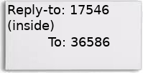
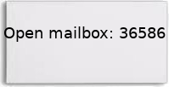
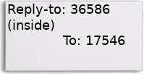
17546
Alice
Alice sends
Bob
Bob sends
36586
Two Way Privacy: The sender and receiver of a message is anonymous
13 – Two Way Privacy
Notes:
One way privacy can be extended to two way privacy.
As before Alice opens and subscribes to a mailbox.
When Alice sends a message to Bob they open a mailbox
In Bob's reply to Alice's mailbox Bob also specifies their mailbox as the location Alice should address.
Conversation continues through these seperate ephemeral mailboxes.
This gives a malicious or compelled Signal only a single opportunity to tie the mailbox to Bob, when they open it immediately after receiving a message. As we've shown before the magnitude of messages that Signal processes requires dozens of messages to de-anonymize users, but in the case where they do successfully deanonymize Bob's tie to their mailbox, a malicious or compelled Signal still gains no information on Alice or their mailbox.

Slide 51
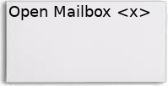
1896
146
17546
8284
32186
67639
17593
98987
25784
62562
14 – Denial of Service
Notes:
A major concern with any new feature is bad actors implementing a Denial of Service attack using the new feature. If any user can create any number mailboxes a bad faith actor could shut Signal down by requesting more than they can support.
To ensure that Signal is not overwhelmed by mailbox requests they can adapt an e-cash like method of blind signatures on a certain number of allocated tokens to each user each day, each token can be verified to Signal using the blind signature protocol for access to a mailbox.
Lets examine the blind signature protocol more in depth

Slide 52
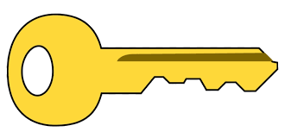

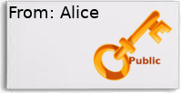
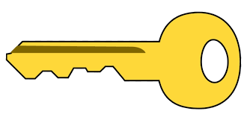
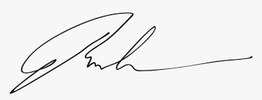
Public
Alice generates
Alice blinds
Alice sends
Signal signs
Signal sends
Public
Private
Private
15 – Blind Signatures
Notes:
First Alice will generate an ephemeral public/private key pair. This will be the public key that she attaches to messages to Bob so they can create a shared key.
Alice will then blind the key, in our case using the RSA blinding method with a random value.
Alice will then send this blinded key to Signal with their Identity. Signal will first verify Alice has not hit their quota to open a mailbox today, and sign the blinded key and send the signature back to Alice.
Alice will privately unblind the signature, to use as proof that they may open a mailbox. As Signal never saw the unblinded key this signature is unlinked to Alice.

Slide 53

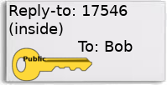
17546
Public
Private
Alice has
Alice sends
Signal verifies
Alice sends
Conversation continues
Public
16 – Improving Sealed Sender
Notes:
With this signature and ephemeral key pair, the true functionality of one-way privacy is as follows:
Alice will request to open a mailbox with their ephemeral public key and unblinded signature. Signal will privately verify their signature on this unblinded key and open the mailbox and subscribe the device to it, without knowing Alice's identity.
Alice will then construct their message To Bob with the mailbox as the reply-to address and the public ephemeral key so that Bob can construct their shared secret and determine Alice as the sender.
Bob continues the conversation as before, sending their replies, delivery receipts, read receipts and typing notifications to the provided mailbox which will be forwarded to Alice.
This exemplifies the protocol for two-way privacy as before.

Slide 54


17 – Deployability
Notes:
The solution presented here uses only simple crypto tricks, efficiently using the RSA blind signature scheme to allow provably anonymous communication between Signal users. This scheme is easily deployable, we were able to estimate on AWS a monthly cost of $40/month for millions of users.

Slide 55
Targeted Statistical Disclosure Attack
Delivery Receipts are mandatory and immediate
Messages are sent to long-term identities
Mailboxes are simple cryptography that deliver on promise of Sealed Sender
  With capability of two way privacy
Ian Martiny, Gabriel Kaptchuk, Adam Aviv, Dan Roche, Eric Wustrow
Notes:
We have demonstrated a targeted statistical disclosure attack using Signal's Sealed Sender.
This attack is possible in part because of mandatory and immediate delivery receipts on Signal Messages and because of use of long-term identities.
Our solution uses mailboxes that are a simple cryptographic and engineering task that deliver on the promise of Signal's Sealed Sender and adds the capability of Two-way privacy

Slide 56
  Proof-of-Censorship: Enabling Centralized Censorship-resistant Content Providers
    Ian Martiny, Ian Miers, and Eric Wustrow
    In Proc. of the 22nd Intl. Conference on Financial Cryptography and Data Security (FC 2018), February 2018.
  ExSpectre: Hiding Malware in Speculative Execution
    Jack Wampler, Ian Martiny, and Eric Wustrow
    In Proc. of Network and Distributed Systems Security Symposium (NDSS 2019), February 2019.
  Improving Signal's Sealed Sender
    Ian Martiny, Gabriel Kaptchuk, Adam Aviv, Dan Roche, and Eric Wustrow
    In Proc. of Network and Distributed Systems Security Symposium (NDSS 2021), February 2021.
  Measuring DNS censorship Methodically
    Ongoing work
Notes:
I’ll conclude today by proposing my ongoing work measuring DNS interference differences in IPv6 and IPv4.
This is an ongoing collaboration with researchers here at CU Boulder and University of Iowa

Slide 57

Mind the IP Gap
Measuring the Impact of IPv6 on DNS censorship
Ian Martiny, Hammas Bin Tanveer, Jack Wampler, Rishab Nithyanand, Eric Wustrow
Notes:
I’ll now present Mind the IP Gap: Measuring the Impact of IPv6 on DNS Censorship, a collaboration between myself, Jack Wampler, and Eric Wustrow at CU Boulder with Hammas Bin Tanveer and Rishab Nithyanand from the University of Iowa

Slide 58
Goals
Determine how countries censor DNS queries differently over IPv6 compared to IPv4
  Asking DNS resolvers hosted on IPv6 addresses
  Asking DNS resolvers for IPv6 addresses of censored domains
These axes are completely independent:
  A record requests ask for the IPv4 address of a domain
  AAAA record requests ask for the IPv6 address of a domain
Notes:
Our goals for this project were to measure how DNS censorship is affected by the growth of IPv6 infrastructure.
A vast body of work exists examining DNS censorship over the IPv4 space but extending those works to IPv6 is a non-trivial process due to the size of the IPv6 address space.
There are two axes that we wanted to examine:
First: what if we issued our DNS queries to resolvers hosted on IPv6 addresses?
Second: what if we asked for the IPv6 address of sensitive domains?
We note these axes are completely independent: a DNS A record request asks a resolver for the IPv4 address of a domain and a DNS AAAA record request asks for the IPv6 address of a domain, both of these requests can be sent to either the IPv4 or IPv6 interface of a DNS resolver

Slide 59
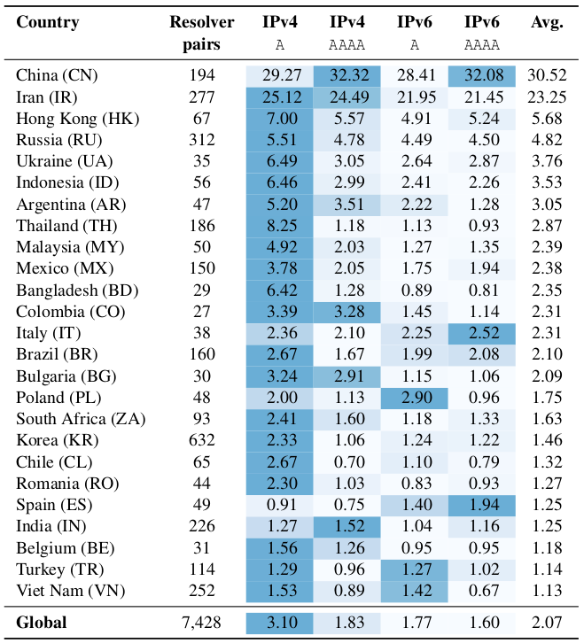
Prevalence of DNS censorship
Base rate of censorship is 2.1%
Concur with previous work on China, Iran, Russia, and Hong Kong as prevalent censoring countries
Balanced Dataset → Unbalanced Results
Notes:
We examined four different cases of censorship:
1. a DNS A query is sent over IPv4
2. a DNS AAAA query is sent over IPv4
3. a DNS A query is sent over IPv6 and
4. a DNS AAAA query is sent over IPv6
Our data shows the base rate of censorship across the world over all query and network types is 2.1%
The table here shows a snippet of censorship rates in each of the four cases in the 25 countries which have at least 25 pairs of resolvers and perform the most censorship. Darker shaded cells indicate a higher rate of DNS censorship in that case compared to that country’s average over all four cases.
Overall our results concur with previous work that China, Russia, Iran, and Hong Kong have significant levels of DNS censorship
Because our dataset is balanced (meaning all domains have A and AAAA records and all resolvers have IPv4 and IPv6 interfaces) if censorship was independent of record type and interface we would expect to see a uniform rate across all cases.
However we see that is not the case: we see that A queries sent over IPv4 are the most heavily censored and that AAAA queries are censored less than A queries regardless of which interface they are sent over.
This immediately suggests that the censorship apparatus in a large number of censoring regions are not fully IPv6-capable
The only statistically significant exception to this general trend is China which I’ll discuss in more detail now before discussing how we collected our data.

Slide 60
Case Studies - China
China was unique in that it blocks AAAA Records more than A records
Resolver 920 Blocklist:
en.wikipedia.org A
en.wikipedia.org AAAA
gmail.com AAAA
shadowsocks.org A
shadowsocks.org AAAA
.
.
.
Notes:
Lets examine the high level results from China. China was unique in our country list in that it is the only statistically significant result that censored AAAA records more than A records.
We found 21 domains whose AAAA records were censored at significantly higher rates than their corresponding A records
For example gmail.com had their AAAA record censored by 95% of resolvers but its A record was only censored by 1% of resolvers
Overall our findings suggest that China is the most readily prepared to censor DNS queries over IPv6, though their IPv6 censorship infrastructure may be independent of their IPv4 censorship infrastructure.

Slide 61
Methodology
Resolvers
Domains
Identifying Censorship
Notes:
In order to make discoveries such as these we need a frame work to eliminate as many variables as possible.
In particular we need:
A set of resolvers that have both IPv4 and IPv6 addresses
A set of domains likely to be censored that have both IPv4 and IPv6 addresses
And finally a method to identify when DNS censorship occurs
In each stage of this study we’ve taken care to ensure our data set is completely balanced we ensure that:
All resolvers that participate in our study have both an IPv4 and IPv6 interface,
All domains have both an A and AAAA record and
All domains support TLS allowing us to quickly and concretely determine whether our DNS query has been censored.
I’ll now briefly cover each of these steps in more detail.

Slide 62
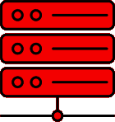
A v6onlyNS.io 1.2.3.4
IPv6
Notes:
I’ll start with our process to identify resolvers that have both an IPv4 and IPv6 interface. This is the most cumbersome step so I’ll spend time explaining our methodology in detail.
To identify resolvers we start by creating a domain whose A record is only available in one publicly announced Name Server that we control. This Name Server is only accessible over IPv6 (represented by its red color here).

Slide 63
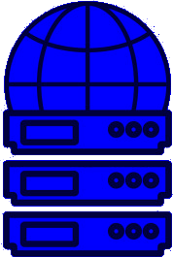
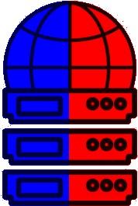
IPv4
IPv6
Notes:
Our next step is to identify as many DNS resolvers as possible. We do this using zmap to scan the entire IPv4 internet with a query for a separate domain we control.
At this stage we are able to identify 7.2 million DNS resolvers over the IPv4 internet. Though we don’t know their characteristics yet some of these resolvers will only have IPv4 interfaces (as represented by the solid blue color) and some will have both IPv4 and IPv6 interfaces (as represented by the split colors). Note we will not be able to identify any IPv6 only resolvers.

Slide 64
A? v6onlyNS.io
IPv4
IPv6
Notes:
To determine which resolvers have an IPv6 interface we will issue an A record request for our domain in the IPv6 only Name Server.
Most resolvers we identified will not have an IPv6 interface and as such our Name Server will not hear any query from that resolver. These IPv4 only DNS resolvers are removed from our study leaving us with 33.7 thousand resolvers.

Slide 65
A? v6onlyNS.io
IPv4
IPv6
Notes:
When our A record request is sent to any DNS resolver that does have IPv6 capabilities...

Slide 66
2001:1278:1::332 v6onlyNS.io
A? v6onlyNS.io
IPv4
IPv6
Notes:
… our request will get forwarded over IPv6
By examining the logs we can identify IPv6 resolvers

Slide 67
2001:1278:1::332 1-1-1-1.v6onlyNS.io
2001:12e8:1012::2 1-2-3-4.v6onlyNS.io
2001:12e8:1012::3 1-7-2-5.v6onlyNS.io
.
.
.
A?
1-1-1-1.v6onlyNS.io
IPv4
IPv6
Notes:
However our goal isn’t just to find IPv6 DNS resolvers, but find dual stack machines: resolvers with both IPv4 and IPv6 interfaces, thus we encode our queries for our IPv6 only domain with sub domains of the IPv4 resolver we queried allowing us to pair interfaces.
In this example we see we are able to pair the IPv4 resolver 1.1.1.1 with an IPv6 address

Slide 68
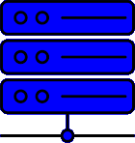
2001:1278:1::332 1-1-1-1.v6onlyNS.io
2001:12e8:1012::2 1-2-3-4.v6onlyNS.io
2001:12e8:1012::3 1-7-2-5.v6onlyNS.io
.
.
.
A v4onlyNS.io 4.3.2.1
IPv4
IPv6
Notes:
So far we have been able to pair resolvers by interface. But for our experiment we want to ensure that the resolvers we are interacting with are truly dual stack, meaning that both their IPv4 and IPv6 interfaces are resolvers, and not the case where a resolvers IPv6 interface simply forwards requests to a separate IPv6 resolver.
Thus we repeat our experiment in reverse, we create a domain whose A record is only available in a Name Server we control that is accessible only over IPv4

Slide 69
2001:1278:1::332 1-1-1-1.v6onlyNS.io
2001:12e8:1012::2 1-2-3-4.v6onlyNS.io
2001:12e8:1012::3 1-7-2-5.v6onlyNS.io
.
.
.
A? v4onlyNS.io
IPv4
IPv6
Notes:
We then issue an A record request to the IPv6 interface of the resolvers we discovered for our IPv4 only domain.
Because of our previous step we expect to hear almost every query. Our question here is whether the IPv6 interface we send our query to will use the IPv4 interface we already discovered.

Slide 70
2001:1278:1::332 1-1-1-1.v6onlyNS.io
2001:12e8:1012::2 1-2-3-4.v6onlyNS.io
2001:12e8:1012::3 1-7-2-5.v6onlyNS.io
.
.
.
A? v4onlyNS.io
1.4.3.2 2001-12e8-1012–-2.v4onlyNS.io
.
.
.
IPv4
IPv6
Notes:
In the case shown here the request is received and then forwarded to a different IPv4 resolver which we are able to see in our logs.
This suggests this machine is not a dual stack resolver, and is removed from our study.
This reduces our set of dual stack resolvers to 6,168 resolver pairs.

Slide 71

Domains
Satellite project from Censored Planet cultivates lists of sensitive domains
Query public DNS resolvers to filter domains that have valid A and AAAA records
Query responses for domains that provide valid TLS certificates
Image Source: censoredplanet.org
Notes:
We move on to Domain selection:
In order to identify inconsistencies in IPv4/IPv6 related DNS censorship we require a list of domains that are sensitive and likely to be censored in a large number of countries and which have valid A and AAAA records associated with them, as one of our research questions is whether censors handle the record requests differently.
Additionally we need a method to identify when censorship has occurred. For the last part we will utilize TLS certificates, I’ll discuss that in more detail shortly.
First we collect sensitive domains so we build on Censored Planet’s Satellite project.
The Satellite project performs global longitudinal measurements of DNS censorship and maintains a list of domains that combines sensitive domains in each country with popular domains randomly chosen from the Alexa top 10 thousand.
Our experiment starts with a list of 2,506 sensitive domains from the Satellite project. However, this does not met our technical requirements in full, so we pare our list down to the domains that do meet our requirements.

Slide 72
1.1.1.1
1.0.0.1
8.8.8.8
8.8.4.4
A? bet365.com
AAAA? bet365.com
A? google.com
AAAA? google.com
www.madamasr.com vnexpress.net get-express-vpn.online www.3wishes.com
blogger.com slickdeals.net www.match.com statista.com bet365.com
www.ifrc.org google.com reddit.com crypto.com netflix.com hulu.com
Notes:
Starting with the list of Satellite’s domains we issue A and AAAA record requests to Cloudflare and Google’s public DNS resolvers

Slide 73
bet365.com
A 123.45.67.89
8.8.4.4
1.1.1.1
google.com
A 213.54.76.98
google.com
AAAA
2001:12e8:1012::2
1.0.0.1
8.8.8.8
bet365.com
NO AAAA
RECORD
www.madamasr.com vnexpress.net get-express-vpn.online www.3wishes.com
blogger.com slickdeals.net www.match.com statista.com bet365.com
www.ifrc.org google.com reddit.com crypto.com netflix.com hulu.com
Notes:
Based on the responses from the public and uncensored DNS resolvers we can determine which of the 2,506 domains have A and AAAA records.

Slide 74
1.1.1.1
1.0.0.1
8.8.8.8
8.8.4.4
www.madamasr.com vnexpress.net get-express-vpn.online www.3wishes.com
blogger.com slickdeals.net www.match.com statista.com bet365.com
www.ifrc.org google.com reddit.com crypto.com netflix.com hulu.com
Notes:
We prune our list of all domains that do not meet these infrastructural requirements.
This reduces our list of domains to 773.

Slide 75
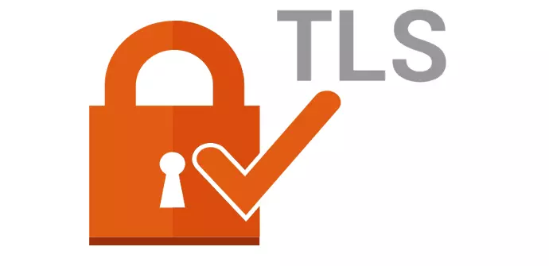
Censorship Identification
TLS is widely adopted
TLS issues certificates which attest to the domain hosted at an IP address
TLS certificates can be quickly acquired and verified
Notes:
With our domain list we need a rigorous method to identify when a DNS query has been censored. Previous work generally relies upon ad hoc identification related to the content returned. Recently this trend has shifted to utilize the vast adoption of TLS across the internet, allowing us to quickly verify which DNS queries have returned valid IP addresses for our queried domains.

Slide 76

123.45.67.89
234.56.78.9
211f::1::3
45.67.89.123
TLS
SNI:
www.madamasr.com
TLS
SNI:
www.3wishes.com
TLS
SNI:
crypto.com
TLS
SNI:
www.ifrc.org
www.madamasr.com vnexpress.net get-express-vpn.online www.3wishes.com
blogger.com slickdeals.net www.match.com statista.com bet365.com
www.ifrc.org google.com reddit.com crypto.com netflix.com hulu.com
Notes:
From our list of 773 domains that have A and AAAA records we create a TLS connection to each IP with the Server Name Indicator of the domain we queried the public DNS resolvers for.
This results in about 7 thousand TLS connections

Slide 77
123.45.67.89
234.56.78.9
211f::1::3
45.67.89.123
VALID TLS CERT
www.madamasr.com
VALID TLS CERT
www.3wishes.com
NO TLS CERT
crypto.com
VALID TLS CERT
www.ifrc.org
www.madamasr.com vnexpress.net get-express-vpn.online www.3wishes.com
blogger.com slickdeals.net www.match.com statista.com bet365.com
www.ifrc.org google.com reddit.com crypto.com netflix.com hulu.com
Notes:
We locally verify the responses of our TLS connections to ensure the TLS certificate is valid for the domain we originally queried for.

Slide 78
www.madamasr.com vnexpress.net get-express-vpn.online www.3wishes.com
blogger.com slickdeals.net www.match.com statista.com bet365.com
www.ifrc.org google.com reddit.com crypto.com netflix.com hulu.com
Notes:
We remove from our list any domain that does not support TLS on both its IPv4 and IPv6 address. We did not find any instance of a domain supporting TLS on only some of its IPs, either it supported TLS on every returned IP (v4 and v6) or on no IP.
This prunes our list to 725 domains that meet our technical requirements of having a valid A record, a valid AAAA record, and supporting TLS on all publicly available IPs.

Slide 79
A? google.com
A? google.com
AAAA? google.com
AAAA? google.com
A? netflix.com
A? google.com
AAAA? google.com
IPv4
IPv6
Notes:
Combining our previous steps we have 6168 dual stack resolvers and 725 domains. We now issue A and AAAA record requests to each interface of each resolver.
This results in 17.8 million DNS requests sent to resolvers across the world

Slide 80
A google.com
187.33.179.99
AAAA google.com
2f2f:172:ﬀ:1
A google.com
187.33.178.99
A netflix.com
12.34.17.9
IPv4
IPv6
Notes:
The vast majority of queries will receive a valid response. Some queries will not receive a response, these may be examples of DNS censorship. We perform this DNS look up step multiple times over multiple days to ensure we have not run into a networking issue.

Slide 81
3.45.199.89
12.5.7.89
2.2.2.9
TLS
SNI:
www.madamasr.com
TLS
SNI:
www.madamasr.com
TLS
SNI:
netflix.com
TLS
SNI:
google.com
2a10:7180:100::17
2c0f:fec8:1000::4
2a0d:7c40:3000:cd9::2
IPv4
IPv6
Notes:
We collate all the responses and create TLS connections to each IP with the Server Name Indicator of the queried domain. This results in us making over 800 thousand TLS connections.

Slide 82
VALID TLS CERT
www.madamasr.com
3.45.199.89
12.5.7.89
2.2.2.9
NO TLS CERT
www.madamasr.com
2a10:7180:100::17
2c0f:fec8:1000::4
INVALID TLS CERT
facebook.com
2a0d:7c40:3000:cd9::2
VALID TLS CERT
netflix.com
IPv4
IPv6
Notes:
By nature of our curating our domains we expect a valid TLS certificate from each connection. To eliminate the possibility of network issues we also perform our TLS connection step multiple times over multiple days.
We locally verify each TLS certificate returned to ensure it is a valid TLS certificate for the domain we originally queried for. We do occasionally see valid TLS certificates for incorrect domains. It appears to be common for China to return Facebook IPs for censored DNS queries.

Slide 83
Balanced Dataset
6,168 Resolver pairs
  6,168 resolvers hosted on IPv4 addresses
  6,168 resolvers hosted on IPv6 addresses
725 sensitive domains
  725 domains with a valid A record
  725 domains with a valid AAAA record
  725 domains with a valid TLS certificate
Notes:
This methodology forms the backbone of our study. We’ve collected completely balanced data.
This allows to answer very low level questions such as does a specific resolver’s IPv6 interface censor access to more domains than its IPv4 interface?
Or does a specific resolver’s IPv4 interface censor A record requests more than AAAA record requests?
Of course our ultimate goal is to answer higher level questions, such as does Thailand censor DNS requests similarly over IPv4 compared to over IPv6?

Slide 84
Case Studies - Thailand
Inadequate IPv6 infrastructure support to properly censor
IPv4 Interface of resolver with largest block list
  Blocked 240 A Records
  Blocked 15 AAAA Records
The IPv6 Interface of the same resolver did not block a single request
Creates opportunities
Notes:
Our study shows that it does not.
In Thailand we find inadequate IPv6 censorship infrastructure
Manually examining the resolver pair with the largest block list we find that the IPv4 interface blocked 240 A record requests, but only 15 AAAA record requests.
Whereas the IPv6 interface of the same resolver did not block any request
This suggests that users in Thailand may be able to effectively circumvent DNS censorship by leveraging IPv6 networks and resource records

Slide 85
Statistically Significant Results
Care taken in answering research questions
  Two sample t-test
  p ≤ .05
  Šidák Correction to control for False Positive errors
Notes:
Similar to the care we took with collecting our data, we take care to answer our research questions.
When comparing two distributions, such as the censorship rates over IPv4 compared to over IPv6 we use a two sample t-test to determine if (within a given country) there is a statistically significant result, using a p value of .05 and a Sidak correction to control for false positives
We find that Thailand, Bangladesh, Pakistan, Chile, Vietnam, Korea, and China show significantly different censorship rates between network interface. That same list of countries as well as the United States and Myanmar also show a significant difference in censorship rates of resource record requested.

Slide 86
Case Studies - Iran
We found 277 resolver pairs in Iran
IPv6 resolvers block at significantly lower rate (-3.2%) than over IPv4
272 of the IPv6 resolvers are 6to4 bridges
  6to4 bridges censor at the same rate as native IPv6 resolvers
Suggests a centralized censorship mechanism
Notes:
I’ll conclude my discussion on this work with a case study on Iran.
We found 277 stable resolvers pairs in Iran and found that the IPv6 interface of resolvers censor at significantly lower rates than their corresponding IPv4 interface.
We also discover that 272 of the IPv6 interfaces are actually 6to4 bridges routers that bridge the gap between the IPv6 and IPv4 internet, and those bridges censor at the same rate as native IPv6 resolvers (though those have an extremely small sample size of only 5)
This suggests a centralized censorship apparatus in Iran whose infrastructure seems to less aggressively censor over IPv6
This also leads to future work geared towards circumventing DNS censorship in Iran by leveraging its lack of IPv6 adoption.

Slide 87
Conclusion
IPv6 DNS censorship does not bifurcate into block or allow
We demonstrate clear trends in IPv6 DNS censorship to motivate future work
Using the first large scale measurement of DNS injection based in IPv6
Censoring countries still favor censoring A records over IPv4
Notes:
In conclusion we discover that IPv6 DNS censorship is not a bifurcation between censoring and allowing but there is nuance in how each country’s apparatus censors allowing censorship circumvention opportunities that can be tailored to each particular population
We showcase clear trends in IPv6 DNS censorship motivating future work
And we demonstrate the first large scale measurement of DNS injection over IPv6 with concrete methodological steps allowing duplication and rigorous statistical analysis

Slide 88

Internet Censorship
IP based censorship
HTTP Proxy
DNS censorship
  DNS Injection
  Blocklists
  Centralized Censorship
Notes:
Internet censorship can be defined broadly as the act of filtering or blocking access to Internet content.
This definition applies to any Internet traffic, whether the entity performing the censorship is a nation state or a corporate network
Our work takes care to identify the likely cause of censorship and not directly apply blame to nation states using Maxmind’s Connection Type database
The most simple and common Internet censorship approaches are: IP based blocking where a censor keeps blocklists of IP addresses and prevents connections to those addresses
HTTP Proxy censorship where a censor acts as a proxy to clients by restricting access to specific content
And of relevance to this talk: DNS censorship where censors inject or return incorrect responses to domains it has decided to censor
We focus solely on this last case and examine which censors restrict access to which domains

Slide 89

IPv6
A vs AAAA Records
Address Space size
IPv6 6to4 Bridges
Image Source: By Ipv6_address.svg: Indeterminatederivative work: BobbyPeru (talk) - Ipv6_address.svg, Public Domain, https://commons.wikimedia.org/w/index.php?curid=9379579
Notes:
As with other critical protocols DNS has adapted to the IPv6 protocol. In this case by adding the AAAA resource record to aid in the resolution of domains to their IPv6 addresses
Further the DNS protocol is IP independent meaning it is common for IPv4 and IPv6-hosted DNS servers to receive both A and AAAA queries (where an A query asks for an IPv4 address and a AAAA query asks for an IPv6 address)
Of particular note for our work is the address space of the IPv4 network vs the IPv6 network.
There are 4.3 Billion IPv4 addresses, an amount that on commodity hardware is easy enough to connect to each address
In contrast there are 340 trillion trillion trillion IPv6 addresses, an amount that would take over 38 billion years to connect to each individual address

Slide 90


IPv6
A vs AAAA Records
Address Space size
IPv6 6to4 Bridges
Image Credits: By Mro - Own work, CC BY-SA 3.0, https://commons.wikimedia.org/w/index.php?curid=10461514
By 6to4_convert_address.png: none7derivative work: Cybjit (talk) - 6to4_convert_address.png, CC BY-SA 3.0, https://commons.wikimedia.org/w/index.php?curid=14054218
Notes:
As a last bit of background I’ll discuss 6to4 bridges, a mechanism to facilitate communication between IPv4 and IPv6 endpoints, as they cannot directly communicate.
This protocol works by assigning a /48 subnet with the local IPv4 address encoded to an interface and allowing that interface to receive (and send) traffic encapsulated in an IPv4 header.
This allows clients without an IPv6 interface to send encapsulated IPv6 packets inside an IPv4 packet to a host that does have an IPv6 interface
Our study sees many vantage points which are connected to the IPv6 internet via 6to4 bridges

Slide 91

Resolvers
Create an IPv6 only domain
Scan internet for IPv4 Resolvers
Ask each IPv4 resolver an encoded request for a website in an IPv6 only Name Server
  Ask 1.1.1.1 to resolve 1-1-1-1.v6onlyNS.io
Current ongoing work reverses this step to ensure resolvers are dual stack
Image Source: On the potential of IPv6 open resolvers for DDoS attacks – PAM 17
Notes:
Our approach to discover open resolvers builds on previous work by Hendricks et al. Who identified IPv6 open resolvers.
We begin by creating a new domain with a name server we control that has an IPv6-only entry, meaning to query for the IP address of this domain you must talk to our Name Server which is only accessible over IPv6
We then use zmap to scan the entire IPv4 address space for a separate IPv4 control domain we own. This yielded a list of 7.2 million IPv4 DNS resolvers
We then issue a DNS A Record Request for a resolver-specific subdomain of our IPv6-only domain to each IPv4 resolver
Since IPv4 only machines cannot directly communicate with IPv6 machines we expect this to fail for IPv4 only resolvers. On the other hand resolvers with any form of IPv6 connectivity will use their IPv6 interface to communicate to our Name Server allowing us to examine the logs of our Name Server to link IPv4 resolvers with IPv6 resolvers
We are able to identify 33.7 thousand (IPv4, IPv6) address pairings
We further reduce our list to ensure that the address pairs geolocate to the same country and that both interfaces of the machine can correctly resolve requests for a control domain.
This reduces our list to 7,843 resolver pairs from 106 distinct countries

Slide 92
Censorship
Stabilize resolvers using control domains
Use ZDNS to perform A and AAAA Record Requests for all sensitive domains
Use Zgrab2 to establish TLS connections to all IPs obtained from DNS scan
Locally verify TLS certificates
If any response leads to a valid TLS certificate it is not censored
Current ongoing work extends this to multiple days of TLS connections to remove instability
Notes:
In general we err on the side of caution to avoid incorrectly labeling a record request as censorship.
Thus we include a set of 3 control domains we own in our sensitive domain list to verify resolver stability.
Then we issue A and AAAA record requests for each domain (714 sensitive and 3 control) to each interface of our 7,843 resolver pairs resulting in 22.4 million DNS queries
We discard data from resolver pairs in which either interface fails to correctly resolve any of our control domains as this is a sign of resolver instability.
Our final dataset then consists of data generated from 7,441 stable resolver pairs.
We then establish TLS connections to all IP addresses returned in resource records from our stable resolvers. We locally verify the returned TLS certificate to identify whether a censorship event has occurred, directly determined by whether the TLS certificate is valid for the domain we queried for.
We repeat this TLS connection for a total of three connections to eliminate errors due to network issues.

Slide 93

A vs AAAA Resource Censorship
pp denotes difference between AAAA blocking rate and A blocking rate
%age denotes percentage change in blocking rates
Notes:
Here we see the differences in blocking rates of our significant countries.
PP is the difference in blocking rate between AAAA and A record requests where a negative value indicates a larger A blocking rate compared to AAAA
The Percentage is the percentage change in blocking rates.
Only results showing a significant difference are reported

Slide 94

A vs AAAA Resource Censorship
Notes:
We label a resolver inconsistent if it shows a statistically significant difference in its handling of A and AAAA queries and examine the characteristics of those resolvers.
We then measure the Autonomous System diversity of censoring resolvers by comparing the entropies of which AS a resolver is in between all resolvers and inconsistent resolvers

Slide 95
A vs AAAA Resource Censorship
Notes:
The nabla sub query column is the KL-divergence between these two distributions.
A low value indicates the diversity of AS in inconsistent resolvers is similar to all of the resolvers in that country suggesting a centralized censorship apparatus, in this case Thailand, Bangladesh, and Pakistan.
A high value indicates a strong change in AS diversity between inconsistent resolvers and all resolvers in the country suggesting a local configuration inconsistency, Korea, China, and the United States all demonstrate a high difference suggesting low level inconsistencies.
For example in the United states resolvers in 5 Ases (out of 249) account for 56% of all A and AAAA inconsistencies.

Slide 96
A vs AAAA Resource Censorship
Notes:
Finally the “Most Inconsistent Type” column denotes the connection type of Resolvers with the most A and AAAA inconsistencies (as labeled by maxmind)
This for example suggests in the United States that corporate resolvers are mostly responsible for the difference in A and AAAA censorship rates.

Slide 97
A vs AAAA Resource Censorship
Group domains on whether they were blocked consistently or inconsistently by Resource Record
United States and Thailand have smallest divergence
  Suggesting inconsistently blocked domains are not from different categories
  US: censorship comes from Corporate Censorship
  Thailand: No policy gaps in censorship, but incomplete AAAA record censorship mechanism
Pakistan and Myanmar have largest divergence
  Suggesting a policy gap in censoring categories of domains between A and AAAA record requests
  Largest contribution from ‘Pornography’ and ‘Government/Military’ categories disproportionally allowing AAAA record requests for those categories to be unblocked
Notes:
We also examined domains that were blocked according to resource type
We grouped domains by whether they were blocked consistently or inconsistently (where again inconsistent means their A and AAAA records were blocked at different rates that were statistically significant)
The United States and Thailand have the smallest divergence which suggests any inconsistently blocked domains share a similar category diversity to all blocked domains
Pakistan and Myanmar have the largest divergence suggesting a policy gap in censoring domains between resource type
For example we found that websites from the Pornography and Government/Military categories disproportionally allow AAAA record requests to go uncensored.

Slide 98

IPv4 vs IPv6 Infrastructure Censorship
Perform the analogous experiment comparing queries made to IPv4 addresses and IPv6 addresses.
United States and Myanmar are significant here, but Korea and Chile are not.
Notes:
We now examine the other axis in our study, whether countries show a censorship difference when asking the IPv4 interface of a resolver compared to the IPv6 interface
Here we find the United States and Myanmar show a significant difference in censorship rates, but Chile and Korea do not.

Slide 99

IPv4 vs IPv6 Infrastructure Censorship
Notes:
We also measure the AS diversity here, labeling a pair as inconsistent if its IPv4 interface censors at a statistically significant different rate compared to its IPv6 interface and compare the AS diversity of the inconsistent resolvers to all resolvers in a country.
The United States has the largest divergence here suggesting regional policies are responsible for the network interface differences
Thailand, Bangladesh, and Myanmar have the lowest divergence suggesting a centralized censorship apparatus.

Slide 100
IPv4 vs IPv6 Infrastructure Censorship
United States, Bangladesh, and Iran have the smallest divergence between inconsistently blocked domain categories compared to all blocked domain categories
  Suggesting no policy gaps
Pakistan, China, and Myanmar have the largest divergence in categories
  “Gambling” websites are most likely to get through for China and Pakistan
  “Government/Military” websites are most likely to get through in Iran
Notes:
We perform analogous measurements on domain category diversity and see the United States, Bangladesh, and Iran have the smallest divergence between inconsistently blocked domain categories and all blocked domain categories suggesting no policy gaps (re affirming our repeated suggestions that the United States’ censorship is likely from Corporate Censorship).
We see Pakistan, China, and Myanmar having the largest divergence between inconsistently censored domain categories and all censored domain categories.
In particular we see in China and Pakistan websites from the “Gambling” category are more inconsistently blocked, depending on network interface.

Slide 101
Current adjustments
Ensuring dual stack machines
Scans over multiple days to remove instability
Begun longitudinal study
Notes:
This work is currently under submission at USENIX 2022, but has received some updates to address weak points of our study
Namely we’ve modified our resolver discovery methodology to ensure that the resolver pairs we discover are actually dual stack.
We do so by performing our discovery step in reverse, asking the IPv6 interface to resolve a domain in an IPv4 only Name Server and ensuring the query comes from the already discovered IPv4 address
We also compare the BIND version of each interface to examine whether they match
To further eliminate network issues as being incorrectly labeled as censorship we now perform our DNS and TLS scans multiple times over consecutive days to ensure when we label a request as censored it is not due to network instability.
Additionally, we have now performed 2 additional scans and continue to perform others to study longitudinal trends.

Slide 102
Thanks!
Questions?

Slide 103

DNS Censorship
Previous research has shown that China and Iran perform DNS censorship
Notes:
It is well established in previous work that China through use of the Great Firewall is injecting packets in response to clients issuing DNS Queries for censored domains. This previous work has predominately focused on A record requests for censored domains, i.e., requests for IPv4 addresses.
In this work one aspect I propose to examine is how censoring countries handle requests for quad A records (i.e., requests for IPv6 addresses) compared to their handling of A records.

Slide 104
IPv6 Address Space
Adoption began in 1995
Recently Adoption has skyrocketed
Vast expansion of number of addresses:
  IPv4: 4.2 x 10⁹
  IPv6: 3.4 x 10³⁸
Notes:
As a brief overview lets examine the IPv6 address space.
Its adoption began back in 1995 but was fairly slow.
However as the IPv4 address space was exhausted, the usage among popular websites has grown rapidly.
While the IPv4 address space has over 4.2 Billion addresses the IPv6 address space has 340 trillion trillion trillion unique IP addresses
Of particular importance later will be the fact that these address spaces are unable to communicate directly. A box with only an IPv4 address cannot communicate directly with a box with only an IPv6 address, and vice versa.

Slide 105
Contributions
Do countries censor requests for IPv6 addresses differently?
Do resolvers hosted on IPv4 addresses censor differently than
  those hosted on IPv6 addresses?
How to determine DNS interference?
How to measure DNS measurements systematically?
Notes:
The research questions I plan to address in this work are:
* Do countries that interfere with DNS A record requests also interfere with quad A record requests?
* Previous work has examined the behavior of resolvers in the IPv4 address space, but do resolvers in the IPv6 address space behave similarly?
* How can you identify resolvers hosted on IPv6 addresses given the size of the address space?
* How do you measure and determine when a DNS response has been interfered with?
* How do you answer these questions systematically, in a non ad-hoc manner?
Of particular note here, DNS is an inherently decentralized system of routers within a Centralized system (the country). This motivates us to not look at resolvers as individual nodes but rather as a collective.
I’d like present my plans to answer these questions I’ll start with one of the later questions: How do we determine when a DNS result has be interfered with? To answer this I’ll start with an example

Slide 106



Colorado Censors Google!
A record request from Broomfield CO
A record request from AWS box in US-East
Notes:
Up until recently the usual method of determining DNS interference was to compare the result of a query to a stored result from an uncensored request (usually generated in the United States or other countries that do not censor information on the internet)
These would lead to unusual results where one might conclude that Colorado Interferes with DNS Queries for google.com
For example when I performed an A record request for google.com from Broomfield Colorado I got 142.250.72.46
When I performed the same request from my AWS box, hosted on the East Coast I got the result of 142.251.33.110
Using the previous methodology of determining DNS interference we would label this as possible DNS interference.

Slide 107
Current Methodology
Satellite is a project of Censored Planet
Scan the IPv4 address space for DNS resolvers
Issue A record requests for the Alexa 1k domains
Compare results to those returned by uncensored requests
Compare static hashes of content
Recently began to compare TLS certificates
Notes:
Obviously that is not true, but it does exemplify the methodology of previous DNS measurements.
Satellite, a project of Censored Planet determines DNS Anomalies, by performing DNS lookups around the world and comparing the results to the result of a request from a box in an uncensoring country.
They thus label any difference as an anomaly and note that the difference could be because of IP localization.
They also attempt to compare static hashes of content from websites
In April they updated to use a more reasonable method, that our team independently decided to use

Slide 108
IPv6 Address Space
Censored Planet scans the IPv4 Address Space for resolvers
What about the IPv6 address space?
Notes:
To continue harping on Censored Planets previous work, which is excellent by the way:
Part of their process is to scan the entire of the IPv4 address space for resolvers.
Using commodity hardware this is an easy process.
However we cannot adapt their methodology to examining the IPv6 address space
Attempting to scan every address in the IPv6 address space would never finish before I plan to give my PhD Defense (I plan to defend before the end of the next 38 Billion years)
This complicates our attempts to answer the question of how IPv6 resolvers are censoring requests for domains
To answer this question we need to identify IPv6 resolvers which we do by adapting unformalized previous work.

Slide 109
1. Setup a domain to have a v6-only NS:
v6.tlsfingerprint.io IN NS v6ns.tlsfingerprint.io
v6ns.tlsfingerprint.io IN AAAA 2604:a880:2:d0::211b:f001 (digitalocean v6 host)
2. pcap on digitalocean v6 host:
tcpdump -n -i eth0 ip6 and udp port 53 -w /tmp/v6.pcap
3. Pick an open IPv4 resolver, send it a query for this domain (encode the resolver IP)
dig @1.1.1.1 1-1-1-1.v6.tlsfingerprint.io
4. Observe DNS requests on v6 pcap:
16:33:26.882163 IP6 2400:cb00:98:1024::ac44:211e.61205 > 2604:a880:2:d0::211b:f001.53: 35389 [1au] A? 1-1-1-1.v6.tlsfingerprint.io. (57)
16:33:27.239300 IP6 2400:cb00:98:1024::ac44:211e.24357 > 2604:a880:2:d0::211b:f001.53: 7182 [1au] A? 1-1-1-1.v6.tlsfingerprint.io. (57)
16:33:27.571780 IP6 2400:cb00:98:1024::ac44:211e.21601 > 2604:a880:2:d0::211b:f001.53: 59231 [1au] A? 1-1-1-1.v6.tlsfingerprint.io. (57)
Pairing Resolvers
Ask an open resolver at an IPv4 address to resolve an IPv6 only Name Server
We use the Name Server as the only resolution for a domain
We encode requests for DNS resolution
Notes:
Because boxes with only IPv4 addresses cannot directly communicate with boxes that only have IPv6 addresses and vice versa we can formalize a method of identifying IPv6 resolvers.
We host a domain that is only in a single Name Server that we control. That Name Server is only accessible over IPv6.
When we ask an identified IPv4 resolver to resolve a request for our domain it must communicate to our IPv6 only box, meaning it must either use its own IPv6 address, or use its preferred IPv6 resolver to ask our box

Slide 110
1. Setup a domain to have a v6-only NS:
v6.tlsfingerprint.io IN NS v6ns.tlsfingerprint.io
v6ns.tlsfingerprint.io IN AAAA 2604:a880:2:d0::211b:f001 (digitalocean v6 host)
2. pcap on digitalocean v6 host:
tcpdump -n -i eth0 ip6 and udp port 53 -w /tmp/v6.pcap
3. Pick an open IPv4 resolver, send it a query for this domain (encode the resolver IP)
dig @1.1.1.1 1-1-1-1.v6.tlsfingerprint.io
4. Observe DNS requests on v6 pcap:
16:33:26.882163 IP6 2400:cb00:98:1024::ac44:211e.61205 > 2604:a880:2:d0::211b:f001.53: 35389 [1au] A? 1-1-1-1.v6.tlsfingerprint.io. (57)
16:33:27.239300 IP6 2400:cb00:98:1024::ac44:211e.24357 > 2604:a880:2:d0::211b:f001.53: 7182 [1au] A? 1-1-1-1.v6.tlsfingerprint.io. (57)
16:33:27.571780 IP6 2400:cb00:98:1024::ac44:211e.21601 > 2604:a880:2:d0::211b:f001.53: 59231 [1au] A? 1-1-1-1.v6.tlsfingerprint.io. (57)
Pairing Resolvers
Setup a domain to have a v6-only NS
    v6.tlsfingerprint.io IN NS v6ns.tlsfingerprint.io
    v6ns.tlsfingerprint.io IN AAAA 2001:0:9d38:6ab8:1c48:3a1c:a95a:b1c2
pcap on v6 host
    tcpdump -n -i eth0 ip6 and udp port 53 -w /tmp/v6.pcap
Pick an open IPv4 resolver, send it a query for this domain (encode the resolver IP)
    dig @1.1.1.1 1-1-1-1.v6.tlsfingerprint.io
Observe DNS requests on v6 pcap:
    16:33:26.882163 IP6 2400:cb00:98:1024::ac44:211e.61205 > 2001:0:9d38:6ab8:1c48:3a1c:a95a:b1c2.53: 35389 [1au] A? 1-1-1-1.v6.tlsfingerprint.io. (57)
    16:33:27.239300 IP6 2400:cb00:98:1024::ac44:211e.24357 > 2001:0:9d38:6ab8:1c48:3a1c:a95a:b1c2.53: 7182 [1au] A? 1-1-1-1.v6.tlsfingerprint.io. (57)
    16:33:27.571780 IP6 2400:cb00:98:1024::ac44:211e.21601 > 2001:0:9d38:6ab8:1c48:3a1c:a95a:b1c2.53: 59231 [1au] A? 1-1-1-1.v6.tlsfingerprint.io. (57)
Notes:
The formal method is as follows.
We host a domain, say v6.tlsfingerprint.io and announce it in a Name Server, say v6ns.tlsfingerprint.io and provide a public quad A record for that Name Server
On the box that runs the Name Server we can take a PCAP of every IPv6 connection it receives
We can then choose to ask a known IPv4 resolver for an encoded request of a subdomain of our domain, including the IP address of the resolver we are asking
In this example we ask 1.1.1.1 to resolve a request for 1-1-1-1.v6.tlsfingerprint.io
Examining the PCAP we can see the IPv6 addresses that requested lookups for our specific subdomain.
This allows us to directly link known IPv4 resolvers to possible IPv6 resolvers.
In this case we can see our request for 1-1-1-1.v6.tlsfingerprint.io came from a specific IPv6 address
There are some simple clean up steps, not every IPv6 address received is actually a resolver, but these can be filtered out by issuing independent queries to verify whether they are resolvers.

Slide 111


Expected Behavior
DNS Interference or weird anomalous behavior?
Use a decentralized service for multiple vantage points
Notes:
Our next issue is determining if our results are anomalous or the norm.
If we ask a resolver to resolve a domain and determine there is interference we are still left with a question: Is the resolver censoring because of a policy from the country or is this resolver showcasing anomalous behavior?
Our first step would be to ask other resolvers in the country, but a second important step is to ensure we aren’t biasing our results based on our path to the resolver.
Our request could be passing through other censoring countries, that could be interfering with the DNS query, possibly causing us to mislabel a resolver in a country as censoring requests for specific domains.
To address this we leverage RIPE Atlas, a Centralized service of decentralized nodes across the world that allows us to make DNS queries from multiple vantage points.
By leveraging this decentralized system we can get a true picture of the decentralized system we wish to measure, DNS resolution.
We achieve this true picture by issuing a multitude of DNS queries from multiple vantage points.

Slide 112
Proposed Work
Which countries are censoring access to domains at the DNS level?
What domains are countries censoring access to at the DNS level?
Are they censoring differently based on whether clients issue A or AAAA records?
Are they censoring differently based on whether clients ask IPv4 resolvers or IPv6 resolvers?
Notes:
Using the previous methodologies presented here and previous work of Censored Planet and Citizen Lab to identify potentially censored domains I propose the work of answering the following questions:
Which countries are censoring access to domains at the DNS level?
What domains are censoring countries blocking access to at the DNS level?
Do countries that censor requests for domains behave differently to requests for A or quad A records?
Do countries that censor requests for domains behave differently to requests going to resolvers at IPv4 addresses compared to IPv6 addresses?

Slide 113
Proposed Methodology
Identify IPv4 resolver
Pair those resolver with IPv6 routers
Citizen Lab domain lists
Filter list to domains that support IPv4, IPv6, and TLS
Perform DNS queries for A and AAAA record lookups (from many vantage points)
Follow up with TLS connections to each IP with SNI
Verify TLS certificates
Notes:
In order to answer my proposed questions we plan to use the methodology presented before, restated all at once here.
We can easily identify IPv4 resolvers by scanning the internet
We can use the previous method to pair those resolvers with IPv6 resolvers
We can use the work of Citizen Lab and Censored planet that have curated lists of domains that are potentially censored
We can filter those lists of domains to those that have an IPv4 address, an IPv6 address and support TLS on those Ips
We can then use the identified IPv4 and IPv6 paired resolvers to perform A and quad A record lookups for the filtered domains.
These queries can be done from multiple vantage points to determine whether the behavior is indicative of country wide policy or malfunctioning resolvers.
For each answer we can follow up with a TLS connection with the SNI filled in for the expected domain
We can then locally verify whether the certificates returned are valid.
Allowing us to directly answer our questions, in a formalized method.

Slide 114
Thank you
Questions?
Notes:
Thank you for your attention.
I’d be happy to address any questions you might have.

