Slide 1

Proof of Censorship
Enabling centralized censorship-resistant content providers
Ian Martiny, Ian Miers, Eric Wustrow

Slide 2


Content Provider Censorship
In 2016 Twitter received 9,465 take-down requests from governments or police entities (and complied with 17% of them)
Notes:
Firewalls, network blocks
Targeted Censorship→ potentially unwillingly
Transparency Reports
Twitter Example
Explicit Example, Brazilian mayoral candidate likened to batman villian, Complied with
This type of censorship is particularly scary
The service itself still works.
In this talk, hold content providers accountable

Slide 3



Prior Attempt: Proof of Retrievability
Client
Server
Notes:
One previous attempt at this goal is PoR
Attempts to hold content providers accountable via…
Upload file
Request piece of file
Pieces can be put together

Slide 4


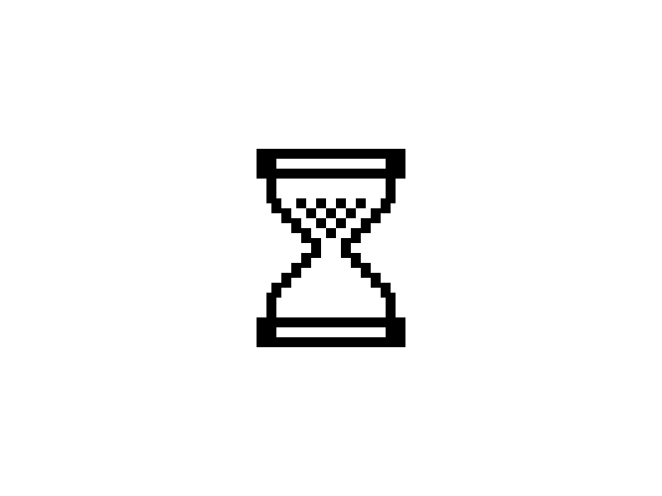
Prior Attempt: Proof of Retrievability
Client
Server
Client
Client
Notes:
There are flaws in this idea
Announce which file we’re requesting
This behavior is also adaptable.

Slide 5
Proof of Censorship
Cryptographic proof
Independently verifiable offline
Required for server to produce
Notes:
To address these issues and others, PoC
PROOF
Offline verification
required

Slide 6
Security Goals
Non-deniability of targeted censorship
  Server automatically generates proofs
  when they censor
Unforgeability of proofs
  Attackers cannot forge a proof of censorship against honest providers
Notes:
Specifically the goals we are set are:
Servers cannot selectively censor
Clients cannot claim honest servers are censoring

Slide 7
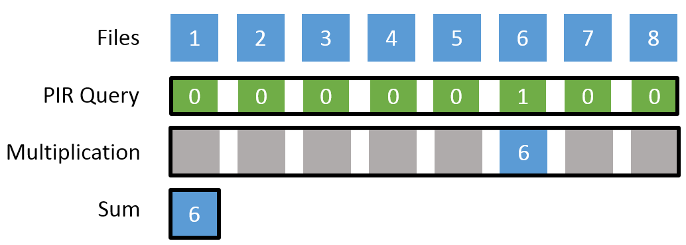
Background:
Private Information Retrieval
D(E(a)+E(b)) = a + b
D(E(a)·b) = a∙b
Notes:
To meet these goals, we use PIR:

Slide 8


Design Overview
Commitment from server to continually host content
Cryptographic proof iff the server fails to uphold this commitment
Notes:
Proof of Censorship has two steps
On upload
On download

Slide 9
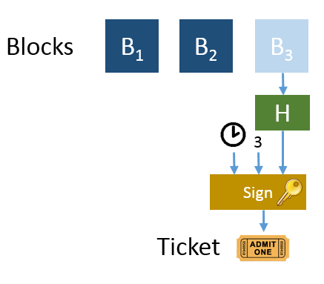
File Upload
Hash of uploaded file
Index (location) of file
Time of commitment
Notes:
For the first step of File Commitment
Hash
Index
Time
The size of this ticket is constant

Slide 10
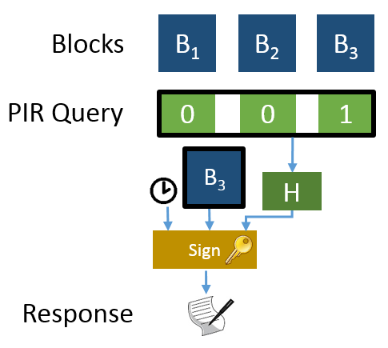
File Download
Hash of query
(Encrypted) result of query
Time of query
Notes:
The second step of automatically creating a proof of Censorship
Committed response
Hash (can’t read this query)
Result of Query
Time

Slide 11
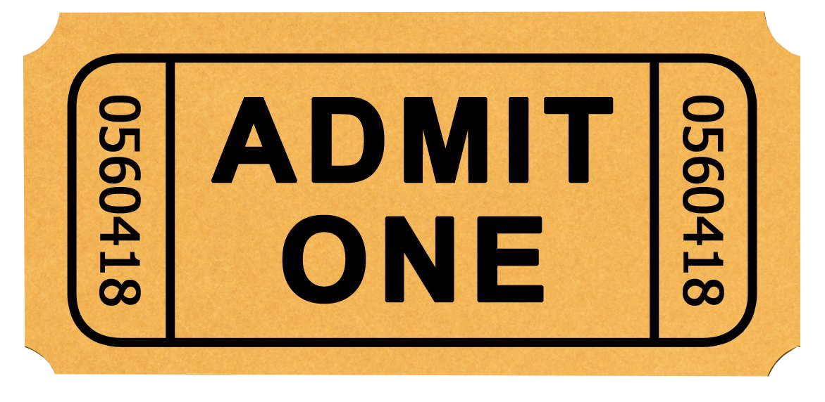


Server is honest
Client
Server
Client
Client
Notes:
Given all these building blocks, Proof of Censorship works as follows
Upload → ticket
Distribute ticket
Generate/send query
Generate response

Slide 12


Server doesn’t respond
Client
Server
Client
Client
Notes:
Two ways server can attempt to misbehave.
If server wants to mimic attack from PoR…
Can’t tell difference between first and second query

Slide 13





Server modifies files
CENSORSHIP
Client
Server
Blocks
B₁
B₂
B₃
PIR Query
0
0
1
H
H
B₃
H
From ticket
Sign
Response
Notes:
The server may also attempt to modify or delete file…
Server modifies file
Client queries
Server cannot see which file is queried
Server computes the result of PIR query, for modified file
Attests to this response as the response to the query
Returns response
Client has correct and modified hash

Slide 14



Proof is Transferable
(Ticket) before (Response)
Verify( , , , 3)
Verify( , , , )
Check =
Client
H
B₃
Verifier
H
H
CENSORSHIP
Notes:
This proof is transferable to independent verifiers. Additionally the proof is offline, the server is not involved
All information transferred to verifier
Check time
Verify ticket
Verify response
Notice hash mismatch

Slide 15
PoC Implementation
Uses (modified) XPIR library
Database of 256 byte tweet-like messages
Notes:
We built a proof of concept implementation
Few hundred line modification to XPIR library
Additionally a 500 line application using OpenSSL for signatures and hashes
Our testing set up consisted of a database of 1 million 256 byte messages

Slide 16
PoC implementation
 | Size | Generation Time | Validation Time
Ticket | 120 bytes | 341 μs | 395 μs
Query | 3.8 Mbytes | 27 ms | N/A
Reply/Proof | 2.0 Mbytes | 967 ms | 45 ms
Notes:
As mentioned the ticket is constant sized and small.
Additionally quick to generate and verify
Effectively the only overhead of PoC, rest is PIR

Slide 17
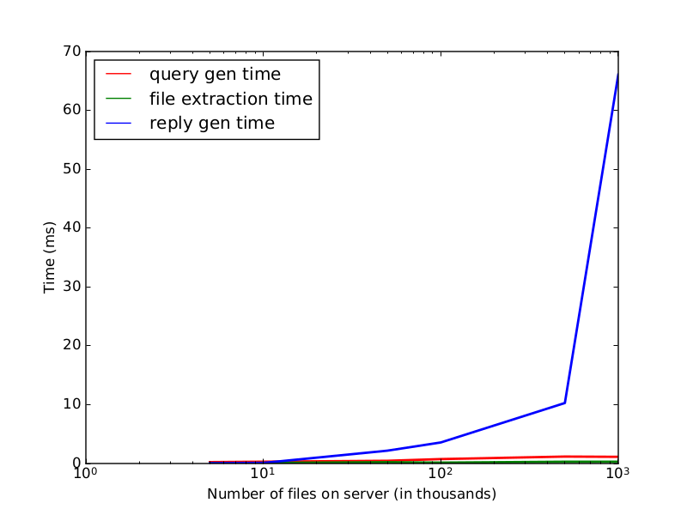
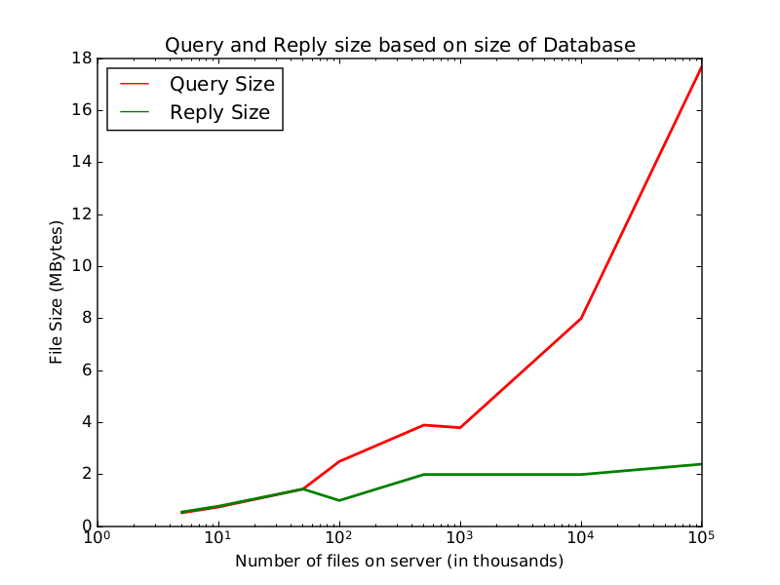
PIR (in)efficiencies
Notes:
Queries size grows based on files in database
Reply size relatively constant
Client side computations (query gen, file extraction) quick
Server side computation order of magnitude heavier.

Slide 18
Applications
Trust-able transparency reports
Penalties for Censored Files
  Smart Contracts
  ZKP slash and burn
PIR limitations
  Epochs
Transparency Applications
  CONIKS
  Certificate Transparency
Notes:
Presented Proof of Censorship
Who would use this?
Companies that wish to be transparent about censorship
Creates more trust-worthy transparency reports
Future interesting work includes examining penalties,
Examining different solutions to PIR limitations
Applying this to other transparency applications building more explicit trust

Slide 19
Questions?
Thank you

