Slide 1
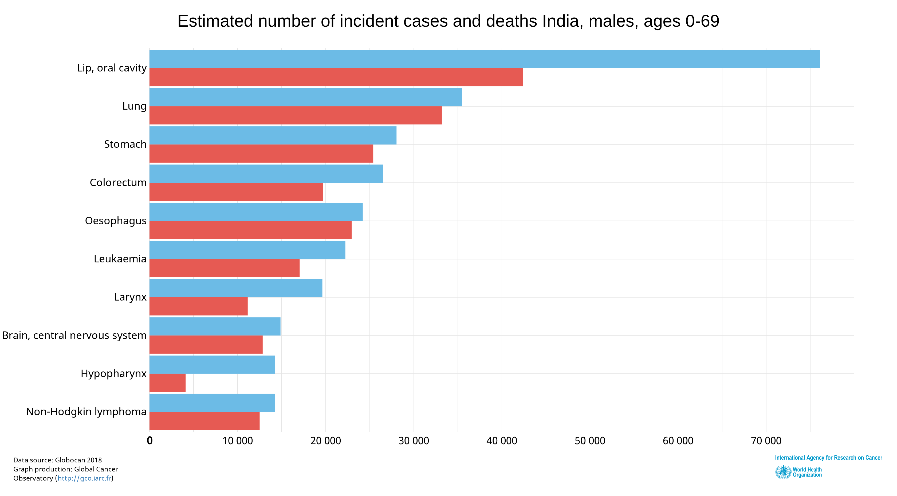
Insert screenshot / snip here
#GCO365 72. In India, for males under 69, Lip and oral cavity cancer is the first cancer with twice as many cases as the second ranking cancer: Lung
@GICR_IARC @IARCWHO
Notes:
Perma-link:
http://gco.iarc.fr/today/online-analysis-multi-bars?v=2018&mode=cancer&mode_population=countries&population=900&populations=356&key=total&sex=1&cancer=39&type=0&statistic=5&prevalence=0&population_group=0&ages_group%5B%5D=0&ages_group%5B%5D=13&nb_items=10&group_cancer=1&include_nmsc=1&include_nmsc_other=1&type_multiple=%257B%2522inc%2522%253Atrue%252C%2522mort%2522%253Atrue%252C%2522prev%2522%253Afalse%257D&orientation=horizontal&type_sort=0&type_nb_items=%257B%2522top%2522%253Atrue%252C%2522bottom%2522%253Afalse%257D&population_group_globocan_id=#collapse-group-0-3

Slide 2
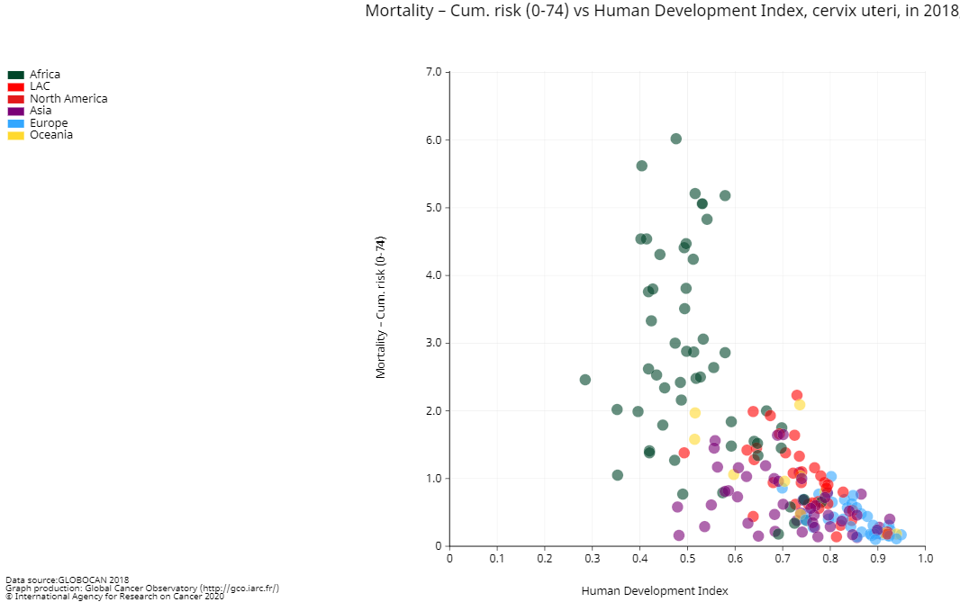
Insert screenshot / snip here
#GCO365 43. High risk of dying of Cervix Uteri cancer is mostly in Africa, in low HDI countries.
@GICR_IARC @IARCWHO
Notes:
Perma-link:
http://gco.iarc.fr/today/online-analysis-scatter-plot?v=2018&mode=cancer&mode_population=continents&population=900&populations=900&key=asr&sex=2&cancer=23&type=0&statistic=5&prevalence=0&population_group=0&ages_group%5B%5D=0&ages_group%5B%5D=17&nb_items=5&group_cancer=1&include_nmsc=1&include_nmsc_other=1&fit_to_screen=1&same_scale=0&axis_indicators=%257B%2522x%2522%253A%2522hdi_value%2522%252C%2522y%2522%253A%2522mort%2522%257D&axis_keys=%257B%2522x%2522%253A%2522asr%2522%252C%2522y%2522%253A%2522cum_risk%2522%252C%2522log_scale_x%2522%253Afalse%252C%2522log_scale_y%2522%253Afalse%257D
(be careful, export change cumulative risk to ASR, I think cumulative risk is more interesting, and the title is wrong (title showing all ages)
So I have to use snipping tool.

Slide 3
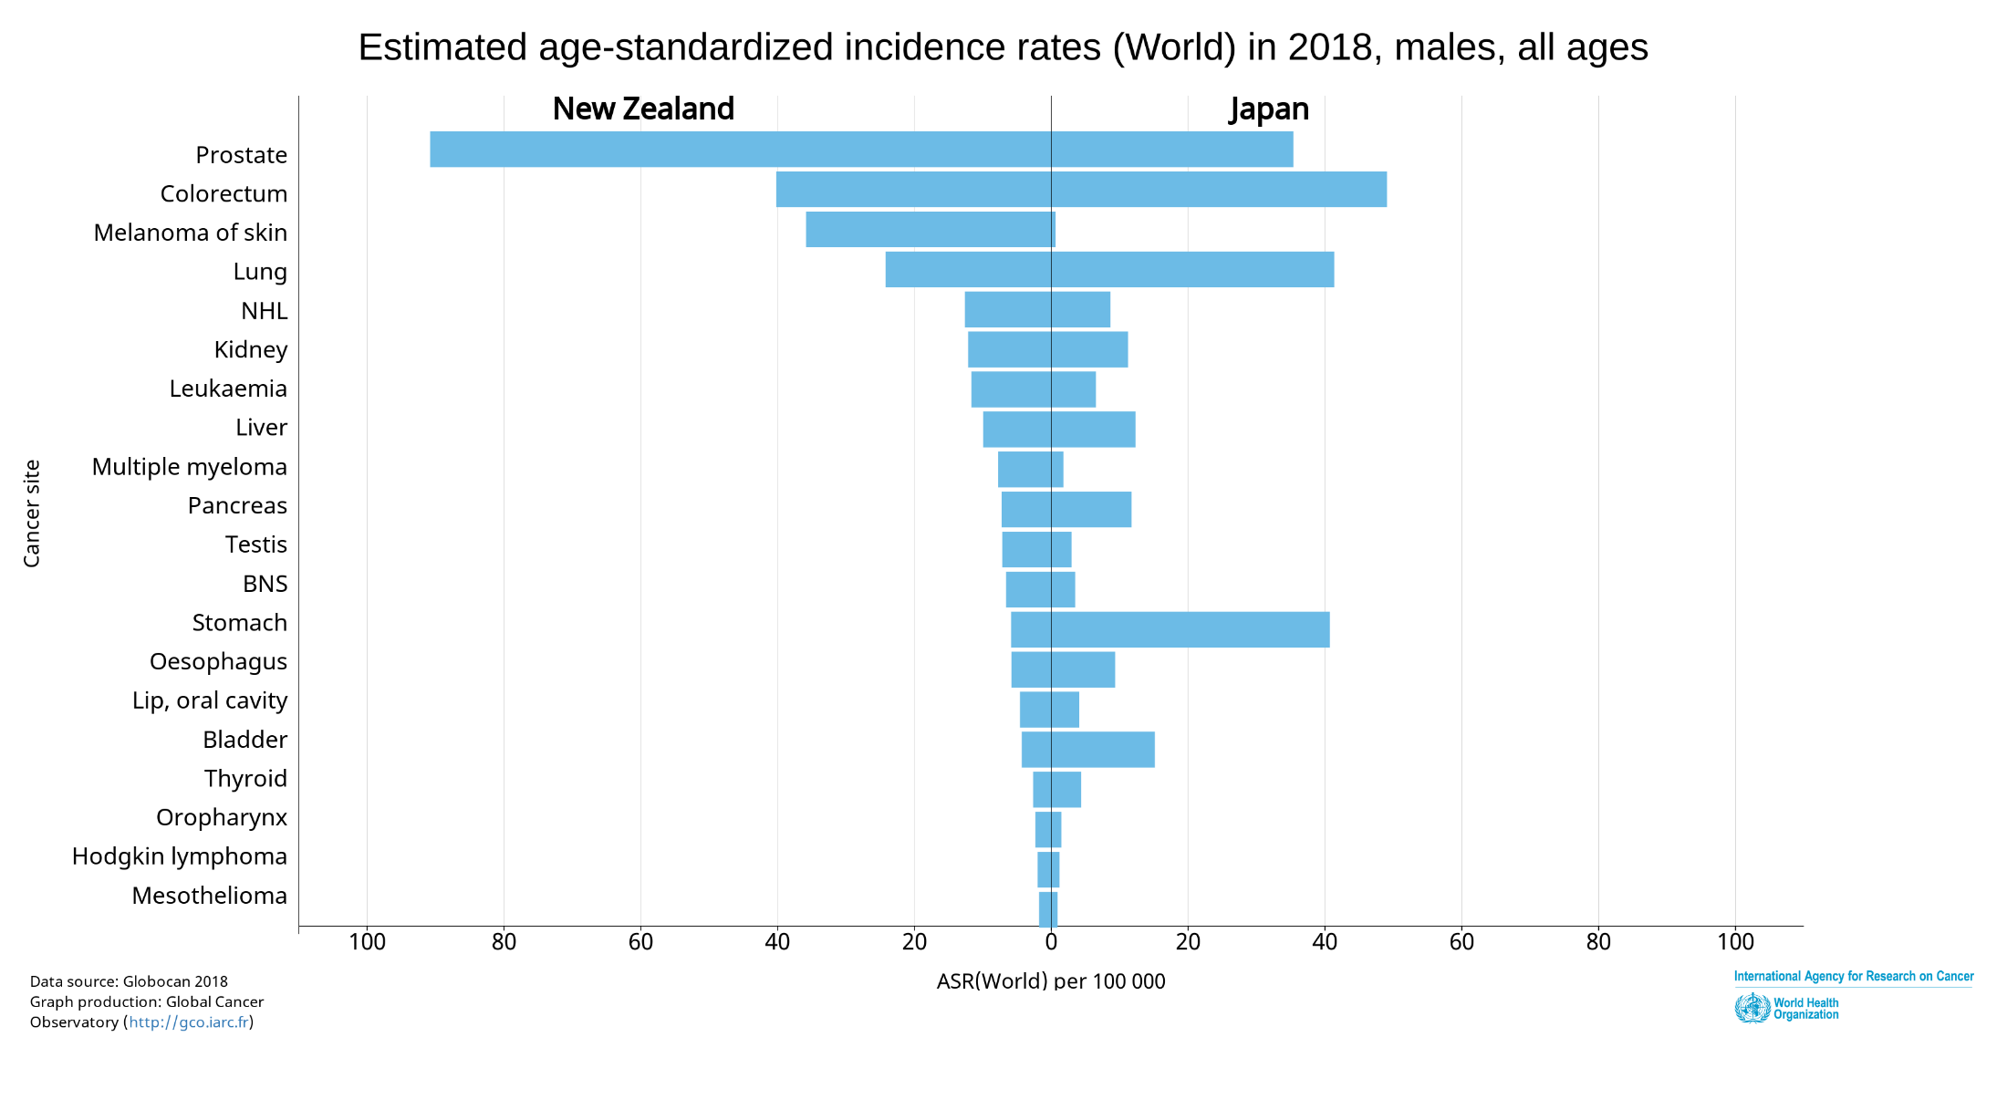
Insert screenshot / snip here
#GCO365 132. Japan and New Zealand, 2 High income countries, 2 different cancers sites distribution.
@GICR_IARC @IARCWHO
Notes:
Perma-link:
http://gco.iarc.fr/today/online-analysis-dual-bars-2?v=2018&mode=cancer&mode_population=regions&population=250&populations=554&key=asr&sex=1&cancer=39&type=0&statistic=5&prevalence=0&population_group=0&ages_group%5B%5D=0&ages_group%5B%5D=17&nb_items=20&group_cancer=1&include_nmsc=1&include_nmsc_other=1&dual_distribution=1&population1=554&population2=392&show_values=false&type_multiple=%257B%2522inc%2522%253Atrue%252C%2522mort%2522%253Afalse%252C%2522prev%2522%253Afalse%257D&population_group_globocan_id=&type_sort=0

