Slide 1
Snowball :
Extracting Relations from Large Plain-Text Collections
Eugene Agichtein
Luis Gravano
Department of Computer Science
Columbia University

Slide 2
Extracting Relations from Documents
Text documents hide valuable structured information.
If we manage to extract this information:
We can answer user queries more accurately
We can run data mining tasks (e.g., finding trends)

Slide 3
GOAL: Extract All Tuples “Hidden” in the Document Collection
System must:
Require minimal training for each new task
Recover from noise
Exploit redundancy of information in documents

Slide 4

Example Task: Organization/Location
Redundancy
Organization
Location
Microsoft's central headquarters in Redmond
is home to almost every product group and division.
Microsoft
Apple Computer
Nike
Redmond
Cupertino
Portland
Brent Barlow, 27, a software analyst and
beta-tester at Apple Computer headquarters
in Cupertino, was fired Monday for "thinking
a little too different."
Apple's programmers "think different" on a "campus" in Cupertino, Cal. Nike employees "just do it" at what the company refers to as its "World Campus," near Portland, Ore.

Slide 5
Extracting Relations from Text Collections
Related Work
The Snowball System
Evaluation Metrics
Experimental Results

Slide 6
Related Work
Traditional Information Extraction
  MUCs (Message Understanding Conferences)
    Significant (manual) training for each new task
Bootstrapping
  Riloff et al. (‘99), Collins & Singer (‘99)
    (Named-entity recognition)
  Brin (DIPRE) (‘98)

Slide 7
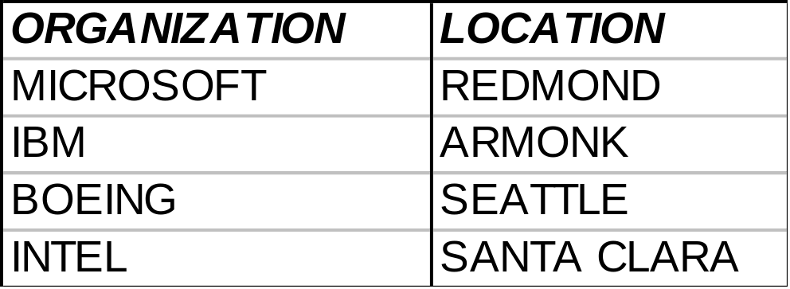
Extracting Relations from Text: DIPRE
Initial Seed Tuples:
Initial Seed Tuples
Occurrences of Seed Tuples
Generate New Seed Tuples
Augment Table
Generate Extraction Patterns

Slide 8
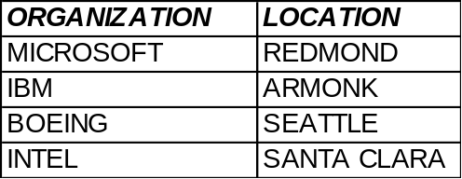
Extracting Relations from Text: DIPRE
Computer servers at Microsoft’s
headquarters in Redmond…
In mid-afternoon trading, share of
Redmond-based Microsoft fell…
The Armonk-based IBM introduced
a new line…
The combined company will operate
from Boeing’s headquarters in Seattle.
Intel, Santa Clara, cut prices of its
Pentium processor.
Occurrences of
seed tuples:
Initial Seed Tuples
Occurrences of Seed Tuples
Generate New Seed Tuples
Augment Table
Generate Extraction Patterns

Slide 9
Extracting Relations from Text: DIPRE
<STRING1>’s headquarters in <STRING2>
<STRING2> -based <STRING1>
<STRING1> , <STRING2>
DIPRE
Patterns:
Initial Seed Tuples
Occurrences of Seed Tuples
Generate New Seed Tuples
Augment Table
Generate Extraction Patterns

Slide 10
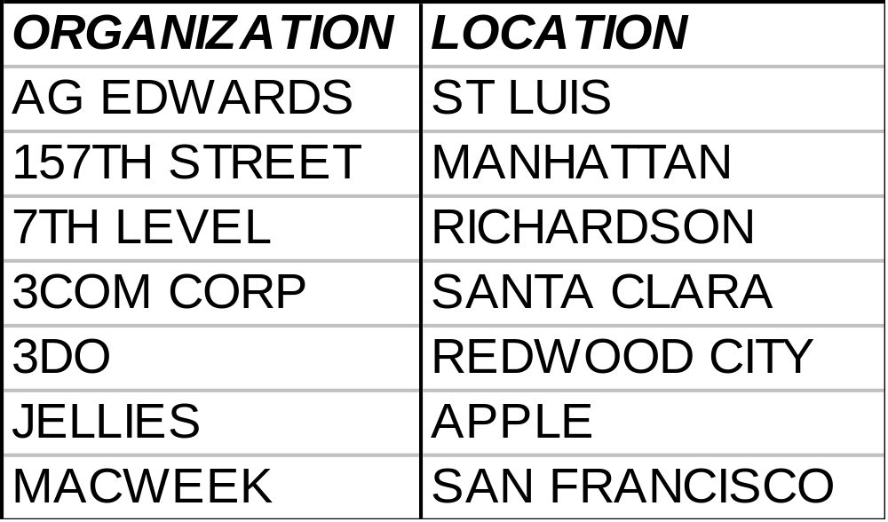
Extracting Relations from Text: DIPRE
Generate
new seed
tuples;
start new
iteration
Initial Seed Tuples
Occurrences of Seed Tuples
Generate New Seed Tuples
Augment Table
Generate Extraction Patterns

Slide 11
Extracting Relations from Text:
Potential Pitfalls
Invalid tuples generated
  Degrade quality of tuples on
  subsequent iterations
  Must have automatic way to select
  high quality tuples to use as new seed
Pattern representation
  Patterns must generalize

Slide 12
Extracting Relations from Text Collections
Related Work
  DIPRE
The Snowball System:
  Pattern representation and generation
  Tuple generation
  Automatic pattern and tuple evaluation
Evaluation Metrics
Experimental Results

Slide 13
Extracting Relations from Text: Snowball
Initial Seed Tuples:
Initial Seed Tuples
Occurrences of Seed Tuples
Generate New Seed Tuples
Tag Entities
Augment Table
Generate Extraction Patterns

Slide 14
Extracting Relations from Text: Snowball
Computer servers at Microsoft’s
headquarters in Redmond…
In mid-afternoon trading, share of
Redmond-based Microsoft fell…
The Armonk-based IBM introduced
a new line…
The combined company will operate
from Boeing’s headquarters in Seattle.
Intel, Santa Clara, cut prices of its
Pentium processor.
Occurrences of
seed tuples:
Initial Seed Tuples
Occurrences of Seed Tuples
Generate New Seed Tuples
Tag Entities
Augment Table
Generate Extraction Patterns

Slide 15
Problem: Patterns Excessively General
Pattern: <STRING2>-based <STRING1>
Today's merger with McDonnell Douglas
positions Seattle -based Boeing to make major money in space.
…, a producer of apple-based jelly, ...
Incorrect!
<jelly, apple>

Slide 16
Extracting Relations from Text: Snowball
Computer servers at Microsoft’s
headquarters in Redmond…
In mid-afternoon trading, share of
Redmond-based Microsoft fell…
The Armonk-based IBM introduced
a new line…
The combined company will operate
from Boeing’s headquarters in Seattle.
Intel, Santa Clara, cut prices of its
Pentium processor.
Tag Entities
Use MITRE’s
Alembic Named
Entity tagger
Initial Seed Tuples
Occurrences of Seed Tuples
Generate New Seed Tuples
Tag Entities
Augment Table
Generate Extraction Patterns

Slide 17
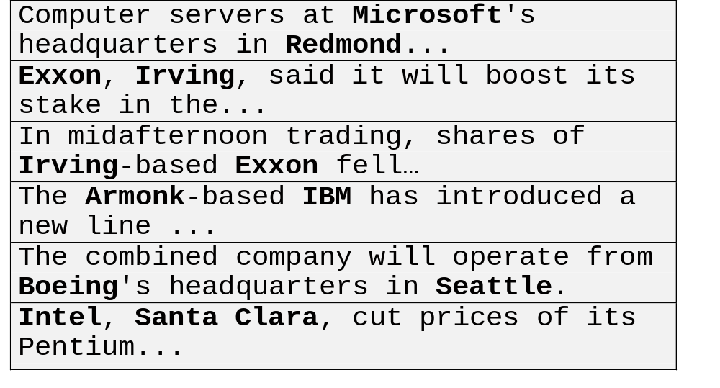
Extracting Relations from Text
<ORGANIZATION>’s headquarters in <LOCATION>
<LOCATION> -based <ORGANIZATION>
<ORGANIZATION> , <LOCATION>
PROBLEM: Patterns too specific:
have to match text exactly.
Initial Seed Tuples
Occurrences of Seed Tuples
Generate New Seed Tuples
Tag Entities
Augment Table
Generate Extraction Patterns

Slide 18
Snowball: Pattern Representation
A Snowball pattern vector is a 5-tuple
<left, tag1, middle, tag2, right>,
  tag1, tag2 are named-entity tags
  left, middle, and right are vectors of weighed terms.
ORGANIZATION 's central headquarters in LOCATION is home to...
{<'s 0.5>, <central 0.5> <headquarters 0.5>,
< in 0.5>}
{<is 0.75>,
<home 0.75> }
ORGANIZATION
LOCATION
< left , tag1 , middle , tag2 , right >

Slide 19
Snowball: Pattern Generation
Tagged Occurrences of seed tuples:
Computer servers at Microsoft’s central headquarters in Redmond…
In mid-afternoon trading, share of Redmond-based Microsoft fell…
The Armonk -based IBM introduced a new line…
The combined company will operate from Boeing’s headquarters in Seattle.

Slide 20
Snowball Pattern Generation:
Cluster Similar Occurrences
Occurrences of seed tuples converted to Snowball representation:
{<servers 0.75>
<at 0.75>}
{<’s 0.5> <central 0.5> <headquarters 0.5> <in 0.5>}
LOCATION
ORGANIZATION
{<shares 0.75>
<of 0.75>}
LOCATION
{<- 0.75>
<based 0.75> }
ORGANIZATION
{<fell 1>}
{<the 1>}
LOCATION
{<- 0.75>
<based 0.75> }
ORGANIZATION
{<introduced
0.75> <a 0.75>}
{<operate 0.75>
<from 0.75>}
{<’s 0.7> <headquarters 0.7>
<in 0.7>}
LOCATION
ORGANIZATION

Slide 21
Similarity Metric
P =
< Lp , tag1 , Mp , tag2 , Rp >
S =
< Ls , tag1 , Ms , tag2 , Rs >
Match(P, S) =
{
Lp . Ls + Mp . Ms + Rp . Rs if the tags match
0 otherwise

Slide 22
Snowball Pattern Generation: Clustering
Cluster 1
{<servers 0.75>
<at 0.75>}
{<’s 0.5> <central 0.5> <headquarters 0.5> <in 0.5>}
LOCATION
ORGANIZATION
{<operate 0.75>
<from 0.75>}
{<’s 0.7> <headquarters 0.7>
<in 0.7>}
LOCATION
ORGANIZATION
Cluster 2
{<shares 0.75>
<of 0.75>}
LOCATION
{<- 0.75>
<based 0.75> }
ORGANIZATION
{<fell 1>}
{<the 1>}
LOCATION
{<- 0.75>
<based 0.75> }
ORGANIZATION
{<introduced
0.75> <a 0.75>}

Slide 23
Snowball: Pattern Generation
Patterns are formed as centroids of the clusters.
Filtered by minimum number of supporting tuples.
{<’s 0.7> <in 0.7> <headquarters 0.7>}
LOCATION
Pattern1
ORGANIZATION
LOCATION
{<- 0.75>
<based 0.75>}
Pattern2
ORGANIZATION

Slide 24
Snowball: Tuple Extraction
Using the patterns, scan the collection to
generate new seed tuples:
Initial Seed Tuples
Occurrences of Seed Tuples
Generate New Seed Tuples
Tag Entities
Augment Table
Generate Extraction Patterns

Slide 25
Snowball: Tuple Extraction
Represent each new text segment in the
collection as the context 5-tuple:
Find most similar pattern (if any)
Netscape 's flashy headquarters in Mountain View is near
{<'s 0.5>, <flashy 0.5>,
<headquarters 0.5>,
< in 0.5>}
ORGANIZATION
LOCATION
{<is 0.75>,
<near 0.75> }
{<'s 0.7>,
<headquarters 0.7>,
< in 0.7>}
ORGANIZATION
LOCATION

Slide 26
Snowball: Automatic Pattern Evaluation
Seed tuples
Pattern “ORGANIZATION, LOCATION” in action:
Boeing, Seattle, said… Positive
Intel, Santa Clara, cut prices… Positive
invest in Microsoft, New York-based Negative
analyst Jane Smith said
Automatically estimate probability of
a pattern generating valid tuples:
Conf(Pattern) = _____Positive____
Positive + Negative
e.g., Conf(Pattern) = 2/3 = 66%
Pattern
Confidence:

Slide 27
Snowball: Automatic Tuple Evaluation
Brent Barlow, 27, a software analyst and beta-tester at Apple Computer headquarters in Cupertino, was fired Monday for "thinking a little too different."
Apple's programmers "think different" on
a "campus" in Cupertino, Cal.
<Apple Computer, Cupertino>
Conf(Tuple) = 1 - Π(1 -Conf(P_{i}))
  Estimation of Probability (Correct (Tuple) )
  A tuple will have high confidence if
  generated by multiple high-confidence
  patterns (P_{i}).

Slide 28
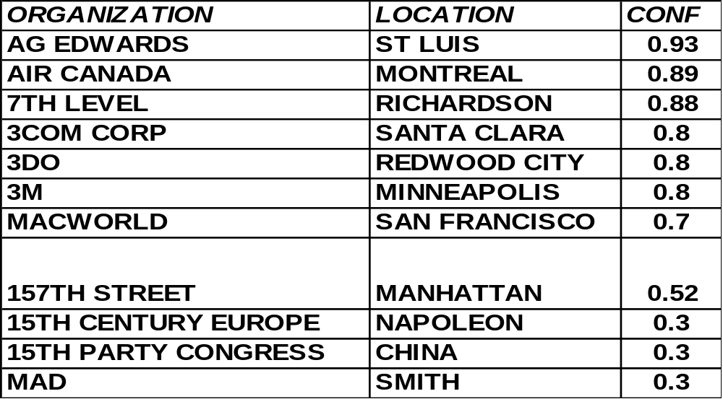
Snowball: Filtering Seed Tuples
Generate
new seed
tuples:
Initial Seed Tuples
Occurrences of Seed Tuples
Generate New Seed Tuples
Tag Entities
Augment Table
Generate Extraction Patterns

Slide 29
Extracting Relations from Text Collections
Related Work
The Snowball System:
  Pattern representation and generation
  Tuple generation
  Automatic pattern and tuple evaluation
Evaluation Metrics
Experimental Results

Slide 30
Task Evaluation Methodology
Data: Large collection, extracted tables
contain many tuples (> 80,000)
Need scalable methodology:
  Ideal set of tuples
  Automatic recall/precision estimation
Estimated precision using sampling

Slide 31
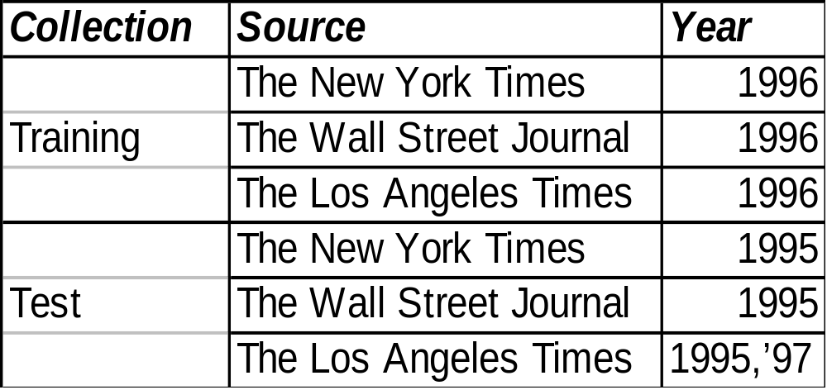
Collections used in Experiments
More than 300,000 real newspaper articles

Slide 32
The Ideal Metric (1)
Creating the Ideal set of tuples
All tuples mentioned
in the collection
Hoover’s directory
(13K+ organizations)
*Ideal
* A perfect, (ideal) system would be able to extract all these tuples

Slide 33
The Ideal Metric (2)
Correct
location
found
Extracted
Ideal
Precision:
| Correct (Extracted ∩ Ideal) |
| Extracted ∩ Ideal |
Recall:
| Correct (Extracted ∩ Ideal) |
| Ideal |

Slide 34
Estimate Precision by Sampling
Sample extracted table
  Random samples, each 100 tuples
Manually check validity of tuples in each
sample

Slide 35
Extracting Relations from Text Collections
Related Work
The Snowball System:
  Pattern representation and generation
  Tuple generation
  Automatic pattern and tuple validation
Evaluation Metrics
Experimental Results

Slide 36
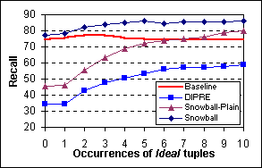
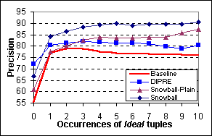
Experimental results: Test Collection
(a)
(b)
Recall (a) and precision (a) using the Ideal metric,
plotted against the minimal number of occurrences
of test tuples in the collection

Slide 37
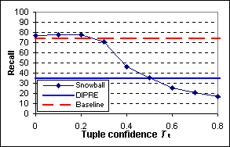
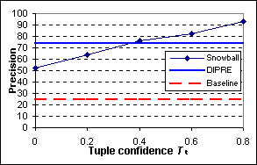
Experimental results: Sample and Check
(a)
(b)
Recall (a) and precision (b) for varying minimum confidence threshold Tt.
NOTE: Recall is estimated using the Ideal metric, precision is estimated by manually checking random samples of result table.

Slide 38
Conclusions
We presented
Our Snowball system:
  Requires minimal training
  (handful of seed tuples)
  Uses a flexible pattern representation
  Achieves high recall/precision
  > 80% of test tuples extracted
Scalable evaluation methodology

Slide 39
Recent and Future Work
Recent (presented in DMKD’00 workshop)
  Alternative pattern representation
  Combining representations
Future Work
  Evaluation on other extraction tasks
  Extensions:
    Non-binary relations
    Relations with no key
   HTML documents

Slide 40
Snowball:
Extracting Relations from Large Plain-Text Collections
Eugene Agichtein (eugene@cs.columbia.edu)
Luis Gravano
Department of Computer Science
Columbia University

Slide 41
Backup Slides

Slide 42
Snowball Solutions
Flexible pattern representation
Pattern generation
Automatic pattern and tuple evaluation
  Able to recover from noise
  Keeps only high quality tuples as new seed

Slide 43
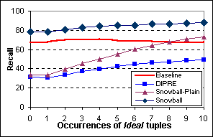
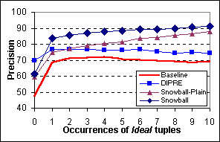
Experimental Results: Training
(a)
(b)
Recall (a) and precision (b) using the Ideal metric
(training collection)

Slide 44
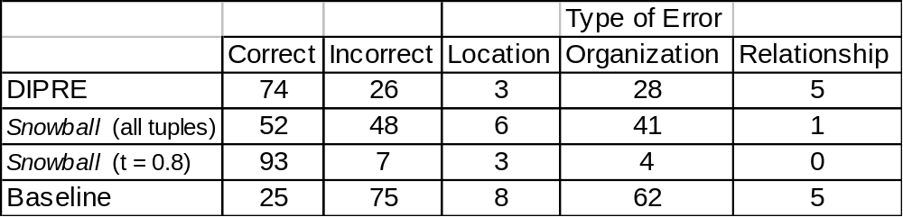
Sampling Results: Error Analysis
The tuples in the random samples were checked by hand
to pinpoint the “culprits” responsible for incorrect tuples.
Sample size is 100.

Slide 45
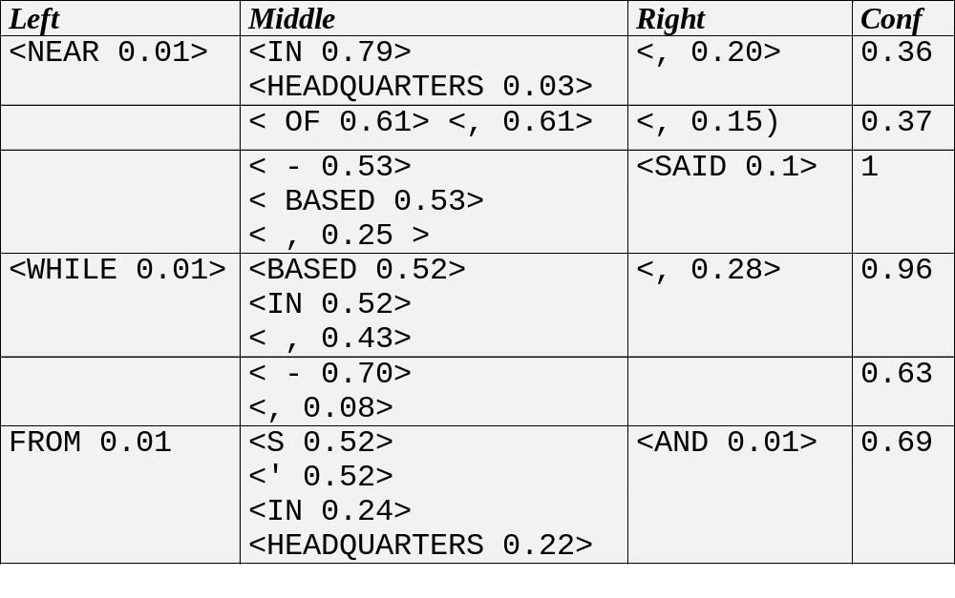
Sample Discovered Patterns

Slide 46
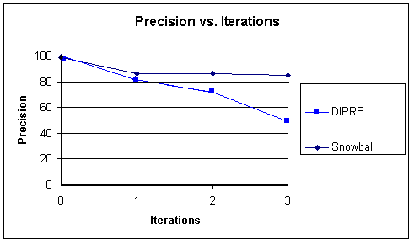
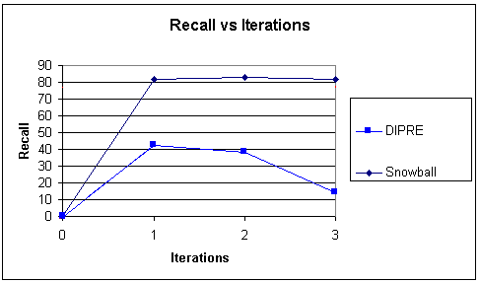
Convergence of Snowball and DIPRE
(a)
(b)
Precision (a) and Recall (b) of the DIPRE and Snowball
with increased iterations

Slide 47
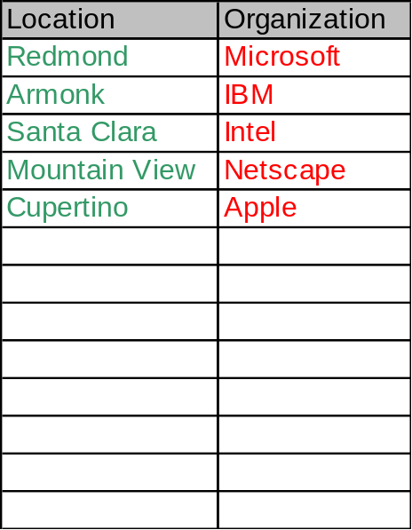
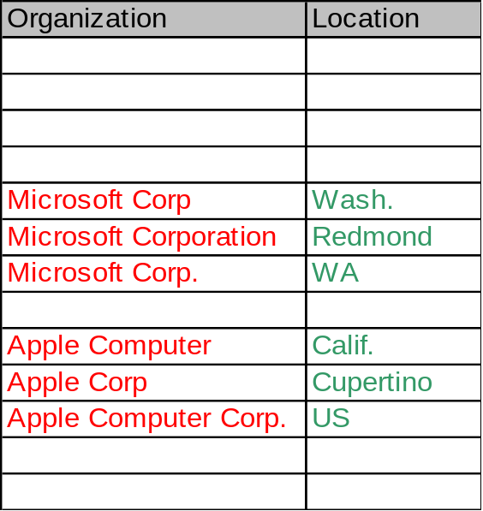
Approximate Matching of Organizations
Use Whirl (W. Cohen @ AT&T) to match similar organization names
Self-join the Extracted table on the Organization attribute
Join resulting table with the Test table, and compare values of
Location attributes
Extracted
Extracted ‘

Slide 48
References
Blum & Mitchell. Combining labeled and unlabeled data with co-training. Proceedings of 1998 Conference on Computational Learning Theory.
Brin. Extracting patterns and relations from the World-Wide Web. Proceedings on the 1998 International Workshop on Web and Databases (WebDB’98).
Collins & Singer. Unsupervised models for named entity classification. EMNLP 1999.
Riloff & Jones. Learning dictionaries for information extraction by multi-level bootstrapping. AAAI’99.
Yarowsky. Unsupervised word sense disambiguation rivaling supervised methods. ACL’95.

