Slide 1
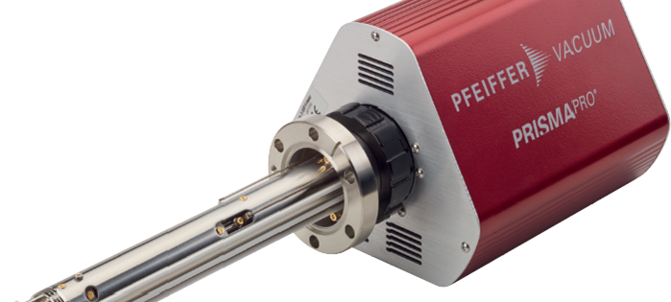
PRISMAPRO
Communication Possibilities
(FW ≥ 1.9.0)

Slide 2
Agenda
1. Introduction to PrismaPro
2. Functionality
3. Communication possibilities
4. API-Communication
5. PV-Cloud
6. Applications
7. Summary

Slide 3
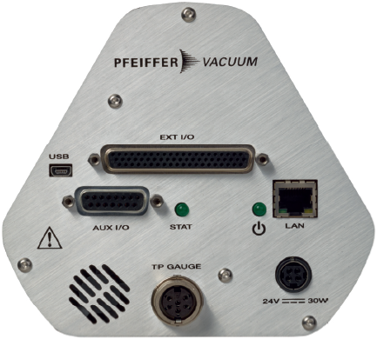

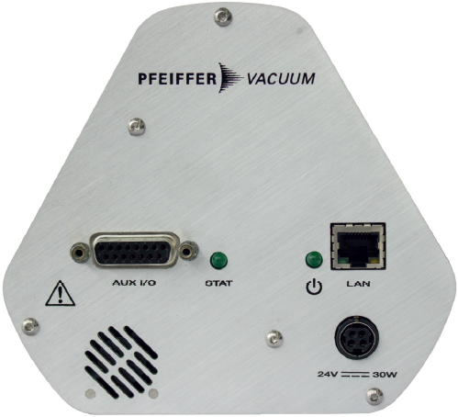

1. Introduction to PrismaPro
Standard: 1x AI, 2x DI, 1 Relay
Extended: 8x AI, 5x DI, 10x DO, 8x AO 1x total Pressure-Transmitter

Slide 4
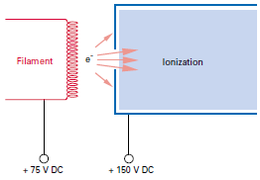
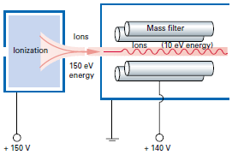
2. Functionality
The PrismaPro is a quadrupole mass spectrometer.
The neutral gas paticles are ionized in an ion source and the ions are separated from each other in a high-frequncy electric quadropole field according to their mass and charge conditions.
The detection of the filtered ions is carried out using Farady Cup or secondary electron multiplier.
The detected ion flow is proportional to the partial pressure of the respective gas components
We are measuring Ion-Current for adjusted amu
https://www.youtube.com/watch?v=TrLMNRyQiaA

Slide 5
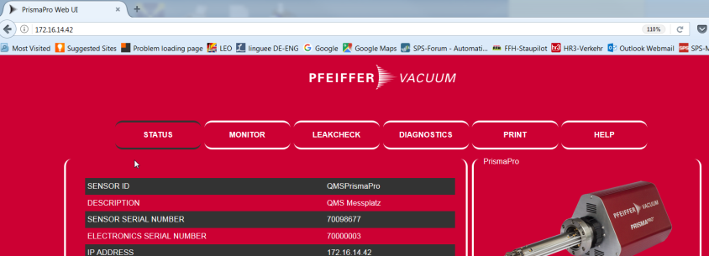
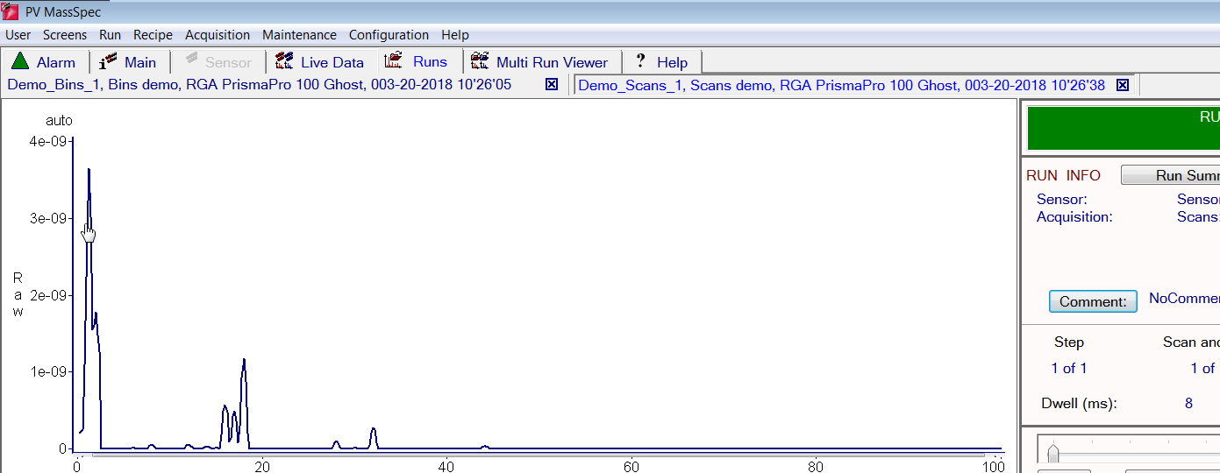
3. Communication possibilities
WebUI: http://192.168.1.100
PVMassSpec: Start exe

Slide 6
3. Communication possibilities
MMSP-API: (Modular Mass Spec - Web-API, http port: 80) Is a web server, whose API is accessed over HTTP.
API: Application Programming Interface Is a set of subroutine definitions, protocols and tools for building application software. In general terms, it is a set of clearly defined methods of communication between various software components (wikipedia)
Documentation for the API usually is provided to facilitate usage and Implementation. https://en.wikipedia.org/wiki/Application_programming_interface

Slide 7
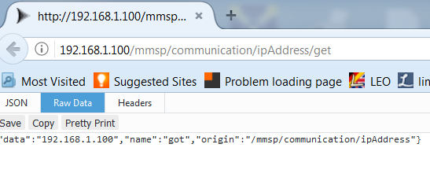
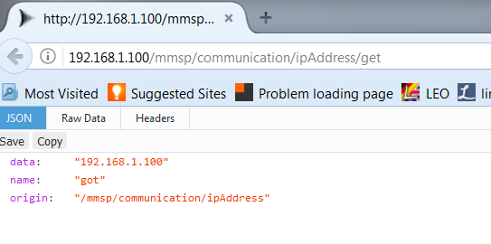
4. API-Communication
Web browser input http://192.168.1.100/mmsp/Communication/ipAddress/get
cURL (.bat-File) API-Get_IP API-Set_Sweep .txt cURL is a command line tool for getting or sending files using URL syntax (wikipedia
Access/Excel mit VBA API-Access API-Excel

Slide 8

4. API-Communication
JSON (JavaScript Object Notation) www.json.org
is an open-standard file format that uses human-readable text to transmit data objects consisting of attribute–value pairs and array data types (wikipedia)
It is a syntax analysis necessary (Parsing) to resolve the dataset into his related elements.
Parse JSON: Raw-Data: {"data":"192.168.1.100","name":"got","origin":"/mmsp/communication/ipAddress"}
into:
data | 192.168.1.100
name | got
origin | /mmsp/communication/ipAddress

Slide 9

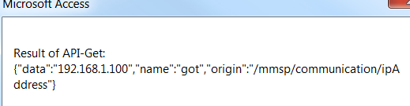
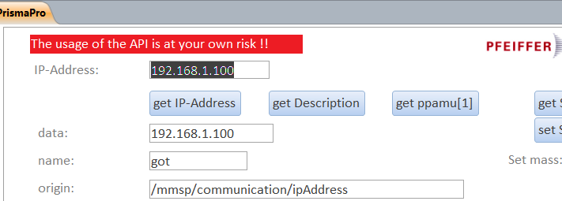
Example 1: MS-Access + VBA: API.accdb Set httpObject = CreateObject(" MSXML2.XMLHTTP ")
httpObject.Open "GET", "" & "http://" & IPADDRESS & "/mmsp/communication/ipAddress/get", False
httpObject.Send
result = httpObject.ResponseText
MsgBox ("Result of API-Get: " & result)
Dim JSON As Object
Set JSON = JsonConverter.ParseJson(result)
Text3.Value = JSON("data")
Text6.Value = JSON("name")
Text8.Value = JSON("origin")
Request
Response

Slide 10
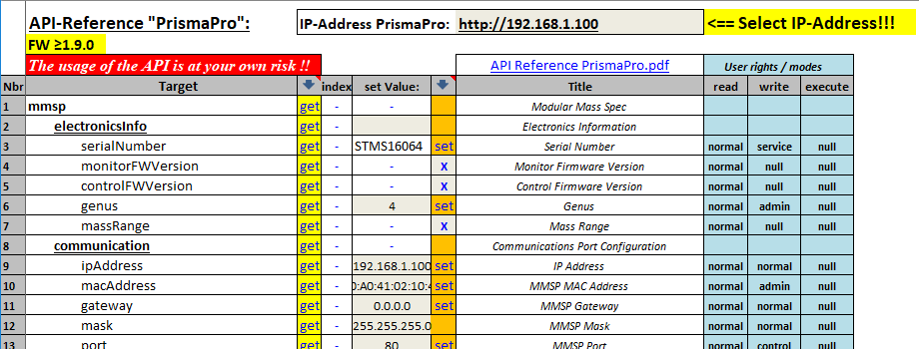
Example 2: MS-Excel: PrismaPro_API.xlsm

Slide 11
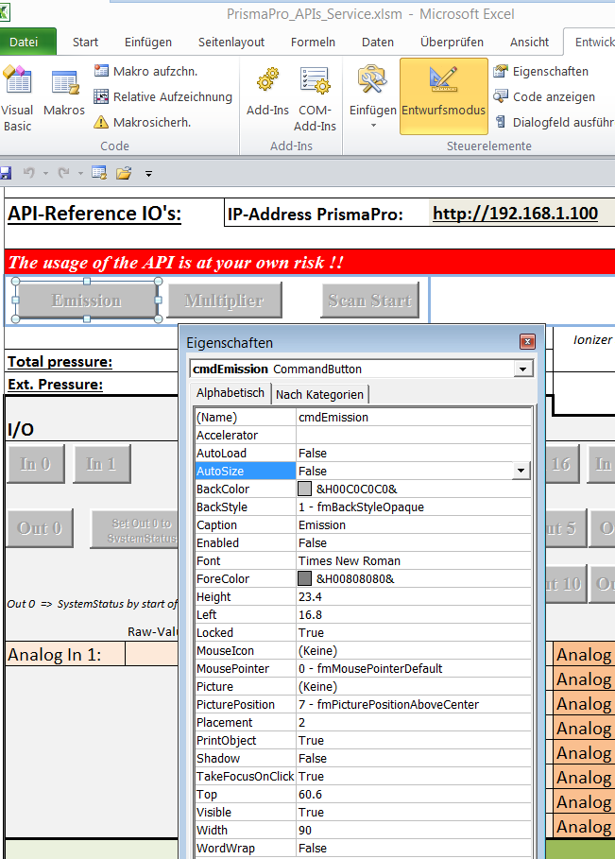
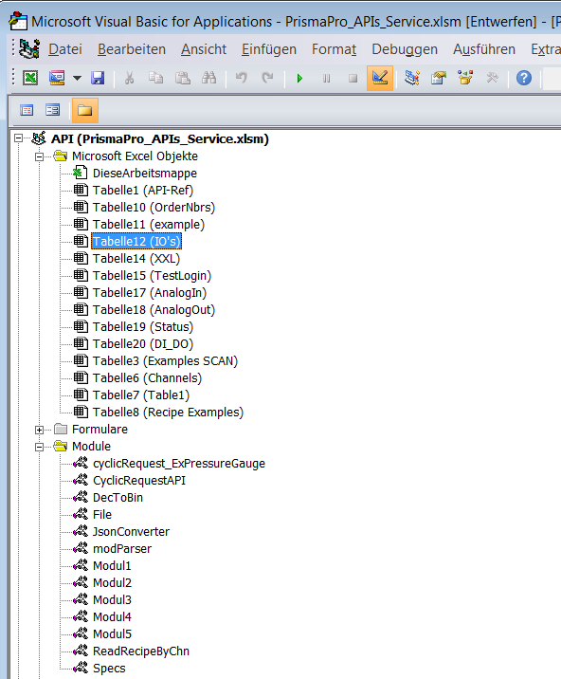

Example 3: MS-Excel + VBA: PrismaPro_API.xlsm (Microsoft Excel sheet with Macros)
Alt
F11

Slide 12
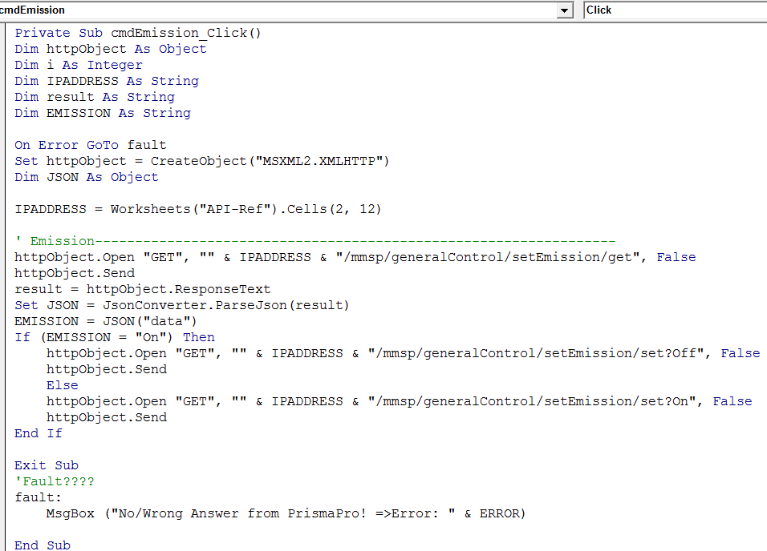
Example 3: Toggle Emission

Slide 13

5. PV-Cloud
Folder: „API“ Password necessary
Content: API Reference List MS-Excel-Sheets with VBA cURL API-Batch LabView-Driver Flowcharts, … Folder will be updated from time to time

Slide 14
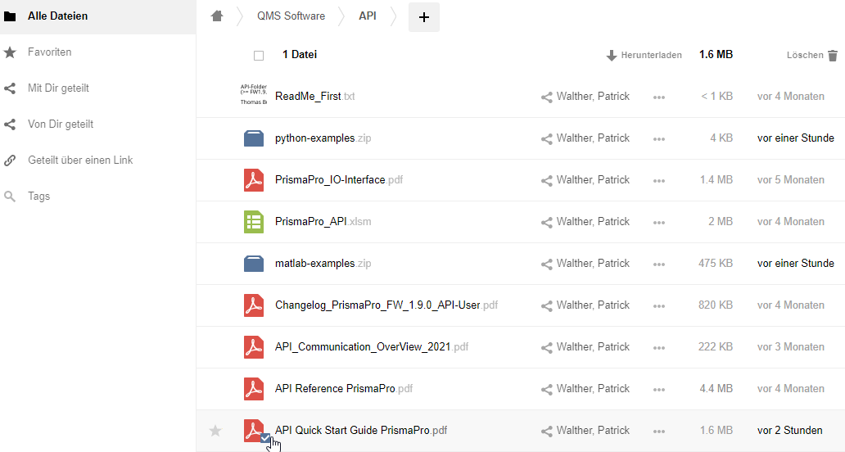
5. PV-Cloud

Slide 15
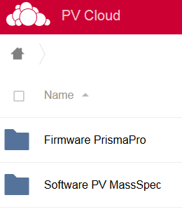
5. PV-Cloud
Folder: „PrismaPro“ PrismaPro User are invited Password necessary
Content: Current Software PVMassSpec Current Firmware for PrismaPro Folder will be updated from time to time and kept up to date

Slide 16
6. Applications
MPP PLC: SIEMENS S7-300/400/1200/1500
PC: SIMATIC IPC127E/227E Nanobox PC Windows 10 OPC-UA: Beckhoff, Rockwell Automation, …. Siemens (any PLC/PC that can work as an „OPC-UA-Server“)
LabView-Driver: Free of charge

Slide 17

7. Summary
For this Communication a PrismaPro is required.
For generell Application and Calibration use PVMassSpec
For a higher-level Communication (e.g. LabView, PC, …) use additional the MMSP-API
For own API programming with C#, VBA, C#, Python, GraphQL,… LabView
Without own API programming use our Application MPP

Slide 18
