Slide 1
SEO and Meta-data Media queries
MAPD 112 Web Technologies for Mobile Platforms
Week 2

Slide 2
Last week
Course introduction
Started HTML and CSS review
Validation

Slide 3
This week
Meta-data
SEO guidelines

Slide 4
Meta-data and SEO

Slide 5
Meta-data
Information about your page
Typically used to specify page description, keywords, author of the document, last modified, and other metadata
The metadata can be used by browsers (how to display content or reload page), search engines (keywords), or other web services
One of the key elements of SEO

Slide 6
Basic meta for HTML5
Define your charset: <meta charset="UTF-8">
Keywords: <meta name="keywords" content="HTML, CSS, XML, XHTML, JavaScript">
Description: <meta name="description" content="Free Web tutorials on HTML and CSS">
Author: <meta name="author" content="Hege Refsnes">
Refresh: <meta http-equiv="refresh" content="30">

Slide 7
Example: basic meta-data
<head> <meta charset="UTF-8"> <meta name="description" content=“My profile website for web dev"> <meta name="keywords" content="HTML, CSS, XML, JavaScript"> <meta name="author" content=“Przemyslaw Pawluk"> </head>
Minimum set of information that each of your pages should contain is:
Charset
Description
Keywords
Author

Slide 8
SEO
Search Engine Optimization
It is all about optimizing a website for search engines
Designing and developing a website to rank well in search engine results
Improving the volume and quality of traffic to a website from search engines
Marketing by understanding how search algorithms work, and what human visitors might search

Slide 9
SEO details
Crawling – automated process of fetching all the web pages linked to a website
Indexing – Process of creating index for all the fetched web pages and keeping them into a giant database from where it can later be retrieved. Keywords and phrases that best describe the site are identified in the process
Relevancy – calculated weight assigned to results retrieved from the index describing how searched keywords or phrases describe the indexed websites

Slide 10
On-page vs. Off-page SEO
On-Page SEO – includes providing good content, good keywords selection, putting keywords on correct places, giving appropriate title to every page, etc.
Off-Page SEO – includes link building, increasing link popularity by submitting open directories, search engines, link exchange, etc.

Slide 11
Group task
Work in groups of 3-4 students
15 minutes
Identify 5 guidelines for SEO that apply to following areas
File and domain names
Layout and structural aspects
Meta-data
Linking
Mobile techniques

Slide 12
Hands-on
Based on the guidelines you collected optimize your profile page
Start with the minimum that is required
Apply structural changes if required
Think mobile-first

Slide 13
Responsive design with media-queries

Slide 14
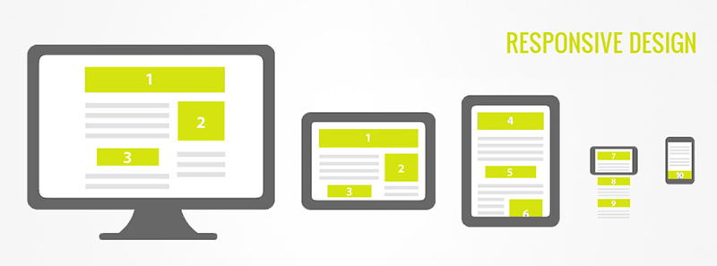
Discussion

Slide 15
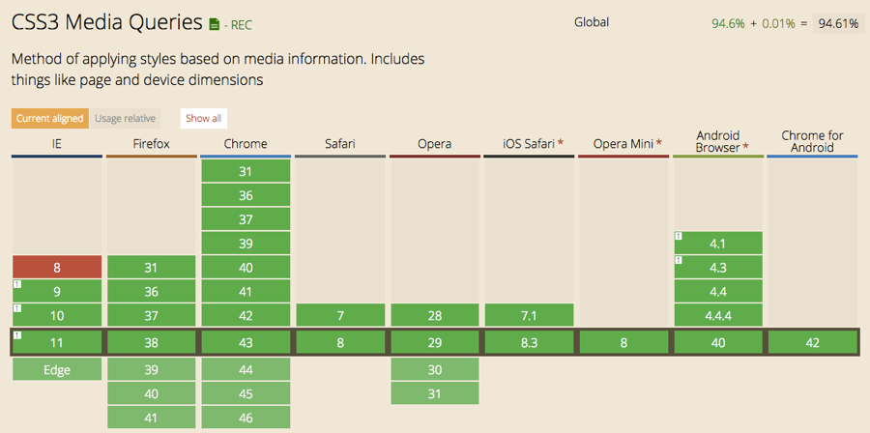
Notes:
http://caniuse.com/#feat=css-mediaqueries

Slide 16
Media query
Media query is a CSS technique introduced in CSS3.
It uses the @media rule to include a block of CSS properties only if a certain condition is true.
@media only screen and (max-width: 500px) { body { background-color: lightblue; } }
Notes:
<!DOCTYPE html>
<html>
<head>
<meta name="viewport" content="width=device-width, initial-scale=1.0"/>
<style>
body {
background-color:lightgreen;
}
@media only screen and (max-width: 500px) {
body {
background-color:lightblue;
}
}
</style>
</head>
<body>
<p>Resize the browser window. When the width of this document is less than 500 pixels, the background-color is "lightblue", otherwise it is "lightgreen".</p>
</body>
</html>

Slide 17
Basic syntax
Defined in CSS or HTML file
@media not|only mediatype and (media feature)
{ CSS-Code; }
Defined in HTML when importing file
<link rel="stylesheet" media="mediatype and|not|only (media feature)" href="mystylesheet.css">

Slide 18
Media types
Value | Description
all | Used for all media type devices
aural | Deprecated. Used for speech and sound synthesizers
braille | Deprecated. Used for braille tactile feedback devices
embossed | Deprecated. Used for paged braille printers
handheld | Deprecated. Used for small or handheld devices
print | Used for printers
projection | Deprecated. Used for projected presentations, like slides
screen | Used for computer screens, tablets, smart-phones etc.
speech | Used for screenreaders that "reads" the page out loud
tty | Deprecated. Used for media using a fixed-pitch character grid, like teletypes and terminals
Tv | Deprecated. Used for television-type devices

Slide 19
Media features
Value | Description
aspect-ratio | The ratio between the width and the height of the viewport
color | The number of bits per color component for the output device
color-index | The number of colors the device can display
device-aspect-ratio | The ratio between the width and the height of the device
device-height | The height of the device, such as a computer screen
device-width | The width of the device, such as a computer screen
grid | Whether the device is a grid or bitmap
height | The viewport height
max-aspect-ratio | The maximum ratio between the width and the height of the display area
See all: http://www.w3schools.com/cssref/css3_pr_mediaquery.asp

Slide 20
Media query
@media only screen and (max-width: 500px) { body { background-color: lightblue; } }
Media type
Media feature

Slide 21
Media queries example: grid system
Big screens
Small screens (<768px)
Set up sizes for the columns e.g.:
12 columns each 8.33% wide
6 columns each 16.66% wide
For each column define a class in your css
.col-1 {width: 8.33%;}
.col-2 {width: 16.66%;}
Decide what happens when the screen is smaller that your threshold
@media only screen and (max-width: 768px) {
/* For mobile phones: */
[class*="col-"] {
width: 100%;
}
}

Slide 22
Lab time: Responsive design

Slide 23



Use the grid system to build responsive web
Smartphone
Tablet
Desktop

Slide 24
Hands-on
Redesign your profile website to accommodate both mobile and desktops in your design
Start with mobile
Build gradually towards larger screens

Slide 25
Best practices

Slide 26
Content determines breakpoints
Do not make yourself tied to standard values like
320px = width of iPhone portrait
480px = width of iPhone landscape
768px = width of iPad portrait
They change!
Look at your content
Start with smallest size you want to support and scale up until it looks bad
That’s time for breakpoint

Slide 27
Mobile-first
Author your styles in a mobile-first manner
Start small and build up to the desktop and TV screens
Better support for smaller, older devices and browsers

Slide 28
Gradation: major and minor breakpoint
Not all of your design have to fit all large and small screens
Use major breakpoints for big things e.g., change no. of columns
Use minor breakpoints to adjust in-between them e.g., adjustment of a font size
Use Sass to manage it seamlessly

Slide 29
Use relative units
Use relative units for your queries
Authoring media queries in relative units allows browsers to adjust the design based on the user zoom level

Slide 30
Conditional loading
Web pages consist of The Thing and a bunch of other stuff that aren’t The Thing (Brad Frost)
Eliminate elements that are not necessary (e.g., large graphics do not need to be served to mobile clients, but they look good on desktop)
Replace removed elements with links

Slide 31
Finally ….
Keep it simple!

Slide 32
Back to work
Review your stylesheets
See how you can apply best practices that we discussed
Use your browser features to test it with different screen sizes

Slide 33
Next time
Fluid layouts
Relative units
Responsive images

